Slide 1
Teaching Everyone about Computing
Mark Guzdial & Barbara Ericson
Notes:
Like Ulrik’s talk – about our vocation, not our jobs. We are CS educators. I will argue that our audience is not just CS specialists or majors. The demand and need is greater elsewhere.

Slide 2
Story
Computing is important for more than just those who choose to major in computing.
  The challenge of computer science isn’t enrollment,
  it’s in creating and meeting the demand.
Part 1: The History of Teaching Computing to All
  Why it’s our job
Part 2: How do we create interest in Computing, and sustain that interest through High School?
Part 3: How do we teach Computer Science to those who do not want to become software engineers or computer scientists?
  Computing for All at Georgia Tech
Notes:
The varied audiences for Education.

Slide 3
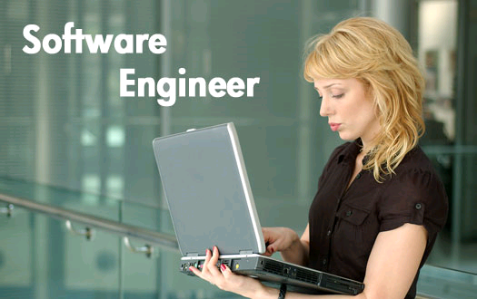
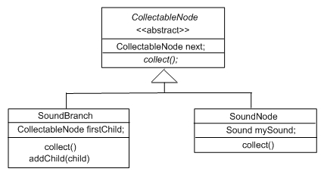
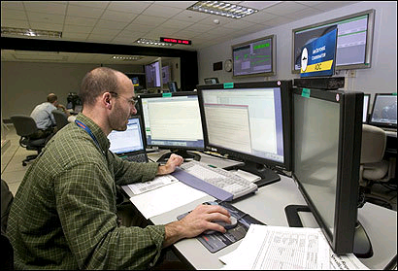
The typical CS student:
Future Software Engineer
To produce reliable, robust, secure software.
To work in interdisciplinary teams.
To use appropriate design notations, such as UML.
To work in multiple programming languages.
Notes:
Our normal student in CS education. We typically want our majors to develop these abilities or skills.

Slide 4
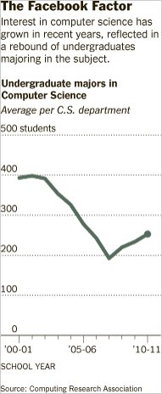
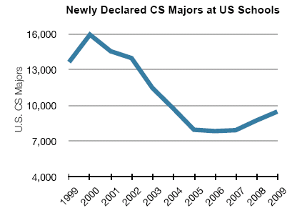
US CRA
Taulbee Numbers
2010 CRA Taulbee Survey of PhD-granting institutions
Notes:
But there are increasingly fewer of these. While we’re in an uptick, it’s a slow return. We’re still far behind BLS estimates of demand.

Slide 5

High School Participation in
AP STEM Disciplines
— Chris Stephenson, CSTA, 2010
Notes:
Graph shows # of students taking the various STEM AP tests since 1997. CS is the sad red line at the bottom. Note that even the relatively new AP courses – statistics and environmental sciences – are doing much better than us.

Slide 6
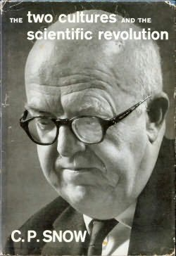

The Two Cultures
Notes:
Why is this a problem? We may not be talking to them right. There is more than one audience for what we have to offer.
Most of them don’t look like us. Some people reject science: Denialists. Global warming? Vaccines? There are no learning styles. Psychological Science in the Public Interest

Slide 7
Who else wants what CS has to offer?
Computing is at the core of the modern society and modern economy.
Computing is key to innovation in many disciplines.
Computer Science has a much larger potential audience beyond software developers.
  Estimates:
  ~13 million non-professional programmer/end-user programmers in US by 2012,
  vs.
  ~3 million professional software developers (Scaffidi, Shaw, & Myers, 2005)
Notes:
There are jobs out there. The classes are good. But students just don’t want to do this.

Slide 8

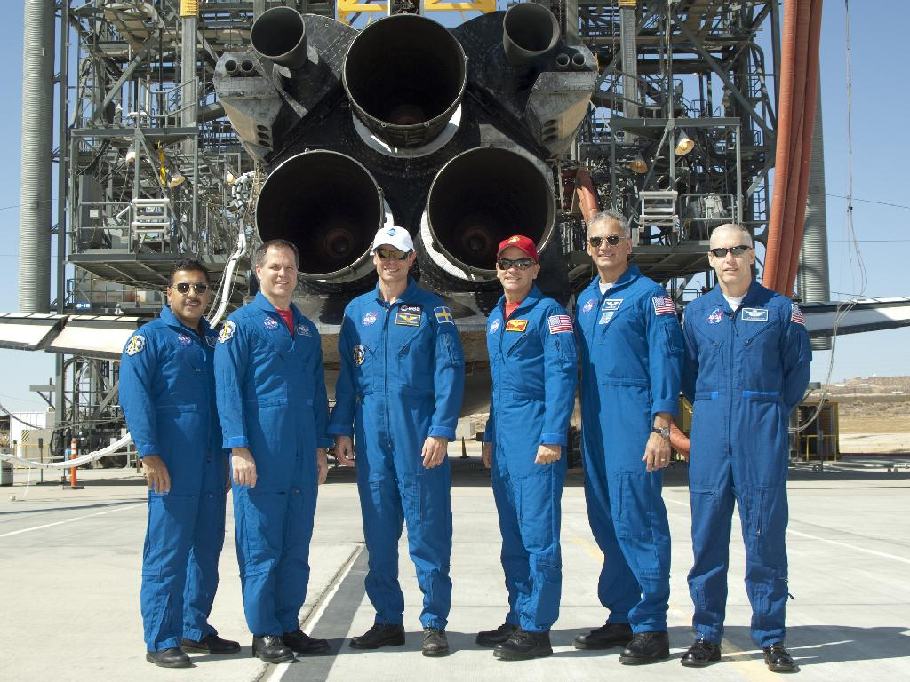
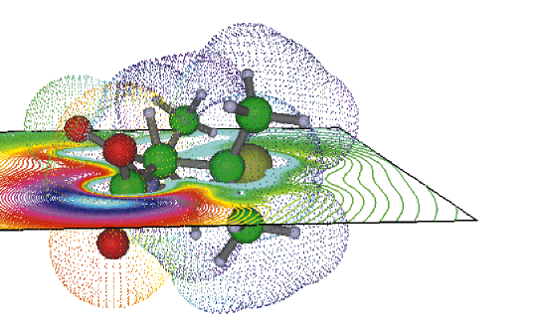
An atypical CS student:
Future computational scientist or engineer
To use computation as a tool to enhance understanding.
To write programs of (at most) 100 lines (most often, 10 lines) for themselves.
  They care about the products of the programs, not the programs.
To learn as few languages as are needed for their tasks.
To work in interdisciplinary teams, including software engineers.
Notes:
This audience aren’t denialists, so that part is easier. But they don’t want to be us. They have different goals.

Slide 9
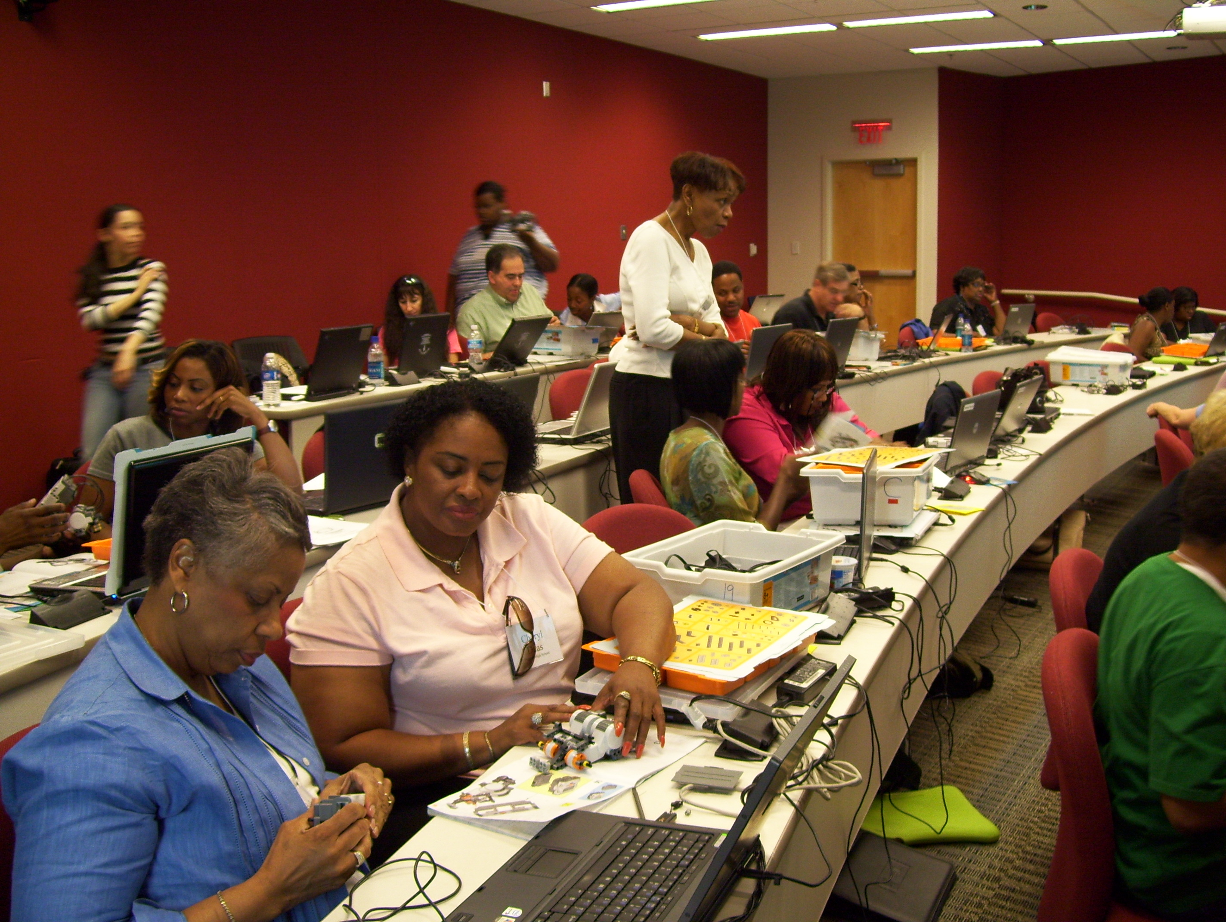
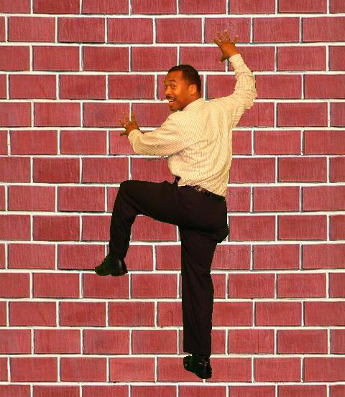
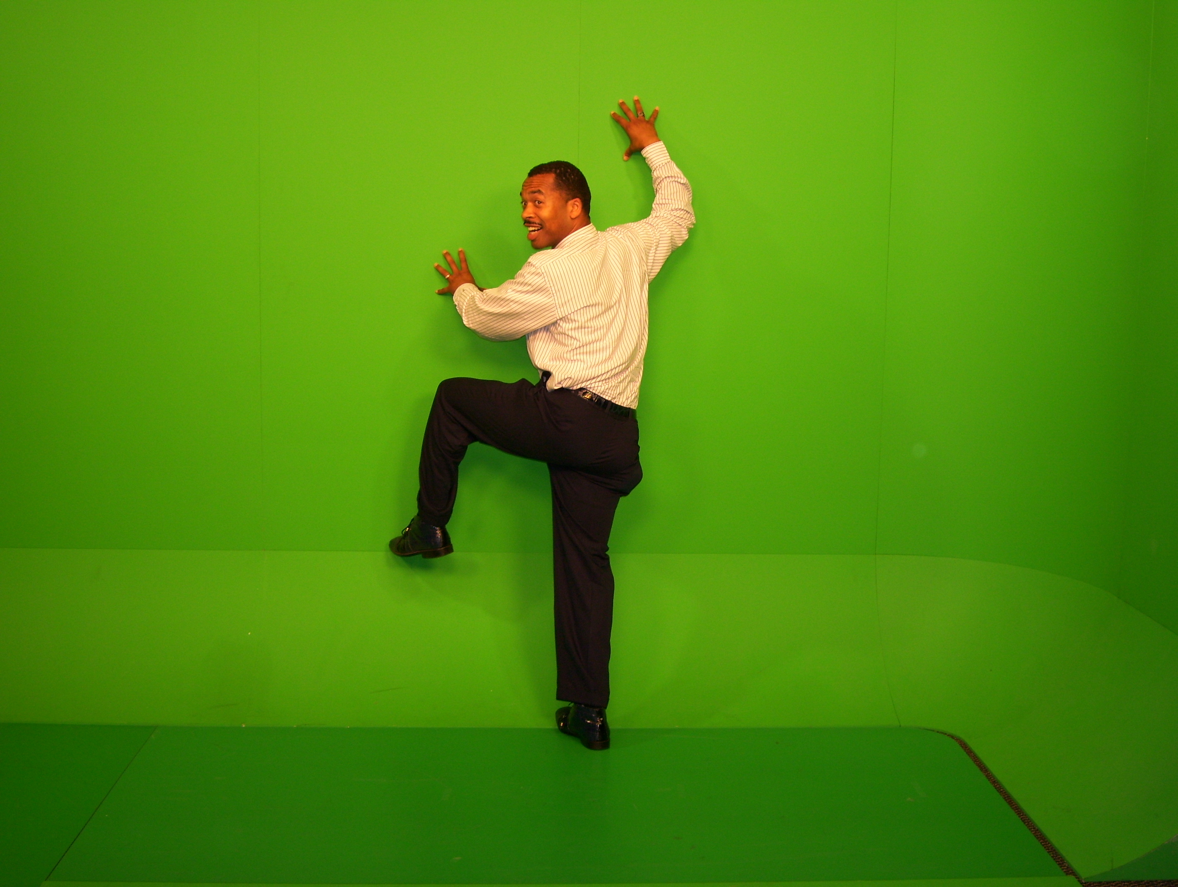
An atypical CS student:
Future high school CS teacher
To use code to explore and understand ideas of computation.
To learn what languages are necessary to meet standards and engage students.
To work with students with a wide range of interests.
  Probably won’t work with professional software engineers
Notes:
We need these people to get more of the rest.
Lijun Ni’s work. It’s important to create an identify of “Computer Science Teacher” for success later. Steve Cooper talked about yesterday.

Slide 10




An atypical CS student:
Future graphics designer
To write programs to improve their efficiency, and to implement their dynamic (e.g., Web) designs.
To do as little coding as possible.
To learn about computing ideas in order to improve their process, but with a focus on people and creativity.
    Probably won’t work with professional software engineers
Notes:
Self-representations from a graphics design website.

Slide 11
How do meet this need?
Our track record for the first CS course is poor.
  30-50% failure or withdrawal rates (Bennedsen & Caspersen, 2007)
Other majors tend to be more female and more ethnically diverse than the typical computing student.
  Our track record with these audiences is particularly poor (Margolis & Fisher, 2003)
Notes:
Ask Michael.

Slide 12
Three points in this space
Part 1: Historical: Should CS be teaching computing to everybody?
Part 2: How do we get them interested? How do we keep them interested in secondary school?
Part 3: How do we teach everyone at University? How do we know if we got there?

Slide 13
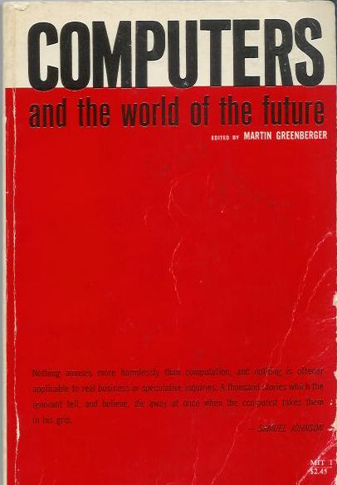
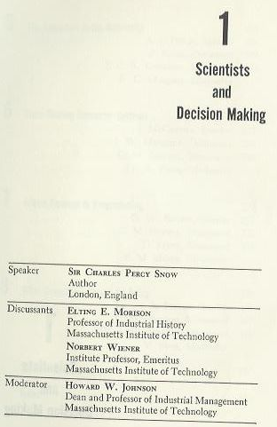
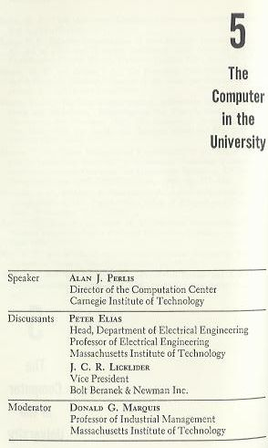
1961 MIT Sloan School
Symposium
Notes:
Why might they want to join us?
In “Dream Machines,” biography of J.C.R. Licklider.
Other speakers include Vannevar Bush, Herbert A. Simon, Marvin L. Minsky, J. C. R. Licklider, Jay W. Forrester, Grace M. Hopper, Claude E. Shannon, John G. Kemeny, Gene M. Amdahl.

Slide 14
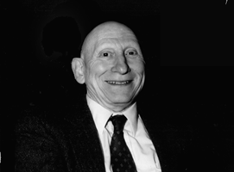
Learn Programming to Re-Think Process Everywhere
Alan Perlis argued that computer science should be part of a liberal education.
  Explicitly, he argued that all students should learn to program.
Why?
  Because Computer Science is the study of process.
  Automated execution of process changes everything
    Including how we think about things we already know
Notes:
Talked about the economics department at Carnegie Tech (at that time). Talk about rethinking Calculus.

Slide 15
Does it have to be programming?
Elias: If the computers, together with sufficiently ingenious languages and programming systems, are capable of doing everything that Professor Perlis describes—and I believe they are (and more)—then they should be ingenious enough to do it without the human symbiote being obliged to perform the mechanical chores which are a huge part of current programming effort, and which are a large part of what must now be taught in the introductory course that he proposes.

Slide 16
Why programming
Licklider: Peter, I think the first apes who tried to talk with one another decided that learning language was a dreadful bore…But some people write poetry in the language we speak.
Perlis: The purpose of a course in programming is to teach people how to construct and analyze processes…A course in programming is concerned with abstraction: the abstraction of constructing, analyzing, and describing processes…The point is to make the students construct complex processes out of simpler ones….A properly designed programming course will develop these abilities better than any other course.

Slide 17
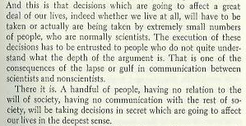
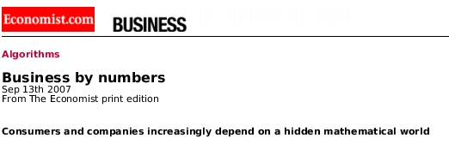
The Power and Fear of Algorithms
The Economist (Sept., 2007) spoke to the algorithms that control us, yet we don’t understand.
  Credit Ratings, Adjustable Rate Mortgages, Search Rankings
C.P. Snow foresaw this in 1961.
  Those who don’t understand algorithms, can’t understand how the decisions are made.
“A handful of people, having no relation to the will of society, having no communication with the rest of society, will be taking decisions in secret which are going to affect our lives in the deepest sense.”

Slide 18
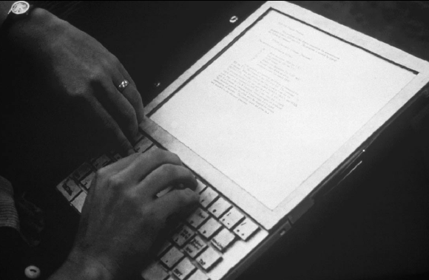
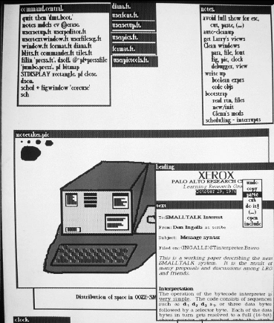
Alan Kay’s
Dynabook (~1970)
Alan Kay (2004 ACM Turing Awardee) sees the Computer as humanity’s first metamedium
  A medium that can represent all other media.
  Programming as an important new medium
The computer-as-Dynabook is for creative metamedia exploration and reading

Slide 19
Richard Dawkins on
Biology as Computer Science
On US National Public Radio in April 2007:
GROSS: You close your book saying, "I am thrilled to be alive at a time when humanity is pushing against the limits of understanding." How do you think that's happening in your field of evolutionary biology?
Mr. DAWKINS: Well, it's the most exciting time to be a biologist… Since Watson and Crick in 1953, biology has become a sort of branch of computer science. I mean, genes are just long computer tapes, and they use a code which is just another kind of computer code. It's quaternary rather than binary, but it's read in a sequential way just like a computer tape. It's transcribed. It's copied and pasted. All the familiar metaphors from computer science fit.
Notes:
This perspective is being taught to biology undergraduates today. Yet we are playing very little role.

Slide 20
Why teach computing to everyone?
Perlis: To have a powerful new tool to think with.
Snow: Because it’s necessary to participate and understand in the modern world.
Kay: To have full expressive power with the most powerful and creative medium humans have ever invented.
Wing and Dawkins: To provide powerful computing metaphors to think with.

Slide 21
Part 2: Creating and Sustaining Interest
How do we create interest in Computing?
  Students lose interest as early as pre-teen years.
How do we sustain interest through secondary school?
  Creating Infrastructure:
  Defining curriculum and teacher certification,
  Preparing teachers

Slide 22
Creating Interest in Computing
Start early
  We start with 4th graders (9 – 10 years old)
Provide lots of opportunities for engagement
  Weekend workshops, afterschool programs, summer camps, courses in 9th – 12th grade
Use activities that are
  Creative and social
Use a variety of activities
  No one thing appeals to everyone
  Students want to learn new things

Slide 23
What have we tried?
Teacher workshops
  4 weeks in summer and about 1 day per month
Computing summer camps
  8 weeks in the summer
Weekend workshops
Competitions
  Alice, Scratch, Advanced Placement CS
Lending library of robot kits and phones
Distance learning website
  Video tutorials and projects

Slide 24
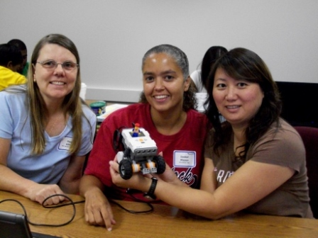
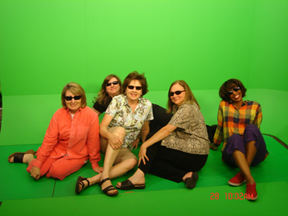
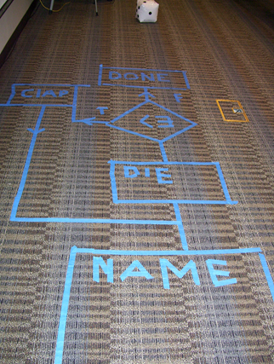
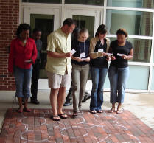
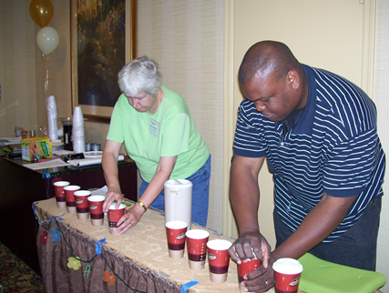
Teacher Workshops

Slide 25
Why Offer Teacher Workshops?
Huge need
  Few teachers have formal training in CS/IT
Multiplier effect
  One teacher has many students each year
  > 450 teachers from > 250 schools since 2004
Teachers believe the stereotypes
  Programming is hard and for geeks
Teachers have influence on students
  Can recruit students and encourage them

Slide 26
Lessons Learned
Many teachers need and appreciate professional development
  Ask what they want to learn
Teachers prefer hands-on learning
Teachers like extensive materials
Teachers need financial support
  Lunch, parking, stipends
Cultivate teacher leaders
  There are some excellent teachers

Slide 27
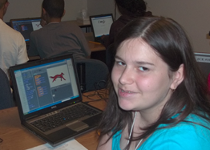
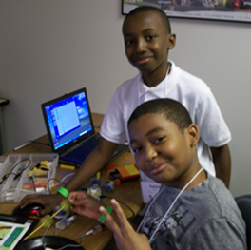
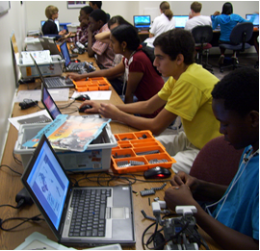
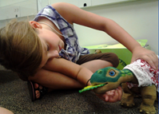
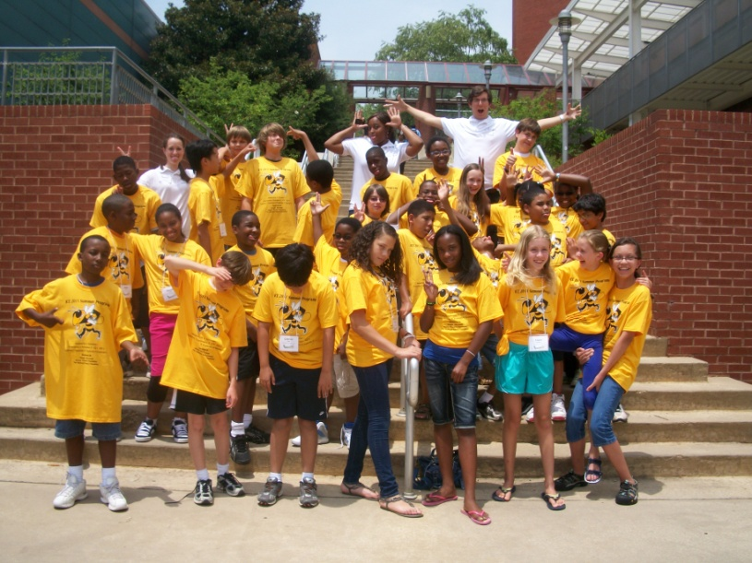
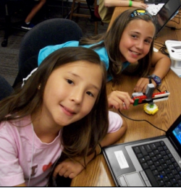
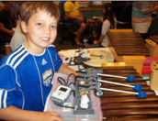
Computing Summer Camps

Slide 28
Why Offer Computing Summer Camps?
To reach more students and especially more minority students
  Many teachers who teach computing are in high end public or private schools
  20% of Georgia teachers have recruited females but many fail to recruit minorities
Camps allow students to have an engaging introduction to computing
  Long enough for learning and attitude changes
Camps can be profitable
  Self-sustaining

Slide 29
Summer Camps
We started with 2 weeks for 9th – 12th grade in 2004
  Camps were popular, but lost money
Added camps for 6th – 8th grade in 2006
  Camps broke even
Added camps for 4th – 6th grade in 2009
  Camps make a profit and show statistically significant changes in attitudes, and learning gains
Notes:
9th – 12th grade is ages 14-18
6th – 8th grade is ages 11 - 14
4th – 6th grades is ages 9-12

Slide 30
Summer Camps 2011
High School - 2 weeks
  App Inventor
  Alice and LEGO NXT and Tetrix robots
Middle School - 2 weeks
  Scratch and PicoCrickets
  Alice and LEGO NXT robots
Elementary School – 4 weeks
  Scratch, Pleo, and LEGO WeDo
  Simulations and Science with Scratch and LEGO NXT robots
  Music with Scratch and LEGO NXT
  Storytelling with Scratch and LEGO NXT

Slide 31
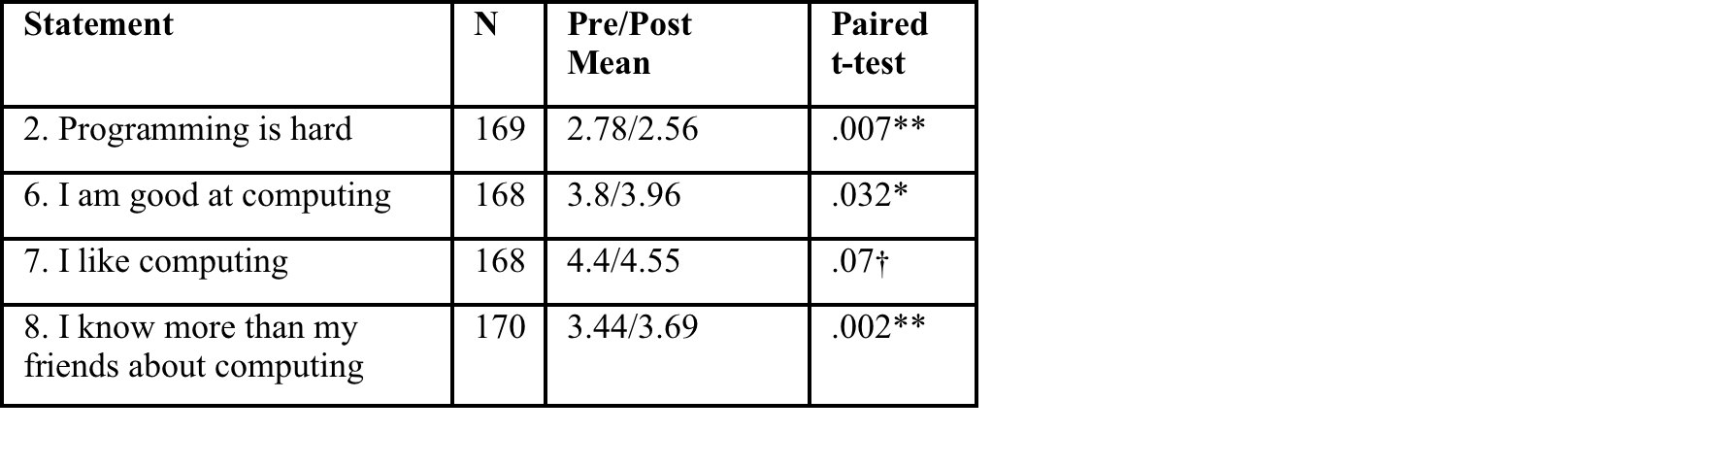
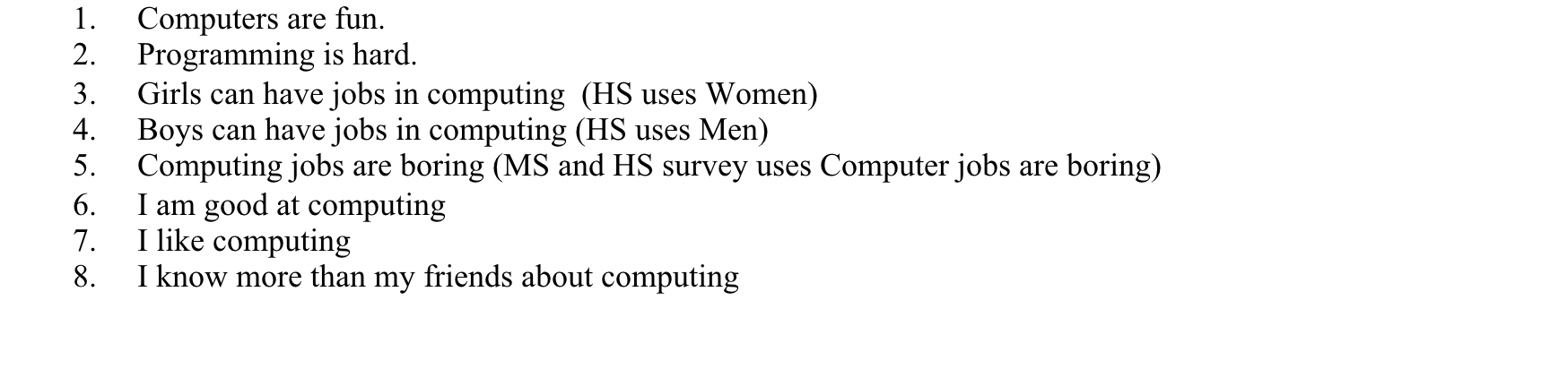
Survey Results – All Camps
Drag and drop programming is easy for beginners
Hands-on simple activities increase confidence

Slide 32
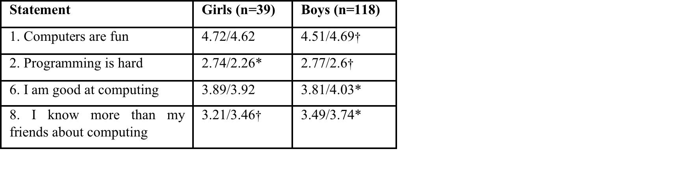
Survey Results by Gender
** p<.01, * p<.05, † p <.1
Girls show a bigger decrease in programming is hard. Boys show improvement for all.

Slide 33
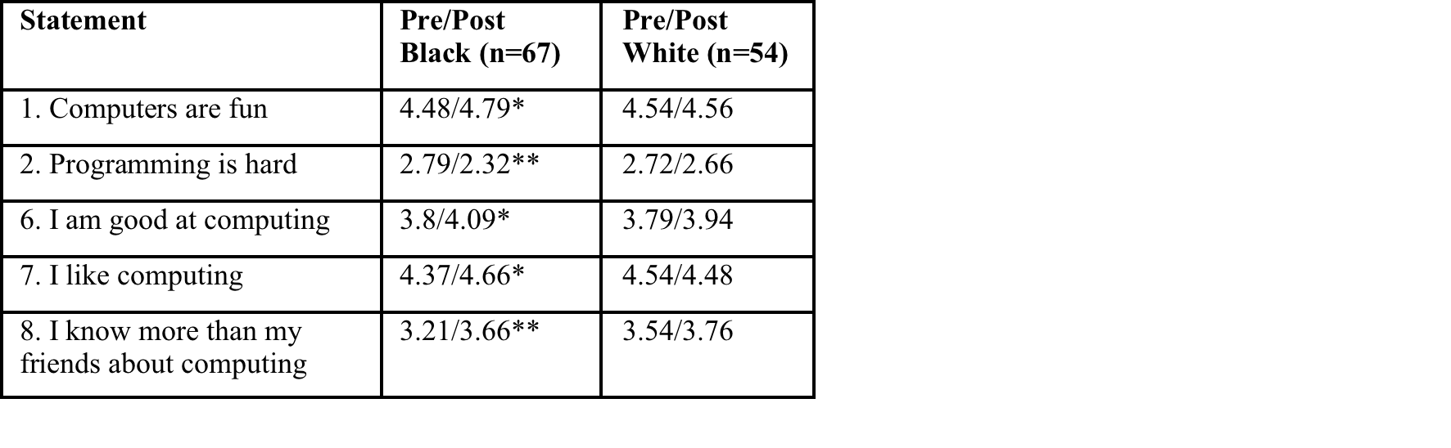
Survey results by Race
Black students show statistical significant changes

Slide 34
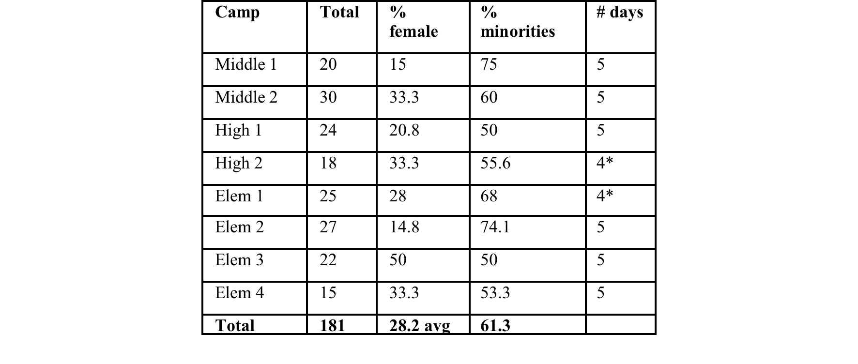
Gender and Race – GT camps

Slide 35
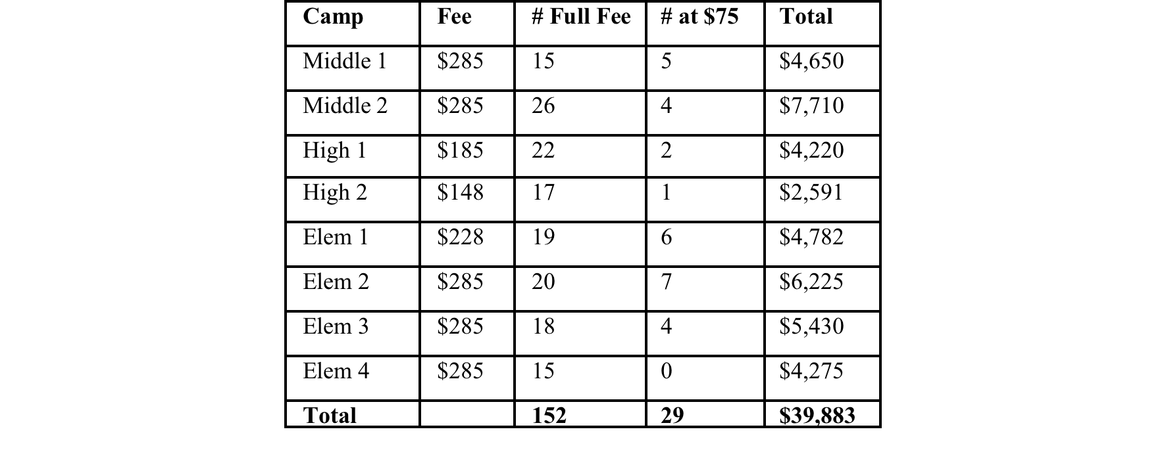
Income from Camps
Application fee of $15 x 181 = $2,715
Total income 39,883 + 2,715 = $42,598

Slide 36
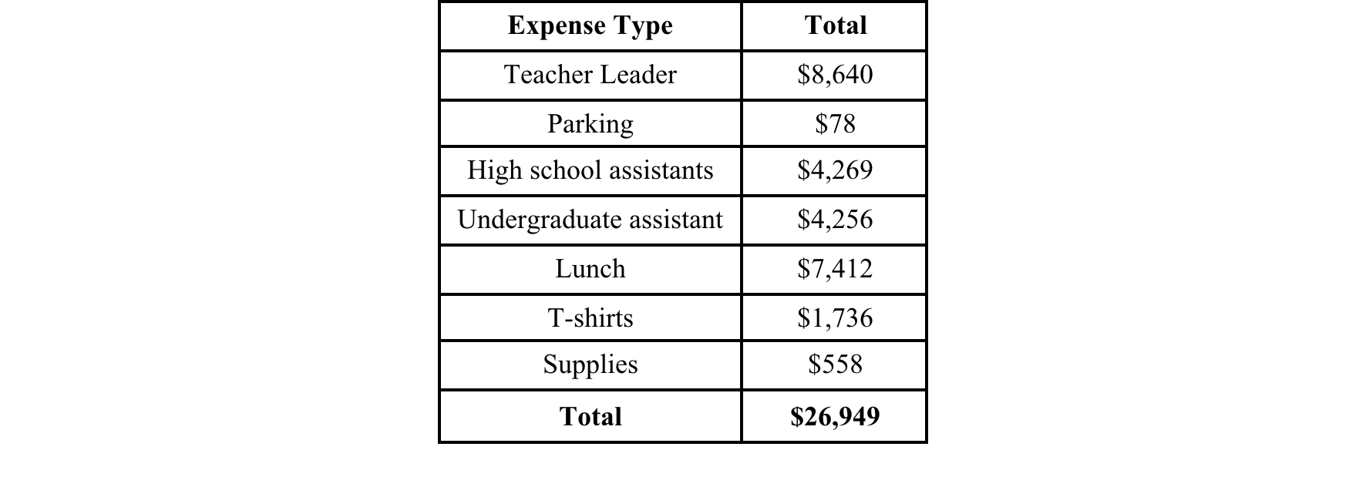
Camp Expenses
$42,598 – $26,949 - $5,000 (admin costs) = $10,649 profit.
Notes:
The total profit from the camps was $42,598 - $26,949 = $15,649. Even if we included the administrative costs the camp made $10,649.

Slide 37
Learning Results – GT Camps
In 2011 we administered pre and post multiple choice tests in Scratch or Alice at most of our camps
  Not the App Inventor camp
Found statistically significant improvements in scores for all camps
No significant difference in learning by gender or race
See http://coweb.cc.gatech.edu/ice-gt/1091

Slide 38
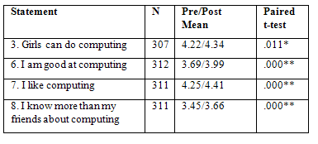
Evaluation Results – Seeded Camps
Seeded camps also show statistically significant changes

Slide 39
Long Term Results
At least 3 kids from our computing summer camps came to Georgia Tech for CS / CM
  Self identified
One black male
  Originally wanted to be a professional basketball player
  Didn't even want to go to our camp
  Was most outstanding Junior in computer science!
Two female students
  One only did our camp between 10th-11th grade
    No computing classes in school
  One came to camp, but didn't decide to major in CS till got into Georgia Tech

Slide 40
Lessons Learned
Hire local teachers to lead camps
  Cheaper and more likely to use materials in their classrooms
Hire undergraduate student helpers
  And high school helpers
  Be sure to include males, females, and minorities
You can charge more than daycare for the younger students
  Huge demand for 4th- 6th grade
Students like free software like Scratch and Alice

Slide 41
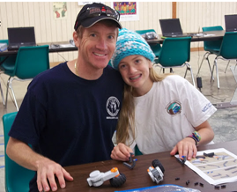
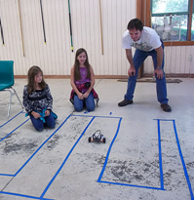
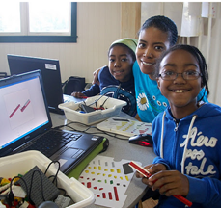
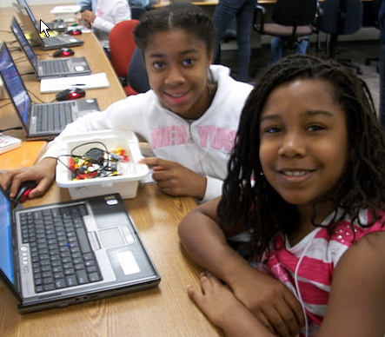
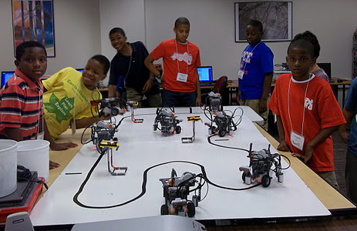
Weekend Workshops

Slide 42
Why Offer Weekend Workshops?
Increase exposure for underserved populations
  Females, minorities, younger students
Undergraduate students enjoy leading these workshops
  More likely to persist in computing
  Best time for undergraduate students to work
Weekend workshops are better than afterschool workshops
  Students pay more attention on weekends

Slide 43
Weekend Workshops
Hundreds of girls through the Girl Scouts
  Girl Scout camps in fall
    When girls are camping with parents
  Girls come to Georgia Tech for workshops
  Train counselors at camps for summer camps
Elementary Workshops – 2 sessions of 24
  Monthly fee based workshops for 4th – 6th graders
  Self-sustaining financially
Get positive changes in attitudes
  Girls and minorities especially gain confidence and see computing as fun

Slide 44
Lessons Learned
Do hands-on activities
Limit "teaching" to 15 minutes
  Allow students time to create something new based on what you taught them
Use activities that are social and where students get to be creative
  Have students work in groups
  Have students show what they created
Tell student leaders not to mention stereotypes
  Reinforces them rather than dispels them
Tie activity to jobs – dot diva site

Slide 45
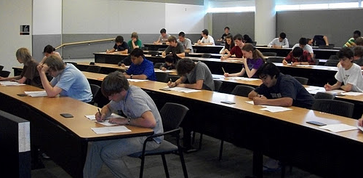
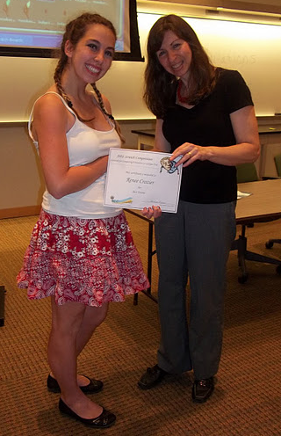
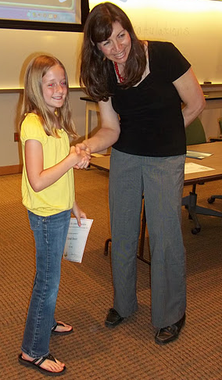
Competitions
Advanced Placement Computer Science A
  Since 2006
  Practice Multiple choice test
  Over 100 students
Scratch and Alice competitions
  Since 2010
  Scratch was 50% female

Slide 46
Why Offer Competitions?
Teachers like them
  Bragging rights and recognition at school
  Encourages teachers to use tools and learn more
Students like them
  Allow group entries to attract more females
  Give prizes in special categories too
Students spend time on their entries
  More time on task leads to more learning
Encourages students to stay in pipeline

Slide 47
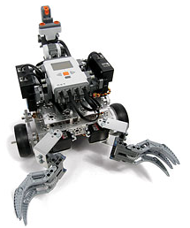
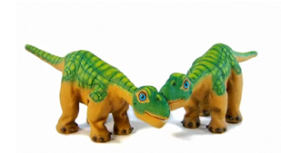
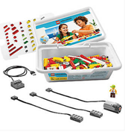


Lending Library
Many schools and teachers can't afford to buy robot kits
  Or want to try them before they buy
We lend our kits out for up to 3 weeks at a time
  Teachers leave a deposit
Teachers can borrow enough for the entire class
  Instead of just a robot club for a few students
Teachers use robots to recruit students

Slide 48
Distance Learning Website
We tried reaching more teachers with webinars
  Not many attend the webinars
  But, many asked to view the recordings
Created a distance learning website
  Short videos tutorials
  Short step-by-step projects
Alice, Scratch, App Inventor, Tetrix, Lightbot

Slide 49









What do we use?
CS Unplugged
Kinesthetic Learning Activities
Scratch
Alice
PicoCrickets
Pleo robots
LEGO robots
IPRE robots
Media Computation
Greenfoot
Android App Inventor
Lightbot 2.0

Slide 50
Piece 3: Teaching
Computing to Everyone
Fall 1999:
All students at Georgia Tech must take a course in computer science.
  Considered part of General Education, like mathematics, social science, humanities…
1999-2003: Only one course met the requirement.
  Shackelford’s pseudocode approach in 1999
  Later Scheme: How to Design Programs (MIT Press)

Slide 51

One-class CS1: Pass (A, B, or C) vs.
WDF (Withdrawal, D or F)
Success Rates in CS1 from Fall 1999 to Spring 2002 (Overall: 78%)
Architecture | 46.7%
Biology | 64.4%
Economics | 53.5%
History | 46.5%
Management | 48.5%
Public Policy | 47.9%
Notes:
Actually, quite good pass rates, compared to many others in CS.
Across campus, these are the pits.
And the women are failing or withdrawing. in greater numbers than the men.
This looks like C.P. Snow’s “Two Cultures”

Slide 52



Contextualized Computing Education
What’s going on?
  Research results: Computing is “tedious, boring, irrelevant”
Since Spring 2003, Georgia Tech teaches three introductory CS courses.
  Based on Margolis and Fisher’s “alternative paths”
Each course introduces computing using a context (examples, homework assignments, lecture discussion) relevant to majors.
  Make computing relevant by teaching it in terms of what computers are good for (from the students’ perspective)
Notes:
Talk about iPods and Blackberries.
This is a Computer as Tool model. We’re not yet at Computing as Literacy.

Slide 53
Our Three CS1’s Today
CS1301/1321 Introduction to Computing
Traditional CS1 for our CS majors and Science majors (math, physics, psychology, etc.). Now, uses robots.
CS1371 Computing for Engineers
CS1 for Engineers. Same topics as CS1301, but using MATLAB with Engineering problems.
CS1315 Introduction to Media Computation for Architecture, Management, and Liberal Arts students.

Slide 54




Media Computation:
Teaching in a Relevant Context
Presenting CS topics with media projects and examples
  Iteration as creating negative and grayscale images
  Indexing in a range as removing redeye
  Algorithms for blending both images and sounds
  Linked lists as song fragments woven to make music
  Information encodings as sound visualizations
54

Slide 55




def clearRed(picture):
for pixel in getPixels(picture):
setRed(pixel,0)
def greyscale(picture):
for p in getPixels(picture):
redness=getRed(p)
greenness=getGreen(p)
blueness=getBlue(p)
luminance=(redness+blueness+greenness)/3
setColor(p, makeColor(luminance,luminance,luminance))
def negative(picture):
for px in getPixels(picture):
red=getRed(px)
green=getGreen(px)
blue=getBlue(px)
negColor=makeColor(255-red,255-green,255-blue)
setColor(px,negColor)

Slide 56





Open-ended, contextualized homework in Media Computation CS1 & CS2
Sound collage
Notes:
56

Slide 57
Results:CS1“Media Computation”
Change in Success rates in CS1 “Media Computation” from Spring 2003 to Fall 2005 (Overall 85%)
Architecture | 46.7% | 85.7%
Biology | 64.4% | 90.4%
Economics | 54.5% | 92.0%
History | 46.5% | 67.6%
Management | 48.5% | 87.8%
Public Policy | 47.9% | 85.4%
Notes:
Be sure to wonder, “But are they learning the same?”

Slide 58
Was the class successful?
Interviewed Intl Affairs student (female): “I just wish I had more time to play around with that and make neat effects. But JES [IDE for class] will be on my computer forever, so… that’s the nice thing about this class is that you could go as deep into the homework as you wanted. So, I’d turn it in and then me and my roommate would do more after to see what we could do with it.”
Survey one year later:
  19% of respondents had programmed since class ended
"Did the class change how you interact with computers?”
  “Definitely makes me think of what is going on behind the scenes of such programs like Photoshop and Illustrator.”
Notes:
FIX HAVE->HAD

Slide 59

Results at Other Schools
Similar retention results at 2 year public Gainesville College (Tew, Fowler, Guzdial, SIGCSE 2005) and at (much more diverse) U. Illinois-Chicago’s CS0.5 (Sloan & Troy, SIGCSE 2008)
Would you like more CS?
  GT 15.2% “Strongly Disagree.” <25% agree.
  More MediaComp? GT and Gainesville over 40% agree.
(Tew, Fowler, Guzdial, SIGCSE 2005)

Slide 60
Results at
University of California, San Diego
Simon, Kinnunen, Porter, Zaskis, ACM ITICSE 2010
Using Java Media Computation as normal CS1 for CS majors at a research university.
Did extensive data collection last semester before switching to Media Computation.
Been following two cohorts of CS1 students for comparison.
Findings:
MediaComp has more focus on problem-solving, less on language.
MediaComp students have higher pass rates and retention rates one year later

Slide 61





A Contextualized CS2:
MediaComp Data Structures
How did the Wildebeests charge over the
ridge in Disney's "The Lion King"?
Notes:
How is it different? The first “tree” that students use is an n-ary tree, a scene graph. Why not start with a binary tree? Because binary trees are irrelevant to media developers.
Java course, all non-majors, 90% success rate

Slide 62
Research Question:
Is context still useful in a second course?
Mixed model research design
  Interviews informing whole-class survey
11% agreed with “Working with media is a waste of time that could be used to learn the material in greater depth.”
  “I didn’t take this class to learn how to make pretty pictures.”
A majority of the class (70%) agreed or strongly agreed that working with media makes the class more interesting.
67% of the students agreed or strongly agreed that they were really excited by at least one class project
66% reported doing extra work on projects to make the outcome look “cool.”
(Yarosh and Guzdial, JERIC, Jan 2008)

Slide 63


Introducing Computing in an
Engineering Context
Developed in collaboration with Civil, Mechanical, and Aerospace Engineering.
Uses Engineering problems and MATLAB
Covers traditional CS1 topics
Among our 3 CS1’s, these are the first students to program outside of class.
The success rate in this class also rose compared to all-in-one.

Slide 64

Comparing Spring 2004
CS for Engineers: ~1200 students/semester
Media Comp: ~300 students/semester
CS for CS majors: ~150 students/semester

Slide 65



A Context for CS1 for
CS majors: Robotics
Microsoft Research has funded the Institute for Personal Robotics in Education
  Leads: Tucker Balch, Deepak Kumar, Doug Blank
  Joint between Bryn Mawr College and Georgia Tech
  http://www.roboteducation.org
Developing a CS1 with robotics as the context.
Notes:
Doug Harms talked about moving Myro API to Java yesterday.

Slide 66
Conclusions
Computing is important for everyone.
It has been our job for 50 years to teach computing to everyone.
Creating and sustaining interest in computing requires a significant outreach effort.
We can use context to retain students and to teach everyone on campus about computer science in terms that make sense for them.

Slide 67
With thanks to our supporters
US National Science Foundation
  Statewide BPC Alliance: Project “Georgia Computes!” http://www.gacomputes.org
  CCLI, CPATH, and CE21 Grants
Microsoft Research
Georgia Tech's College of Computing
Georgia’s Department of Education
GVU Center,
GT President's Undergraduate Research Award,
Toyota Foundation

Slide 68




Thank you!
http://coweb.cc.gatech.edu/ice-gt
http://ice-web.cc.gatech.edu/dl
http://www.cc.gatech.edu/~mark.guzdial
http://home.cc.gatech.edu/csl
http://www.georgiacomputes.org
For more on MediaComp approach:
http://www.mediacomputation.org

Slide 69
Extra slides

Slide 70


Simon et al. Key Findings Summarized
Notes:
It’s about changing definitions of computer science.

Slide 71

Schools in Georgia Teaching AP CS
2006
GaComputes starts

Slide 72

As percent of schools, best in Southeast

Slide 73

AP CS Test Taking in Georgia
2006
GaComputes starts

Slide 74

Number of AP CS Tests

Slide 75

Who’s taking those tests?
2006
GaComputes starts

Slide 76

And how are they doing?
Percentage of students earning a 3 or higher.
2006
GaComputes starts

