Slide 1
Computer Science: An Extraordinarily Liberating Art
Mark Guzdial
School of Interactive Computing

Slide 2
Story
Beyond teaching computing to more,
teaching computing to everyone.
Computing for All at Georgia Tech
  1999-2003: One course for all
  2003-2008: Contextualized Computing Education
Designing a course to introduce computing to Liberal Arts majors is like designing a theme park
  Principles of Imagineering

Slide 3
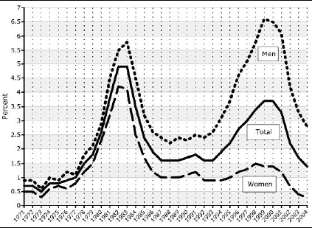
Declining Enrollments in Computer Science
Source: Higher Education Research Institute at UCLA, 2005

Slide 4
Degree Production vs. Job Openings
160,000
140,000
Ph.D.
Master’s
120,000
Bachelor’s
100,000
Projected job openings
80,000
60,000
40,000
20,000
Engineering
Physical Sciences
Biological Sciences
Computer Science
Sources:
Adapted from a presentation by John Sargent, Senior Policy Analyst, Department of Commerce, at the CRA Computing Research Summit, February 23, 2004. Original sources listed as National Science Foundation/Division of Science Resources Statistics; degree data from Department of Education/National Center for Education Statistics: Integrated Postsecondary Education Data System Completions Survey; and NSF/SRS; Survey of Earned Doctorates; and Projected Annual Average Job Openings derived from Department of Commerce (Office of Technology Policy) analysis of Bureau of Labor Statistics 2002-2012 projections. See http://www.cra.org/govaffairs/content.php?cid=22.

Slide 5
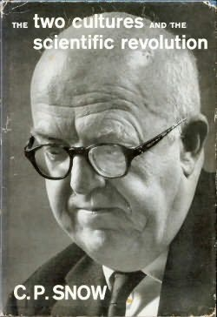
The Two Cultures
Notes:
We want everyone – different camps. How do we draw them in? Why would they want to join us?

Slide 6
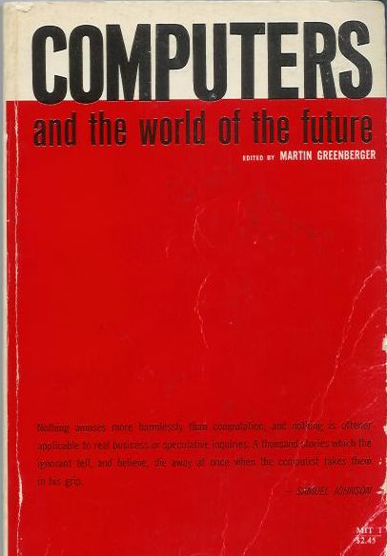
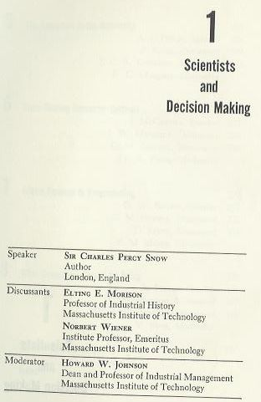
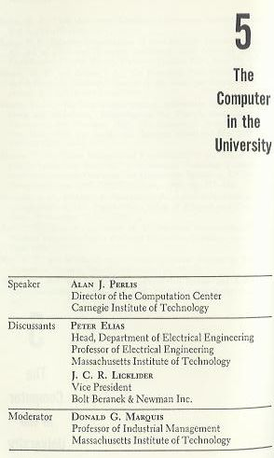
1961 MIT Sloan School Symposium
Notes:
Why might they want to join us?
In “Dream Machines,” biography of J.C.R. Licklider.
Other speakers include Vannevar Bush, Herbert A. Simon, Marvin L. Minsky, J. C. R. Licklider, Jay W. Forrester, Grace M. Hopper, Claude E. Shannon, John G. Kemeny, Gene M. Amdahl.

Slide 7
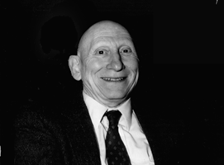
Learn Programming to Re-Think Process Everywhere
Alan Perlis argued that computer science should be part of a liberal education.
  Explicitly, he argued that all students should learn to program.
Why?
  Because Computer Science is the study of process.
  Automated execution of process changes everything
    Including how we think about things
Notes:
Talked about the economics department at Carnegie Tech (at that time). Talk about rethinking Calculus.

Slide 8
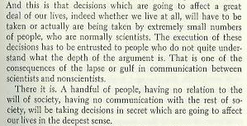
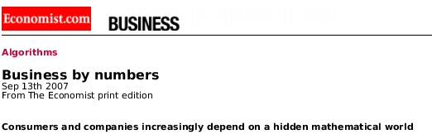
The Power and Fear of Algorithms
The Economist (Sept., 2007) spoke to the algorithms that control us, yet we don’t understand.
  Credit Ratings, Adjustable Rate Mortgages, Search Rankings
C.P. Snow foresaw this in 1961.
  Those who don’t understand algorithms, can’t understand how the decisions are made.
“A handful of people, having no relation to the will of society, having no communication with the rest of society, will be taking decisions in secret which are going to affect our lives in the deepest sense.”

Slide 9
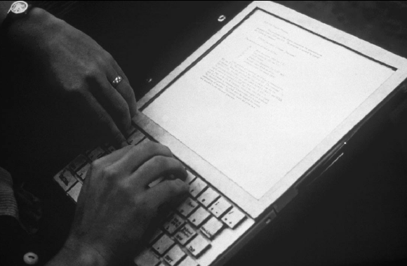
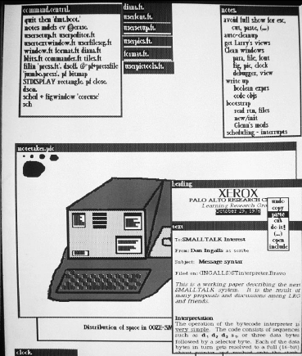
1970- : Alan Kay’s Dynabook
Alan Kay (2004 ACM Turing Awardee) sees the Computer as humanity’s first metamedium
  A medium that can represent all other media.
  Programming as an important new medium
The computer-as-Dynabook is for creative metamedia exploration and reading

Slide 10
Fall 1999: Georgia Tech
Fall 1999:
All students at Georgia Tech must take a course in computer science.
  Considered part of General Education, like mathematics, social science, humanities…
Why did Georgia Tech make that decision?
  Computing was a College.
    Solved a problem for Engineering
  Making a competitive distinction for Liberal Arts

Slide 11
Computing for Everyone is
Already Happening
Computing is already cross-campus
  Bio2010 (NRC) calls for programming for mathematical and computational models.
  Physics teaches VPython for labs where they solve three-body problems.
Computer science provides the tools and metaphors for understanding our world
  Jeanette Wing’s “Computational Thinking”
Scientists and engineers use computing to model, simulate, and understand.
  Why shouldn’t students?
Notes:
Bio2010 in NRC.
New approach by Ruth Chabay and Bruce Sherwood, being adopted now at Georgia Tech, Purdue, and North Carolina State.
It’s a problem for them and us.

Slide 12
Richard Dawkins on Fresh Aire
GROSS: You close your book saying, "I am thrilled to be alive at a time when humanity is pushing against the limits of understanding." How do you think that's happening in your field of evolutionary biology?
Mr. DAWKINS: Well, it's the most exciting time to be a biologist… Since Watson and Crick in 1953, biology has become a sort of branch of computer science. I mean, genes are just long computer tapes, and they use a code which is just another kind of computer code. It's quaternary rather than binary, but it's read in a sequential way just like a computer tape. It's transcribed. It's copied and pasted. All the familiar metaphors from computer science fit.
Notes:
This perspective is being taught to biology undergraduates today. Yet we are playing very little role.

Slide 13
Computer Science = = Computer Science
Key Point: Only one course met the requirement:
CS1321 Introduction to Computing
  Shackelford’s pseudocode approach in 1999
  Later Scheme: How to Design Programs (MIT Press)
Why only one?
  It’s all the same computer science.
  Resource issues
  “Service Ghetto”

Slide 14
One-class CS1: Pass (A, B, or C) vs.
WDF (Withdrawal, D or F)
Success Rates in CS1 from Fall 1999 to Spring 2002
Architecture | 46.7%
Biology | 64.4%
Economics | 53.5%
History | 46.5%
Management | 48.5%
Public Policy | 47.9%
Notes:
Actually, quite good pass rates, compared to many others in CS.
Across campus, these are the pits.
And the women are failing or withdrawing. in greater numbers than the men.
This looks like C.P. Snow’s “Two Cultures”

Slide 15
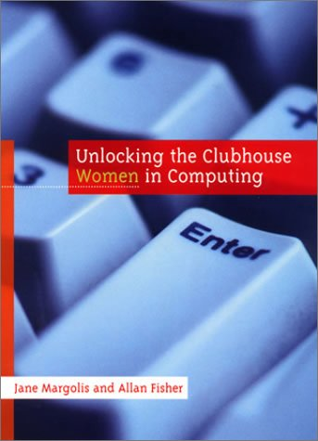
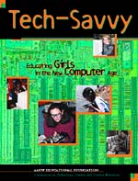

Contextualized Computing Education
What’s going on?
  Research results: Computing is “tedious, boring, irrelevant”
Since Spring 2003, Georgia Tech teaches three introductory CS courses.
  Based on Margolis and Fisher’s “alternative paths”
Each course introduces computing using a context (examples, homework assignments, lecture discussion) relevant to majors.
  Make computing relevant by teaching it in terms of what computers are good for (from the students’ perspective).
Notes:
Talk about iPods and Blackberries.

Slide 16
Our Three CS1’s Today
CS1301/1321 Introduction to Computing
Traditional CS1 for our CS majors and Science majors (math, physics, psychology, etc.). Uses robots.
CS1371 Computing for Engineers
CS1 for Engineers. Same topics as CS1301, but using MATLAB with Engineering problems in homework and examples.
CS1315 Introduction to Media Computation

Slide 17
Introduction to Media Computation
Average 300 students/term
  Overall, CS1315 has been 51% female
  Required in Architecture, Management, Ivan Allen College of Liberal Arts, and Biology
Focus: Learning programming and CS concepts within the context of media manipulation and creation
  Computing for communications, not calculation
Notes:
But could be taught for CS

Slide 18
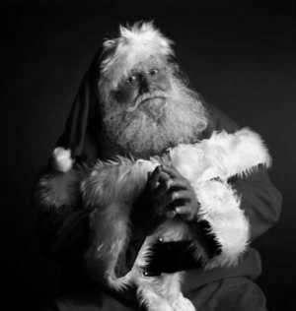
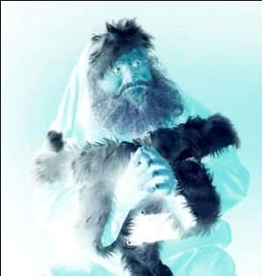
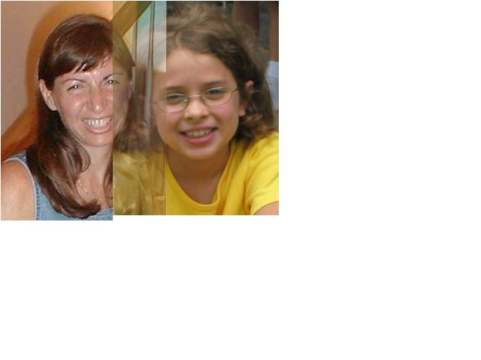

Media Computation: Teaching in a Relevant Context
Presenting CS topics with media projects and examples
  Iteration as creating negative and grayscale images
  Indexing in a range as removing redeye
  Algorithms for blending both images and sounds
  Linked lists as song fragments woven to make music
  Information encodings as sound visualizations

Slide 19
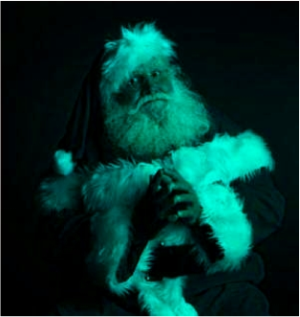
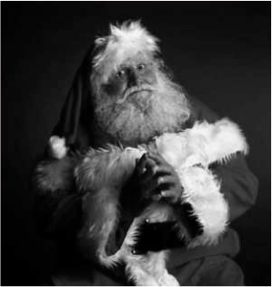
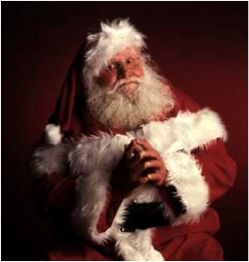
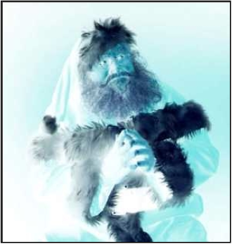
def clearRed(picture):
for pixel in getPixels(picture):
setRed(pixel,0)
def greyscale(picture):
for p in getPixels(picture):
redness=getRed(p)
greenness=getGreen(p)
blueness=getBlue(p)
luminance=(redness+blueness+greenness)/3
setColor(p, makeColor(luminance,luminance,luminance))
def negative(picture):
for px in getPixels(picture):
red=getRed(px)
green=getGreen(px)
blue=getBlue(px)
negColor=makeColor(255-red,255-green,255-blue)
setColor(px,negColor)

Slide 20
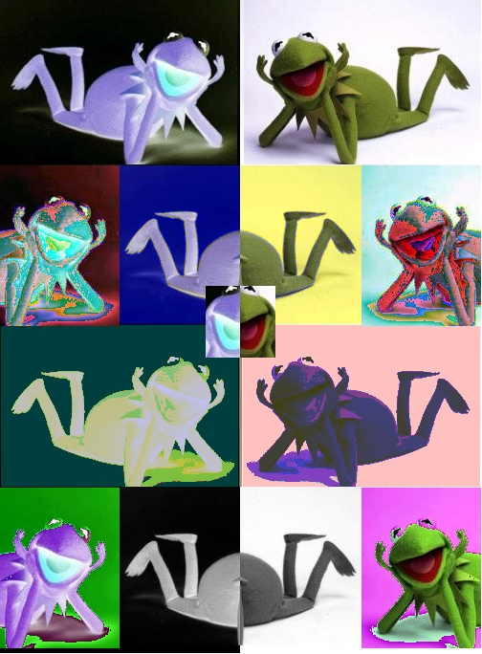
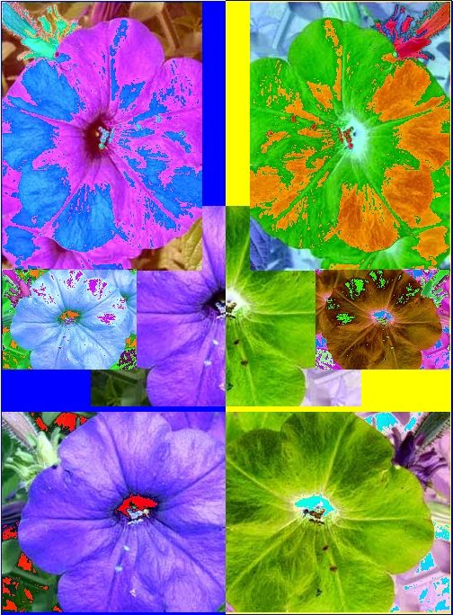
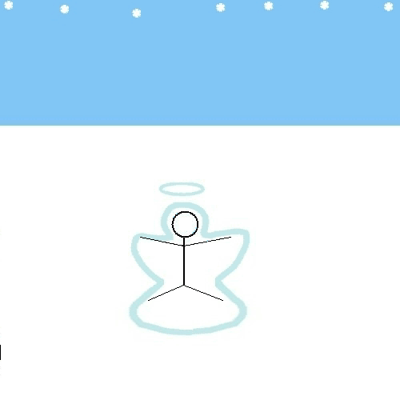
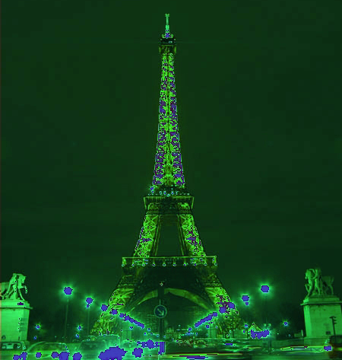
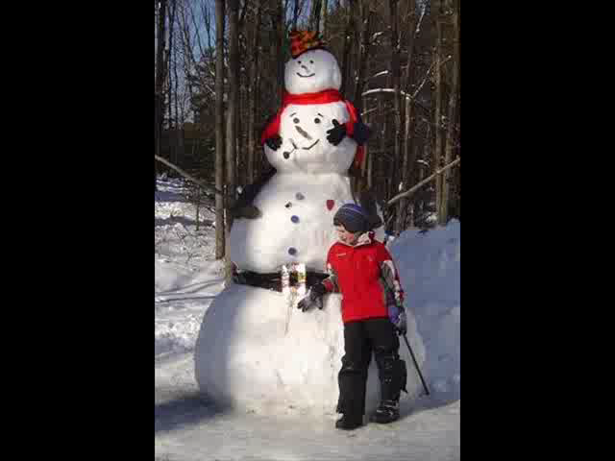

Open-ended, contextualized homework in Media Computation CS1
Sound collage

Slide 21
Results:CS1“Media Computation”
Change in Success rates in CS1 “Media Computation” from Spring 2003 to Fall 2005
Architecture | 46.7% | 85.7%
Biology | 64.4% | 90.4%
Economics | 54.5% | 92.0%
History | 46.5% | 67.6%
Management | 48.5% | 87.8%
Public Policy | 47.9% | 85.4%

Slide 22
Voices fromMedia Computation Students
Intl Affairs student (female): “I just wish I had more time to play around with that and make neat effects. But JES [IDE for class] will be on my computer forever, so… that’s the nice thing about this class is that you could go as deep into the homework as you wanted. So, I’d turn it in and then me and my roommate would do more after to see what we could do with it.”
Results from a survey a year later.
  19% of respondents had programmed since class ended
  “Did the class change how you interact with computers?”
    80% say “Yes”
Notes:
FIX HAVE->HAD

Slide 23
“Did the class change how you interact with computers?”
Results from a survey a year later:
  “Definitely makes me think of what is going on behind the scenes of such programs like Photoshop and Illustrator.”
  'I understand technological concepts more easily now; I am more willing and able to experience new things with computers now’
  'I have learned more about the big picture behind computer science and programming. This has helped me to figure out how to use programs that I've never used before, troubleshoot problems on my own computer, use programs that I was already familiar with in a more sophisticated way, and given me more confidence to try to problem solve, explore, and fix my computer.’

Slide 24
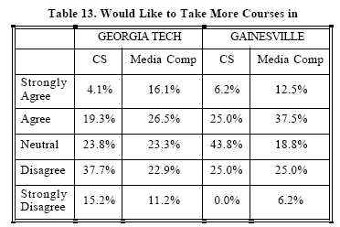
Results at Gainesville College
(Tew, Fowler, Guzdial, SIGCSE 2005)

Slide 25
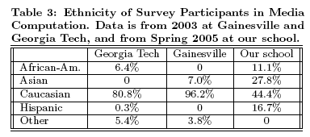
Results at U. Illinois-Chicago
(Sloan and Troy, SIGCSE 2008)

Slide 26
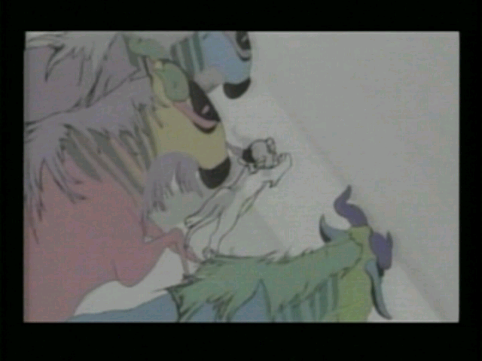
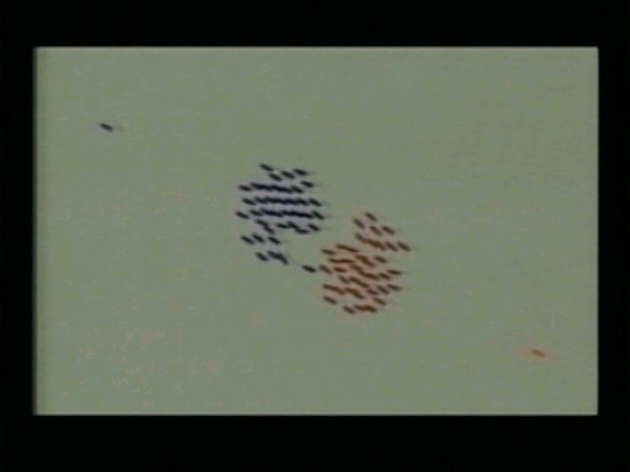
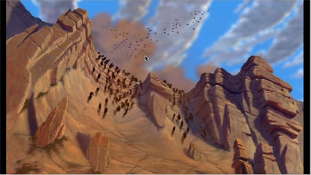
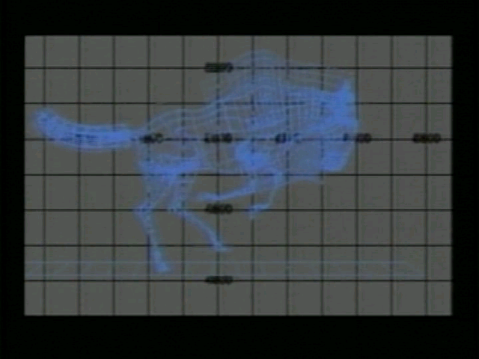
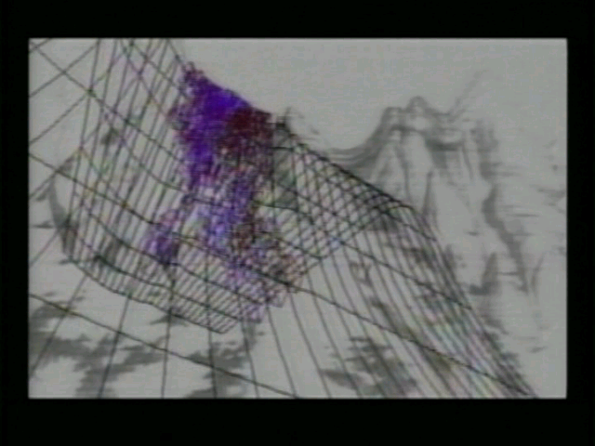
AContextualized CS2: MediaComp Data Structures
How did the Wildebeests charge over the ridge in Disney's "The Lion King"?
Notes:
How is it different? The first “tree” that students use is an n-ary tree, a scene graph. Why not start with a binary tree? Because binary trees are irrelevant to media developers.
Java course, all non-majors, 90% success rate

Slide 27
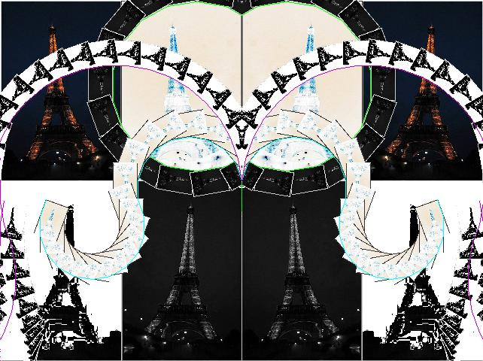
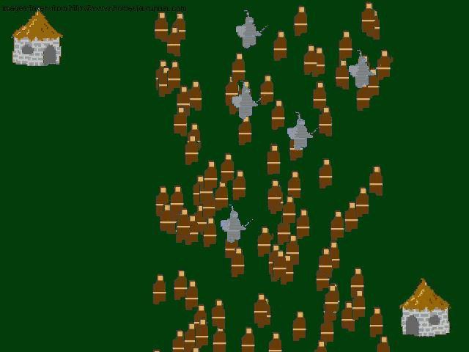
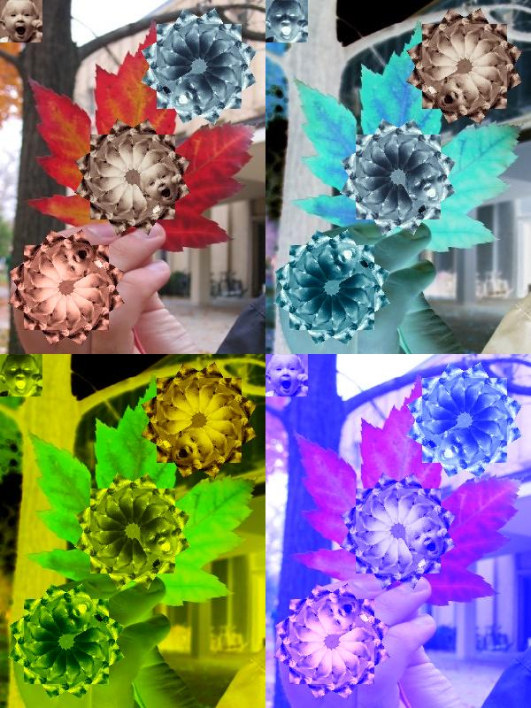
Contextualized Homework in CS2
Music

Slide 28
Research Question: Is context still useful in a second course?
11% agreed with “Working with media is a waste of time that could be used to learn the material in greater depth.”
  “I didn’t take this class to learn how to make pretty pictures.”
A majority of the class (70%) agreed or strongly agreed that working with media makes the class more interesting.
67% of the students agreed or strongly agreed that they were really excited by at least one class project
66% reported doing extra work on projects to make the outcome look “cool.”
(Yarosh and Guzdial, JERIC, Jan 2008)

Slide 29
Why does Media Computation work?
We are preparing students for a world where computation (explicitly, programming) is part of communications and knowledge building practices in liberal arts, architecture, and management.
That world is not easily perceptible today.
To engage students, we must convince them that it exists.
Why do we believe that a white-gloved, six foot mouse can talk?

Slide 30
Disney’s Imagineering
Using theme park design to provide insight into course design:
1. Start from the Story
2. Start from where the expectations are
3. Pay attention to Details
4. Where necessary, change reality
5. Pay attention to Transitions
6. Make the Cast part of the Story

Slide 31
1. Start from the Story
Everything at Disney theme parks starts with a story.
Even changes to vendor booths start from a story.
Examples:
  Tomorrowland
  Big Thunder Railroad
  Splash Mountain
  Emporium

Slide 32
1. Start from the Story
In CS1315, we tell a consistent story
  All media are going digital
  Digital media are manipulated in software
  Knowing how to program is an advantage in a profession that manipulates media.
In CS1316, it’s all about the wildebeests and the villagers

Slide 33
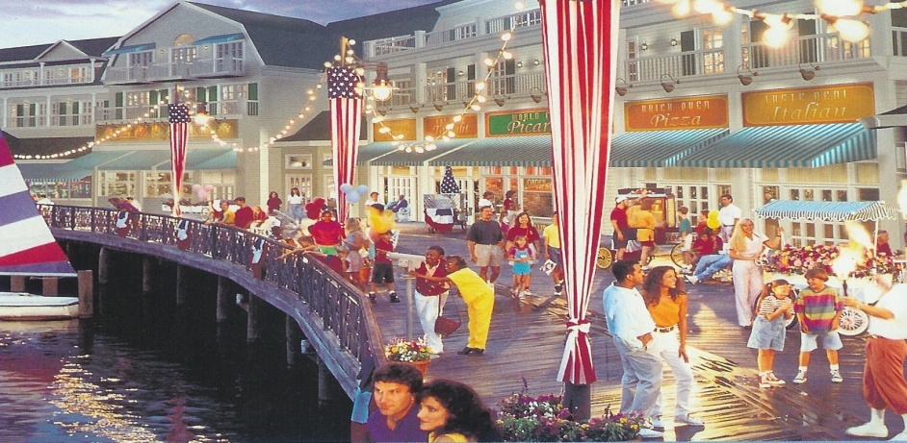

2. Start from where the expectations are
“Just as Main Street, U.S.A. in the Magic Kingdom and Hollywood Boulevard at Disney-MGM Studios are not meant to represent factual history, but to evoke a collective cultural memory, the flavor of the 1920’s mid-Atlantic coast is apparent at Disney’s BoardWalk”
--Kurti, Since the World Began
Notes:
From Swiss Family Robinson to Tarzan’s Treehouse. Was there really a Dance Hall on Atlantic City Boardwalks? Who cares?

Slide 34
2. Start from where the expectations are
These students have been peripherally participating in media manipulation culture
(what is called legitimate peripheral participation.)
  All collect media
  Many use Photoshop
  Some work with MIDI and sound (“Acid”)
We start with the media and manipulations they know.

Slide 35
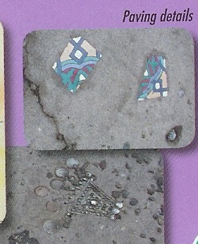
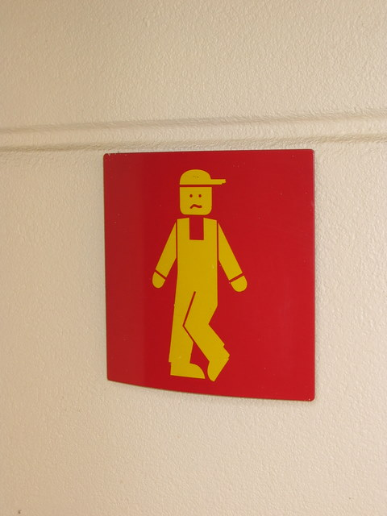
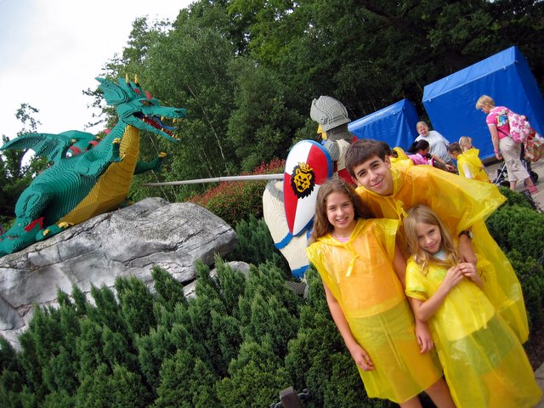
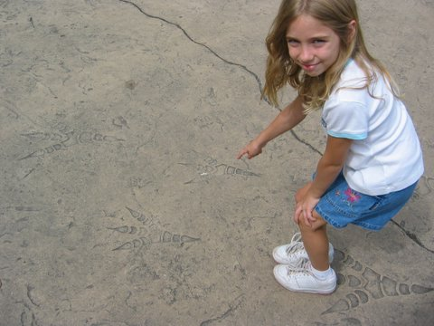
3. Pay Attention to Details
All the elements play off one another and feed into a consistent view.

Slide 36
3. Pay Attention to Details
The lectures
match the book
which matches the assignments (which are about media manipulation)
which match the shared on-line Galleries.
The examples in the book used the same media as on the CD at the back of the book.
The story is told consistently and are self-supporting pieces of evidence.
  “Of course people manipulate media with Python! Go look at all the great things in the on-line Galleries!”

Slide 37
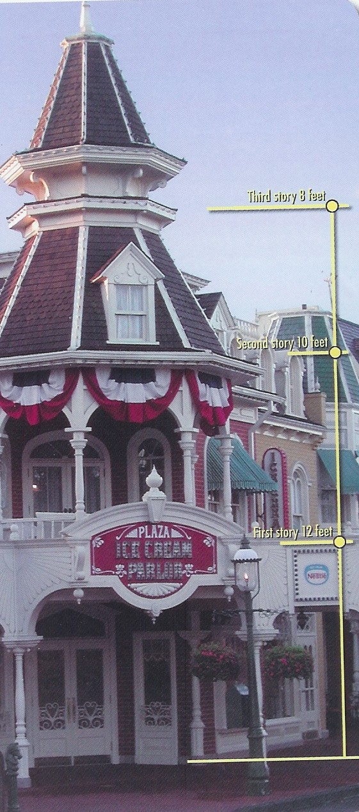
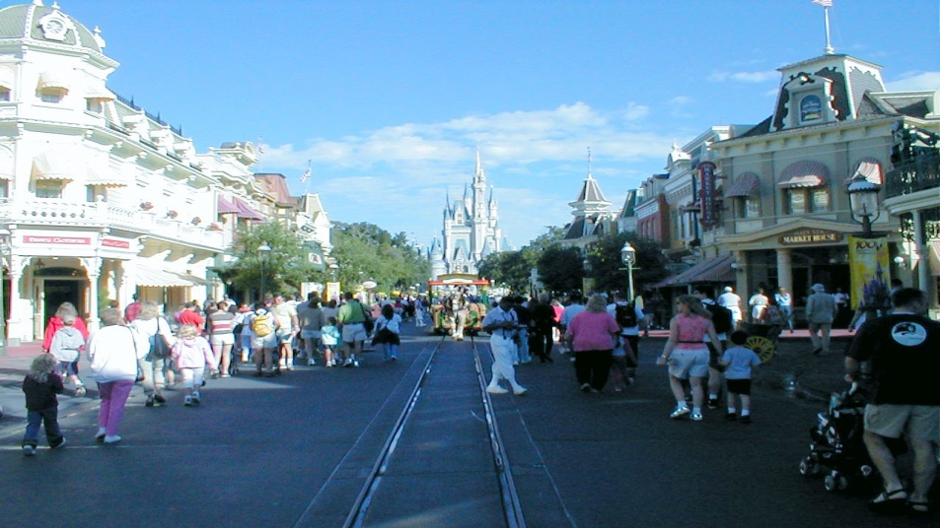
4. Where necessary, change reality
Three story buildings in Disney World aren’t really three stories.
My Favorite Example:
Cinderella’s Castle
The View
The Tunnel

Slide 38
4. Where necessary, change reality
Python does not support media manipulation.
  So we wrote a set of libraries and tools.
  We embedded them into the programming environment so that students never even see the media libraries being imported.
  Now, obviously, Python supports media manipulation.
Java’s media support is complicated.
  We never teach it.
  We teach Picture, Sound, Pixel, and SoundSamples.
  Result: Java multimedia is easy.

Slide 39
5. Pay Attention to Transitions
Imagineers care about what you see between places.
  Why are there water buffalo on top of the Tiki-Tiki room?
  Why are the Thunder Mountain mountains scarier in Florida than California?

Slide 40
5. Pay Attention to Transitions
At each new topic, we relate the transition to the story.
  We don’t start teaching string processing,
  we start teaching HTML.
  We don’t teach linked lists,
  we teach how to dynamically and creatively insert and remove media elements.

Slide 41
6. Make the Cast Part of the Story

Slide 42
6. Make the Cast part of the Story
Students become part of the story in lecture:
  “This is a great collage on the Gallery this week. Who did it?
  You?
  How’d you do it? How’d you get this great effect?”
TA’s get sucked in.
  Some of the best media on the Gallery pages are by the TA’s (“as examples”)

Slide 43
Conclusions
Computing is important for everyone,
We should aim to be able to teach computing to everyone.
Contextualized Computing has great promise for achieving the goal of enabling everyone to use computing for exploration and communication.
  Media Computation is an example of contextualized computing.
How do we convince students to buy-in, to engage with the context?
  In the same way that, in Disney World, you accept a six foot talking mouse.

Slide 44
With thanks to our funding supporters
National Science Foundation
  Statewide BPC Alliance: Project “Georgia Computes!” http://www.gacomputes.org
  CCLI Grant
Microsoft Research
Georgia Tech's College of Computing
Georgia’s Department of Education
GVU Center,
Al West Fund,
President's Undergraduate Research Award,
Toyota Foundation

Slide 45
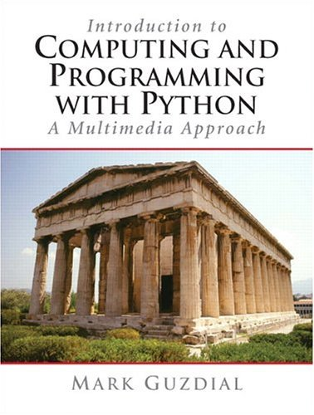
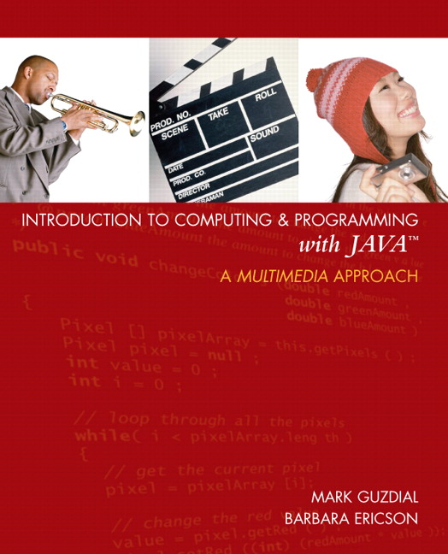
Thank you!
http://www.cc.gatech.edu/~mark.guzdial
http://home.cc.gatech.edu/csl
For more on MediaComp approach (including papers, software, and slides, and workshops):
http://coweb.cc.gatech.edu/mediaComp-plan
Media Computation Teachers’ Site:
http://coweb.cc.gatech.edu/mediaComp-teach

