Slide 1
Creating Computer Science for All Students
Mark Guzdial
School of Interactive Computing
Notes:
About our vocation, not our jobs. We are CS educators. I will argue that our audience is not just CS specialists or majors. The demand and need is greater elsewhere.

Slide 2
Story
Computing is important for more than just those who choose to major in computing.
  Who are those (the majority) who need computing but won’t major in computing? What do they need from CS, and why aren’t they in our classes? How do they now learn CS?
Teaching those who do not want to become software engineers or computer scientists
  The Story of Computing for All at Georgia Tech.
Meeting the needs of the majority, with technology:
  Matching or tailoring the context to the person.
  How to find what they really want and need.
  Teaching CS concepts without apprenticeship.
Notes:
The challenge of computer science isn’t enrollment,
it’s in meeting the demand.

Slide 3
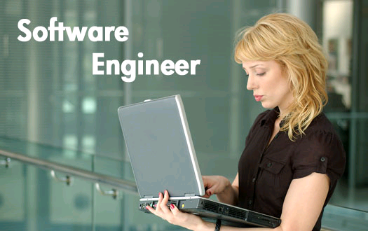
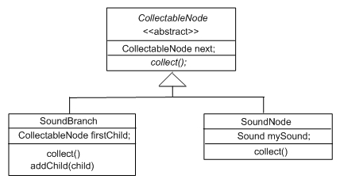
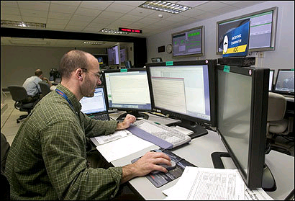
The typical CS student:
Future Software Engineer
To produce reliable, robust, secure software.
To work in interdisciplinary teams.
To use appropriate design notations, such as UML.
To work in multiple programming languages.
Notes:
Our normal student in CS education. We typically want our majors to develop these abilities or skills.

Slide 4
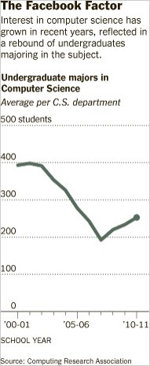
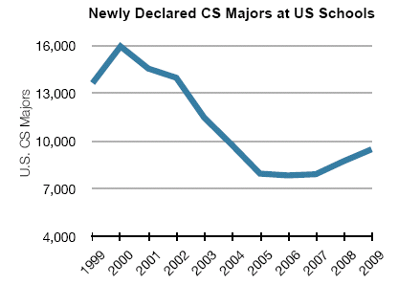
US CRA
Taulbee Numbers
2010 CRA Taulbee Survey of PhD-granting institutions
Notes:
But there are increasingly fewer of these. While we’re in an uptick, it’s a slow return. We’re still far behind BLS estimates of demand.

Slide 5

High School Participation in
AP STEM Disciplines
— Chris Stephenson, CSTA, 2010
Notes:
Graph shows # of students taking the various STEM AP tests since 1997. CS is the sad red line at the bottom. Note that even the relatively new AP courses – statistics and environmental sciences – are doing much better than us.

Slide 6
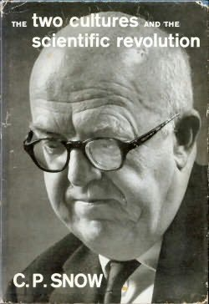

The Two Cultures
Notes:
Why is this a problem? We may not be talking to them right. There is more than one audience for what we have to offer.
Most of them don’t look like us. Some people reject science: Denialists. Global warming? Vaccines? There are no learning styles. Psychological Science in the Public Interest

Slide 7
Who else wants what CS has to offer?
Computing is at the core of the modern society and modern economy.
Computing is key to innovation in many disciplines.
Computer Science has a much larger potential audience beyond software developers.
  Estimates:
  ~13 million non-professional programmer/end-user programmers in US by 2012,
  vs.
  ~3 million professional software developers (Scaffidi, Shaw, & Myers, 2005)
Notes:
There are jobs out there. The classes are good. But students just don’t want to do this.

Slide 8


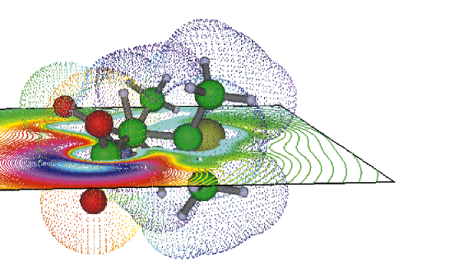
An atypical CS student:
Future computational scientist or engineer
To use computation as a tool to enhance understanding.
To write programs of (at most) 100 lines (most often, 10 lines) for themselves.
  They care about the products of the programs, not the programs.
To learn as few languages as are needed for their tasks.
To work in interdisciplinary teams, including software engineers.
Notes:
This audience aren’t denialists, so that part is easier. But they don’t want to be us. They have different goals.

Slide 9
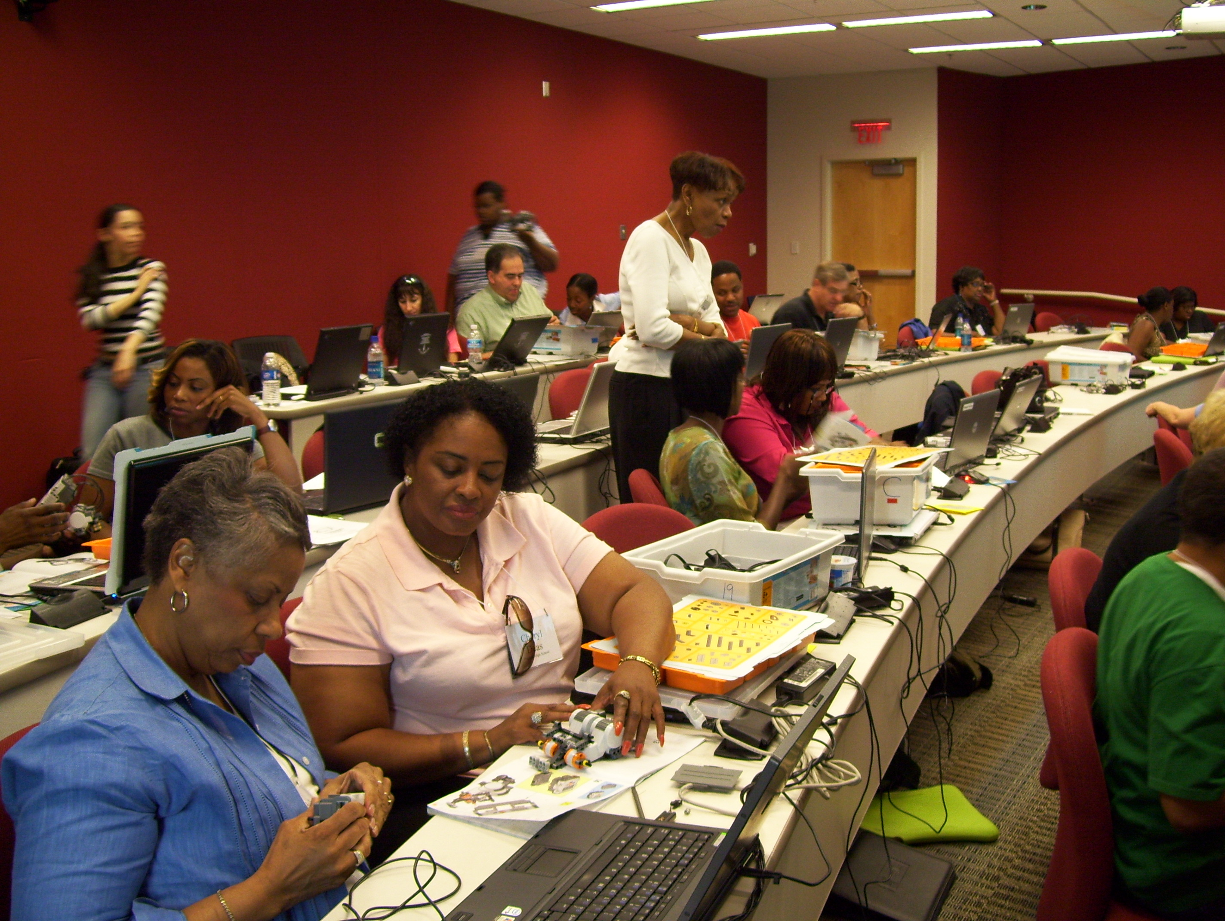

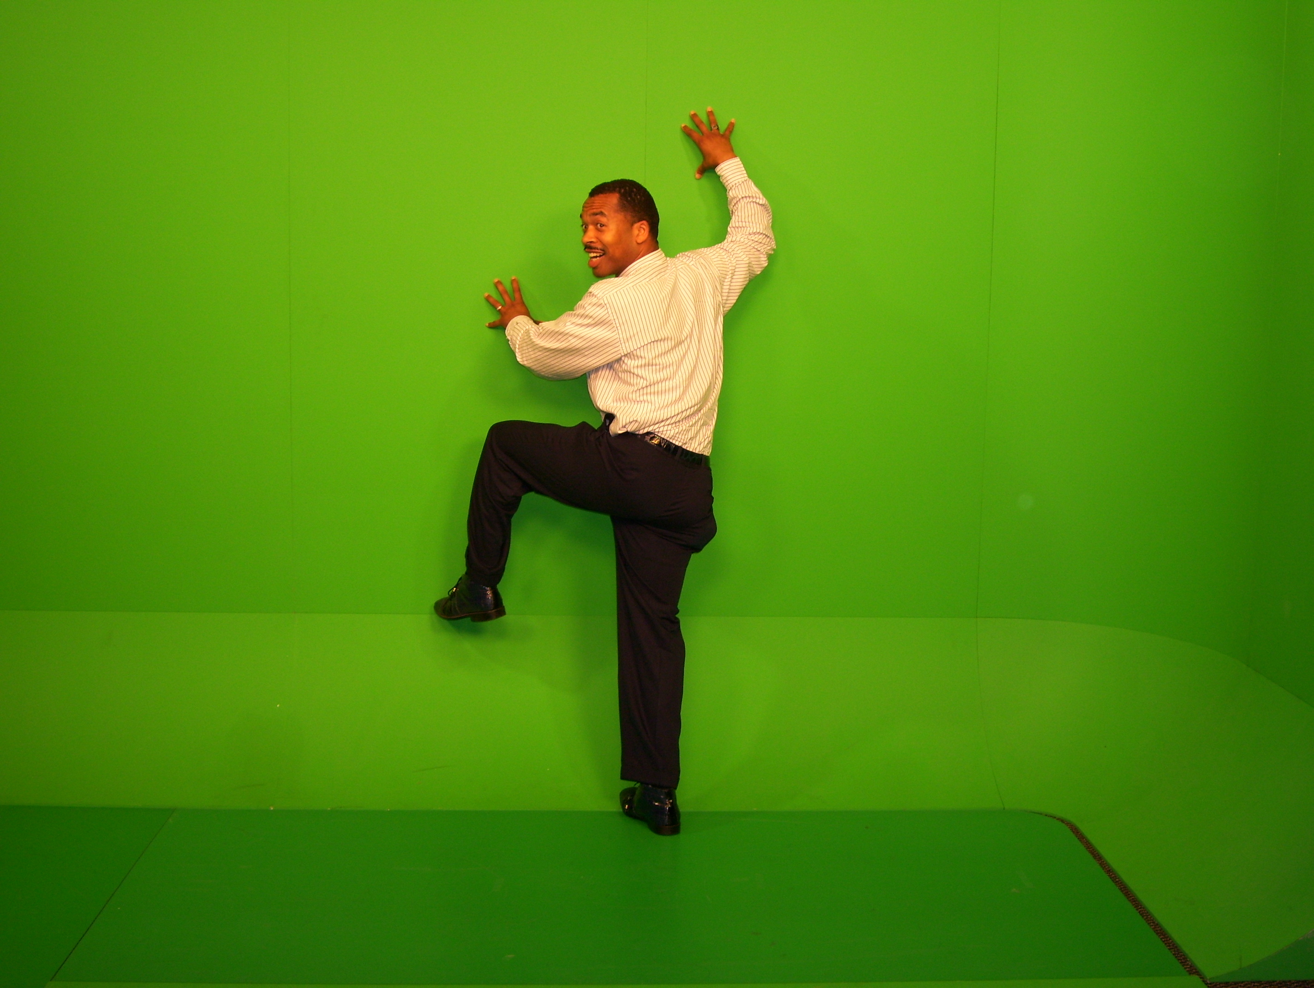
An atypical CS student:
Future high school CS teacher
To use code to explore and understand ideas of computation.
To learn what languages are necessary to meet standards and engage students.
To work with students with a wide range of interests.
  Probably won’t work with professional software engineers
Notes:
We need these people to get more of the rest.
Lijun Ni’s work. It’s important to create an identify of “Computer Science Teacher” for success later. Steve Cooper talked about yesterday.

Slide 10




An atypical CS student:
Future graphics designer
To write programs to improve their efficiency, and to implement their dynamic (e.g., Web) designs.
To do as little coding as possible.
To learn about computing ideas in order to improve their process, but with a focus on people and creativity.
    Probably won’t work with professional software engineers
Notes:
Self-representations from a graphics design website.

Slide 11
How do meet this need?
Our track record for the first CS course is poor.
  30-50% failure or withdrawal rates (Bennedsen & Caspersen, 2007)
Other majors tend to be more female and more ethnically diverse than the typical computing student.
  Our track record with these audiences is particularly poor (Margolis & Fisher, 2003)
Notes:
Ask Michael.

Slide 12
Technology can help.
We should lead.
As computer scientists (and CS teachers),
we can and should lead in developing using technology to improve learning.
  Unlike most teachers, we can build our own technology.
  Done well, our solutions may inform other disciplines.
We need technology to support CS learning for the majority of people.
  Those who need computing, but don’t want to be programmers.

Slide 13
Three Needs
First, the importance of context in teaching computing.
  Need #1: Match or tailor context to make sense to students.
Second, why aren’t the majority looking to our classes in CS? Where are they looking?
  Need #2: Help “amateur” (non-CS professional) programmers find the help they need.
Third, teaching CS with less programming.
  Need #3: Create new kinds of instructional materials for a new pedagogy of computing education.

Slide 14
Piece 1: Teaching
Computing to Everyone
Fall 1999:
All students at Georgia Tech must take a course in computer science.
  Considered part of General Education, like mathematics, social science, humanities…
1999-2003: Only one course met the requirement.
  Shackelford’s pseudocode approach in 1999
  Later Scheme: How to Design Programs (MIT Press)

Slide 15
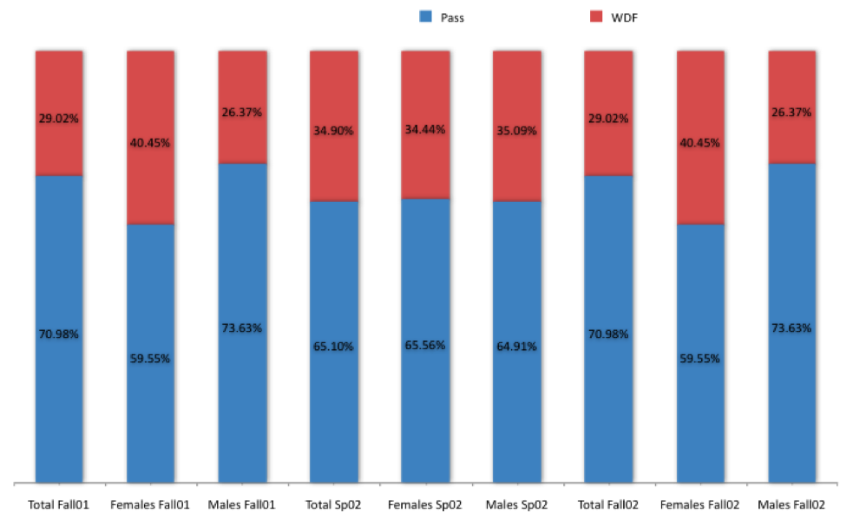
One-class CS1: Pass (A, B, or C) vs.
WDF (Withdrawal, D or F)
Success Rates in CS1 from Fall 1999 to Spring 2002 (Overall: 78%)
Architecture | 46.7%
Biology | 64.4%
Economics | 53.5%
History | 46.5%
Management | 48.5%
Public Policy | 47.9%
Notes:
Actually, quite good pass rates, compared to many others in CS.
Across campus, these are the pits.
And the women are failing or withdrawing. in greater numbers than the men.
This looks like C.P. Snow’s “Two Cultures”

Slide 16
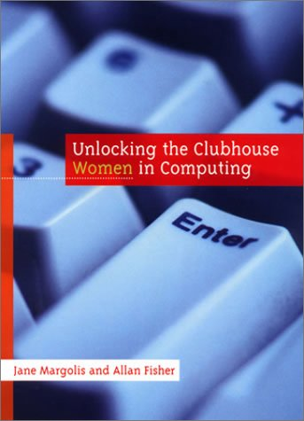
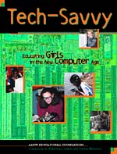
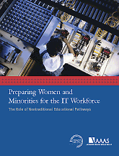
Contextualized Computing Education
What’s going on?
  Research results: Computing is “tedious, boring, irrelevant”
Since Spring 2003, Georgia Tech teaches three introductory CS courses.
  Based on Margolis and Fisher’s “alternative paths”
Each course introduces computing using a context (examples, homework assignments, lecture discussion) relevant to majors.
  Make computing relevant by teaching it in terms of what computers are good for (from the students’ perspective)
Notes:
Talk about iPods and Blackberries.
This is a Computer as Tool model. We’re not yet at Computing as Literacy.

Slide 17
Our Three CS1’s Today
CS1301/1321 Introduction to Computing
Traditional CS1 for our CS majors and Science majors (math, physics, psychology, etc.). Now, uses robots.
CS1371 Computing for Engineers
CS1 for Engineers. Same topics as CS1301, but using MATLAB with Engineering problems.
CS1315 Introduction to Media Computation for Architecture, Management, and Liberal Arts students.

Slide 18

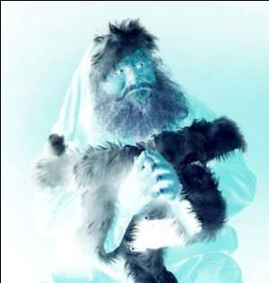
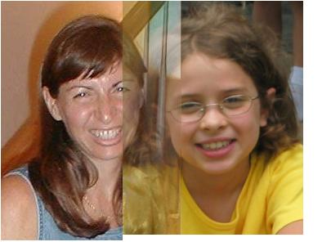
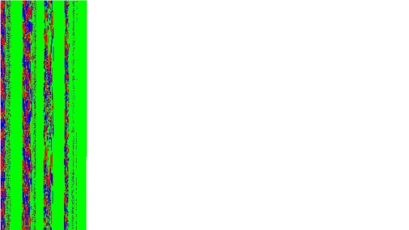
Media Computation:
Teaching in a Relevant Context
Presenting CS topics with media projects and examples
  Iteration as creating negative and grayscale images
  Indexing in a range as removing redeye
  Algorithms for blending both images and sounds
  Linked lists as song fragments woven to make music
  Information encodings as sound visualizations
18

Slide 19
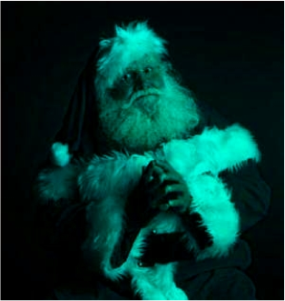
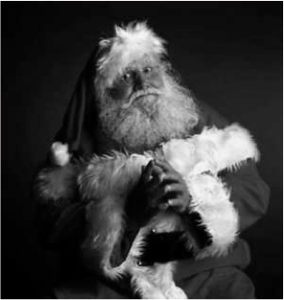
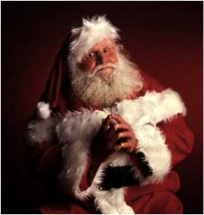
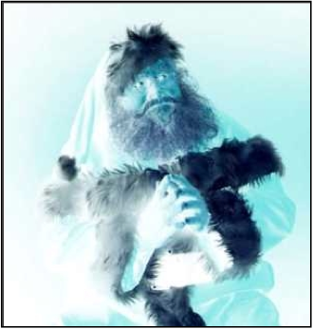
def clearRed(picture):
for pixel in getPixels(picture):
setRed(pixel,0)
def greyscale(picture):
for p in getPixels(picture):
redness=getRed(p)
greenness=getGreen(p)
blueness=getBlue(p)
luminance=(redness+blueness+greenness)/3
setColor(p, makeColor(luminance,luminance,luminance))
def negative(picture):
for px in getPixels(picture):
red=getRed(px)
green=getGreen(px)
blue=getBlue(px)
negColor=makeColor(255-red,255-green,255-blue)
setColor(px,negColor)

Slide 20
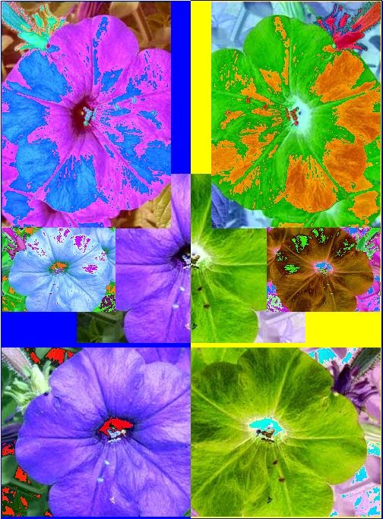
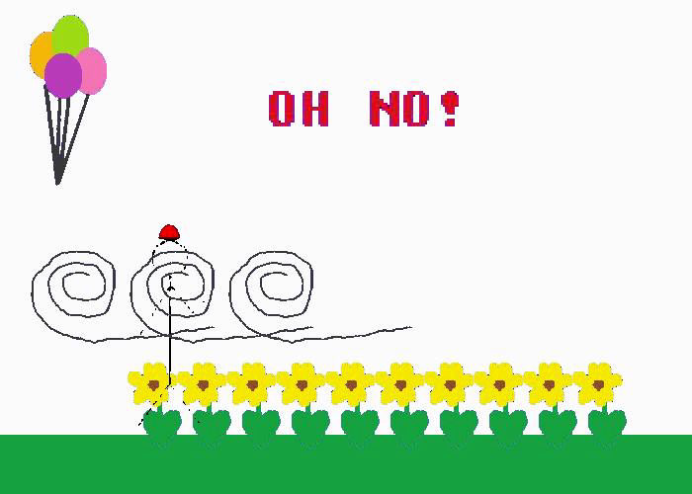
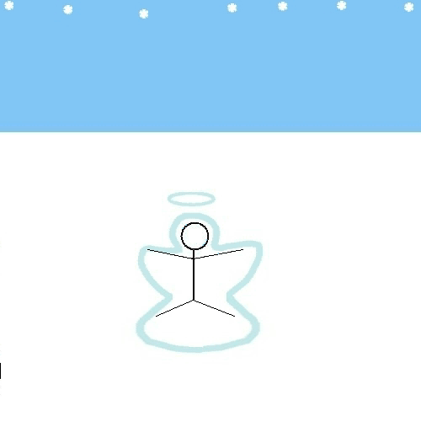
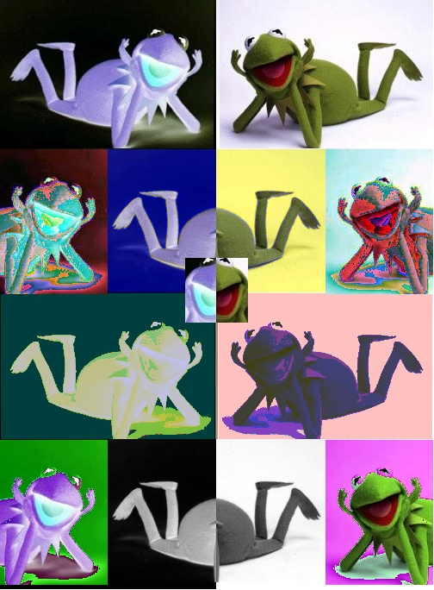


Open-ended, contextualized homework in Media Computation CS1 & CS2
Sound collage
Linked list as canon
Notes:
20

Slide 21
Results:CS1“Media Computation”
Change in Success rates in CS1 “Media Computation” from Spring 2003 to Fall 2005 (Overall 85%)
Architecture | 46.7% | 85.7%
Biology | 64.4% | 90.4%
Economics | 54.5% | 92.0%
History | 46.5% | 67.6%
Management | 48.5% | 87.8%
Public Policy | 47.9% | 85.4%
Notes:
Be sure to wonder, “But are they learning the same?”

Slide 22
Was the class successful?
Interviewed Intl Affairs student (female): “I just wish I had more time to play around with that and make neat effects. But JES [IDE for class] will be on my computer forever, so… that’s the nice thing about this class is that you could go as deep into the homework as you wanted. So, I’d turn it in and then me and my roommate would do more after to see what we could do with it.”
Survey one year later:
  19% of respondents had programmed since class ended
"Did the class change how you interact with computers?”
  “Definitely makes me think of what is going on behind the scenes of such programs like Photoshop and Illustrator.”
Notes:
FIX HAVE->HAD

Slide 23
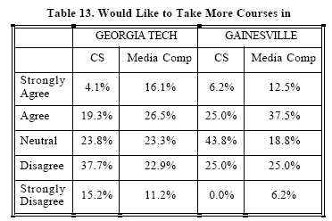
Results at Other Schools
Similar retention results at 2 year public Gainesville College (Tew, Fowler, Guzdial, SIGCSE 2005) and at (much more diverse) U. Illinois-Chicago’s CS0.5 (Sloan & Troy, SIGCSE 2008)
Would you like more CS?
  GT 15.2% “Strongly Disagree.” <25% agree.
  More MediaComp? GT and Gainesville over 40% agree.
(Tew, Fowler, Guzdial, SIGCSE 2005)

Slide 24
Results at
University of California, San Diego
Simon, Kinnunen, Porter, Zaskis, ACM ITICSE 2010
Using Java Media Computation as normal CS1 for CS majors at a research university.
Did extensive data collection last semester before switching to Media Computation.
Been following two cohorts of CS1 students for comparison.
Findings:
MediaComp has more focus on problem-solving, less on language.
MediaComp students have higher pass rates and retention rates one year later

Slide 25
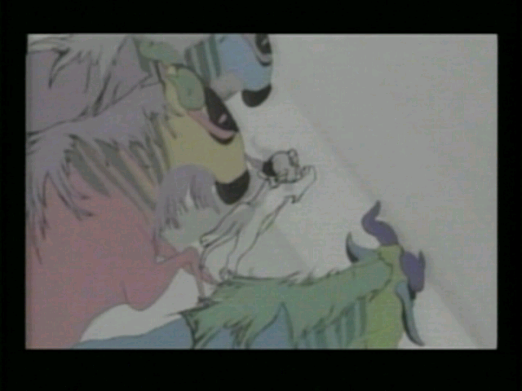
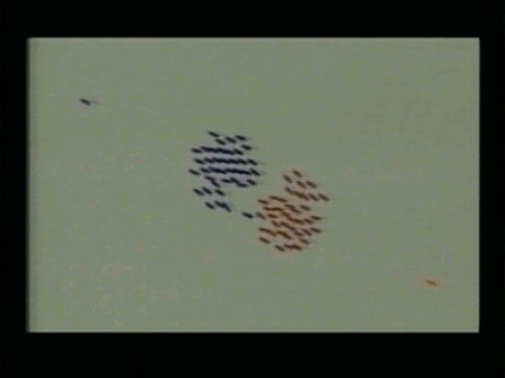
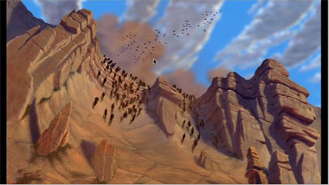
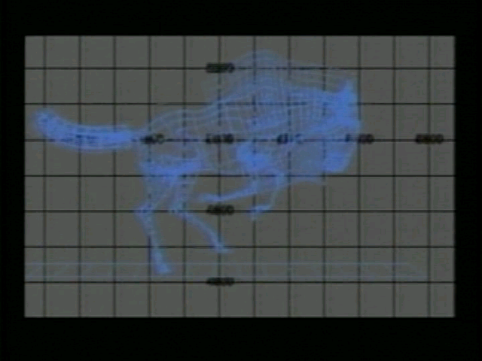
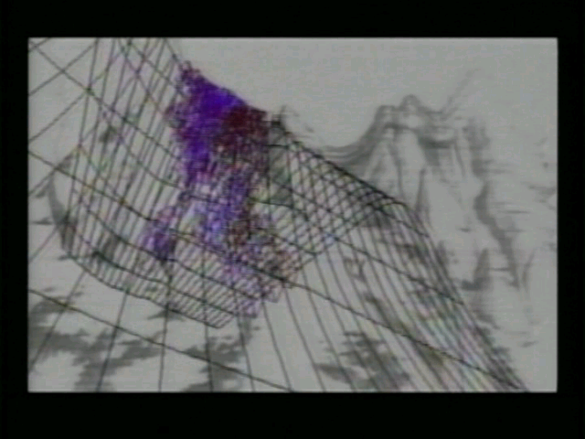
A Contextualized CS2:
MediaComp Data Structures
How did the Wildebeests charge over the
ridge in Disney's "The Lion King"?
Notes:
How is it different? The first “tree” that students use is an n-ary tree, a scene graph. Why not start with a binary tree? Because binary trees are irrelevant to media developers.
Java course, all non-majors, 90% success rate

Slide 26
Research Question:
Is context still useful in a second course?
Mixed model research design
  Interviews informing whole-class survey
11% agreed with “Working with media is a waste of time that could be used to learn the material in greater depth.”
  “I didn’t take this class to learn how to make pretty pictures.”
A majority of the class (70%) agreed or strongly agreed that working with media makes the class more interesting.
67% of the students agreed or strongly agreed that they were really excited by at least one class project
66% reported doing extra work on projects to make the outcome look “cool.”
(Yarosh and Guzdial, JERIC, Jan 2008)

Slide 27
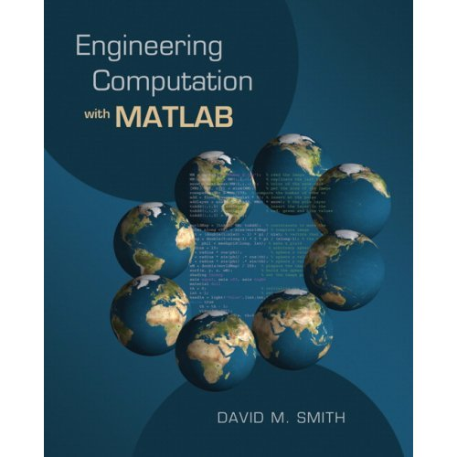
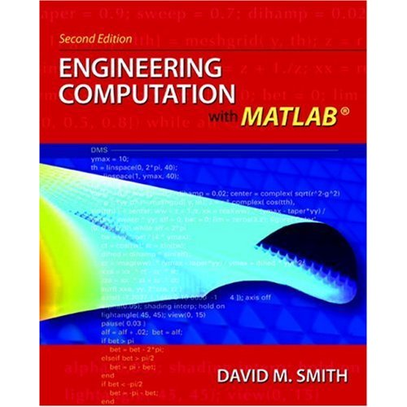
Introducing Computing in an
Engineering Context
Developed in collaboration with Civil, Mechanical, and Aerospace Engineering.
Uses Engineering problems and MATLAB
Covers traditional CS1 topics
Among our 3 CS1’s, these are the first students to program outside of class.
The success rate in this class also rose compared to all-in-one.

Slide 28
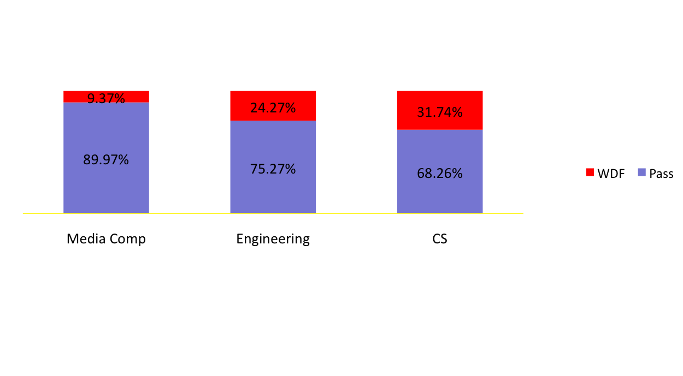
Comparing Spring 2004
CS for Engineers: ~1200 students/semester
Media Comp: ~300 students/semester
CS for CS majors: ~150 students/semester

Slide 29
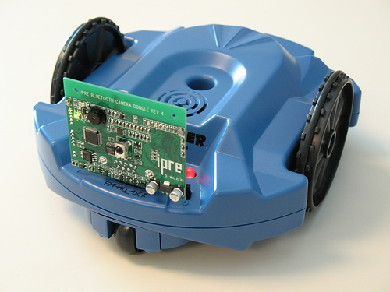
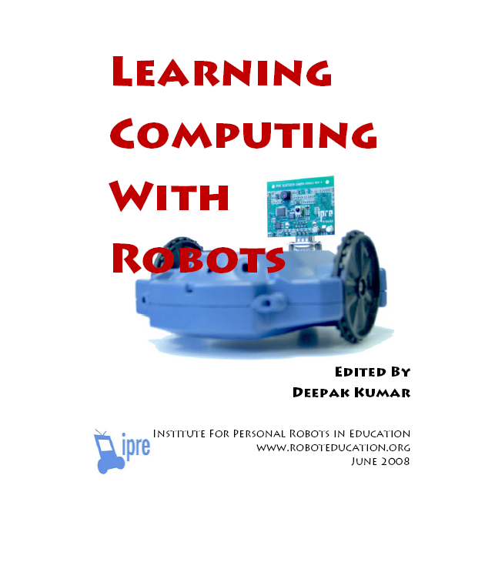
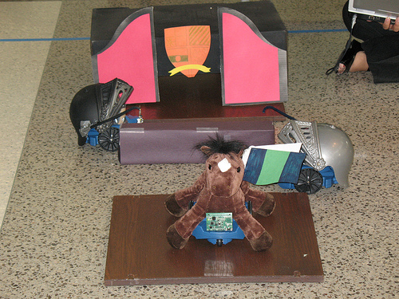
A Context for CS1 for
CS majors: Robotics
Microsoft Research has funded the Institute for Personal Robotics in Education
  Leads: Tucker Balch, Deepak Kumar, Doug Blank
  Joint between Bryn Mawr College and Georgia Tech
  http://www.roboteducation.org
Developing a CS1 with robotics as the context.
Notes:
Doug Harms talked about moving Myro API to Java yesterday.

Slide 30
Need #1: Finding or Making Context
Context is important.
  It works to support success and engage students.
  But, there is no universally successful context.
    At Georgia Tech, there are continued demands for finer granularity (e.g., business, biology).
CS Teaching Need #1:
Help students and teachers to match interests and abilities to contextualized educational material, or
From a general form, instantiate template into a given context (e.g., sampling, sorting, searching)
Notes:
Here’s what we know.
In CS, we continue to see evidence for needing a fourth CS1 or CS2, that this major or that doesn’t fit THAT WELL in the current course.
If we had a bunch of courses or content, how would we help a student choose?
If a teacher, how could you find the right content for your students?
Two possibilities: Find it, or make it.

Slide 31
CS Need #1: Matching or Tailoring
Matching students to existing contextualized content.
  What variables are important? Level, major, desired degree, previous background.
  More than a search engine.
Tailoring content from descriptions of context-specific features to learning objectives.
  Pixels in pictures and samples in sounds: Sampling
  Discrete event simulation queues: Sorting
Notes:
A personalized search engine.
Could we tailor? Sampling works for both pixels and samples. However sorting was really hard. Could we have a general “sorting” lesson, a template, to tune to a specific context? What features of a context would you need to know, and would the same features help to teach more than one kind of template or learning objective?

Slide 32
Piece 2: What do they need that we have to offer?
Brian Dorn studied graphics designers who program.
Conducted a series of interviews and assessment activities.
Found that these subjects want more computer science, but don’t find courses (and most other resources) adequate (Dorn & Guzdial, ICER 2010)
P10: So, that was a really long way of saying yes, I think that an academic study would make me a better programmer, but not by a whole lot.

Slide 33
What do software engineers do?
Answer: The Boring Stuff.
P2: I was able to take different samples from different places and instead of just being let's say an MIS major, or computer science major, you know it's—you're not going to be front-end anything with computer science. You're going to be back-end everything.
P4: I think as a front-end developer, you focus more on the design and the usability, and you're focusing more on the audience. And then on the back-end I think you're focused on more, these are like the software developers. And they're programming something, and they don't really see what it's gonna look like; they're just making it work.

Slide 34
Why don’t they take CS classes?
P7: I started out in computer science, but didn't like it at all. The fact that I wasn't learning anything new. I took an intro to programming course, and then I talked to some other people in the program and it was all repetition and I guess there wasn't any really new. So you weren't really learning any concepts. You were learning the languages, and I didn't like that at all. So that's why I left…
Do we just teach languages?
Why don’t they see the concepts?

Slide 35
They are not afraid of coding
“What interests you about web design?”
P12: The coding! I don't like to code. But the things that the code can do is amazing, like you can come up with this and voila, you know, it's there. Javascript for one. The plugins and stuff. I think that's very interesting, intriguing and stuff. Because I mean like the code is just, there's so much you can do with code and stuff. It's just like wow.

Slide 36
They’re Lost without Initial Knowledge
They learn from websites, reading lots of code, books where they can, friends.
  Rarely courses.
Surprising tidbit: Learning less than they might because of a lack of deep knowledge.
  For example: Exploring code by searching Google for function and variable names.
Brian’s experiment: Given a case library with conceptual information vs. a code repository alone, what gets learned, used, and liked? (ICER 2011)

Slide 37
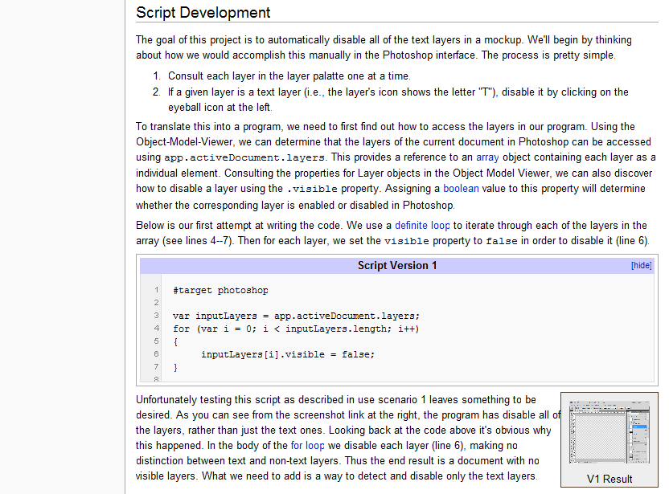

Slide 38
Bottomline: Cases work
They like the cases.
They code the same.
Case-users learn the concepts, while repository users do not.
Suggests how we might help non-CS professionals who discover computing late.

Slide 39
Need 2: Interpreting Code for Search
CS Teaching Need #2:
Given a piece of code, suggest CS concepts and examples, or productive/appropriate search terms.
Patterns to recognize: (simple) recursion, sorting, linked lists, API use.
Tagging of examples?
Machine learning approach: Given code X in IDLE or Eclipse, what search terms led to fruitful (defined?) results?

Slide 40
Piece 3: Teaching CS as a study, not just an apprenticeship
For the most part, we teach CS as apprenticeship.
  We model (lecture), students practice (code),
  we try to coach.
Practice is always important.
Do we rely on it too much?
  Are we more like STEM or Architecture?
Claim: No other science and engineering field teaches so much through practice.
  Result: CS learning is hard and time-consuming.
Notes:
How many of have have students who just get it FROM the practice and NEVER come to lecture?

Slide 41
Can we teach more of CS without programming?
Can we teach about variables behavior, how loops work, how conditionals behave – without a half hour of “where goes the semi-colon”?
  Matt Jadud [2006] (and others) has shown us how small Java errors can lead to an enormous waste of time.
Can we reduce the wasted time?
  Analogy: Does coursework in a foreign language make it easier to be immersed in the new language, or is immersion the only way to learn?
Notes:
Orni’s Scratch paper – yet we keep seeing the same errors.

Slide 42
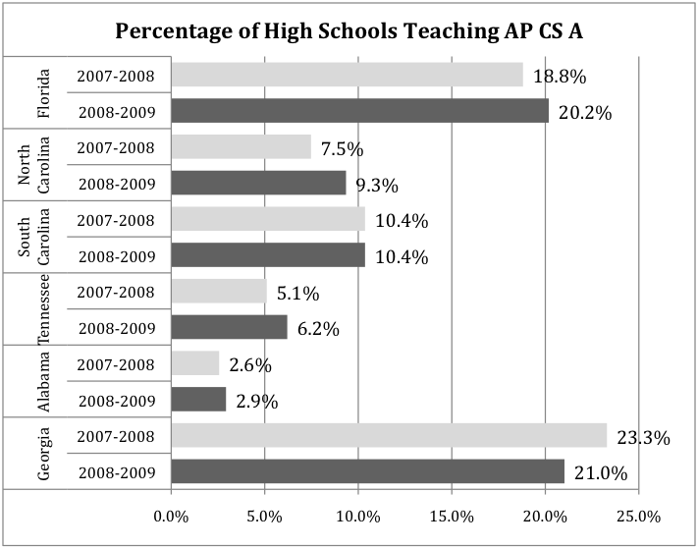
Problem: Too little secondary school CS

Slide 43
US NSF’s Solution: CS:P => CS10K
First, create a new, high-quality course that attracts students and can be taught nationally – that reduces the focus on programming.
  http://www.csprinciples.org
Secondly, have 10,000 teachers ready and able to teach this course in 10,000 schools by 2015: CS10K

Slide 44
How do we go from 2K to 10K?
Claim: They are not going to come from pre-service teacher education.
  UTeach at U-T@Austin has offered pre-service CS ed for 15 years, with only 7 graduates.
  Purdue has a program, with only one teacher enrolled.
  Using pre-service to ramp-up an area doesn’t work:
  The student-teaching problem.
Claim: We have to do in-service CS teacher education a whole lot better.
  Experiences at Columbus State in Georgia.
Notes:
You heard Steve Cooper talk about the summer workshop model. Could that work for 8000 teachers?

Slide 45
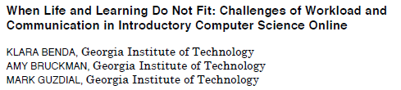
Studying the issues of
In-service CS Teacher Education
Study of adult/professional students in CS classes.
  They don’t have the time to spend hours in front of the IDE.
  Lacking background, e.g., in mathematics.
  They get stymied by small errors.
Notes:
They don’t have the pre-requisite skills; they can’t spend hours in front of a computer.

Slide 46
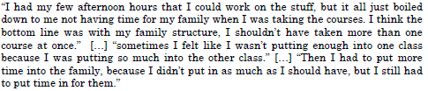

Notes:
They don’t have the pre-requisite skills; they can’t spend hours in front of a computer.
These are adults, professionals – though they probably sound like your students.

Slide 47
Options?
If we want to have thousands of high school students studying CS, we have two options:
  Option #1: Give up on teachers
  Option #2: Figure out a pedagogy that works for in-service teachers.

Slide 48
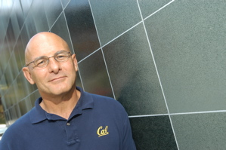

Option 1: Don’t Use Teachers
Dave Patterson (Berkeley) and Alan Kay:
Use Technology Instead.
“My belief that the K-12 CS education problem is practically unsolvable for the next 10-20 years in the US is based on:
  No room in the high-school curriculum for CS.
  Low pay for new teachers.
  Changing education policy is hard and takes a long time, and there is little reason to believe you will succeed. This is a state by state, school district by school district level of change involving many advocacy groups.
  Most proposed solutions don’t scale. There are roughly 50,000 high schools and 80,000 elementary schools and middle schools in the US. Whatever you are proposing, think about the time scale your innovation would take to affect 10% of these schools.”
Notes:
http://computinged.wordpress.com/2010/06/25/dave-patterson-on-fixing-high-school-cs-education/ These are all real and significant problems. #1 and #3 may be solved by APCS. #2 is particular significant for Operation: Reboot.

Slide 49
Option #2: Figure out a new way to teach high school CS teachers
Given a focus on in-service teachers:
  It must be distance education to fit with schedules.
  Learning must happen primarily in 20-60 minute chunks.
Can learn from Open University successes.
  But a complete solution does not exist for creating secondary school CS teachers that the US could import.
  Something we could use for 8K teachers in 4 years?

Slide 50
Role 3: Re-Think the Way We
Teach CS.
Could we build technology (e.g., cognitive tutors) to teach all of CS:Principles without teachers?
Or can we build technology to guide teacher learning with less programming?
  Where “book” study can reduce wasted time in front of IDE?
  Challenge: Not rote memorization, not boring, and usable by teacher with little background knowledge.
  Idea: A little educational psychology can go a long way.
CS Teaching Need #3:
Create materials that support the learning of computing concepts reducing the hours spent programming.
Notes:
Could we program *inside* the book? Use approaches like WeScheme, where the IDE is just on some pages of the book, maybe with template code already there, maybe with problem-specific error messages?

Slide 51
Conclusions
Computing is important for everyone.
Students who want computing succeed with contexts.
  Need #1: Match students to contextualized materials, or develop the ability to tailor materials to a context.
End-user programmers want what CS has to offer, and there are more of them than there are professional software developers. But they don’t know enough CS.
  Need #2: Support discovery and development of base knowledge.
Teach CS with less apprenticeship, less programming.
  Need #3: Provide new approaches to learning CS to support learning of concepts so that time spent programming is fruitful, not wasteful.

Slide 52
With thanks to our supporters
US National Science Foundation
  Statewide BPC Alliance: Project “Georgia Computes!” http://www.gacomputes.org
  CCLI and CPATH Grants, and now CE21 to produce new media
Microsoft Research
Georgia Tech's College of Computing
Georgia’s Department of Education
GVU Center,
GT President's Undergraduate Research Award,
Toyota Foundation

Slide 53
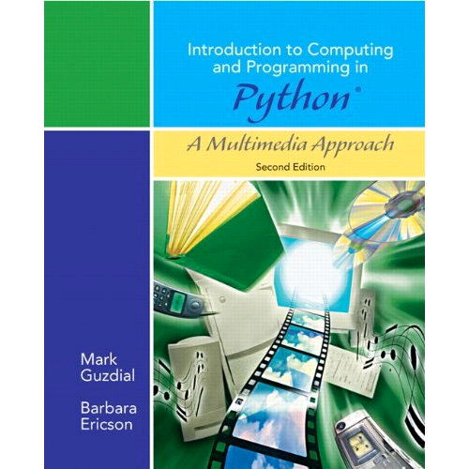
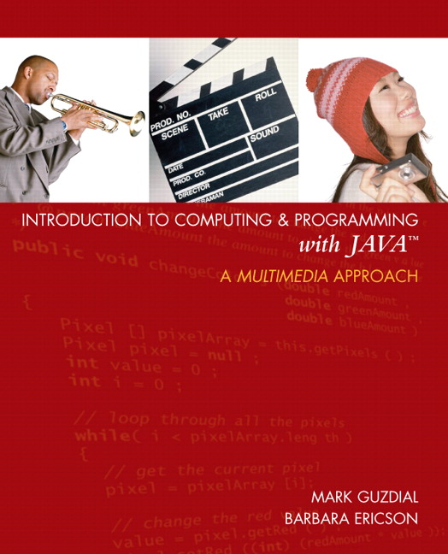
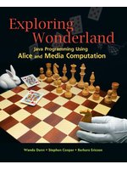

Thank you!
http://www.cc.gatech.edu/~mark.guzdial
http://home.cc.gatech.edu/csl
http://www.georgiacomputes.org
For more on the new APCS.
http://www.csprinciples.org
For more on MediaComp approach:
http://www.mediacomputation.org

Slide 54
Extra slides

Slide 55
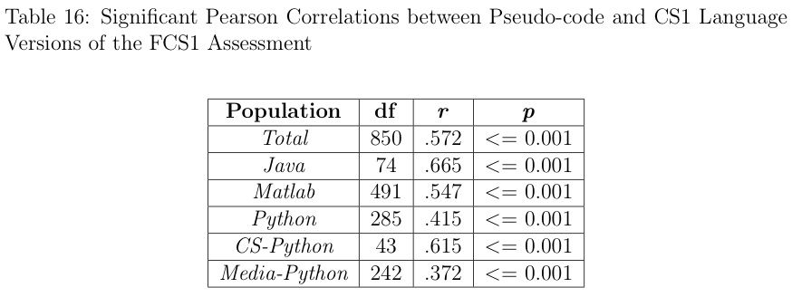
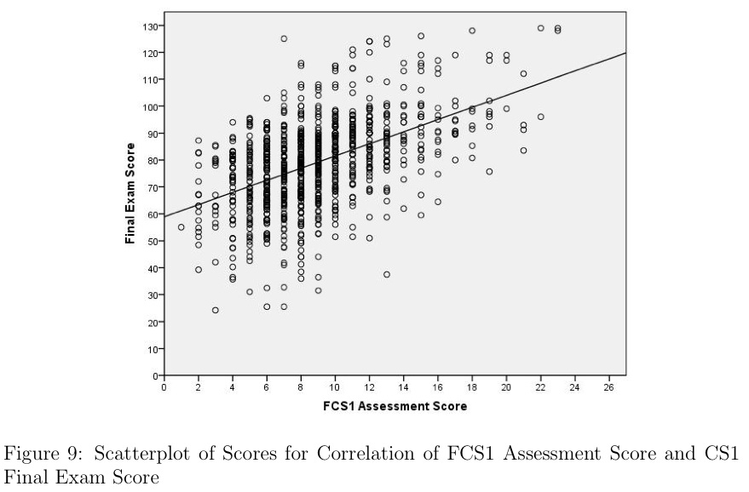
Are they learning the same?
We don’t know,
but now we can know.
Allison Elliott Tew has just completed the first language-independent validated test of CS1 knowledge.

Slide 56
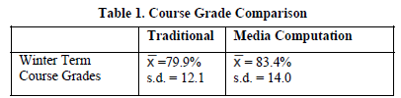
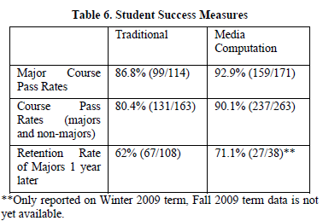
Simon et al. Key Findings Summarized
Notes:
It’s about changing definitions of computer science.

Slide 57
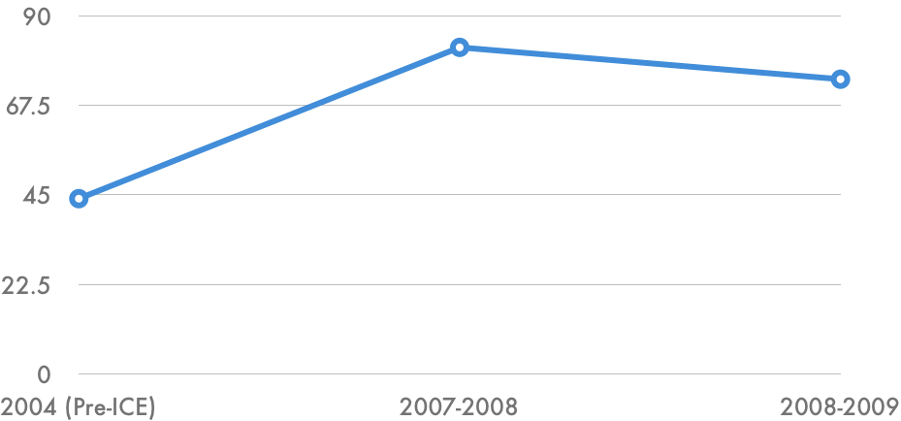
Schools in Georgia Teaching AP CS
2006
GaComputes starts

Slide 58
As percent of schools, best in Southeast

Slide 59
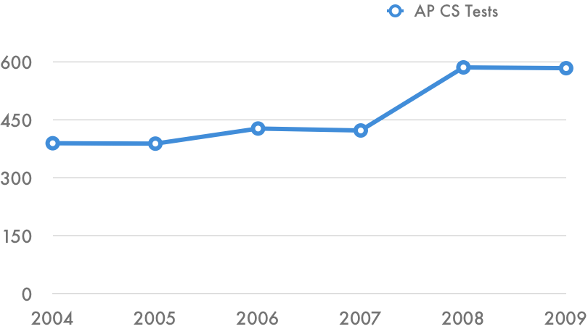
AP CS Test Taking in Georgia
2006
GaComputes starts

Slide 60

Number of AP CS Tests

Slide 61

Who’s taking those tests?
2006
GaComputes starts

Slide 62

And how are they doing?
Percentage of students earning a 3 or higher.
2006
GaComputes starts

