Slide 1
Project Rise Up 4 CS
Barbara Ericson
Ja'Quan Taylor
Georgia Tech

Slide 2
Agenda
What is Project Rise Up 4 CS?
Related research
National data on AP CS A by race
Georgia data on AP CS A by race
Project details
Project evaluation
Project outcomes
Project cost
Future plans

Slide 3
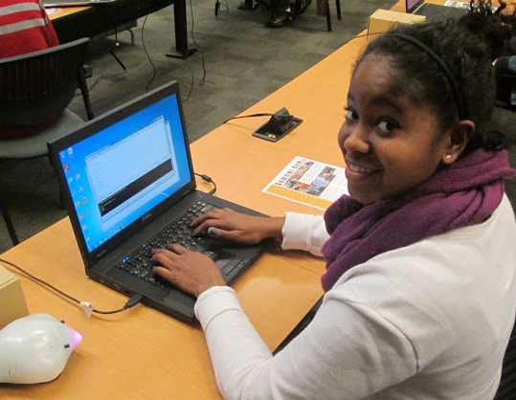
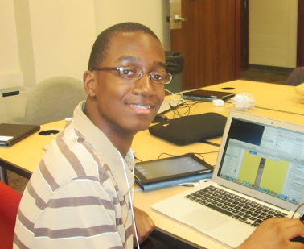
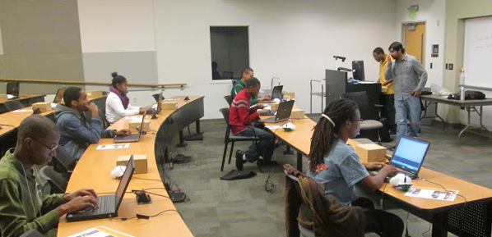
Project Rise Up 4 CS
Goal: Help more Black students pass the Advanced Placement Computer Science A exam in Georgia
Increase Black students interest in computing careers
Increase Black students confidence in their computing abilities
Increase their perception of the usefulness of computing

Slide 4
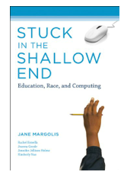
Stuck in the Shallow End
Study of computing courses in 3 schools in LA
Rich suburban
Middle class mostly Black
Poor mostly Hispanic
Many minority students don't have access to computing courses in high school
Other than keyboarding and computing apps

Slide 5
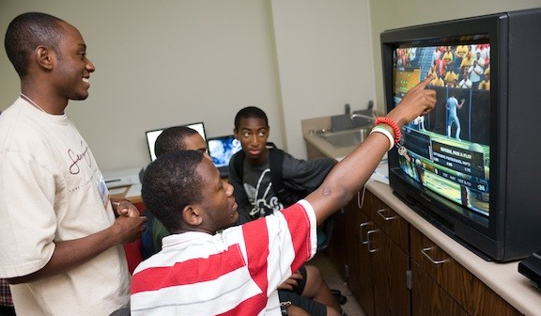
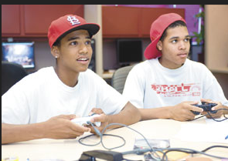
Glitch Game Testers
BPC demonstration project led by Betsy DiSalvo
Georgia Tech and Morehouse College
Entice Black males into computing by hiring them to test video games
Most of the participants that went on to college are studying computing or digital media
Not interested originally in computing careers

Slide 6
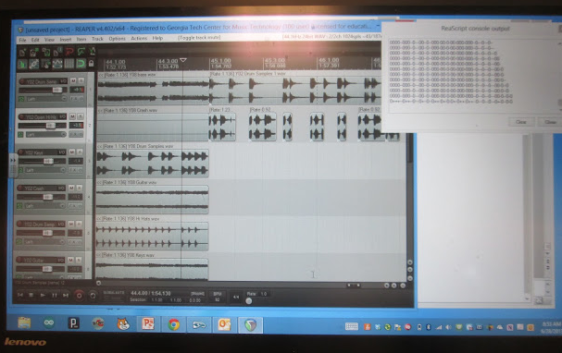
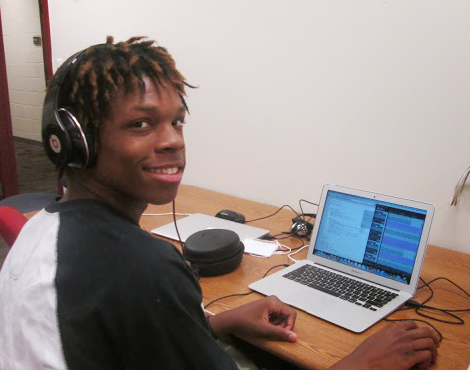
EarSketch
CE21 grant at Georgia Tech
Collaborative computational music composition and remixing
Via programming in Python
Goal is to attract more Black students to computing
http://earsketch.gatech.edu

Slide 7
Why focus on AP CS?
A student taking one AP computer science exam has a little over 4.5 times the odds of majoring in computer sciences than a student who did not take any AP computer sciences exams.
A student taking two AP computer sciences exams has a little over 9 times the odds of majoring in computer sciences than a student who did not take any AP computer sciences exams

Slide 8
National AP CS A Data
Computer Science AP CS A
Calculus AP AB
24,782 total
1,014 Black students
256,163 total
13,852 Black students

Slide 9
National AP CS A Pass Rates
24,782 total
15,678 passed (63%)
White – 13,320
8,846 passed (66%)
Asian – 6,869
4,802 passed (70%)
Hispanic – 1,919
764 passed (40%)
Black – 1,014
277 passed (27%)
Black pass rate for Calculus AB in 2012 was
29% with 3,980 passing.

Slide 10
Georgia CS AP A 2012
1037 total
481 passed (46%)
White - 532
289 passed (54%)
Asian – 254
127 passed (50%)
Hispanic – 56
21 passed (37.5%)
Black – 137
22 passed (16%)
Black pass rate for Calculus AB in 2012 in Georgia was 22.5% with 314 passing.

Slide 11
Black students and AP CS A
Maryland had the highest number of black (African American) students take the exam at 144. However, Texas had the most pass the exam at 52 (out of 142).
Washington had the highest pass rate for black (African American) students at 60%, but that was only 6 of 10.
The top 5 states with the highest number of black (African American) male students take the exam was: Maryland with 115, Texas 110, Georgia 98, Florida 78, and Virginia at 47.
The top 5 states with the highest number of black (African American) male students who passed the exam was: Texas with 43, Maryland with 30, Georgia and California with 18 each, and New Jersey with 16.
Only 9 states had 10 or more black (African American) females take the exam: Georgia 39, Texas 32, Maryland 29, Florida 27, New York 18, California 15, Illinois 14, South Carolina 12, and Virginia 11
Texas had the most black (African American) females pass the exam with 9 (out of 32). Black females have a lower pass rate than black males.
Notes:
See data at http://home.cc.gatech.edu/ice-gt/548 from the College Board data for 2012 for each state.

Slide 12
Project Implementation
First meeting in Jan 2013
Wanted to start in fall, but had to wait for IRB approval
Monthly 3 hours sessions at Georgia Tech on Sunday afternoons
Hands-on with Greenfoot, Finch, sorting, test preparation
Twice a week webinars
Wednesday evenings at 7:00pm
Saturday mornings at 11:00am
Huge discount on advanced app camps
$75 instead of $500

Slide 13
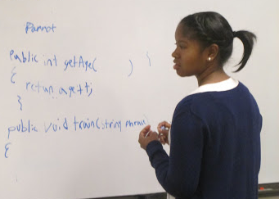
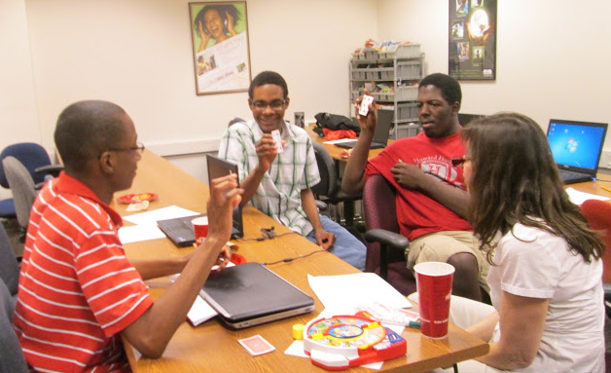
Topics Covered
Greenfoot – games
Finch robots with Java
Inheritance
Class basics
Polymorphism
Interfaces
Abstract classes
Lists
2D arrays
Sorting
Recursion
Free response questions
Test preparation

Slide 14
Project Requirements
Research project with IRB approval
Participants must
Complete a pre and post attitude survey
16 questions with a 5-point likert scale
Complete a pre and post content knowledge assessment
30 multiple choice questions
Attend at least 4 help sessions
Any mix of in-person and webinars
Pass with a 3 or higher to earn $100

Slide 15
Project Outcomes
27 students started the program
14 students attended the required 4 or more help sessions
8 of 12 reporting students passed with a 3 or higher (pass rate of 66%)
Haven't heard from 2 participants yet

Slide 16
Participant Demographics
Came from 11 different schools and one was homeschooled
Two of the schools had teachers that were new to AP CS A
Gender
Grade

Slide 17
Project Evaluation
The program was effective in statistically significantly increasing students’
confidence in computing
enjoyment
perceptions of computing’s usefulness and importance
motivation to succeed
feelings of belongingness
creative expression in computing
Students also show considerable improvement in their intentions to persist in computing

Slide 18
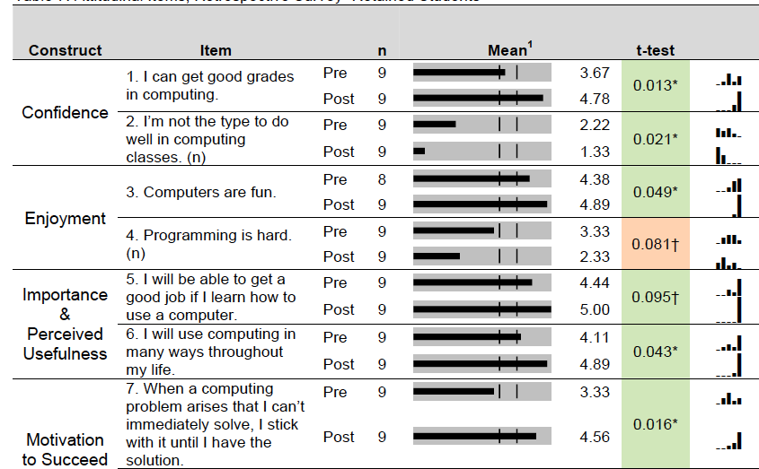

Slide 19
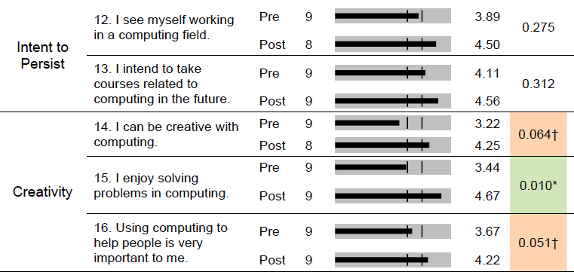

Slide 20
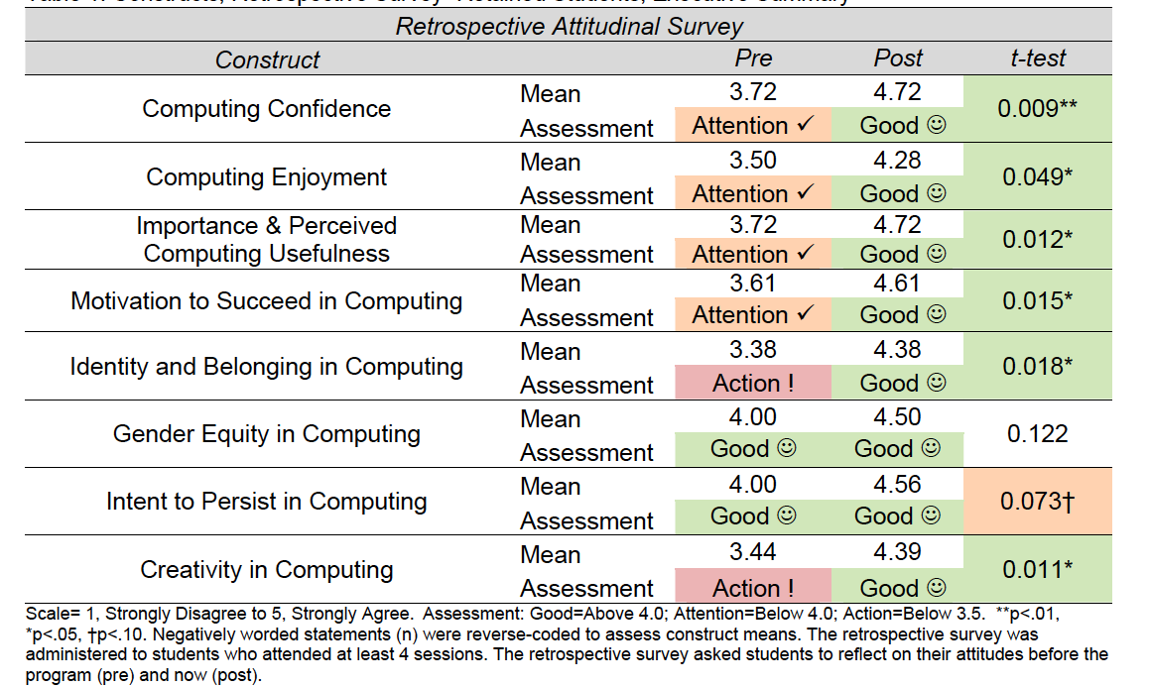

Slide 21
Student Reactions
Students indicate that the program statistically significantly improved their abilities to pass the AP CS exam with a score of 3 or higher.
Specifically, 78% of students report that they have a “very good” or “excellent” chance of passing the exam after participating in the program, compared to only 11% before the program.

Slide 22
Predicting Passing
A 30-item content knowledge assessment was administered to students at pre and post.
Among students who attended at least 4 sessions, the average percent correct statistically significantly improved from 36% at pretest to 61% at posttest.

Slide 23
Student Feedback
A student said that the webinars “allowed us to ask any questions…and get professional help…on how to do things and apply them to real life.”
Another student insists that “without this program, [he] doubts a 3 would be in [his] future.”
Importantly, the “various real life situations” presented by the instructors received high marks by the students; this pedagogical approach helped make the material relatable.
One student indicated that socializing and working with other African-American students were the best aspects of the program.

Slide 24
Retained vs Non-retained
Retained students scored well above non-retained students across all psychosocial constructs.
In particular, the data suggests a wide and statistically significant (or approaching statistical significant, p<.10) gap between retained and non-retained students’ enjoyment of computing and motivations to succeed in computing; the latter show markedly more positive attitudes than the former.
Retained students seem to have entered the program with more motivation to persist in computing, more positive attitudes towards the field in general, and, arguably, more determination to “pass” the AP CS exam.

Slide 25
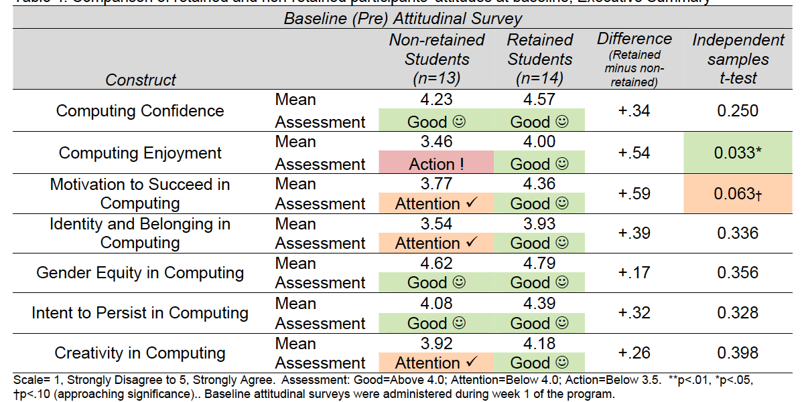
Predicting who will complete?

Slide 26
Reasons for Stopping
Too busy
“I wanted to attend the session[s], but I had a busy schedule at the time."
Senioritis
“The project really couldn't have done much more to encourage my attendance. I think it was very well run and should be applauded for such. The one thing I would say is that I would have liked for it to start in the fall, as soon as school started. After getting into the colleges of my choice, my motivation wavered.”

Slide 27
Project cost about $4,200
We paid undergraduate students to run the webinars and help sessions
About $3,000 for 1 semester
We paid 8 students $100 for passing
$800
We gave some extra prizes for competitions to participants
About $400

Slide 28
Future plans
Start program in September
Recruit more female Black students
Add Sunday sessions on Alice and Media Computation
Add more practice with free response questions
Add more review of questions they got wrong
Have students do the post content knowledge assessment before the exam
Use Research Experience for Undergraduates to continue the program
Apply for a Google RISE grant by Sept 30

Slide 29
AP CS A Materials
AP CS A course information
http://apcentral.collegeboard.com/apc/public/courses/teachers_corner/4483.html
Georgia Tech multiple choice questions
http://ice.cc.gatech.edu/apexam_final/
http://ice.cc.gatech.edu/apexam_final/TeacherRegistration.jsp to create a teacher login
Codingbat - http://codingbat.com
Practice-It - http://practiceit.cs.washington.edu
Jeliot - http://cs.joensuu.fi/jeliot/

Slide 30
Other Resources
Alice 3
http://www.alice.org/index.php
Greenfoot
http://www.greenfoot.org/door
Finch robots
http://www.finchrobot.com
Media Computation
http://coweb.cc.gatech.edu/mediaComp-teach

Slide 31
Summary
There is a huge need to improve the pass rate for Black students in AP CS A
See http://home.cc.gatech.edu/ice-gt/548
STARS groups can help Black students pass the AP CS A
Improve confidence in computing ability
Improve enjoyment of computing
Provide role models to high school students

