Slide 1
PNUTS: Yahoo’s Hosted Data Serving Platform
Jonathan Danaparamita
jdanap at umich dot edu
University of Michigan
Some slides/illustrations from Adam Silberstein’s
PNUTS presentation in OSCON July 26 2011

Slide 2
What is PNUTS?
Trivia: Abbreviation
Real meaning
Goals/Requirements
Scalability, Scalability, Scalability
Low latency
Availability (…or else, $--)
A certain degree of Consistency
Notes:
PNUTS: Platform for Nimble Universal Table Storage..
Scalability is main focus
Very low latency while maintaining a certain degree of consistency
Availability is important or less profits.

Slide 3
PNUTS Applications
Yahoo!’s User Database
Social Applications
Content Meta-Data
Listings Management
Session Data

Slide 4
Design Outlines
Data and Query Model
Simple relational model
Key / Range scan (Hash and Ordered tables)
Global Accesses
Asynchronous (global) replication
Low latency local access
Consistency
Fault tolerant and Load balancing

Slide 5
Data Storage and Retrieval
Horizontal partitioned table into tablets (groups of records)
Storage unit: where the tablets are stored
Router
Interval mapping: boundaries of each tablet
Locates the storage unit given a tablet
Is the cache version of…
Tablet controller
Stores all the mappings
Polled by router for changes
Determines when to split/move tablets

Slide 6
PNUTS-Single Region
From Silberstein’s OSCON 2011 slide
Routes client requests to correct storage unit
Caches the maps from the tablet controller
Maintains map from database.table.key to tablet to storage-unit
Stores records
Services get/set/delete requests

Slide 7
Data Retrieval for Hash
Hash space is divided to intervals each corresponds to a tablet
Key -> hash value -> interval -> storage unit found

Slide 8
Data Model: Hash
Primary Key | Record
Grape | {"liquid" : "wine"}
Lime | {"color" : "green"}
Apple | {"quote" : "Apple a day keeps the …"}
Strawberry | {"spread" : "jam"}
Orange | {"color" : "orange"}
Avocado | {"spread" : "guacamole"}
Lemon | {"expression" : "expensive crap"}
Tomato | {"classification" : "yes… fruit"}
Banana | {"expression" : "goes bananas"}
Kiwi | {"expression" : "New Zealand"}
0x0000
0x2AF3
Tablet
0x911F

Slide 9
Data Retrieval for Ordered Table
Key -> interval -> storage unit found
As opposed to Hash:
Key -> hash value -> interval -> storage unit

Slide 10
Data Model: Ordered
Primary Key | Record
Apple | {"quote" : "Apple a day keeps the …"}
Avocado | {"spread" : "guacamole"}
Banana | {"expression" : "goes bananas"}
Grape | {"liquid" : "wine"}
Kiwi | {"expression" : "New Zealand"}
Lemon | {"expression" : "expensive crap"}
Lime | {"color" : "green"}
Orange | {"color" : "orange"}
Strawberry | {"spread" : "jam"}
Tomato | {"classification" : "yes… fruit"}
Tablet

Slide 11
Tablet Splitting & Balancing
From Silberstein’s OSCON 2011 slide
Each storage unit has many tablets (horizontal partitions of the table)
Storage unit may become a hotspot
Overfull tablets split
Tablets may grow over time
Shed load by moving tablets to other servers

Slide 12
Data Model: Limitations
No constraints
Is a challenge to the asynchronous system
No ad hoc queries (joins, group-by, …)
Is a challenge while maintaining response-time SLA
MapReduce Interface
Hadoop: MapReduce implementation for large scale data analysis
Pig: the language

Slide 13
Yahoo! Message Broker
Pub/sub (publish/subscribe)
Clients subscribe to updates
Updates done by a client are propagated to other clients
Thus, the subscribing clients are notified of the updates
Usages
Updates: updates are “committed” only when they are published to YMB
Notifications
Notes:
User notifications

Slide 14
Geographical Replication
Same copies of a “single region” node across data centers
Why?
Reduced latency for regions distant from the “master” region
Backup
But...more latency for updates
On updates, propagate the changes to all replicas
This is done using Yahoo! Message Broker
This is one where the latency comes from

Slide 15
PNUTS Multi-Region
From Silberstein’s OSCON 2011 slide

Slide 16
Consistency Model
Per-record Timeline Consistency

Slide 17
Record-level Mastering
Assigns one cluster is the “master” for each record
Local update -> record master for complete “commit”
Choosing the right master
85% of writes are typically done from the same datacenter
Therefore, choose the “frequent writer” datacenter as the master
If the writes moves, reassign the master accordingly
Tablet master (not record master) enforces primary key constraints

Slide 18
Recovery
Find the replica to copy from
Checkpoint message for in-flight updates
Copy lost tablets from the chosen replica
Which replica to choose?
A nearby “backup region” can efficiently accommodate this need

Slide 19
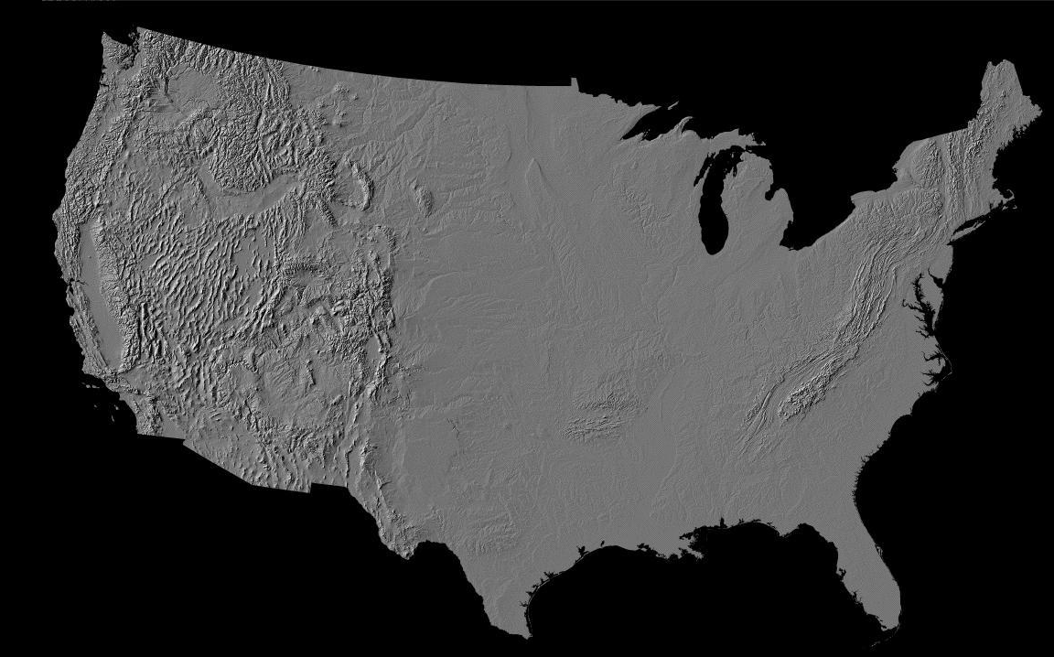
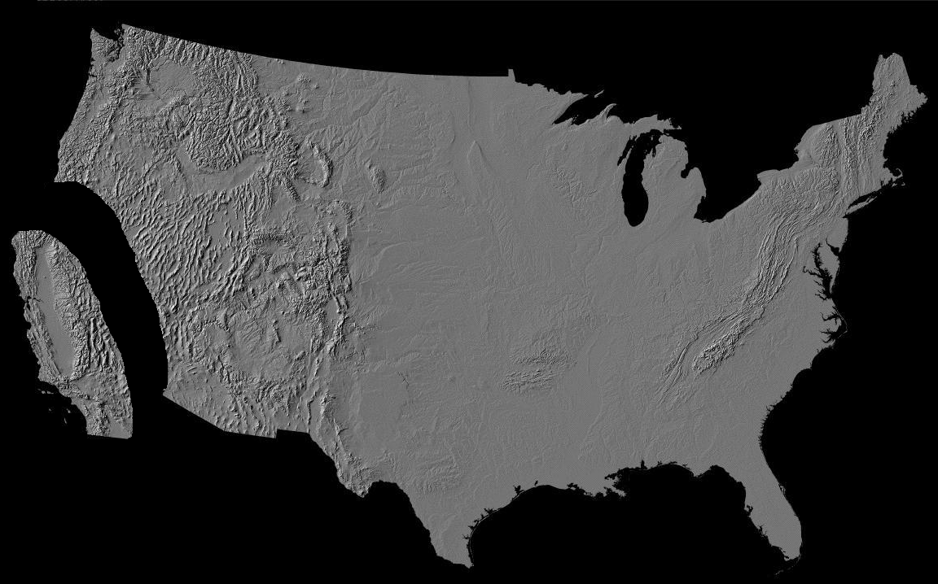
Asynchronous Replication
From Silberstein’s OSCON 2011 slide

Slide 20
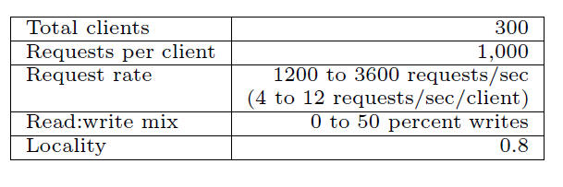
Experiments
Metric: latency
Being compared: hash and ordered tables
Clusters: three-region PNUTS cluster
2 to the west, 1 to the east
Parameters

Slide 21
Inserting Data
One region (West 1) is the tablet master
Hash: 99 clients (33 per region), MySQL: 60 clients
1 million records, 1/3 per region
Result:
Hash: West1: 75.6ms; West2: 131.5ms, East 315.5ms
Ordered: West1: 33ms; West2: 105.8ms, East 324.5ms
Lesson: MySQL is faster than hash, although more vulnerable to contention
More observations

Slide 22
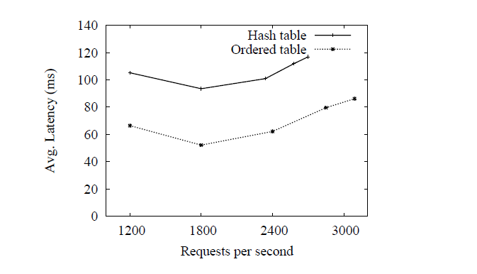
Varying Load
Requests vary between 1200 – 3600 requests/second with 10% writes
Result:
Observation or Anomaly?

Slide 23
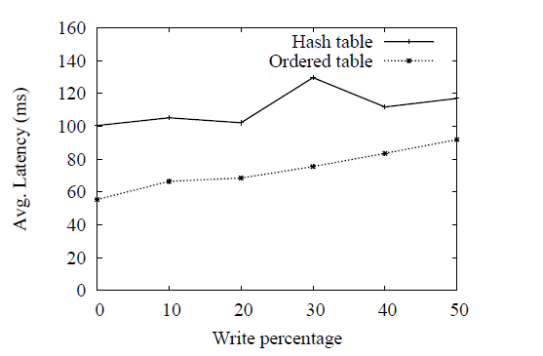
Varying Read/Write Ratio
Ratios vary between 0 and 50%
Fixed 1,200 requests/second

Slide 24
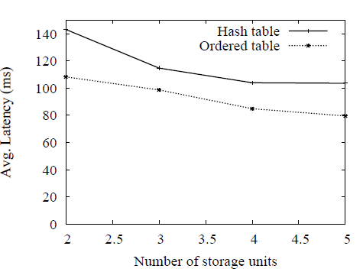
Varying Number of Storage Units
Storage units per region vary from 2-5
10% writes, 1,200 requests/seconds

Slide 25
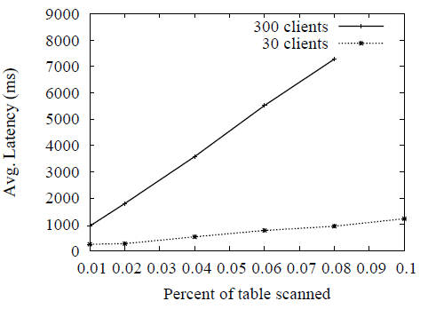
Varying Size of Range Scans
Range scan between 0.01 to 0.1% size
Ordered table only
30 clients vs. 300 clients

Slide 26
Thank you
Questions?

