Slide 1
C-Store
Paritosh Aggarwal
Rushi Nadimpally

Slide 2
Agenda – Part I
Motivation and Basic Idea
C-Store Data Model
Bimodal Architecture
Compression Schemes
Working on compressed data

Slide 3
Agenda – Part II
Transactions and Updates
C-Store Performance
Experiments on Compression
Conclusions

Slide 4
Agenda
Motivation and Basic Idea
C-Store Data Model
Bimodal Architecture
Compression Schemes
Working on compressed data

Slide 5
Motivation and Basic Idea
Row stores
Traditional systems
Most natural order for storing data
Can we do better?
Reads generally involve only a subset of the attributes
Row stores perform well on OLTP workloads – small reads and writes with B-Trees, etc.
They fare badly in read intensive applications e.g. OLAP

Slide 6
New Idea!
What is C-Store?
Store data by columns
Read optimization for OLAP applications
C-Stores lend themselves to a variety of other advantages over row stores

Slide 7
Main Strengths
Read in only required columns
COMPRESSION – probably the USP for C-Stores
A contiguous sequence of domain limited values lend themselves very nicely to compression schemes
Do away with padding
You don’t even have to decompress sometimes!
SELECT AVG(salary) from EMP: Work on RLE encoded data all along
Memory and disk bandwidth is not as abundant as one would like – Compression is a good idea (better cache performance, lower page faults, etc.)

Slide 8
There’s no free lunch – Main Drawbacks
To answer many queries, joins must be calculated on projections
Join indices must be maintained between pairs of relations
Leads to added complexity

Slide 9
Agenda
Motivation and Basic Idea
C-Store Data Model
Bimodal Architecture
Compression Schemes
Working on compressed data

Slide 10
Data Model
Standard relational logical data model
Difference in physical representation – you can think of the relational interface as a view
Projections are implemented and stored in column-order
Projections represented as ti (<names of fields>)
Notes:
Move to #5

Slide 11
Data Model
Projections
One column may appear in multiple projections
Aggressive compression ~ no explosion in space requirements
All projects must form a covering on all attributes of the relation
Advantages in a distributed system
High availability which actually contributes something useful!
K-safety

Slide 12
Segments, storage keys
Every projection is horizontally partitioned into 1 or more segments, each with a segment identifier Sid
Each segment is associated with a key (key range to be precise)
The projections must form a covering of all columns
All rows should be reconstructable from the given set of projections

Slide 13
Each segment associates every data value of every column with a storage key, SK
Sk | Name | Age | Dept | Salary
1 | Bob | 25 | Math | 10K
2 | Bill | 27 | EECS | 50K
3 | Jill | 24 | Biology | 80k
1 | 2 | 3 | 1 | 2 | 3 | 1 | 2 | 3 | 1 | 2 | 3
Name
Age
Dept
Salary
Items in numbers represent storage keys.
Only one segment is shown, but this may have been divided into multiple segments

Slide 14
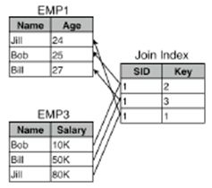
Sort orders, join indices
Join indices: A mapping from one sort order to another sort order
To reconstruct T segments Ti: find a path through a set of join indices that maps each attribute of T into some sort order O*.
Notes:
Formally: a join index from M segments in T1 to N segments in T2 is a collection of M tables, one per segment S of T1, consisting of rows of the form: (s: SID in T2, k:Storage Key in Segment s)

Slide 15
Agenda
Motivation and Basic Idea
C-Store Data Model
Bimodal Architecture
Compression Schemes
Working on compressed data

Slide 16
Bimodal Architecture
We cannot ignore reads
Retaining sort order on columns difficult while insertion
Sub-optimal query performance if insertion order allowed in columns
Simply consider: if we maintain insertion order on a given projection, the various advantages of sorting over a certain attribute go away (indexing, compression)

Slide 17
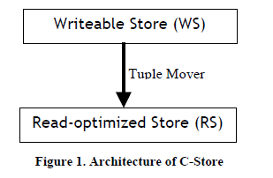
Bimodal Architecture
Small WS : write-opt
Larger RS : read-opt
Tuple mover : transport from WS to RS

Slide 18
Bimodal Architecture
Writes sent to WS / Reads from RS / Updates = Insert + Delete
Tuple-Mover uses LSM-tree to bulk-move WS objects into RS
Locking
Snapshot isolation: queries are run in historical mode – read only queries run only at snapshot T, and are semantically accurate

Slide 19
Agenda
Motivation and Basic Idea
C-Store Data Model
Bimodal Architecture
Compression Schemes
Working on compressed data

Slide 20
Integrating Compression and Execution in Column-Oriented Database Systems
Benefits of Compression
Improved seek times
Reduced transfer times
Higher buffer hit rate
CPU overhead of decompression compensated by I/O improvement
Sometimes, compressed data can be worked on directly (shown later)

Slide 21
Various Compression Schemes
Null Suppression
Leading zeros or blanks in data are deleted and replaced with the location and number pair.
Field sizes are allowed to be variable to avoid padding. Exact size of field is stored before the field, in two bits
Run-length Encoding
Runs of same value are replaced with triples (value, start position, run_length)
Example: 111000000110000000000 may become 111110010110110
Notes:
State their use cases - Add examples

Slide 22
Various Compression Schemes
Dictionary Encoding
32 values for an attribute A ⬄ 5 bits to represent it
1 value in 1 byte, 3 values in 2 bytes, 4 values in 3 bytes, etc.
If 5 is 00000, 25 is 00001; 31 is 00010, then: X000000000100010 -> 31 25 1
Decoding: Read in two bytes, lookup bit pattern in dictionary.

Slide 23
Various Compression Schemes
Bit-Vector Encoding
Original String: 1132231
Compressed String(maybe stored in a table): 1 => 1100001 2 => 0001100 3 => 0010010
Lempel-Ziv Encoding
Takes variable sized patterns and replaces them with fixed length codes
Used by the unix program gzip

Slide 24
Lempel – Ziv Algorithm (Example thanks to: http://www.data-compression.com/lempelziv.html)
Initialize the dictionary to contain all blocks of length one (D={a,b}).
Search for the longest block W which has appeared in the dictionary.
Encode W by its index in the dictionary.
Add W followed by the first symbol of the next block to the dictionary.
Go to Step 2.

Slide 25
Agenda
Motivation and Basic Idea
C-Store Data Model
Bimodal Architecture
Compression Schemes
Working on compressed data

Slide 26
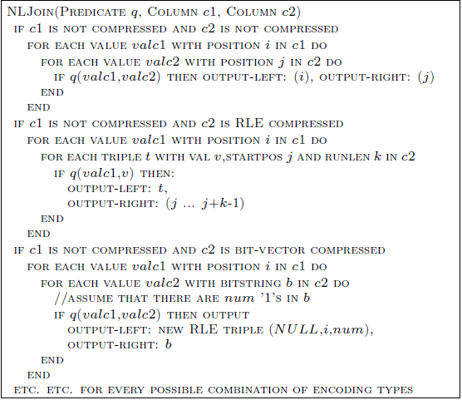
Example

Slide 27
Compression-Aware Optimizations - Comments
The example illustrates how processing can be done directly and efficiently on compressed data.
It also shows how easily the code can digress to a separate if..then..else block for each section.
What’s the solution?

Slide 28
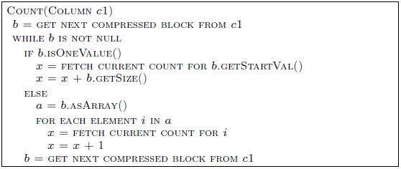
Compression-Aware Optimizations -Solution
Code based on properties of compression that actually determine the optimization
SELECT c1, COUNT(*) FROM t GROUP BY c1

Slide 29
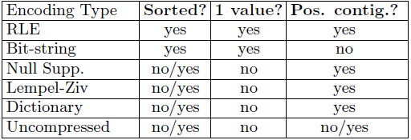
Compression-Aware Optimizations -Solution

Slide 30
Agenda – Part II
Transactions and Updates
C-Store Performance
Experiments on Compression
Conclusions

Slide 31
Agenda – Part II
Transactions and Updates
C-Store Performance
Experiments on Compression
Conclusions

Slide 32
Updates & Transactions
Dealt with in Writeable Store.
Insertion is just a collection in WS.
Implementation is shielded logically: User still deals with logical rows.
No synchronization needed between nodes.
Large main memories: Not an issue nowadays.

Slide 33
Snapshot Isolation
Snapshots of RS at different epoch periods, after writes committed.
Reads view the closest snapshot.
Terms:
High Water Mark: Most recent time at which a snapshot isolation can be run.
Low Water Mark: The earliest time at which snapshot isolation can be run.
IV (Insertion Vector) & DRV (Deleted Record Vector), maintained in WS.

Slide 34
Maintaining HWM
HWM maintained by the Timestamp Authority(TA) and a system of messages.
Reclamation of epochs to conserve space.

Slide 35
Locking-Based Concurrency
No Force +Steal, locking mechanism.
Distributed Commit Processing:
Master distributes the work.
No prepare phase.
Not the conventional two phase mechanism.
Transaction Rollback: Using UNDO log

Slide 36
Distributed Recovery
Loss cases :
No Data loss:
Direct Recovery
Track updates in the network.
Catastrophic failure: RS and WS eliminated.
Reconstruct using projections in other nodes.
Not a likely scenario as only tuple mover writes to RS.
Only WS fails: Most Likely

Slide 37
Recovering Writeable Store
Find all the elements in the WS after that latest timestamp in RS.
Are all columns overlapped? If yes, Done !!
No? Then query remote site for all its content and perform a differencing operation with the local RS segment.
Tuple Mover maintains a log of the segment , epoch number of tuple before it was moved from WS.

Slide 38
Tuple Mover
Operates as a background task.
Records on the DRV list are deleted.
Records on IV list are inserted/updated.
Join indexes are maintained.
New RS segment created. Old one is not updated !!
Old RS records are copied in bulk and system now ignores original RS segment.

Slide 39
Query Execution: Operators
Decompress
Select
Mask
Project
Sort
Aggregation
Concatenation
Permute
Join
Bit operations
Optimization
Cost depends on Compression type.
A major decision: Which projections to use to answer a query ?

Slide 40
Agenda – Part II
Transactions and Updates
C-Store Performance
Experiments on Compression
Conclusions

Slide 41
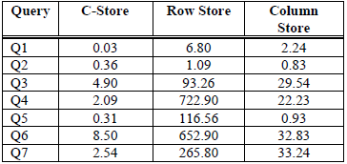
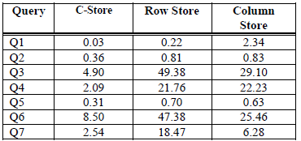
How good is C-Store ?
No write/update measurements !!
3.0 Ghz Pentium, RedHat Linux, 2 GB of memory. 750 GB of disk.

Slide 42
Why is it better? By How much?
Reasons :
Column representation
Storing overlapping projections
Better compression
Operations on compressed data.
Figures:
164 times X row store; 21 times X column store.
Unconstrained space:
6.4 X row store (with space X 1/6)
16.5 X column store. (with space X 1/1.83)

Slide 43
Agenda – Part II
Transactions and Updates
C-Store Performance
Experiments on Compression
Conclusions

Slide 44
Experiments on Compression
Purpose: To identify situations where encoding provides significant gains.
Test Variations:
Eager Decompression.
Lazy Decompression. (After computation)
Tests with CPU contention
Identify performance criteria:
The length of sorted runs
The number of distinct values

Slide 45
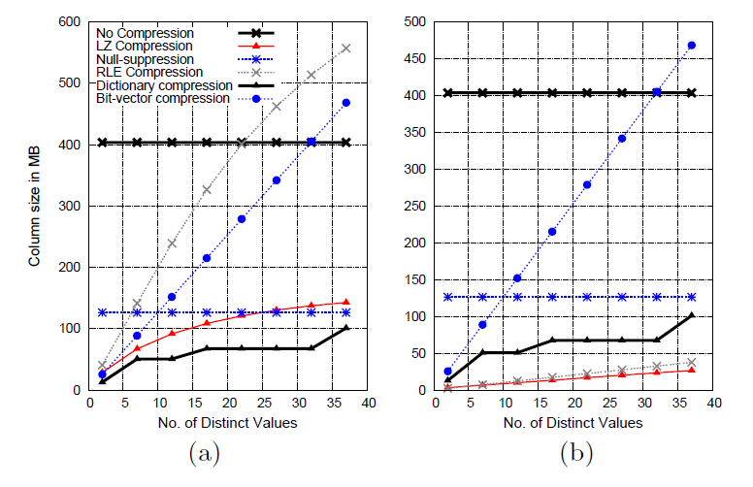
Savings in Size
Run length: 50
Run length: 1000

Slide 46
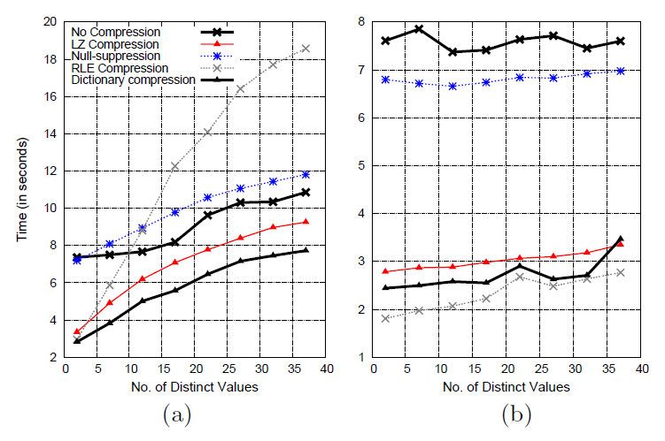
Improvements in Speed
Run length: 50
Run length:1000

Slide 47
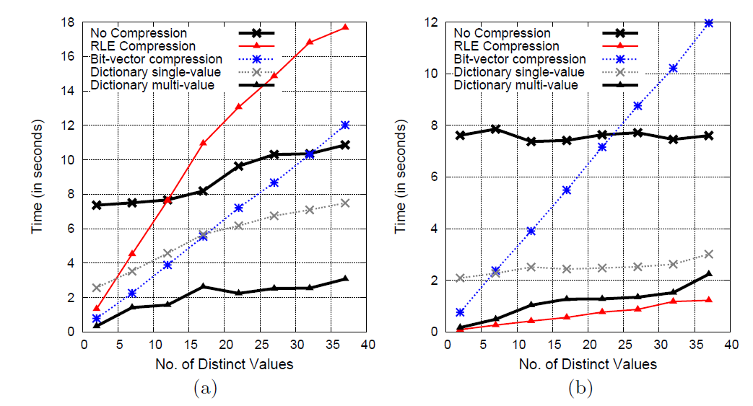
Computing on Compressed Data
Run length: 50
Run length: 1000

Slide 48
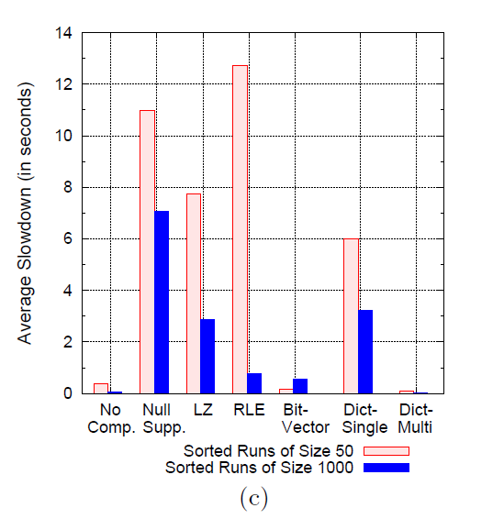
Does CPU Contention matter in a database system ?

Slide 49
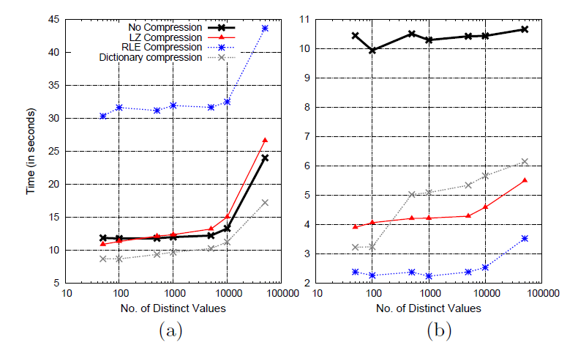
Extreme Cases: (High Cardinality)
Run length:1
Run length:14

Slide 50
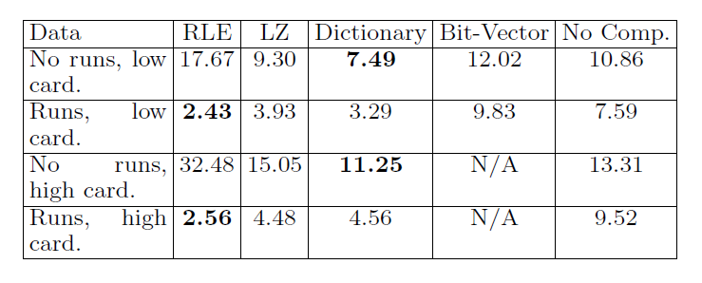
Relative Performance

Slide 51
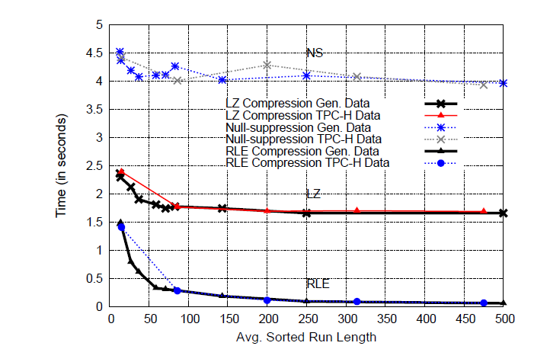
How applicable is it to Real-World data ?

Slide 52
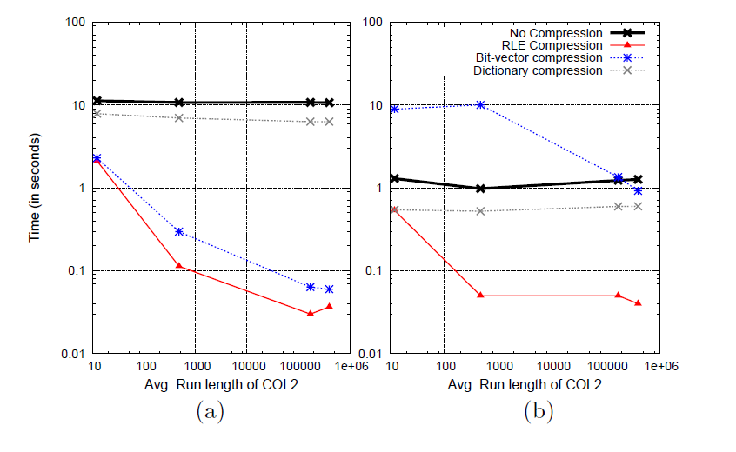
How Does Ordering Matter ?

Slide 53
Agenda – Part II
Transactions and Updates
C-Store Performance
Experiments on Compression
Conclusions

Slide 54
Conclusions on C-Store:
Column store representation.
Hybrid architecture .
Data Compression.
Overlapping projections.
Distributed transactions without redo log or two phase commit.
Efficient Snapshot isolation.

Slide 55
Decision Tree for Compression
Are these moderate length runs ? (Average size>4)
Solution: Compress columns with RLE.
Is the number of distinct values large (>50,000) ?
Is this column likely to be used in a contiguous fashion ?
Does the data exhibit good locality ?
Solution: Use Dictionary Encoding
Is the number of distinct values > 50
Solution: Use Dictionary Encoding
Solution: Use Bit Vector Encoding.
Solution: Use LZ
Solution: Don’t compress
Yes
No
Yes
No
Yes
Yes
No
No
Yes

Slide 56
Conclusions on Compression
Low cardinality items on the left side of the sorting order. (Provides larger runs)
Its a good idea to operate directly on the compressed data.
Sacrificing heavy weight compression schemes for those which can be efficiently computed on is a good idea.
Compression-Aware Optimizer
Taking only IO costs is a bad idea !!

