Slide 1
Join Processing in Database Systems with Large Main Memories (part 2)
Yongjoo (Young) Park
[1] Query Optimization for Parallel Execution, Ganguly et al.
[2] Logic per track devices, Slotnick
[3] Implementing a relational database by means of specialzed hardware, Bobb
[4] Database System Concepts, 5ed, p.861-862
[5] Netezza_Appliance_Architecture_WP.pdf

Slide 2
Contents
Comparison of Four Join Methods
Partition Overflow
Other Tools
Memory Management Strategy

Slide 3
First
Comparison of Four Join Methods
Merge, Simple Hash, GRACE, Hybrid
Partition Overflow
Other Tools
Memory Management Strategy

Slide 4
Assumptions Made
No relations ordered or indexed
Minimum memory size
for Sort-merge
for Hash
Fixed real memory size

Slide 5
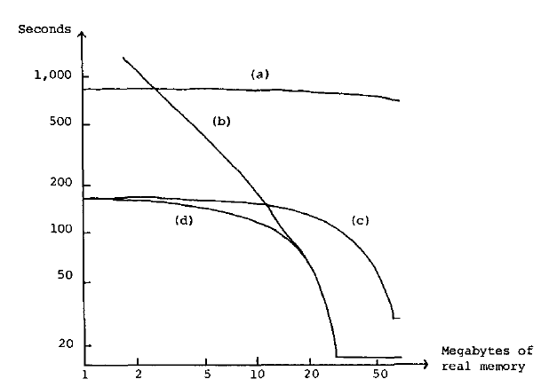
CPU + I/O Times
Try to guess what’s what
among..
GRACE
Simple hash
Sort Merge
Hybrid hash
Notes:
Students are expected to answer that each index corresponds to which hashing methods

Slide 6
CPU + I/O Times
Answer is
Sort-merge
Simple hash
GRACE
Hybrid hash

Slide 7
CPU + I/O Times
Large memory area
Simple hash dominates
Hybrid acts like Simple hash

Slide 8
CPU + I/O Times
Small memory area
GRACE dominates
Hybrid generally acts like GRACE
It also use remaining memory

Slide 9
Comparisons Made
In Paper
Hybrid > Simple
Hybrid > GRACE
Hybrid > Merge
GRACE > Merge
1st and 2nd are covered here

Slide 10
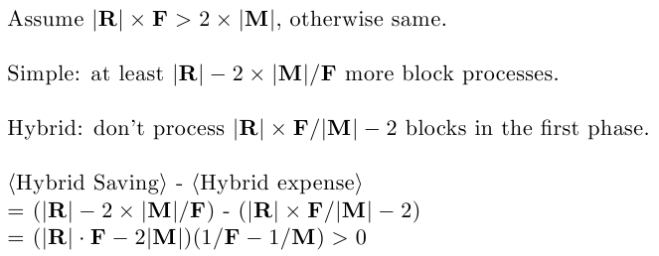
Hybrid vs. Simple

Slide 11
GRACE and Hybrid
They behave slightly diff, when there’s remaining memory
Comparison on next slides with:
|R| = 1000, F = 1.4, |M| = 100

Slide 12
GRACE and Hybrid
GRACE (1st phase):
Used as output buffer
= 38
…
Each

Slide 13
GRACE and Hybrid
GRACE (1st phase modified):
Used to save passed-over
Used as output buffer
= 38
= 62
…

Slide 14
GRACE and Hybrid
Hybrid (1st phase):
Used as Output buffer
Used to build hash table
= 86
= 14
…

Slide 15
GRACE and Hybrid
GRACE:
Saved = 62 blocks
Hybrid:
Saved = 86 blocks

Slide 16
Other Advantage of Hash over Merge
Your thinking?

Slide 17
Other Advantage of Hash over Merge
Good response time
Easier to pipeline to next join [1]
Wait until J₁ finish,
if Merge join
Not ordered
J₂
J₁
R₁
R₂
R₃

Slide 18
Hybrid Always Win?
Scenario that Sort-merge is better than Hybrid?
Notes:
If either or both relations are sorted.
Partition overflow

Slide 19
Sort-merge Worth to Consider
Scenario that Sort-merge is better than Hybrid
Either relation is sorted
Hard to estimate data distribution

Slide 20
Second
Comparison of Four Join Methods
Partition Overflow
Other Tools
Memory Management Strategy

Slide 21
Partition Overflow
Previous assumption
Ideal hash function that partition into same size of sets
GRACE handle overflow by ‘tuning’
Begin with small partitions
Combine them when size is known

Slide 22
Other Approach to Prevent O/F
Hash function with random property
Uniformly distribute data
Store statistics about distribution
System catalog in previous paper
Use of histogram
These are Not Enough!

Slide 23
On Disk Overflow
Partition is too large to fit in memory
Reprocess the partition into smaller ones
One that exactly fit in memory, plus add smaller one to another partition
Relation S should use same function too

Slide 24
In Memory Overflow
Currently hashed subset is too large
Reassign some buckets onto disk
Use different hash function
Relation S should use same function too

Slide 25
Third
Comparison of Four Join Methods
Partition Overflow
Other Tools
Disk filters
Bobb array
Semijoin
Memory Management Strategy

Slide 26
Database Filter
Mechanism to process records as they come off disk
Use per-track wired logic circuits [2]
Company Netezza use similar approach with FPGAs [5]
“The Netezza architecture is based on … to filter out extraneous data as early in the data stream as possible and as fast as data streams off the disk.”

Slide 27
Bobb Array
Researched as an extension to CAFS
Content Addressable File Store (CAFS), company product
More on Wikipedia : )
Disk-head-attached logic device [3]
Highly dependent on layout of data

Slide 28
Semijoin
How to calculate
Construct
Join and , which is semijoin of and
Join semijoin to
Good in distributed environment and with low selectivity of [4]

Slide 29
Fourth
Comparison of Four Join Methods
Partition Overflow
Other Tools
Memory Management Strategy
Hot set + VM
Why bad utilization

Slide 30
Challenges in Memory Mgmt
No fixed amount of memory
OS needs to consider future processes
What if several processes request

Slide 31
Hot Set + Virtual Memory
All requests in virtual memory
Compete for real memory
Hot set wired down to real memory
Hot set size is estimated by the access planner

Slide 32
Good Case
If
Only two sets and are constructed
Read back in opposite order
All blocks in real memory are processed before paged out

Slide 33
Bad Case
If
Only blocks are read directly
is ratio of ‘in memory’
See next slide for calculation

Slide 34
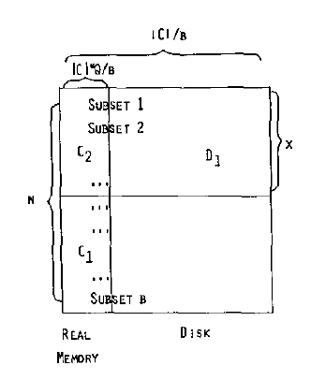
Bad Case
C₁, C₂, C₃ in C
C₁ were on disk, and processed
C₂ were in memory, and processed
C₃ were in memory, and not processed

Slide 35
Thank You

