Slide 1
Join Processing in Databases Systems with Large Main Memories
By
Leonard D. Shapiro
Presented By
Aditya Tayade
Yongjoo Park

Slide 2
Motivation make the most of what you have
Joins tend to be one of the most costly operations.
Proposing new algorithms which use the large memories at our disposal.
Traditional algorithms (eg. Nested Loop Join) do not take the advantage of large main memories available today.

Slide 3
Join Algorithms
Sort-Merge Join
Simple Hash Join
GRACE Hash-Join
Hybrid Hash-Join

Slide 4
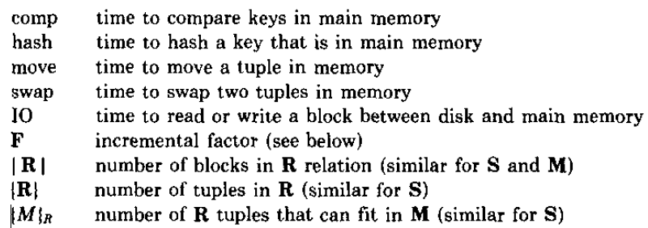
Notations & Assumptions
Goal – Perform Equi-Join of relations R & S.
Full track blocking
|R| <= |S|
Fixed amount of Memory is allocated upfront by the Proc. Manager and the DB process knows how much it is.

Slide 5
Sort-Merge Join
Sort (using k-way merge) & then check for match of join parameters over the sorted o/p.
1) Produce runs of S ,move them to disk and then produce runs of R.
2) Merge R & S concurrently. Check for match over the output.

Slide 8
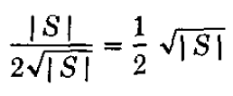
Sort Merge Join
Memory |M| assumed to be at least sqrt(|S|)
At least distinct runs of each S and R.
Since one input buffer required per run, our sqrt(|S|) assumption is still valid.
The Total Cost

Slide 9
The Hashing Approach
Classical Approach – Build a Hash Table for R (as it is smaller among the two). Compare hashed values of each S tuple with the hashed R values.
Works fine is hash of R fits in the memory. All the following algorithms try to propose a way out of this limitation.
Define buckets H_{i} of hashed values and the corresponding R_{i} and S_{i} which map into.
Join the individual buckets.
Notes:
Each of the three algorithms we describe uses partitioning, as described above. Each proceeds in two phases: the first is to partition each relation. The second phase is to build hash table(s) for R and probe for matches with each tuple of S.

Slide 10
Notes:
Each of the three algorithms we describe uses partitioning, as described above. Each proceeds in two phases: the first is to partition each relation. The second phase is to build hash table(s) for R and probe for matches with each tuple of S.

Slide 11
Simple Hash Join
Algorithm
Performs well only when |R| ~ |M|
Try only one bucket at a time.
If not, then multiple disk r/w occur which leads to bad performance.

Slide 12
Simple Hash Join
Algorithm
Performs well only when |R| ~ |M|
If not, then multiple disk r/w occur which leads to bad performance.

Slide 13
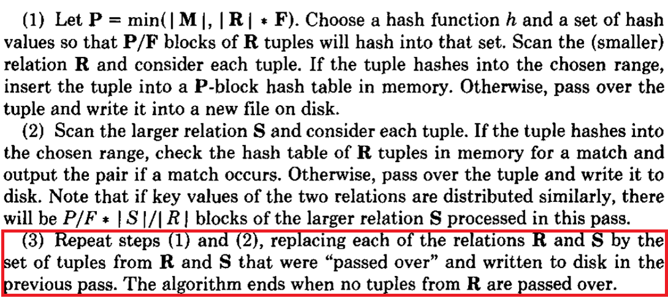
Simple Hash Join
Algorithm
Performs well only when |R| ~ |M|
If not, then multiple disk r/w occur which leads to bad performance.

Slide 14
A phase of Simple Hash Join

Slide 15
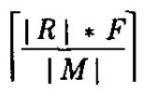
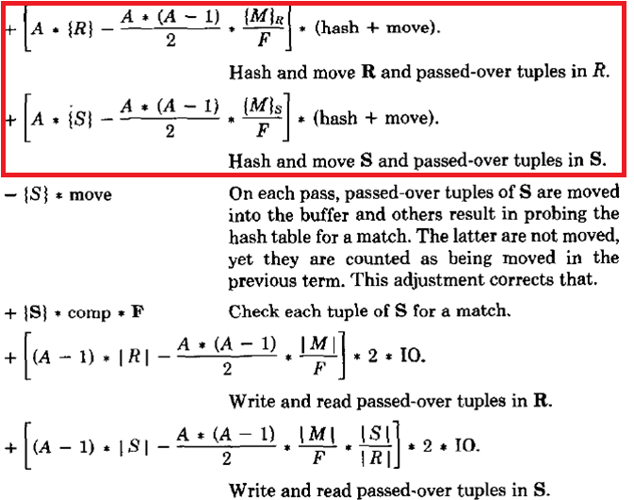
Simple Hash Join
A = , the number of passes to execute
The cost function –

Slide 16
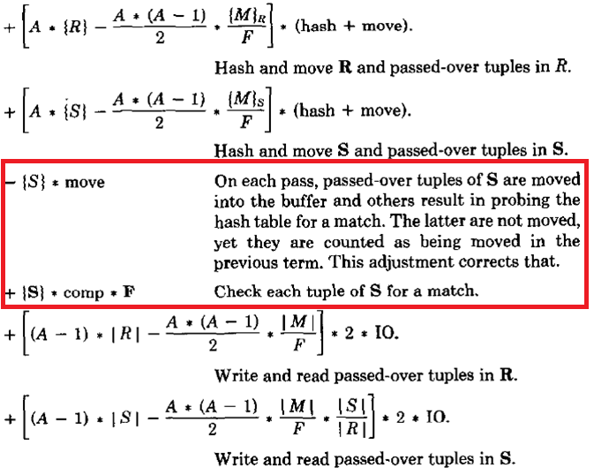
Simple Hash Join
A = , the number of passes to execute
The cost function –

Slide 17
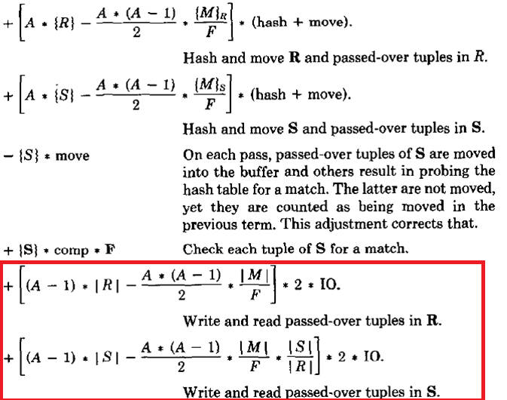
Simple Hash Join
A = , the number of passes to execute
The cost function –

Slide 18
GRACE Hash Join
Build all the hash partitions concurrently.
Equal sized partitions of R are made.
Memory availability assumed to be at least .
The algorithm
Choose a hash bucket such that R is partitioned into partitions, each one of approximately equal size. Allocate output buffers, one each for each partition of R.
Scan R. Hash each tuple and place it in the appropriate output buffer. When an output buffer fills, it is written to disk. After R has been completely scanned, flush all output buffers to disk.
Scan S. Use same hash function which was used for R and repeat the process in previous step.
Read R_{i} into memory and build a hash table for it.
Hash each tuple of S_{i} with same hash function used previously and probe for a match. If match exists, output tuple in result, move on to the next tuple.

Slide 20
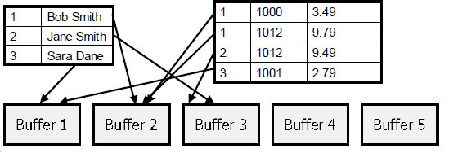
Phase 1
Phase 2

Slide 21
GRACE Hash Join
Memory is indeed sufficient. Each R_{i} is of size
Since F is the fudge factor, hash table size is
Cost Function –

Slide 22
Hybrid Hash Join
Midway between GRACE-Join & Simple-Hash.
Number of partitions fixed to B.
B blocks of memory used for output buffering while rest |M|-B used to store to store hash tables.
Hash R. If it belongs to R₀ place it in hash table in memory otherwise write it to disk.
Hash S. If it belong to S₀ compare it to the hash in memory otherwise write it to the disk. After this step only R₁….R_{i} & S₀…S_{i} are on the disk.
Repeat the above two steps for each R_{i} & S_{i} previously written to the disk.

Slide 25
Hybrid Hash Join
q = |R₀| / |R|, fraction of R represented by R₀.
The cost function –

