Slide 1
An event-triggered programmable prefetcher for irregular Workloads
Sam Ainsworth and Timothy M. Jones
Presenters: Leul Belayneh and Nicholas Wendt
Presentation for EECS 583

Slide 2
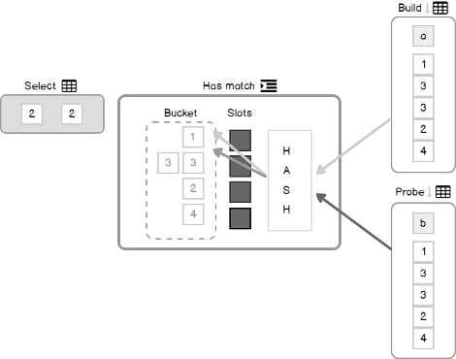
Irregular Workloads are Everywhere

Slide 3
Common Memory Accesses: Sequential
A[ i ]
A
4
1
10
6
9
Simple next-line prefetchers

Slide 4
Common Memory Accesses: Indirect
B[ A[ i ] ]
B
A
4
1
10
6
9
Sequential
Irregular
Software prefetching

Slide 5
Common Memory Accesses: List
A -­> next
B
Event-based prefetching
Irregular

Slide 6
Pseudocode HashJoin
// HashJoin algorithm
// data structures initialization
for(x = 0; x < in.size; x++){
Hash h = hash(x);
Bucket b = htab[h];
ListElement l = b.listStart;
while(l != NULL){
if(l->key == k){ out.size++;}
l = l->next;
}
}
Mem Indirect
List
List

Slide 7
The problem: inefficient computation
Irregular workload execution in general purpose processors are characterized by:
- Irregular memory accesses: difficult to capture using caches
- Excess cache line size for small data (~8 bytes): waste of memory bandwidth
- Low computational intensity: simple computations for each data

Slide 8
Prior solutions
Fetcher Units*
domain specific architecture
Helper Threads ‡
uses separate CPU threads
no extra hardware required
memory-centric optimization
Configurable Prefetchers†
exposed at the architectural level
target specific traversals
+ higher performance
- leads to heavy stalling to prefetch based on prefetches
non overlapping memory accesses
*Sqrl: Hardware accelerator for collecting software data structures. PACT, 2014
† Compiler-directed content-aware prefetching for dynamic data structures. PACT, 2003
‡ Design and evaluation of compiler algorithms for pre-execution. ASPLOS, 2002

Slide 9
Key Idea – Memory-Level Parallelism
How can we parallelise memory accesses instead of computation?
Observation: parallelizing loads via prefetching
Triggering a new prefetch by reacting to old prefetches and loads

Slide 10
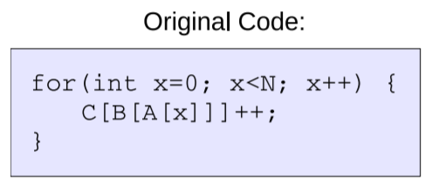
Execution Flow: Events
Events
Original Code:
Observe Load to A[n]
Prefetch A[n+N]
Prefetch B[A[n+N] ]
Prefetch C[B[A[n+N] ] ]

Slide 11
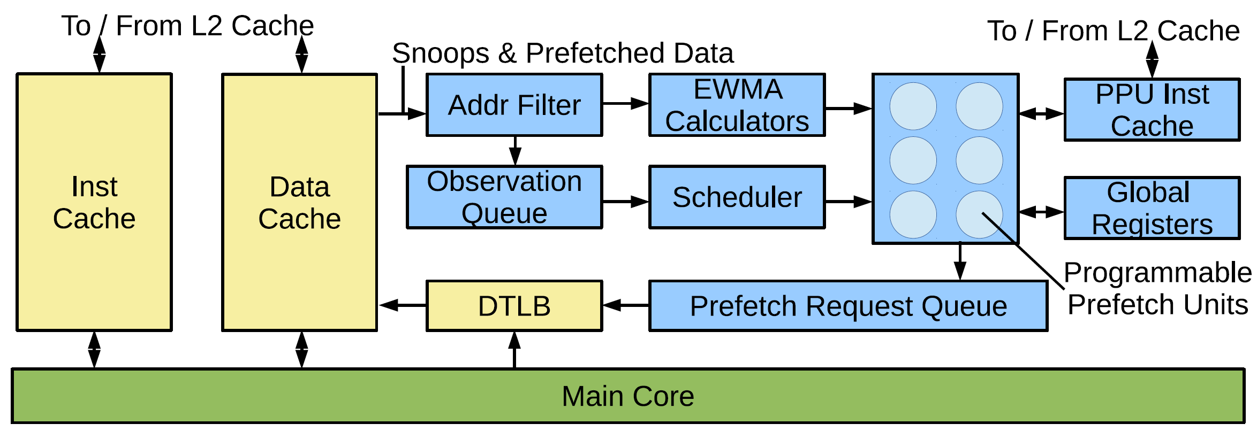
Architecture

Slide 12
Architecture: Address Filter
Addr Filter

Slide 13
Architecture: Scheduler
Scheduler

Slide 14
Architecture: Prefetch Units

Slide 15
Application Support
Requires event functions and an address table

Slide 16
Application Support
Requires event functions and an address table

Slide 17
Application Support
Requires event functions and an address table
Address Table:
2 1 0

Slide 18
Compiler Assistance
Prefetcher can be integrated manually

Slide 19
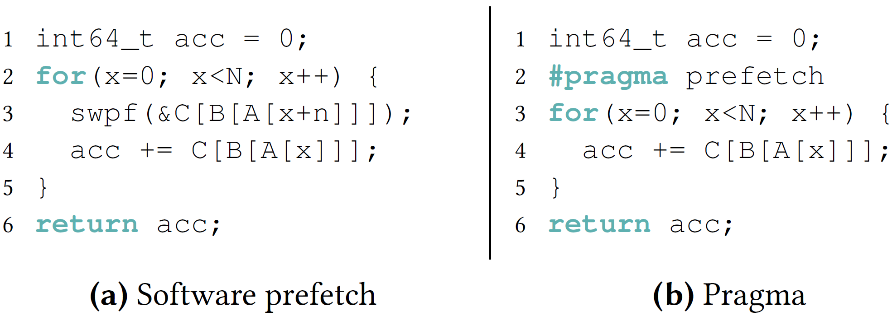
Compiler Assistance
Prefetcher can be integrated manually
Automated integration through two passes:
Software prefetch conversion
Loop pragmas

Slide 20
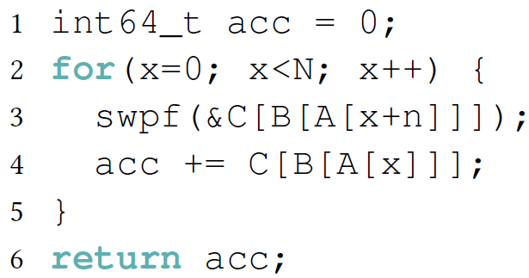
Software Prefetch Example Program
1: alloc A, sizea
2: alloc B, sizeb
3: alloc C, sizec

Slide 21
Software Prefetch Example Program
1: alloc A, sizea
2: alloc B, sizeb
3: alloc C, sizec
4: mov acc, #0
5: mov x, #0
6: cmp x, N
7: beq 19

Slide 22
Software Prefetch Example Program
1: alloc A, sizea
2: alloc B, sizeb
3: alloc C, sizec
4: mov acc, #0
5: mov x, #0
6: cmp x, N
7: beq 19
8: phi v0, x, v6
9: add v1, v0, #128
10: load v2, v1(A)
11: lshift v3, v2, #3
12: load v4, v3(B)
13: lshift v5, v4, #3
14: prefetch v5(C)

Slide 23
Software Prefetch Example Program
1: alloc A, sizea
2: alloc B, sizeb
3: alloc C, sizec
4: mov acc, #0
5: mov x, #0
6: cmp x, N
7: beq 19
8: phi v0, x, v6
9: add v1, v0, #128
10: load v2, v1(A)
11: lshift v3, v2, #3
12: load v4, v3(B)
13: lshift v5, v4, #3
14: prefetch v5(C)
15: ...
16: add v6, v0, #1
17: cmp v6, v0, #1
18: bne 8
19: return acc

Slide 24
Software Prefetch Conversion
1: alloc A, sizea
2: alloc B, sizeb
3: alloc C, sizec
4: mov acc, #0
5: mov x, #0
6: cmp x, N
7: beq 19
8: phi v0, x, v6
9: add v1, v0, #128
10: load v2, v1(A)
11: lshift v3, v2, #3
12: load v4, v3(B)
13: lshift v5, v4, #3
14: prefetch v5(C)
15: ...
16: add v6, v0, #1
17: cmp v6, v0, #1
18: bne 8

Slide 25
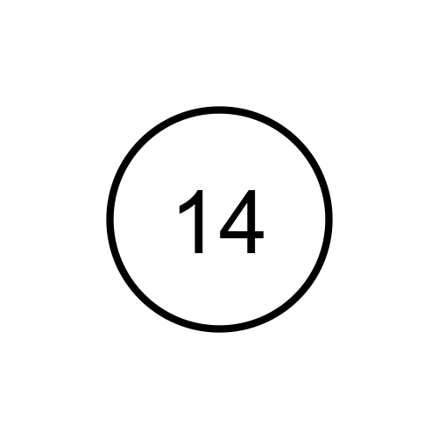
Software Prefetch Conversion
1: alloc A, sizea
2: alloc B, sizeb
3: alloc C, sizec
4: mov acc, #0
5: mov x, #0
6: cmp x, N
7: beq 19
8: phi v0, x, v6
9: add v1, v0, #128
10: load v2, v1(A)
11: lshift v3, v2, #3
12: load v4, v3(B)
13: lshift v5, v4, #3
14: prefetch v5(C)
15: ...
16: add v6, v0, #1
17: cmp v6, v0, #1
18: bne 8
Prefetch is root of dependency graph

Slide 26
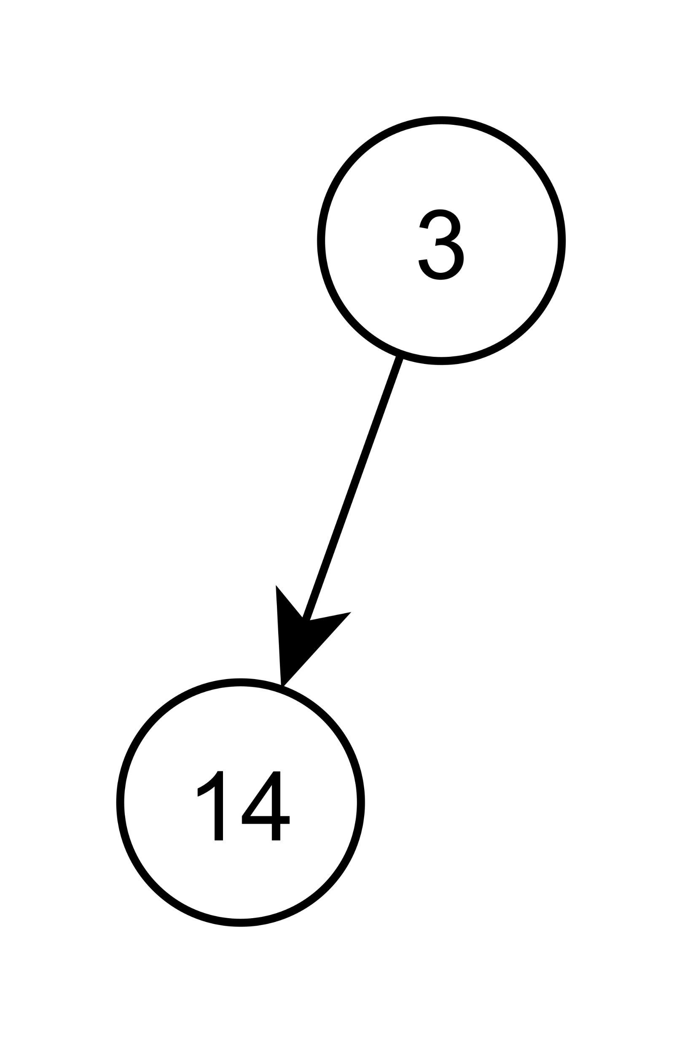
Software Prefetch Conversion
1: alloc A, sizea
2: alloc B, sizeb
3: alloc C, sizec
4: mov acc, #0
5: mov x, #0
6: cmp x, N
7: beq 19
8: phi v0, x, v6
9: add v1, v0, #128
10: load v2, v1(A)
11: lshift v3, v2, #3
12: load v4, v3(B)
13: lshift v5, v4, #3
14: prefetch v5(C)
15: ...
16: add v6, v0, #1
17: cmp v6, v0, #1
18: bne 8
Loop-invariant, stop
(constant)
C

Slide 27
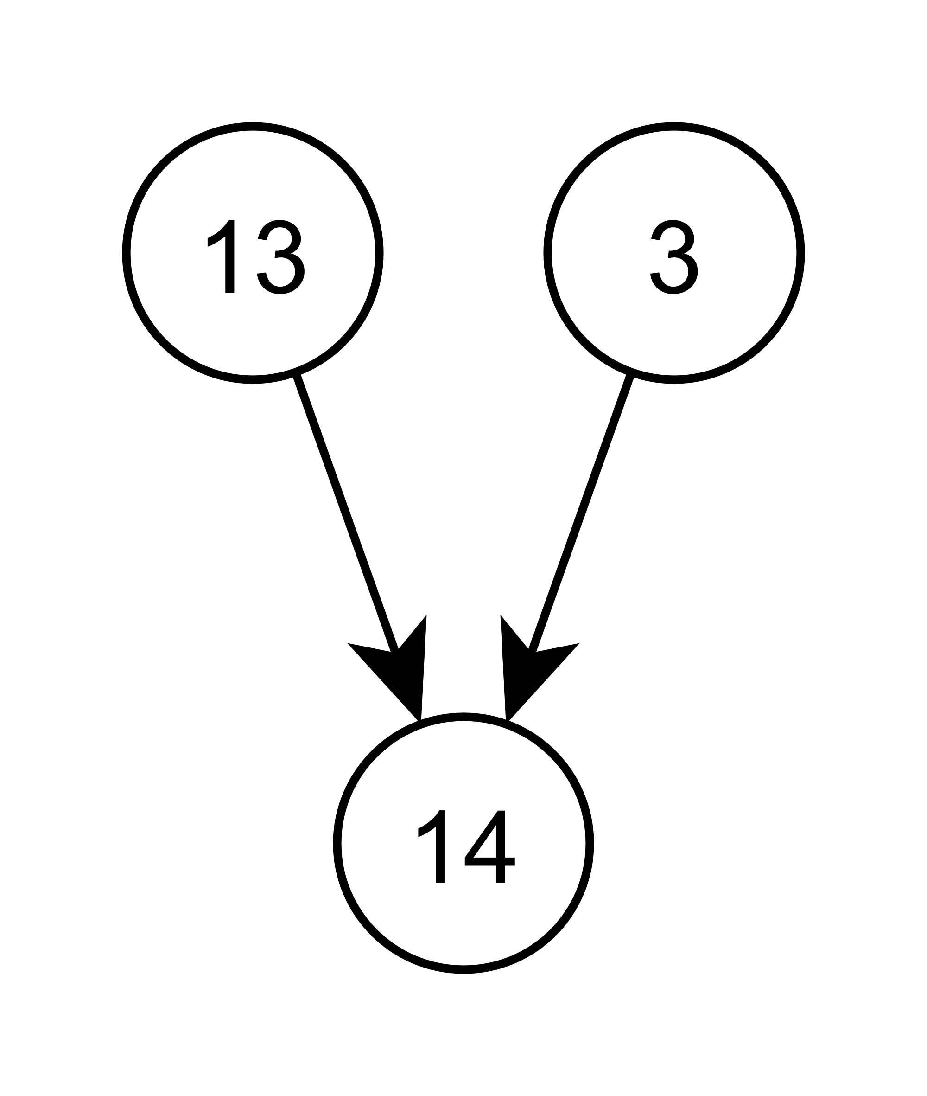
Software Prefetch Conversion
1: alloc A, sizea
2: alloc B, sizeb
3: alloc C, sizec
4: mov acc, #0
5: mov x, #0
6: cmp x, N
7: beq 19
8: phi v0, x, v6
9: add v1, v0, #128
10: load v2, v1(A)
11: lshift v3, v2, #3
12: load v4, v3(B)
13: lshift v5, v4, #3
14: prefetch v5(C)
15: ...
16: add v6, v0, #1
17: cmp v6, v0, #1
18: bne 8
v5
C

Slide 28
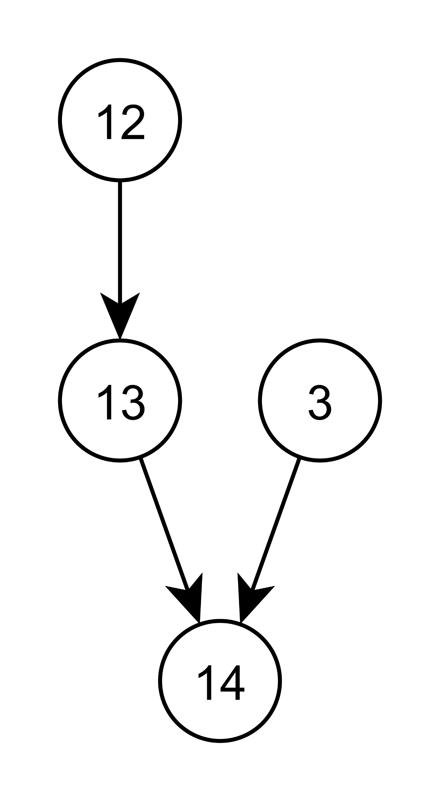
Software Prefetch Conversion
1: alloc A, sizea
2: alloc B, sizeb
3: alloc C, sizec
4: mov acc, #0
5: mov x, #0
6: cmp x, N
7: beq 19
8: phi v0, x, v6
9: add v1, v0, #128
10: load v2, v1(A)
11: lshift v3, v2, #3
12: load v4, v3(B)
13: lshift v5, v4, #3
14: prefetch v5(C)
15: ...
16: add v6, v0, #1
17: cmp v6, v0, #1
18: bne 8
Loop-variant load, stop
(will be prefetched)
v4
v5
C

Slide 29
Software Prefetch Conversion
1: alloc A, sizea
2: alloc B, sizeb
3: alloc C, sizec
4: mov acc, #0
5: mov x, #0
6: cmp x, N
7: beq 19
8: phi v0, x, v6
9: add v1, v0, #128
10: load v2, v1(A)
11: lshift v3, v2, #3
12: load v4, v3(B)
13: lshift v5, v4, #3
14: prefetch v5(C)
15: ...
16: add v6, v0, #1
17: cmp v6, v0, #1
18: bne 8
Will run when B’s prefetch completes
// on_B_prefetch()
1: lshift offset, bVal, #3
2: prefetch fetch

Slide 30
Software Prefetch Conversion
Address Table
1: alloc A, sizea
2: alloc B, sizeb
3: alloc C, sizec
4: mov acc, #0
5: mov x, #0
6: cmp x, N
7: beq 19
8: phi v0, x, v6
9: add v1, v0, #128
10: load v2, v1(A)
11: lshift v3, v2, #3
12: load v4, v3(B)
13: lshift v5, v4, #3
14: prefetch v5(C)
15: ...
16: add v6, v0, #1
17: cmp v6, v0, #1
18: bne 8
Index | Base | End | Load Ptr | PF Ptr
1 | B | B+sizeb | 0 | &on_B_prefetch
Triggering event’s data placed in a local register when scheduled
// on_B_prefetch()
1: get_data bVal
2: lshift offset, bVal, #3
3: prefetch fetch

Slide 31
Software Prefetch Conversion
Address Table
1: alloc A, sizea
2: alloc B, sizeb
3: alloc C, sizec
4: mov acc, #0
5: mov x, #0
6: cmp x, N
7: beq 19
8: phi v0, x, v6
9: add v1, v0, #128
10: load v2, v1(A)
11: lshift v3, v2, #3
12: load v4, v3(B)
13: lshift v5, v4, #3
14: prefetch v5(C)
15: ...
16: add v6, v0, #1
17: cmp v6, v0, #1
18: bne 8
Index | Base | End | Load Ptr | PF Ptr
1 | B | B+sizeb | 0 | &on_B_prefetch
2 | C | C+sizec | 0 | 0
// on_B_prefetch()
1: get_data bVal
2: get_base base, #2
3: lshift offset, bVal, #3
4: add fetch, base, offset
5: prefetch fetch

Slide 32
Software Prefetch Conversion
Address Table
1: alloc A, sizea
2: alloc B, sizeb
3: alloc C, sizec
4: mov acc, #0
5: mov x, #0
6: cmp x, N
7: beq 19
8: phi v0, x, v6
9: add v1, v0, #128
10: load v2, v1(A)
11: lshift v3, v2, #3
12: load v4, v3(B)
13: lshift v5, v4, #3
14: prefetch v5(C)
15: ...
16: add v6, v0, #1
17: cmp v6, v0, #1
18: bne 8
Index | Base | End | Load Ptr | PF Ptr
1 | B | B+sizeb | 0 | &on_B_prefetch
2 | C | C+sizec | 0 | 0
// on_B_prefetch()
1: get_data bVal
2: get_base base, #2
3: lshift offset, bVal, #3
4: add fetch, base, offset
5: prefetch fetch
Process repeats for
B’s load… then A’s load…

Slide 33
Software Prefetch Conversion
Address Table
Index | Base | End | Load Ptr | PF Ptr
0 | A | A+sizea | &on_A_load | &on_A_prefetch
1 | B | B+sizeb | 0 | &on_B_prefetch
2 | C | C+sizec | 0 | 0

Slide 34
Software Prefetch Conversion
1: alloc A, sizea
2: alloc B, sizeb
3: alloc C, sizec
4: mov acc, #0
5: mov x, #0
6: cmp x, N
7: beq 19
// config_addr_tbl 0
// config_addr_tbl 1
// config_addr_tbl 2
8: phi v0, x, v6
9: add v1, v0, #128
10: load v2, v1(A)
11: lshift v3, v2, #3
12: load v4, v3(B)
13: lshift v5, v4, #3
14: prefetch v5(C)
15: ... // Load value, update acc
...
Address Table
Index | Base | End | Load Ptr | PF Ptr
0 | A | A+sizea | &on_A_load | &on_A_prefetch
1 | B | B+sizeb | 0 | &on_B_prefetch
2 | C | C+sizec | 0 | 0
Load address table into address filter unit
Software prefetch code is now unneeded, remove it

Slide 35
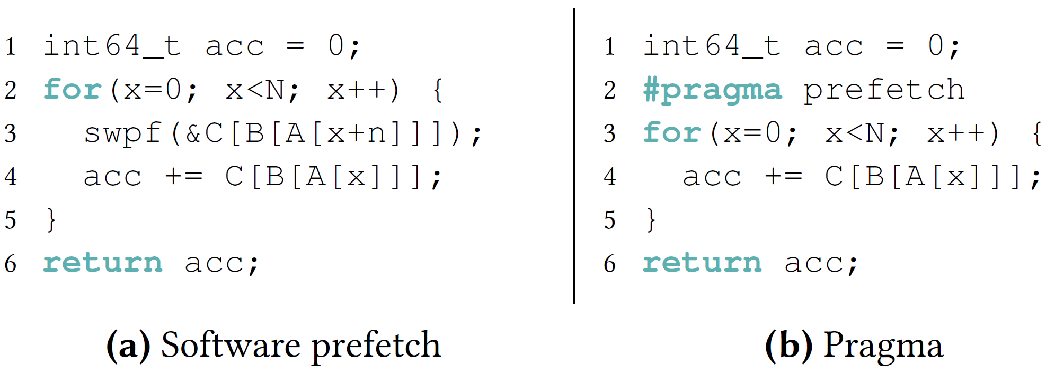
Loop Pragmas
Label loops with a pragma directive
Runs SPC-like pass on each load
More convenient for the programmer

Slide 36
OS Support
OS only sees prefetcher’s context switching state
Global PPU registers (loop-invariant values)
Address table
(All other state is discarded)

Slide 37
OS Support
OS only sees prefetcher’s context switching state
Global PPU registers (loop-invariant values)
Address table
(All other state is discarded)
PPU faults terminate their execution

Slide 38
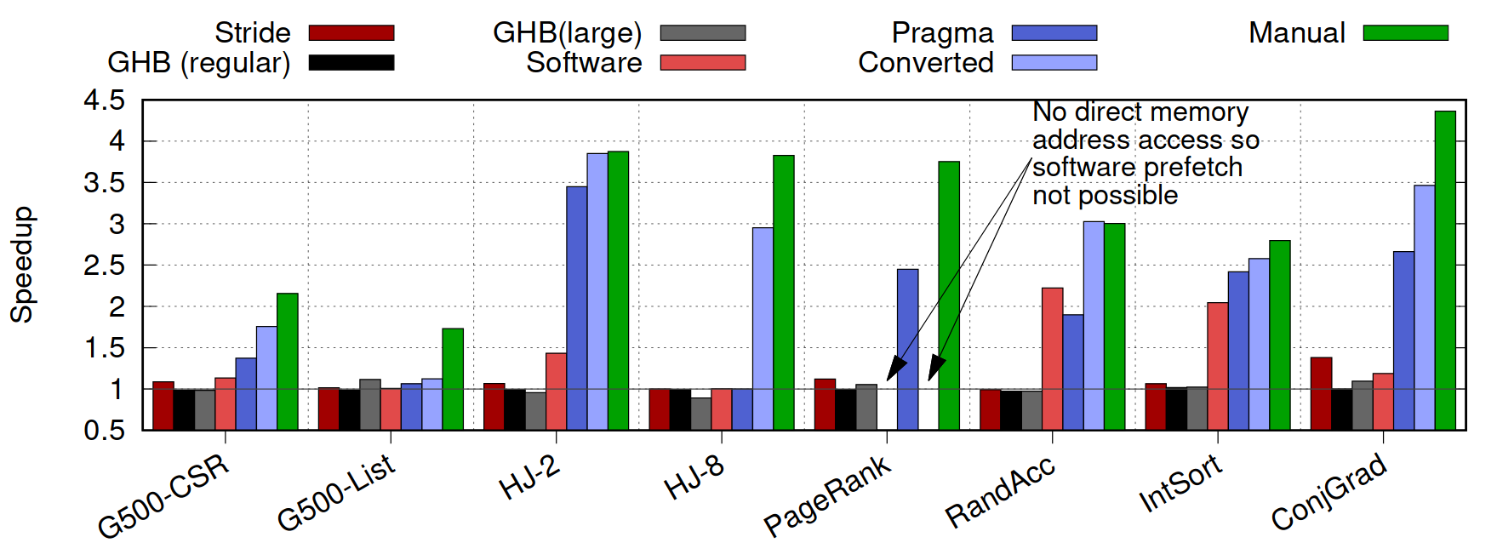
Evaluation Results: Speedup
Notes:
Simulated OoO ARMv8 core in gem5 (running Linux)
Compared programmable prefetcher performance to:
No prefetching (baseline)
Stride prefetcher
Markov global history buffer prefetcher
2,048 entries
67,108,864 entries
Used several memory-bound benchmarks
Note manual > spc > pragma
-All but G500: >~80% L1 prefetches utilized before eviction
-Speedup as L1 cache hit rates have increased (~2x increase)

Slide 39
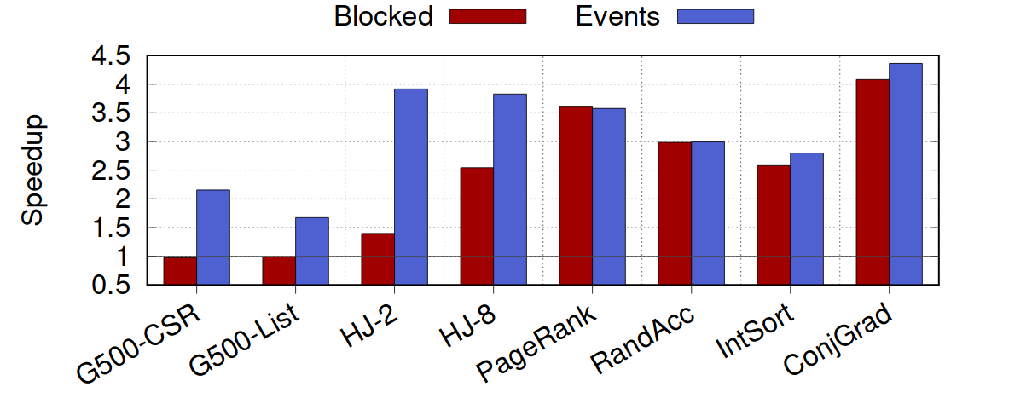
Analysis: Blocking Intermediate Loads

Slide 40
Discussion
Presented a programmable, event-driven prefetcher
Provided compiler techniques to automate utilization
Demonstrated average speedups of 3x in memory-bound benchmarks
Small hardware footprint, ~3% area overhead on a Cortex A57
Must be targeted during software development to be useful
Compiler passes could be improved to close the gap with manual
Large amount of hidden state may hinder tuning

Slide 41
Q/A
Thank you!

Slide 42
Backup Slides
42

Slide 43
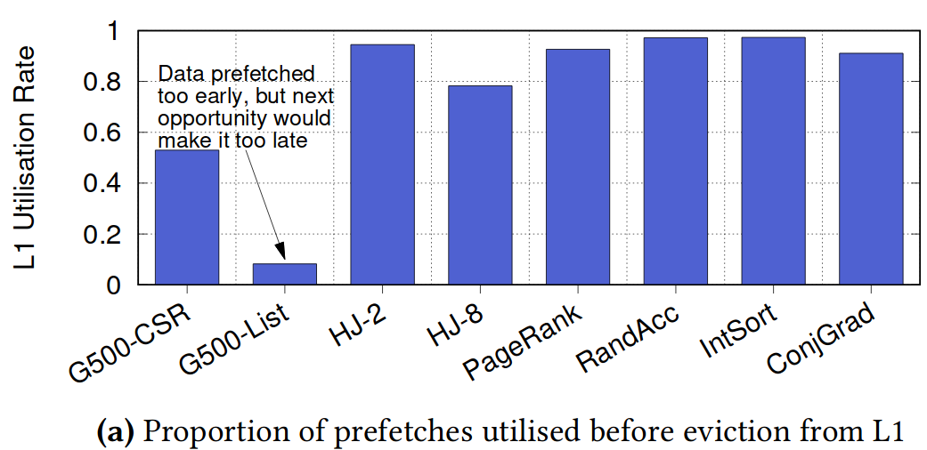
Evaluation: L1 Evictions

Slide 44
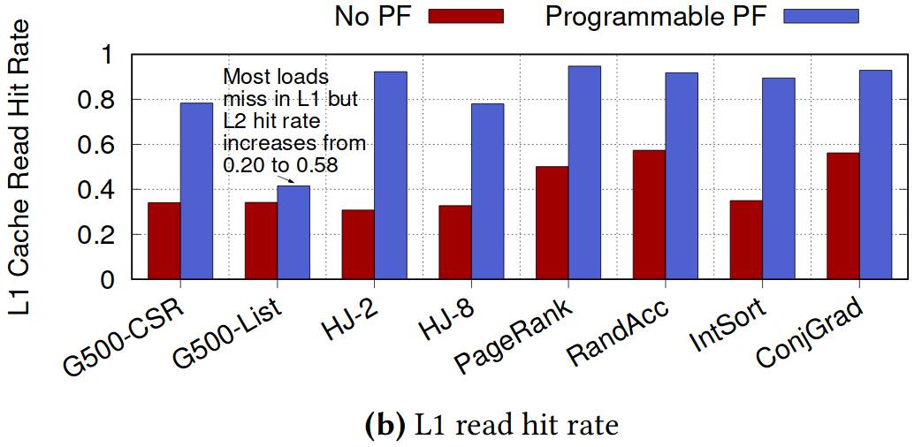
Evaluation: L1 Hit Rate

Slide 45
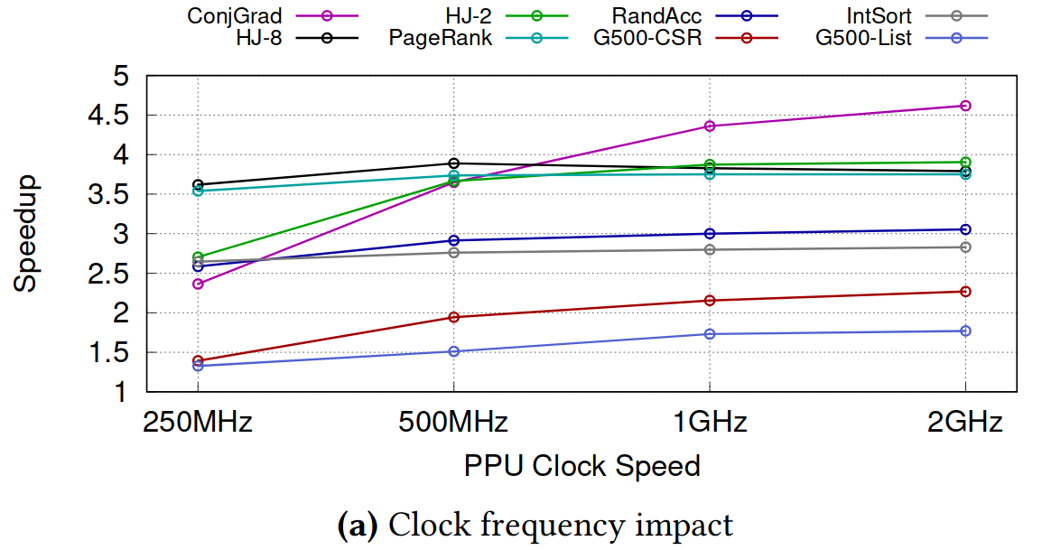
Analysis: PPU Frequency

Slide 46
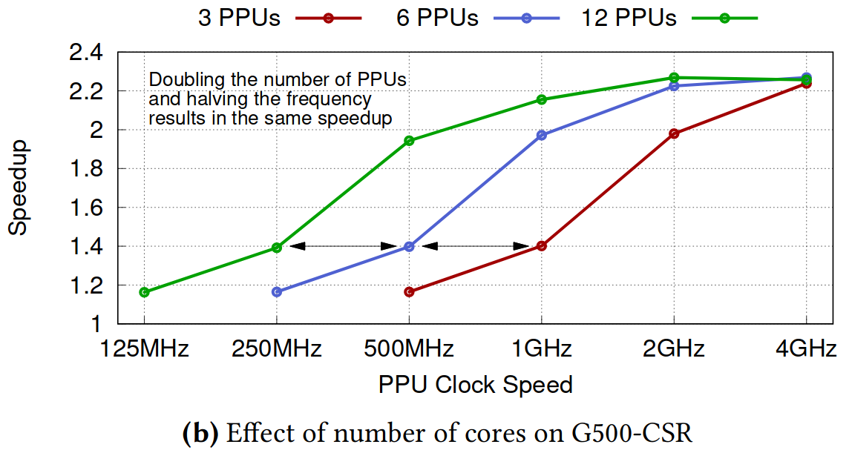
Analysis: PPU Count

Slide 47
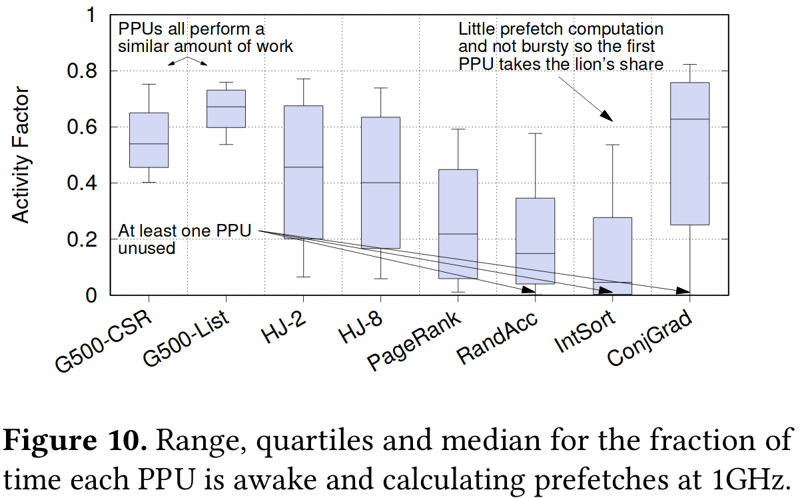
Analysis: PPU Utilization

