Slide 1
Optimization and (Under/over)fitting
EECS 442 – Prof. David Fouhey
Winter 2019, University of Michigan
http://web.eecs.umich.edu/~fouhey/teaching/EECS442_W19/

Slide 2
Administrivia
We’re grading HW2 and will try to get it back ASAP
Midterm next week
Review sessions next week (go to whichever you want)
We will post priorities from slides
There’s a post on piazza looking for topics you want reviewed

Slide 3
Previously

Slide 4
Regularized Least Squares
Add regularization to objective that prefers some solutions:
Before:
$$\arg{\min_{w}{{\left\|y−Xw\right\|}_{2}^{2}}}$$
Loss
After:
$$\arg{\min_{w}{{\left\|y−Xw\right\|}_{2}^{2}+λ{\left\|w\right\|}_{2}^{2}}}$$
Loss
Trade-off
Regularization
Want model “smaller”: pay a penalty for w with big norm
Intuitive Objective: accurate model (low loss) but not too complex (low regularization). λ controls how much of each.

Slide 5
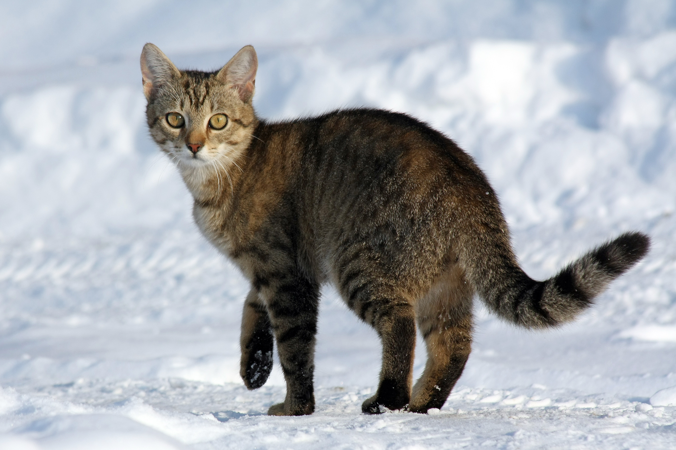
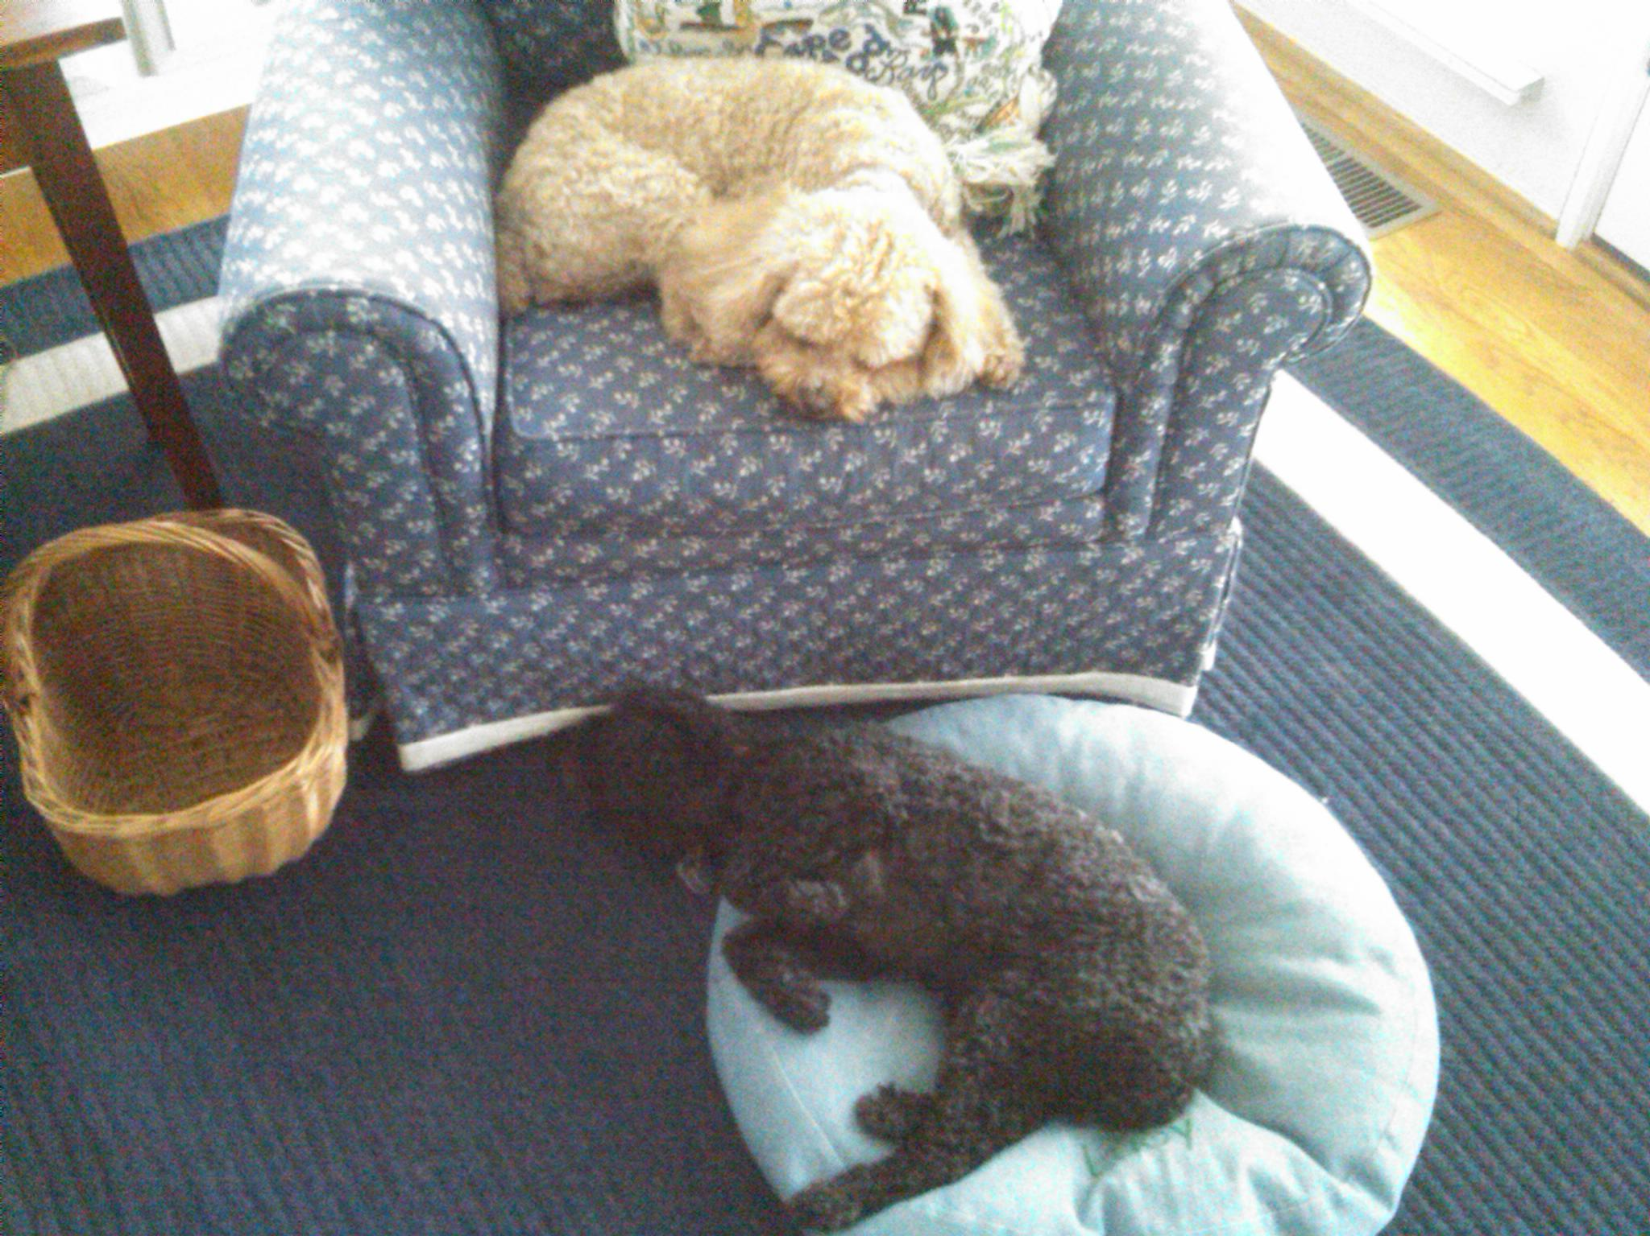
Nearest Neighbors
Known Images
Labels
Test
Image
$$x_{1}$$
$$D(x_{1},x_{T})$$
$$x_{T}$$
Cat
Cat!
…
$$D(x_{N},x_{T})$$
(1) Compute distance between feature vectors (2) find nearest (3) use label.
$$x_{N}$$
Dog

Slide 6
Picking Parameters
What distance? What value for k / λ?
Training
Validation
Test
Use these data
points for lookup
Evaluate on these points for different k, λ, distances

Slide 7
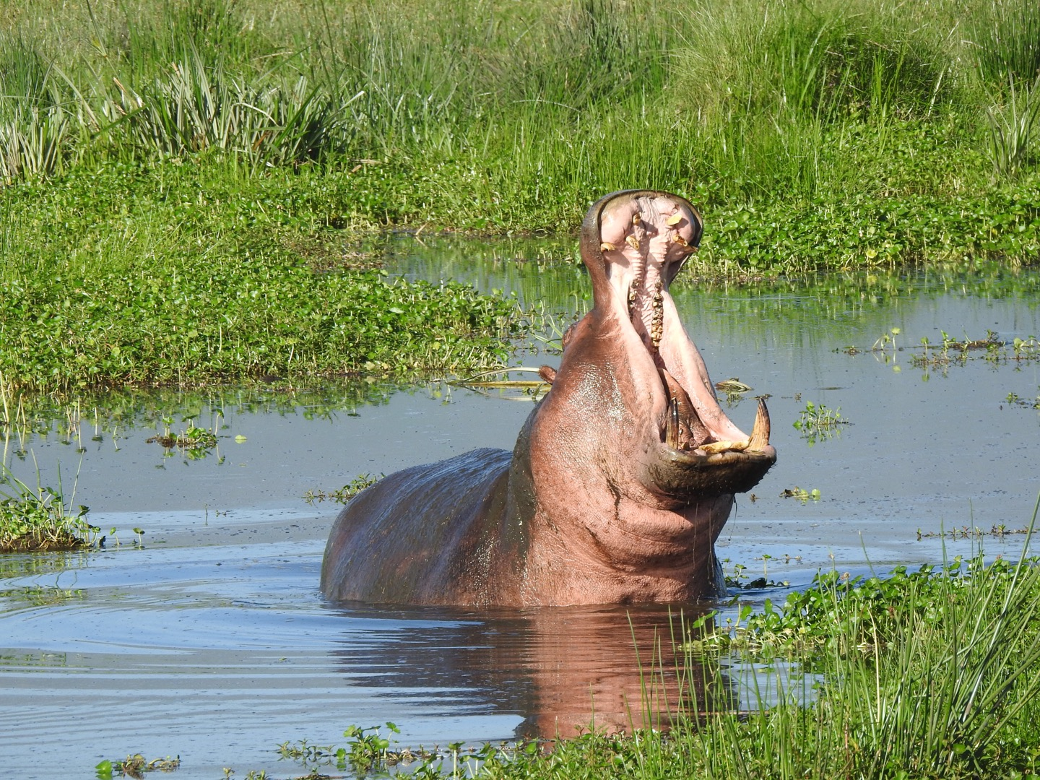
Linear Models
Example Setup: 3 classes
Model – one weight per class:
$$w_{0},w_{1}, w_{2}$$
$$w_{0}^{T}x$$
big if cat
Want:
$$w_{1}^{T}x$$
big if dog
$$w_{2}^{T}x$$
big if hippo
Stack together:
$$W_{3xF}$$
where x is in R^{F}

Slide 8
Linear Models
Cat weight vector
0.2
-0.5
0.1
2.0
1.1
56
-96.8
Cat score
Dog weight vector
1.5
1.3
2.1
0.0
3.2
231
437.9
Dog score
Hippo weight vector
0.0
0.3
0.2
-0.3
-1.2
24
61.95
Hippo score
2
$$W$$
$$Wx_{i}$$
1
Weight matrix a collection of scoring functions, one per class
Prediction is vector where jth component is “score” for jth class.
$$x_{i}$$
Diagram by: Karpathy, Fei-Fei

Slide 9
Objective 1: Multiclass SVM
(Take the class whose weight vector gives the highest score)
Inference (x,y):
$$\arg{\max_{k}{ }{\left(Wx\right)}_{k}}$$
Training (x_{i},y_{i}):
$$\arg{\min_{W}{λ{\left\|W\right\|}_{2}^{2}+ \sum_{i=1}^{n}{\sum_{j ≠y_{i}}{\max{{\left(0,(Wx_{i}\right)}_{j}−{\left(Wx_{i}\right)}_{y_{i}}+m)}}}}}$$
Regularization
Pay no penalty if prediction for class y_{i} is bigger than j by m (“margin”). Otherwise, pay proportional to the score of the wrong class.
Over all data points
For every class j that’s NOT the correct one (y_{i})

Slide 10
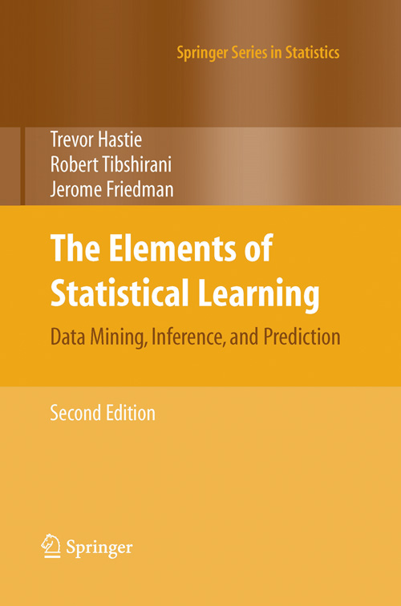
Objective 1:
Called: Support Vector Machine
Lots of great theory as to why this is a sensible thing to do. See
Useful book (Free too!):
The Elements of Statistical Learning
Hastie, Tibshirani, Friedman https://web.stanford.edu/~hastie/ElemStatLearn/

Slide 11
Objective 2: Making Probabilities
Converting Scores to “Probability Distribution”
Cat score
-0.9
e^{-0.9}
0.41
0.11
P(cat)
Dog score
0.4
exp(x)
e^{0.4}
1.49
Norm
0.40
P(dog)
Hippo score
0.6
e^{0.6}
1.82
0.49
P(hippo)
∑=3.72
$$\frac{\exp{{\left((Wx\right)}_{j})}}{\sum_{k}{\exp{({\left(Wx\right)}_{k})}}}$$
Generally P(class j):
Called softmax function
Inspired by: Karpathy, Fei-Fei

Slide 12
Objective 2: Softmax
(Take the class whose weight vector gives the highest score)
Inference (x):
$$\arg{\max_{k}{ }{\left(Wx\right)}_{k}}$$
$$\frac{\exp{{\left((Wx\right)}_{j})}}{\sum_{k}{\exp{({\left(Wx\right)}_{k})}}}$$
P(class j):
Why can we skip the exp/sum exp
thing to make a decision?

Slide 13
Objective 2: Softmax
(Take the class whose weight vector gives the highest score)
Inference (x):
$$\arg{\max_{k}{ }{\left(Wx\right)}_{k}}$$
Training (x_{i},y_{i}):
P(correct class)
$$\arg{\min_{W}{λ{\left\|W\right\|}_{2}^{2}+ \sum_{i=1}^{n}{−\log\left(\frac{\exp{({\left(Wx\right)}_{y_{i}})}}{\sum_{k}{exp⁡({\left(Wx\right)}_{k}))}}\right)}}}$$
Regularization
Over all data points
Pay penalty for not making correct class likely.
“Negative log-likelihood”

Slide 14
Today
Optimizing things
Time permitting:
(Under/over)fitting or (Bias/Variance)
(Not on the exam)

Slide 15
How Do We Optimize Things?
Goal: find the w minimizing some loss function L.
$$\arg{\min_{w∈R^{N}}{L(w)}}$$
$${L\left(W\right)={λ{\left\|W\right\|}_{2}^{2}+ \sum_{i=1}^{n}{−\log\left(\frac{\exp{({\left(Wx\right)}_{y_{i}})}}{\sum_{k}{exp⁡({\left(Wx\right)}_{k}))}}\right)}}}$$
Works for lots of different Ls:
$$L(w){={λ{\left\|w\right\|}_{2}^{2}+ \sum_{i=1}^{n}{{\left(y_{i}−w^{T}x_{i}\right)}^{2}}}}$$
$$L\left(w\right)={C{\left\|w\right\|}_{2}^{2}+\sum_{i=1}^{n}{max⁡\left(0,1−y_{i}w^{T}x_{i}\right)}}$$

Slide 16
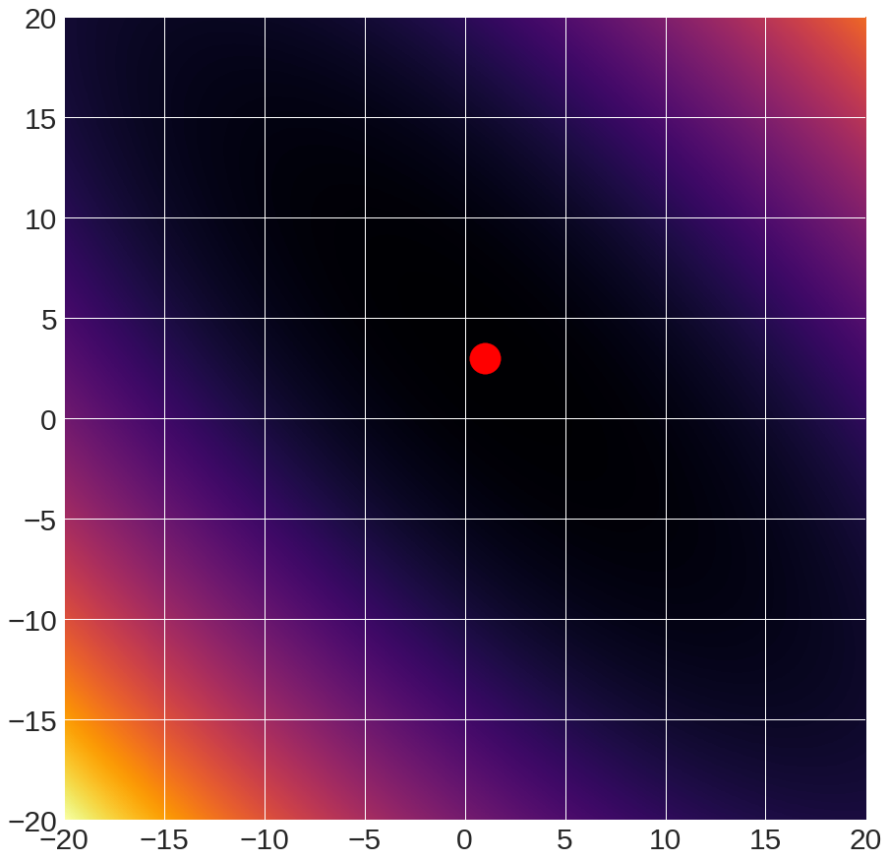
Sample Function to Optimize
f(x,y) = (x+2y-7)² + (2x+y-5)²
Global minimum

Slide 17
Sample Function to Optimize
I’ll switch back and forth between this 2D function (called the Booth Function) and other more-learning-focused functions
Beauty of optimization is that it’s all the same in principle
But don’t draw too many conclusions: 2D space has qualitative differences from 1000D space
See intro of: Dauphin et al. Identifying and attacking the saddle point problem in high-dimensional non-convex optimization NIPS 2014
https://ganguli-gang.stanford.edu/pdf/14.SaddlePoint.NIPS.pdf

Slide 18
A Caveat
Each point in the picture is a function evaluation
Here it takes microseconds – so we can easily see the answer
Functions we want to optimize may take hours to evaluate

Slide 19
A Few Caveat
Model in your head: moving around a landscape with a teleportation device
20
-20
-20
20
Landscape diagram: Karpathy and Fei-Fei

Slide 20
Option #1A – Grid Search
#systematically try things
best, bestScore = None, Inf
for dim1Value in dim1Values:
….
for dimNValue in dimNValues:
w = [dim1Value, …, dimNValue]
if L(w) < bestScore:
best, bestScore = w, L(w)
return best

Slide 21
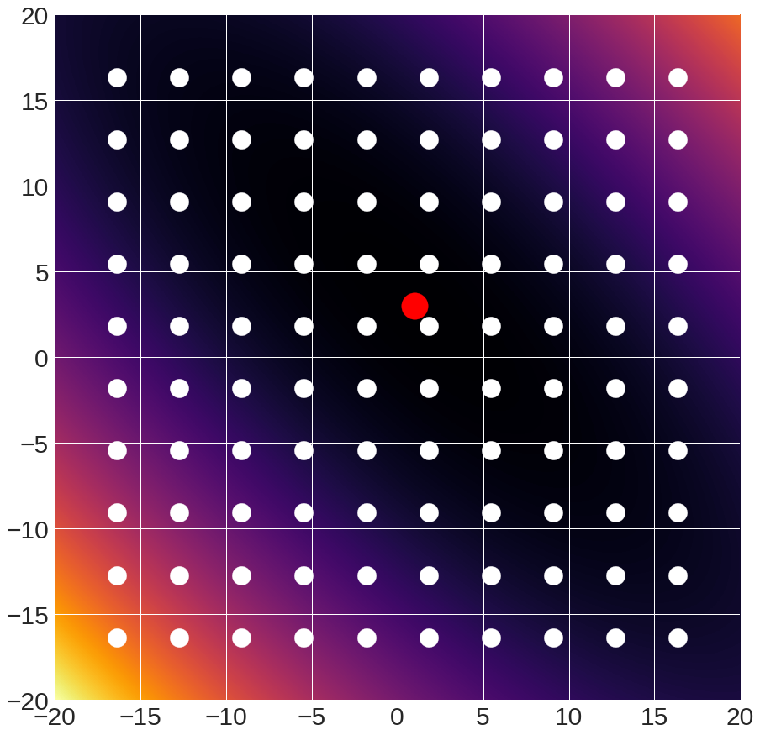
Option #1A – Grid Search

Slide 22
Option #1A – “Grid Search”
Pros:
Super simple
Only requires being able to evaluate model
Cons:
Scales horribly to high dimensional spaces
Complexity: samplesPerDim^{numberOfDims}

Slide 23
Option #1B – Random Search
#Do random stuff RANSAC Style
best, bestScore = None, Inf
for iter in range(numIters):
w = random(N,1) #sample
score = $L\left(w\right)$ #evaluate
if score < bestScore:
best, bestScore = w, score
return best

Slide 24
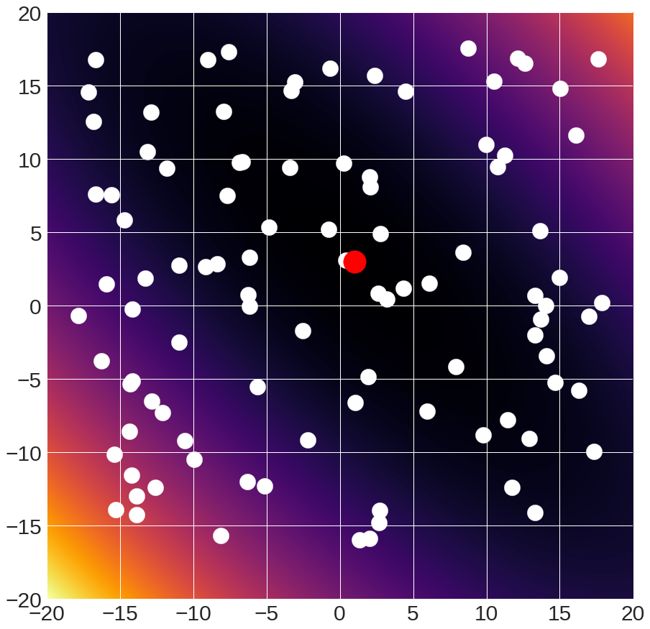
Option #1B – Random Search

Slide 25
Option #1B – Random Search
Pros:
Super simple
Only requires being able to sample model and evaluate it
Cons:
Slow and stupid –throwing darts at high dimensional dart board
Might miss something
P(all correct) =
ε^{N}
ε
Good parameters
All parameters
0
1

Slide 26
When Do You Use Options 1A/1B?
Use these when
Number of dimensions small, space bounded
Objective is impossible to analyze (e.g., test accuracy if we use this distance function)
Random search is arguably more effective; grid search makes it easy to systematically test something (people love certainty)

Slide 27
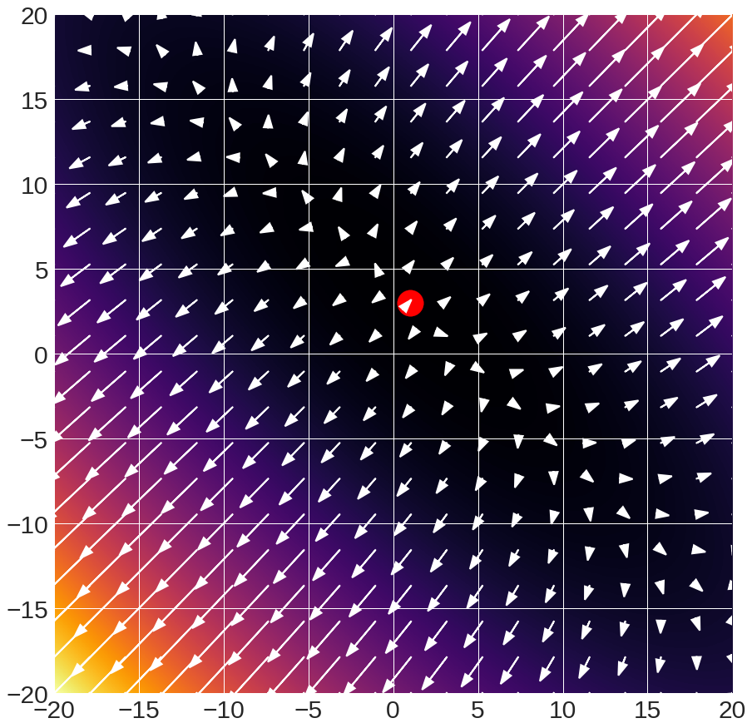
Option 2 – Use The Gradient
Arrows:
gradient

Slide 28
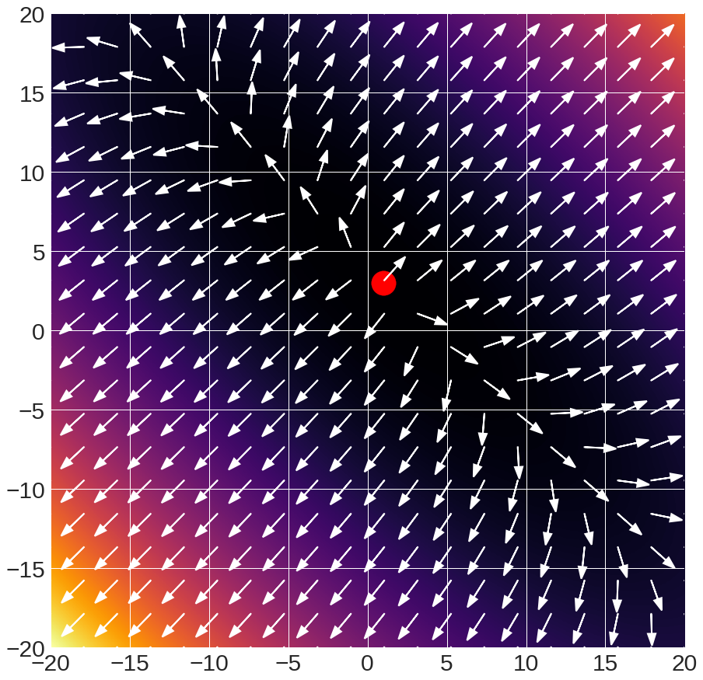
Option 2 – Use The Gradient
Arrows:
gradient direction
(scaled to unit length)

Slide 29
Option 2 – Use The Gradient
Want:
$$\arg{\min_{w}{L(w)}}$$
$$∇_{w}L\left(w\right)=\left[\begin{matrix}∂L/∂x_{1} \\ ⋮ \\ ∂L/∂x_{N}\end{matrix}\right]$$
What’s the geometric interpretation of:
Which is bigger (for small α)?
$$≤?$$
$$L\left(w\right)$$
$$L\left(w+{α∇}_{w}L(w)\right)$$
$$>?$$

Slide 30
Option 2 – Use The Gradient
Arrows:
gradient direction
(scaled to unit length)
$$x$$
$$x+α∇_{ }$$

Slide 31
Option 2 – Use The Gradient
Method: at each step, move in direction of negative gradient
w0 = initialize() #initialize
for iter in range(numIters):
g = $∇_{w}L\left(w\right)$ #eval gradient
w = w + -stepsize(iter)*g #update w
return w

Slide 32
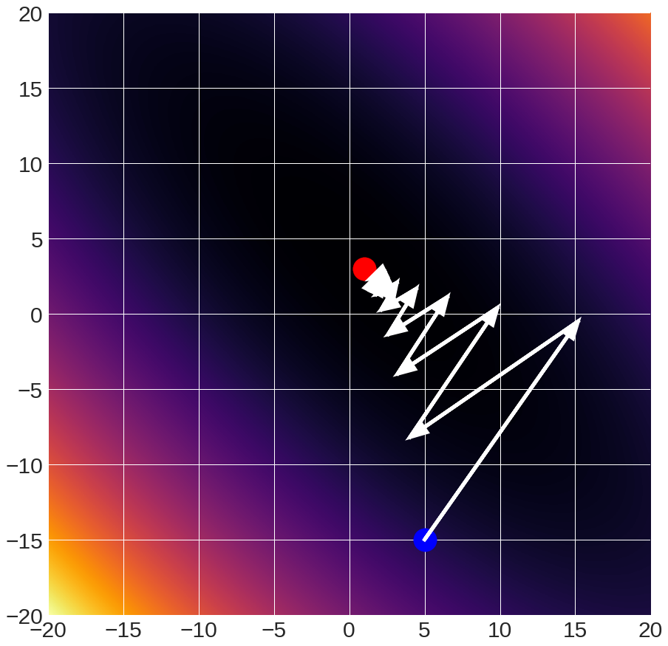
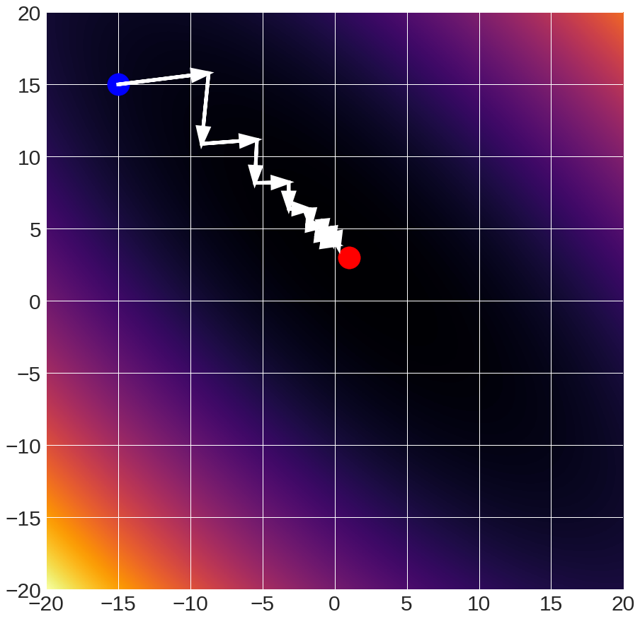
Gradient Descent
Given starting point (blue)
w_{i+1} = w_{i} + -9.8x10⁻² x gradient

Slide 33
Computing the Gradient
How Do You Compute The Gradient?
Numerical Method:
How do you compute this?
$$∇_{w}L\left(w\right)=\left[\begin{matrix}\frac{∂L(w)}{∂x_{1}} \\ ⋮ \\ \frac{∂L(w)}{∂x_{n}}\end{matrix}\right]$$
$$\frac{∂f(x)}{∂x}=\lim_{ε→0}{\frac{f\left(x+ε\right)−f(x)}{ε}}$$
In practice, use:
$$\frac{f\left(x+ε\right)−f\left(x−ε\right)}{2ε}$$

Slide 34
Computing the Gradient
How Do You Compute The Gradient?
Numerical Method:
Use:
$$\frac{f\left(x+ε\right)−f\left(x−ε\right)}{2ε}$$
$$∇_{w}L\left(w\right)=\left[\begin{matrix}\frac{∂L(w)}{∂x_{1}} \\ ⋮ \\ \frac{∂L(w)}{∂x_{n}}\end{matrix}\right]$$
How many function
evaluations per dimension?

Slide 35
Computing the Gradient
How Do You Compute The Gradient?
Analytical Method:
$$∇_{w}L\left(w\right)=\left[\begin{matrix}\frac{∂L(w)}{∂x_{1}} \\ ⋮ \\ \frac{∂L(w)}{∂x_{n}}\end{matrix}\right]$$
Use calculus!

Slide 36
Computing the Gradient
$$L(w){={λ{\left\|w\right\|}_{2}^{2}+ \sum_{i=1}^{n}{{\left(y_{i}−w^{T}x_{i}\right)}^{2}}}}$$
$$\frac{∂}{∂w}$$
$$∇_{w}L(w)= 2λw+\sum_{i=1}^{n}{−\left(2\left(y_{i}−w^{T}x_{i}\right)x_{i}\right)}$$
Note: if you look at other derivations, things are written either (y-w^{T}x) or (w^{T}x – y); the gradients will differ by a minus.

Slide 37
Interpreting the Gradient
Recall:
w = w + -$∇_{w}L\left(w\right)$ #update w
$$∇_{w}L(w)= 2λw+\sum_{i=1}^{n}{−\left(2\left(y_{i}−w^{T}x_{i}\right)x_{i}\right)}$$
α
Push w towards 0
$${−∇}_{w}L\left(w\right)=−2λw+\sum_{i=1}^{n}{\left(2\left(y_{i}−w^{T}x_{i}\right)x_{i}\right)}$$
If y_{i} > w^{T}x_{i} (too low): then w = w + αx_{i} for some α
Before: w^{T}x
After: (w+ αx)^{T}x = w^{T}x + αx^{T}x

Slide 38
Quick annoying detail: subgradients
What is the derivative of |x|?
|x|
Derivatives/Gradients
Defined everywhere but 0
$$\frac{∂}{∂x}f\left(x\right)=sign(x)$$
$$x ≠0$$
undefined
$$x=0$$
Oh no! A discontinuity!

Slide 39
Quick annoying detail: subgradients
Subgradient: any underestimate of function
|x|
Subderivatives/subgradients
Defined everywhere
$$\frac{∂}{∂x}f\left(x\right)=sign(x)$$
$$x ≠0$$
$$\frac{∂}{∂x}f\left(x\right)∈[−1,1]$$
$$x=0$$
In practice: at discontinuity, pick value on either side.

Slide 40
Let’s Compute Another Gradient

Slide 41
Computing The Gradient
Multiclass Support Vector Machine
$$\arg{\min_{W}{λ{\left\|W\right\|}_{2}^{2}+ \sum_{i=1}^{n}{\sum_{j ≠y_{i}}{\max{{\left(0,(Wx_{i}\right)}_{j}−{\left(Wx_{i}\right)}_{y_{i}}+m)}}}}}$$
Notation:
W → rows w_{i} (i.e., per-class scorer)
(Wx_{i})_{j} → w_{j}^{T}x_{i}
$$\arg{\min_{W}{λ\sum_{j=1}^{K}{{\left\|w_{j}\right\|}_{2}^{2}}+ \sum_{i=1}^{n}{\sum_{j ≠y_{i}}{max⁡(0,w_{j}^{T}x_{i}−w_{y_{i}}^{T}x_{i}+m)}}}}$$
Derivation setup: Karpathy and Fei-Fei

Slide 42
Computing The Gradient
$$\arg{\min_{W}{λ\sum_{j=1}^{K}{{\left\|w_{j}\right\|}_{2}^{2}}+ \sum_{i=1}^{n}{\sum_{j ≠y_{i}}{max⁡(0,w_{j}^{T}x_{i}−w_{y_{i}}^{T}x_{i}+m)}}}}$$
$$w_{j}^{T}x_{i}−w_{y_{i}}^{T}x_{i}+m≤0:$$
$$0$$
$$\frac{∂}{∂w_{j}}:$$
$$w_{j}^{T}x_{i}−w_{y_{i}}^{T}x_{i}+m>0:$$
$$x_{i}$$
$${→1(w}_{j}^{T}x_{i}−w_{y_{i}}^{T}x_{i}+m>0)x_{i}$$
Derivation setup: Karpathy and Fei-Fei

Slide 43
Computing The Gradient
$$\arg{\min_{W}{λ\sum_{j=1}^{K}{{\left\|w_{j}\right\|}_{2}^{2}}+ \sum_{i=1}^{n}{\sum_{j ≠y_{i}}{max⁡(0,w_{j}^{T}x_{i}−w_{y_{i}}^{T}x_{i}+m)}}}}$$
$$\frac{∂}{∂w_{y_{i}}}:$$
$$\sum_{j≠y_{i}}{1\left(w_{j}^{T}x_{i}−w_{y_{i}}^{T}x_{i}+m>0\right)\left(−x_{i}\right)}$$
Derivation setup: Karpathy and Fei-Fei

Slide 44
Interpreting The Gradient
$$−\frac{∂}{∂w_{j}}:$$
$${1(w}_{j}^{T}x_{i}−w_{y_{i}}^{T}x_{i}+m>0){−x}_{i}$$
If we do not predict the correct class by at least a score difference of m …
Want incorrect class’s scoring vector to score that point lower.
Recall:
Before: w^{T}x;
After: (w-αx)^{T}x = w^{T}x - ax^{T}x
Derivation setup: Karpathy and Fei-Fei

Slide 45
Computing The Gradient
Numerical: foolproof but slow
Analytical: can mess things up ☺
In practice: do analytical, but check with numerical (called a gradient check)
Slide: Karpathy and Fei-Fei

Slide 46
Implementing Gradient Descent
Loss is a function that we can
evaluate over data
$${−∇}_{w}L\left(w\right)=−2λw+\sum_{i=1}^{n}{\left(2\left(y_{i}−w^{T}x_{i}\right)x_{i}\right)}$$
All
Data
Subset
B
$${−∇}_{w}L_{B}\left(w\right)=−2λw+\sum_{i∈B}^{ }{\left(2\left(y_{i}−w^{T}x_{i}\right)x_{i}\right)}$$

Slide 47
Implementing Gradient Descent
Option 1: Vanilla Gradient Descent
Compute gradient of L over all data points
for iter in range(numIters):
g = gradient(data,L)
w = w + -stepsize(iter)*g #update w

Slide 48
Implementing Gradient Descent
Option 2: Stochastic Gradient Descent
Compute gradient of L over 1 random sample
for iter in range(numIters):
index = randint(0,#data)
g = gradient(data[index],L)
w = w + -stepsize(iter)*g #update w

Slide 49
Implementing Gradient Descent
Option 3: Minibatch Gradient Descent
Compute gradient of L over subset of B samples
for iter in range(numIters):
subset = choose_samples(#data,B)
g = gradient(data[subset],L)
w = w + -stepsize(iter)*g #update w
Typical batch sizes: ~100

Slide 50
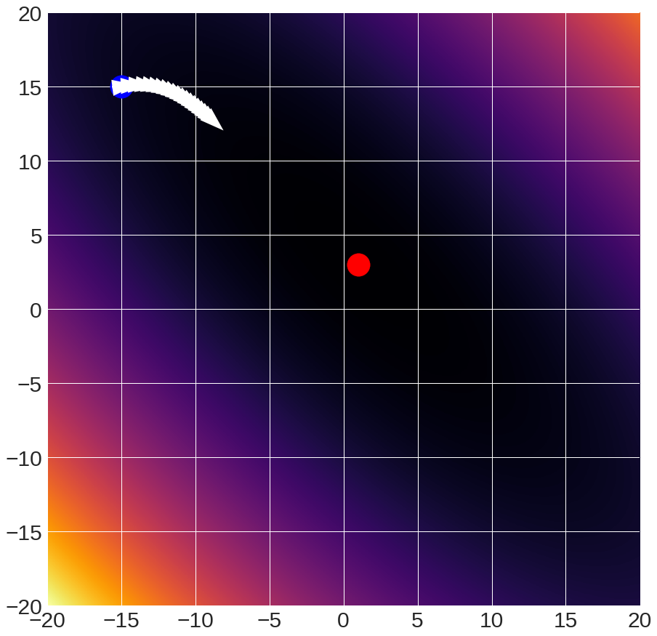
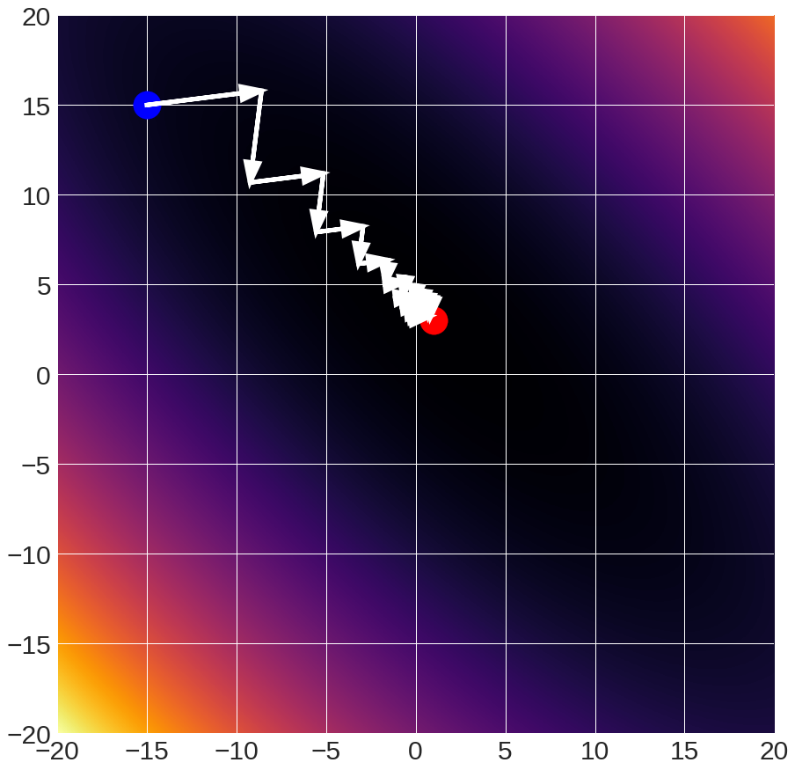
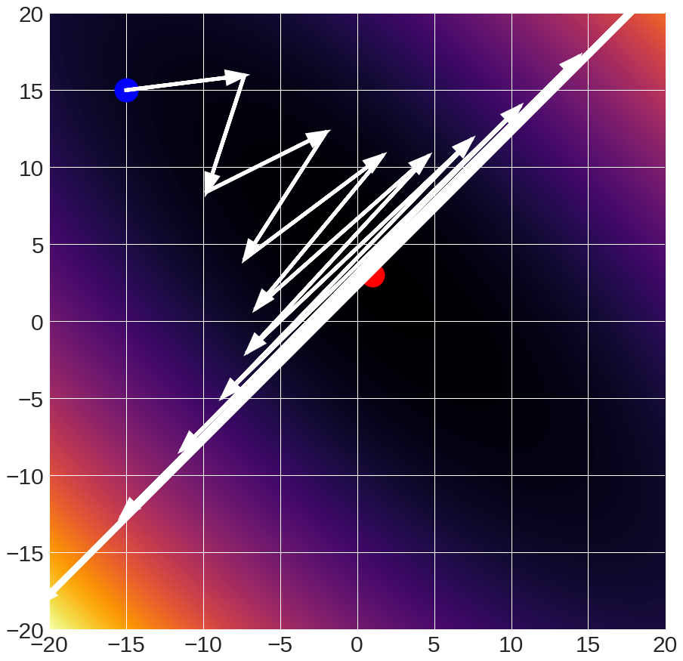
Gradient Descent Details
Step size (also called learning rate / lr)
critical parameter
1x10⁻²
10x10⁻²
12x10⁻²
falls short
converges
diverges

Slide 51
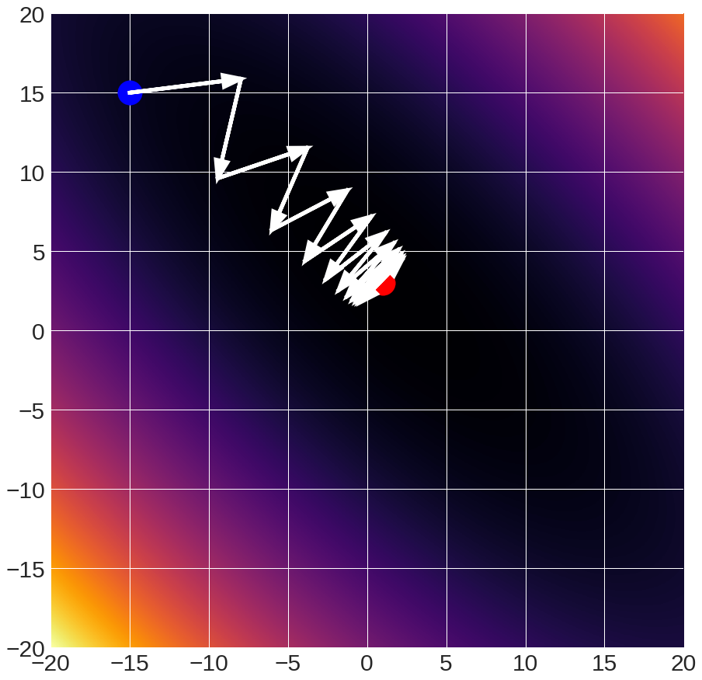
Gradient Descent Details
11x10⁻² :oscillates
(Raw gradients)

Slide 52
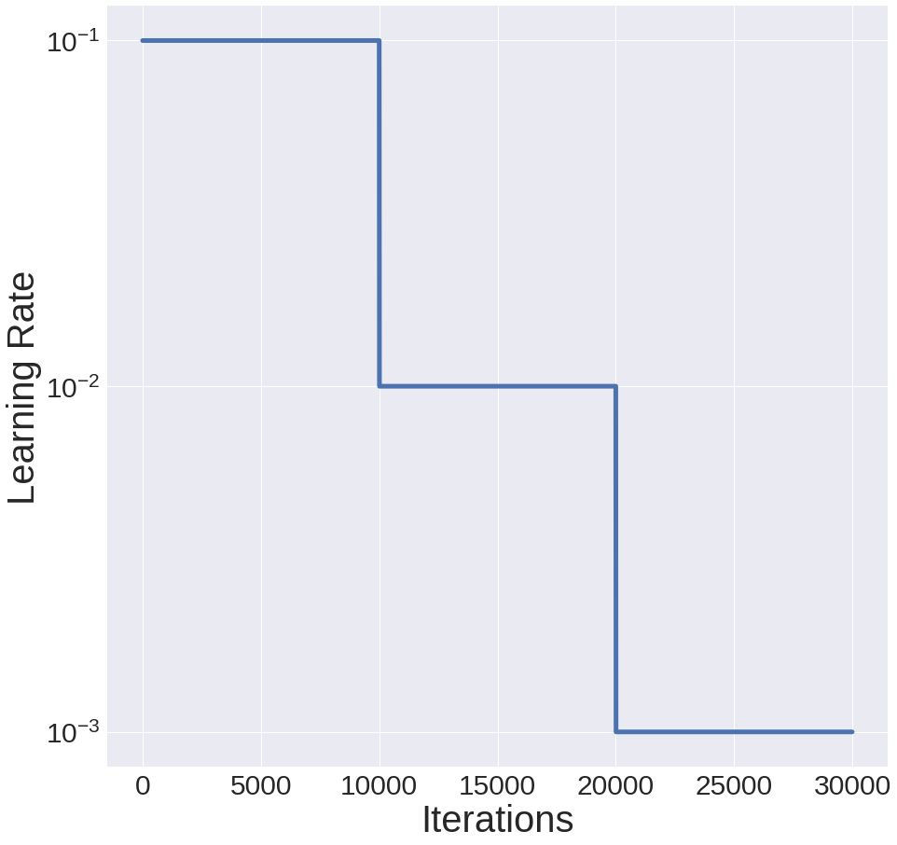
Gradient Descent Details
Typical solution: start with initial rate lr, multiply by f every N interations
init_lr = 10⁻¹
f = 0.1
N = 10K

Slide 53
Gradient Descent Details
11x10⁻² :oscillates
(Raw gradients)
Solution:
Average gradients
With exponentially decaying weights, called “momentum”

Slide 54
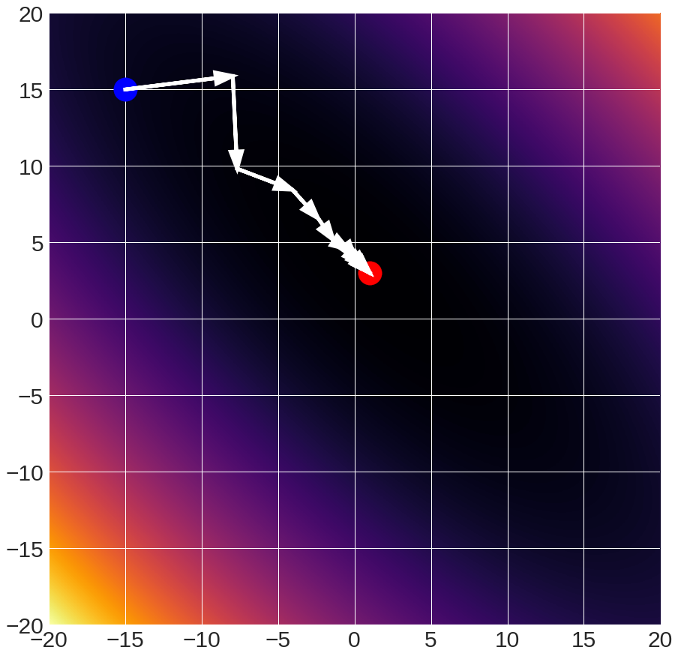
Gradient Descent Details
11x10⁻² :oscillates
(Raw gradients)
11x10⁻²
(0.25 momentum)

Slide 55
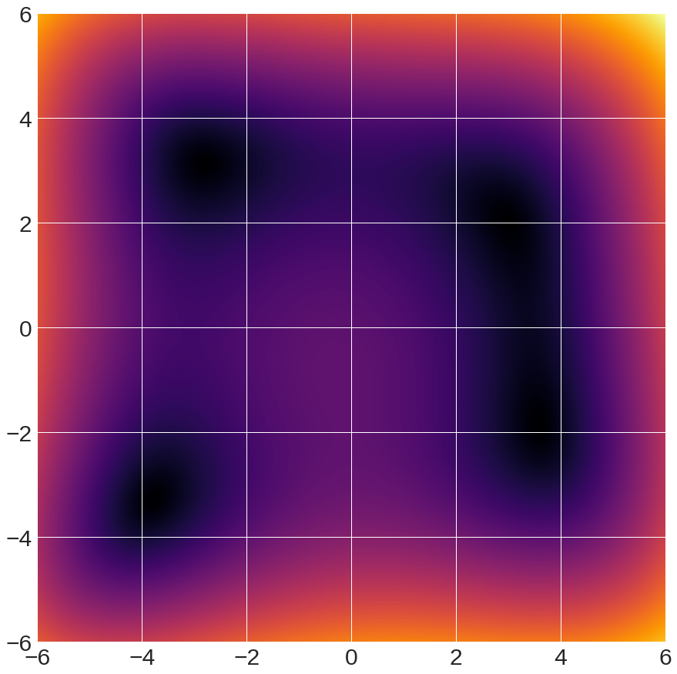
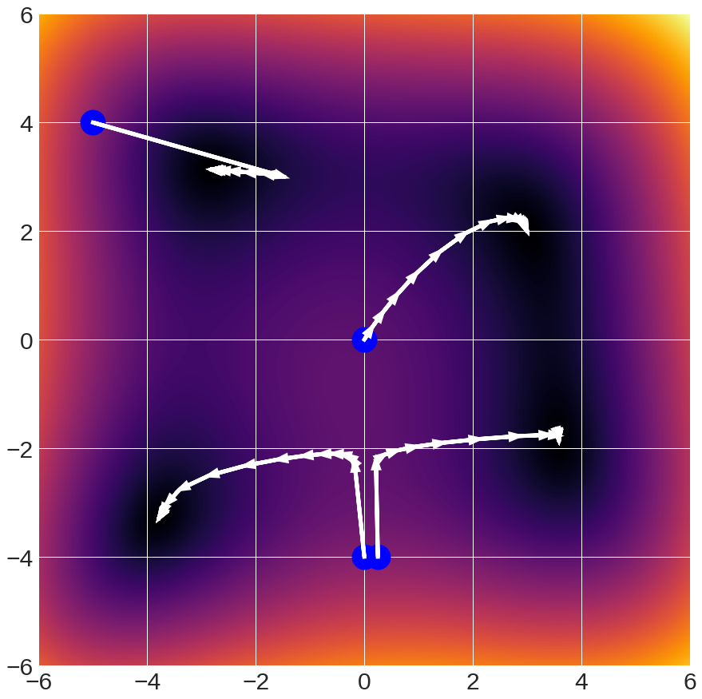
Gradient Descent Details
Multiple Minima
→
Gradient Descent
Finds local
minimum

Slide 56
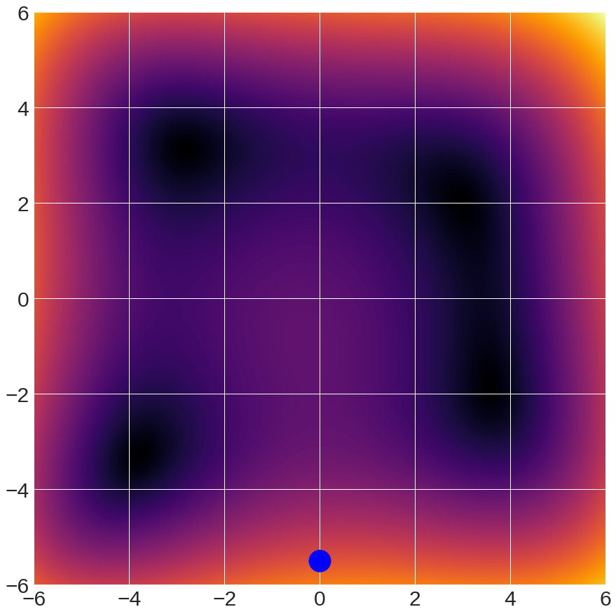
Gradient Descent Details
Guess the minimum!
2
3
1
4
start

Slide 57
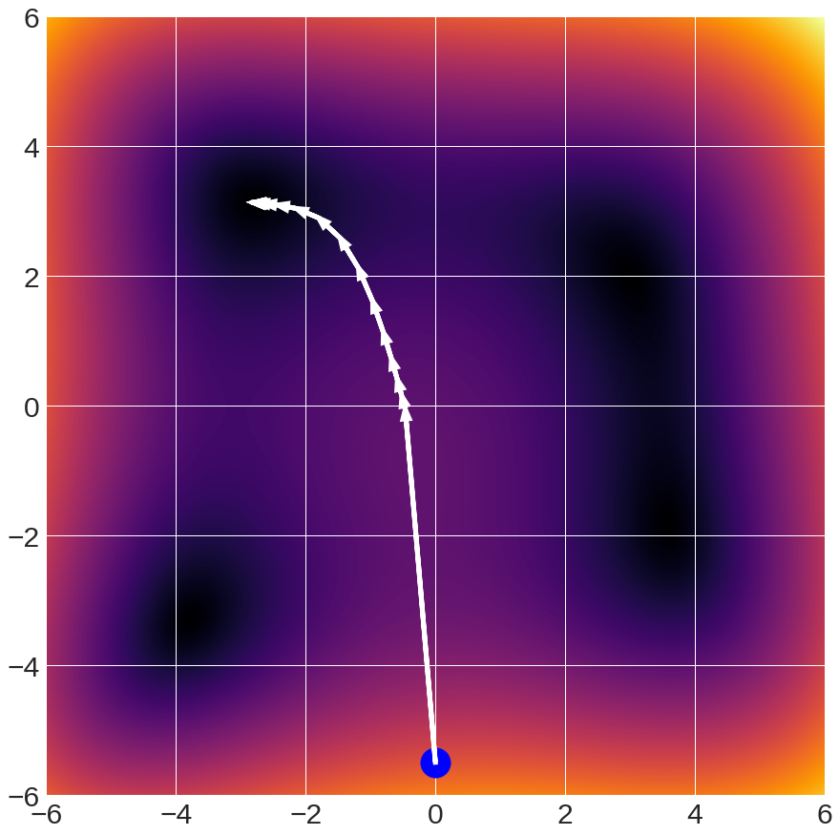
Gradient Descent Details

Slide 58
Gradient Descent Details
Guess the minimum!
2
3
1
4
start

Slide 59
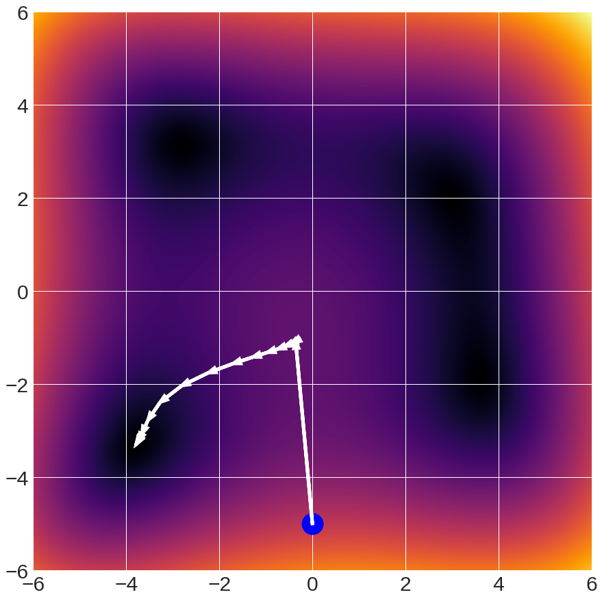
Gradient Descent Details
Dynamics are fairly complex
Many important functions are convex: any local minimum is a global minimum
Many important functions are not.

Slide 60
In practice
Conventional wisdom: minibatch stochastic gradient descent (SGD) + momentum (package implements it for you) + decaying learning rate
The above is typically what is meant by “SGD”
Other update rules exist; benefits in general not clear (sometimes better, sometimes worse)

Slide 61
Optimizing Everything
$${L\left(W\right)={λ{\left\|W\right\|}_{2}^{2}+ \sum_{i=1}^{n}{−\log\left(\frac{\exp{({\left(Wx\right)}_{y_{i}})}}{\sum_{k}{exp⁡({\left(Wx\right)}_{k}))}}\right)}}}$$
$$L(w){={λ{\left\|w\right\|}_{2}^{2}+ \sum_{i=1}^{n}{{\left(y_{i}−w^{T}x_{i}\right)}^{2}}}}$$
Optimize w on training set with SGD to maximize training accuracy
Optimize λ with random/grid search to maximize validation accuracy
Note: Optimizing λ on training sets it to 0

Slide 62
(Over/Under)fitting and Complexity
Let’s fit a polynomial: given x, predict y
Note: can do non-linear regression with copies of x
$$\left[\begin{matrix}y_{1} \\ ⋮ \\ y_{N}\end{matrix}\right]=\left[\begin{matrix}\begin{matrix}\begin{matrix}x_{1}^{F} \\ ⋮ \\ x_{N}^{F}\end{matrix} & \begin{matrix}⋯ \\ ⋱ \\ ⋯\end{matrix}\end{matrix}\begin{matrix} \\ \\ \end{matrix} \begin{matrix}x_{1}^{2} \\ ⋮ \\ x_{N}^{2}\end{matrix} & \begin{matrix}\begin{matrix}x_{1} \\ ⋮ \\ x_{N}\end{matrix} & \begin{matrix}1 \\ ⋮ \\ 1\end{matrix}\end{matrix}\end{matrix}\right]\left[\begin{matrix}w_{F} \\ \begin{aligned}⋮ \\ w_{2} \\ w_{1}\end{aligned} \\ w_{0}\end{matrix}\right]$$
Matrix of all polynomial degrees
Weights: one per polynomial degree

Slide 63
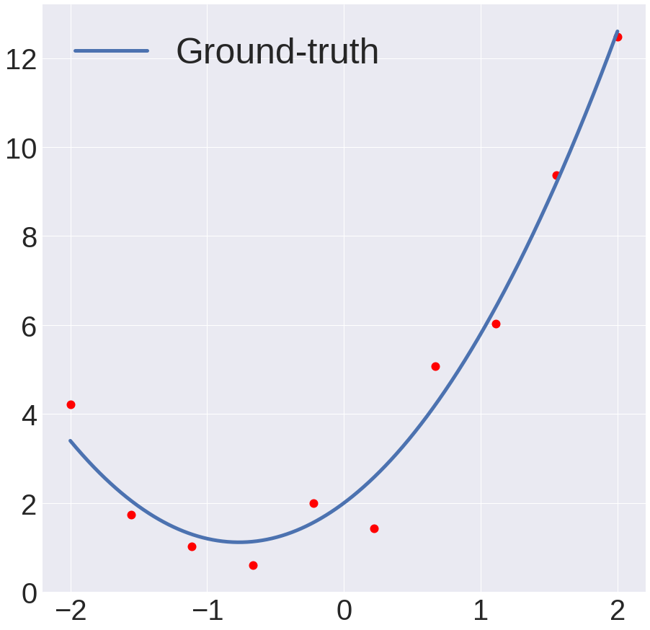
(Over/Under)fitting and Complexity
Model: 1.5x² + 2.3x+2 + N(0,0.5)

Slide 64
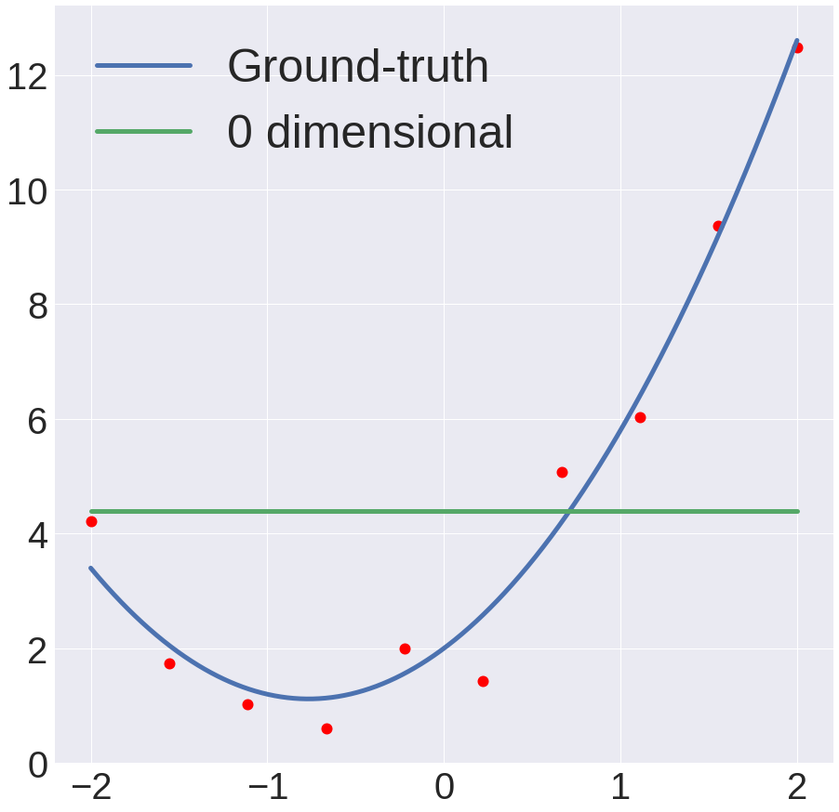
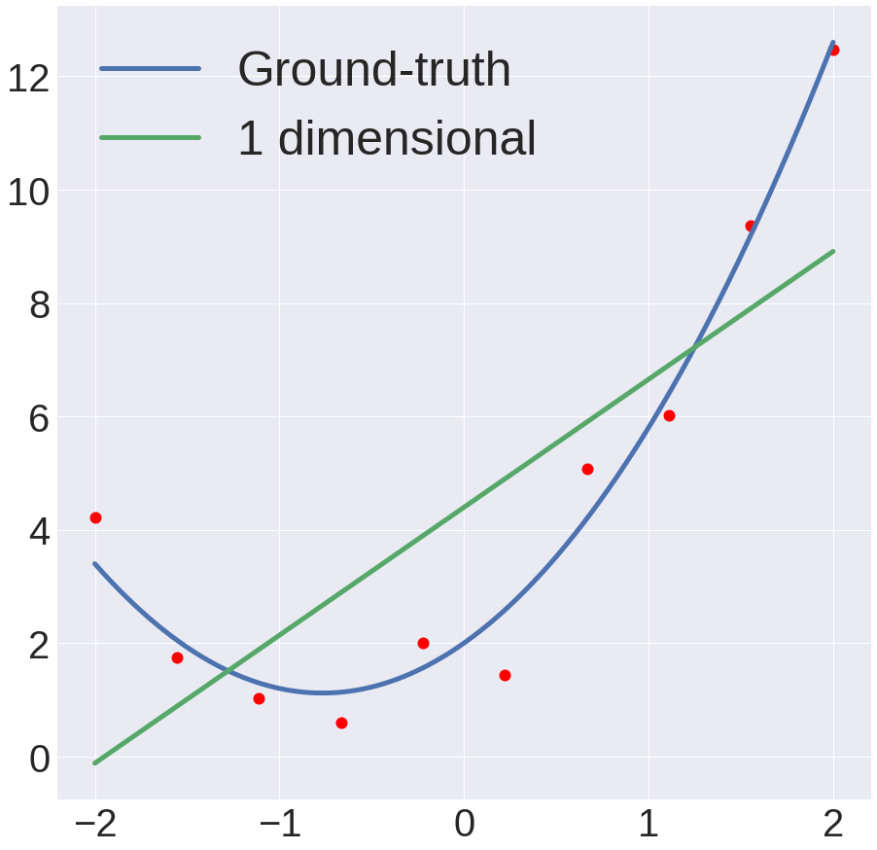
Underfitting
Model: 1.5x² + 2.3x+2 + N(0,0.5)

Slide 65
Underfitting
Model doesn’t have the parameters to fit the data.
Bias (statistics): Error intrinsic to the model.

Slide 66
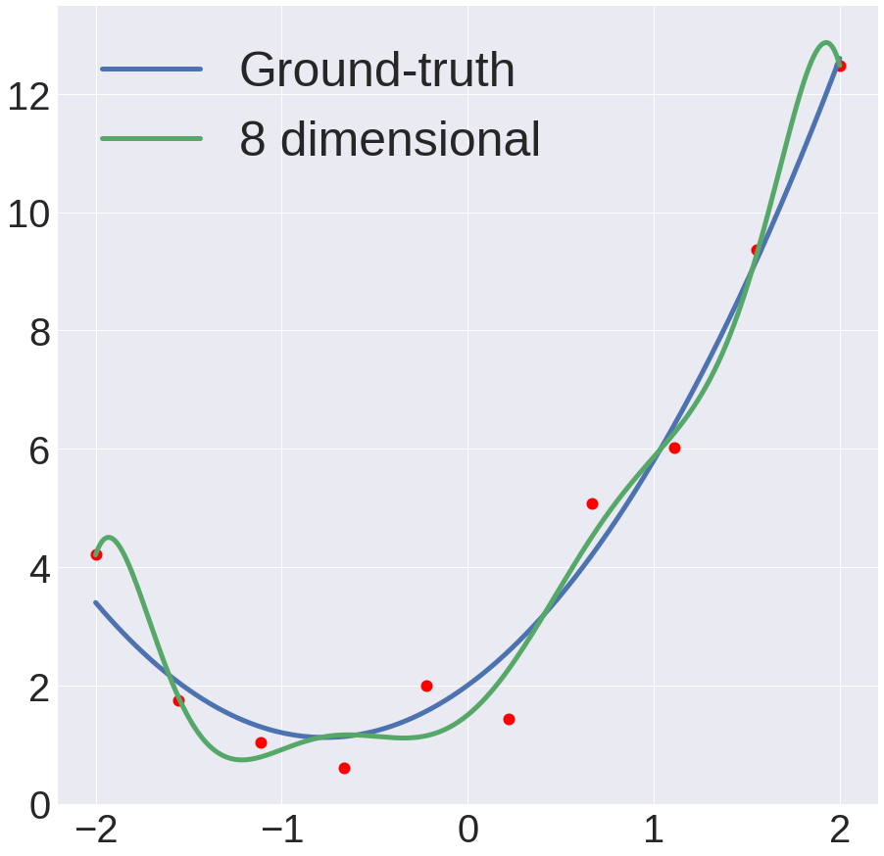
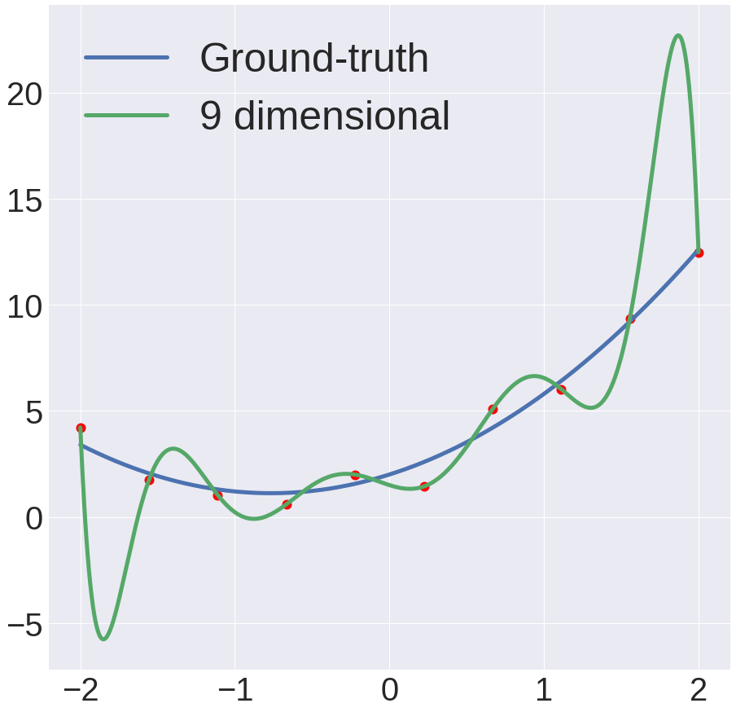
Overfitting
Model: 1.5x² + 2.3x+2 + N(0,0.5)

Slide 67
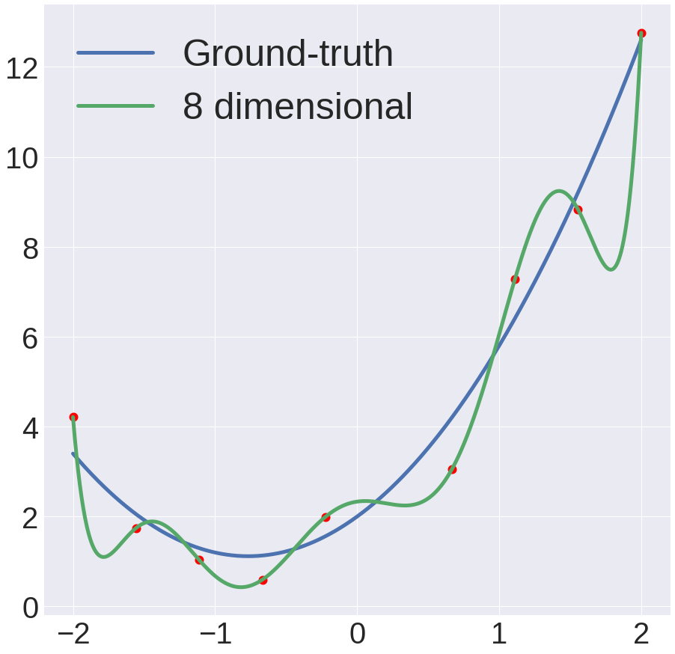
Overfitting
Model has high variance: remove one point, and model changes dramatically

Slide 68
(Continuous) Model Complexity
$$\arg{\min_{W}{λ{\left\|W\right\|}_{2}^{2}+ \sum_{i=1}^{n}{−\log\left(\frac{\exp{({\left(Wx\right)}_{y_{i}})}}{\sum_{k}{exp⁡({\left(Wx\right)}_{k}))}}\right)}}}$$
Regularization: penalty for complex model
Pay penalty for negative log-likelihood of correct class
Intuitively: big weights = more complex model
Model 1: 0.01*x₁ + 1.3*x₂ + -0.02*x₃ + -2.1x₄ + 10
Model 2: 37.2*x₁ + 13.4*x₂ + 5.6*x₃ + -6.1x₄ + 30

Slide 69
Fitting Model
Again, fitting polynomial, but with regularization
$$\arg{\min_{w}\left\|y−Xw\right\|+λ\left\|w\right\| }$$
$$\left[\begin{matrix}\begin{matrix}\begin{matrix}x_{1}^{F} \\ ⋮ \\ x_{N}^{F}\end{matrix} & \begin{matrix}⋯ \\ ⋱ \\ ⋯\end{matrix}\end{matrix}\begin{matrix} \\ \\ \end{matrix} \begin{matrix}x_{1}^{2} \\ ⋮ \\ x_{N}^{2}\end{matrix} & \begin{matrix}\begin{matrix}x_{1} \\ ⋮ \\ x_{N}\end{matrix} & \begin{matrix}1 \\ ⋮ \\ 1\end{matrix}\end{matrix}\end{matrix}\right]$$
$$\left[\begin{matrix}w_{F} \\ ⋮ \\ w_{0}\end{matrix}\right]$$

Slide 70
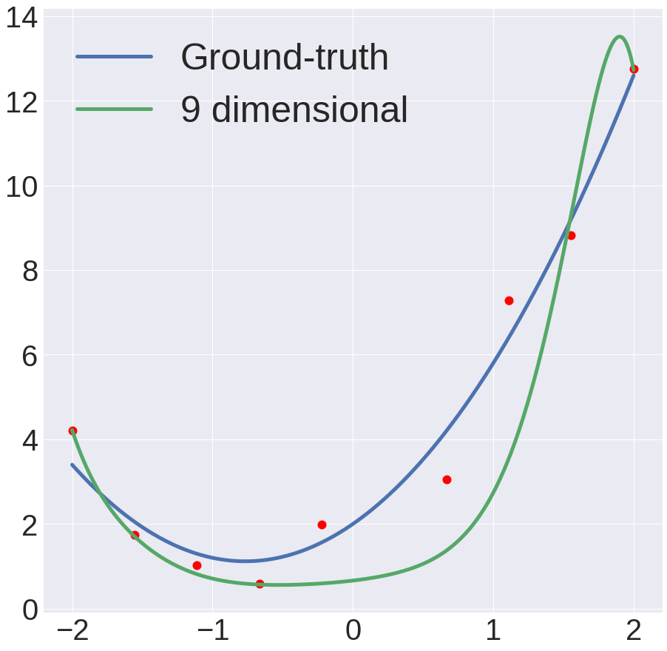
Adding Regularization
No regularization:
fits all data points
Regularization:
can’t fit all data points

Slide 71
In General
Error on new data comes from combination of:
Bias: model is oversimplified and can’t fit the underlying data
Variance: you don’t have the ability to estimate your model from limited data
Inherent: the data is intrinsically difficult
Bias and variance trade-off. Fixing one hurts the other.

Slide 72
Underfitting and Overfitting
Underfitting!
Overfitting!
Test
Error
Getting Better
Error
Training
Error
High Bias
Low Variance
Complexity
Low Bias
High Variance
Diagram adapted from: D. Hoiem

Slide 73
Underfitting and Overfitting
Small data
Overfits w/small model
Big data
Overfits w/bigger model
Test
Error
High Bias
Low Variance
Complexity
Low Bias
High Variance
Diagram adapted from: D. Hoiem

Slide 74
Underfitting
Do poorly on both training and validation data due to bias.
Solution:
More features
More powerful model
Reduce regularization

Slide 75
Overfitting
Do well on training data, but poorly on validation data due to variance
Solution:
More data
Less powerful model
Regularize your model more
Cris Dima rule: first make sure you can overfit, then stop overfitting.

Slide 76
Next Class
Non-linear models (neural nets)

