Slide 1
Epipolar Geometry
EECS 442 – David Fouhey
Fall 2019, University of Michigan
http://web.eecs.umich.edu/~fouhey/teaching/EECS442_F19/

Slide 2
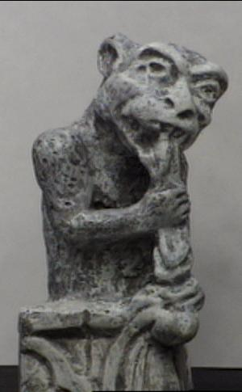
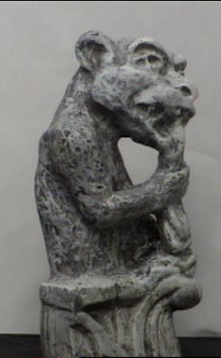
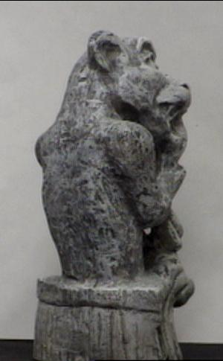
Multi-view geometry
Image Credit: S. Lazebnik

Slide 3
Multi-view geometry problems
Recovering structure:
Given cameras and correspondences, find 3D.
?
Camera 1
Camera 3
R₁,t₁
Camera 2
R₃,t₃
R₂,t₂
Slide credit: Noah Snavely
Notes:
Structure from motion solves the following problem:
Given a set of images of a static scene with 2D points in correspondence, shown here as color-coded points, find…
a set of 3D points P and
a rotation R and position t of the cameras that explain the observed correspondences. In other words, when we project a point into any of the cameras, the reprojection error between the projected and observed 2D points is low.
This problem can be formulated as an optimization problem where we want to find the rotations R, positions t, and 3D point locations P that minimize sum of squared reprojection errors f. This is a non-linear least squares problem and can be solved with algorithms such as Levenberg-Marquart. However, because the problem is non-linear, it can be susceptible to local minima. Therefore, it’s important to initialize the parameters of the system carefully. In addition, we need to be able to deal with erroneous correspondences.

Slide 4
Multi-view geometry problems
Stereo/Epipolar Geomery:
Given 2 cameras and find where a point could be
Camera 1
Camera 3
R₁,t₁
Camera 2
R₃,t₃
R₂,t₂
Slide credit: Noah Snavely
Notes:
Structure from motion solves the following problem:
Given a set of images of a static scene with 2D points in correspondence, shown here as color-coded points, find…
a set of 3D points P and
a rotation R and position t of the cameras that explain the observed correspondences. In other words, when we project a point into any of the cameras, the reprojection error between the projected and observed 2D points is low.
This problem can be formulated as an optimization problem where we want to find the rotations R, positions t, and 3D point locations P that minimize sum of squared reprojection errors f. This is a non-linear least squares problem and can be solved with algorithms such as Levenberg-Marquart. However, because the problem is non-linear, it can be susceptible to local minima. Therefore, it’s important to initialize the parameters of the system carefully. In addition, we need to be able to deal with erroneous correspondences.

Slide 5
Multi-view geometry problems
Motion:
Figure out R, t for a set of cameras given correspondences
Camera 1
?
Camera 2
?
?
Camera 3
R₁,t₁
R₃,t₃
R₂,t₂
Slide credit: Noah Snavely
Notes:
Structure from motion solves the following problem:
Given a set of images of a static scene with 2D points in correspondence, shown here as color-coded points, find…
a set of 3D points P and
a rotation R and position t of the cameras that explain the observed correspondences. In other words, when we project a point into any of the cameras, the reprojection error between the projected and observed 2D points is low.
This problem can be formulated as an optimization problem where we want to find the rotations R, positions t, and 3D point locations P that minimize sum of squared reprojection errors f. This is a non-linear least squares problem and can be solved with algorithms such as Levenberg-Marquart. However, because the problem is non-linear, it can be susceptible to local minima. Therefore, it’s important to initialize the parameters of the system carefully. In addition, we need to be able to deal with erroneous correspondences.

Slide 6


Two-view geometry
Image Credit: Hartley & Zisserman

Slide 7
Camera Geometry Reminder
X (3D point)
4 h. coordinates
K⁻¹p (Ray)
3 h. coordinates
0
p (2D point)
3 h. coordinates
Pretending image plane is in front
p (2D point)
3 h. coordinates
Actual location
Have camera with pinhole at origin 0

Slide 8
Epipolar Geometry
o
o'
Suppose we have two cameras at origins o, o’
Baseline is the line connecting the origins

Slide 9
Epipolar Geometry
X
p
p'
o
o'
Now add a point X, which projects to p and p’

Slide 10
Epipolar Geometry
X
p
p'
o
o'
The plane formed by X, o, and o’ is called the epipolar plane
There is a family of planes per o, o’

Slide 11
Epipolar Geometry
X
p
p'
o
e
e'
o'
Epipoles e, e’ are where the baseline intersects the image planes
Projection of other camera in the image plane

Slide 12
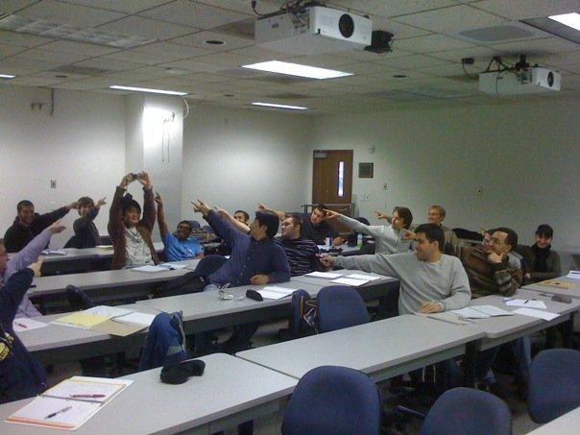
The Epipole
Photo by Frank Dellaert

Slide 13
Epipolar Geometry
X
p
p'
o
e
e'
o'
Epipolar lines go between the epipoles and the projections of the points.
Intersection of epipolar plane with image plane

Slide 14
Example: Converging Cameras
p
p'
o
e
e'
o'
Epipoles finite, maybe in image; epipolar lines converge

Slide 15
Example: Converging Cameras
p
p'
o
e
e'
o'
Epipolar lines come in pairs: given a point p, we can construct the epipolar line for p’.

Slide 16
Example 1: Converging Cameras
Image Credit: Hartley & Zisserman

Slide 17
Example: Parallel to Image Plane
Suppose the cameras are both facing outwards.
Where are the epipoles (proj. of other camera)?

Slide 18
Example: Parallel to Image Plane
p
p'
e'
e
Epipoles infinitely far away, epipolar lines parallel

Slide 19


Example: Parallel to Image Plane
Image Credit: Hartley & Zisserman

Slide 20
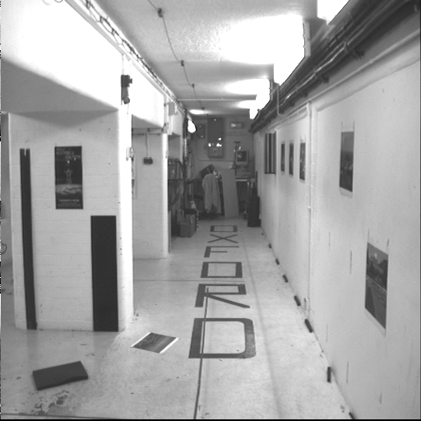
Example: Forward Motion
Image Credit: Hartley & Zisserman

Slide 21
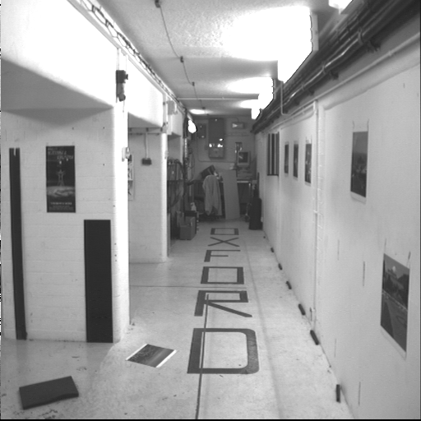
Example: Forward Motion
Image Credit: Hartley & Zisserman

Slide 22
Example: Forward Motion
Epipole is focus of expansion / principal point of the camera.
Epipolar lines go out from principal point

Slide 23

Motion perpendicular to image plane
http://vimeo.com/48425421

Slide 24
So?

Slide 25
Epipolar Geometry
p
o
e
e'
o'
Suppose we don’t know X and just have p
Can construct the epipolar line in the other image

Slide 26
Epipolar Geometry
p
o
e
e'
o'
Suppose we don’t know X and just have p
Corresponding p’ is on corresponding epipolar line

Slide 27
Epipolar Geometry
p'
o
e
e'
o'
Suppose we don’t know X and just have p’
Corresponding p is on corresponding epipolar line

Slide 28
Epipolar Geometry
If I want to do stereo, I want to find a corresponding pixel for each pixel in the image:
Naïve search:
  For each pixel, search every other pixel
With epipolar geometry:
  For each pixel, search along each line (1D search)

Slide 29
Epipolar constraint example
Slide Credit: S. Lazebnik

Slide 30
Epipolar Constraint: One Note
If you look around for other reading, you’ll find derivations with p, p’ flipped and constraints derived in a flipped way
It all works the same

Slide 31


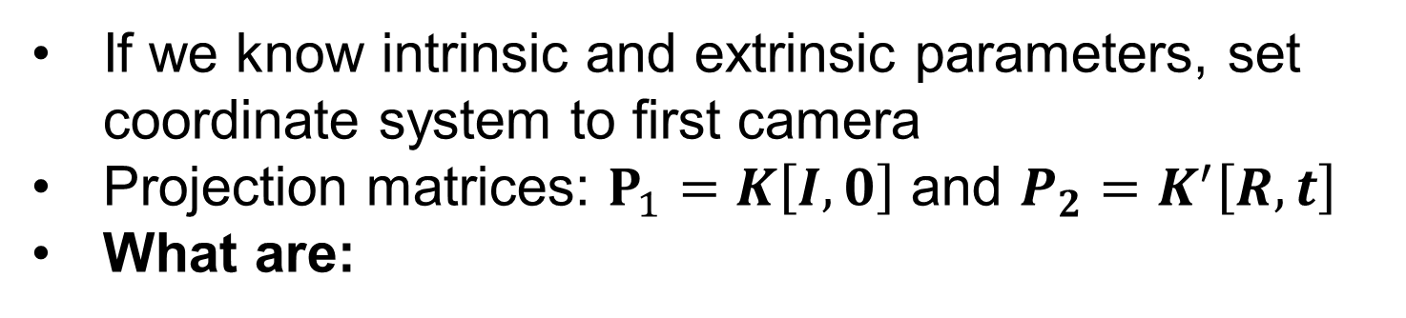



Epipolar Constraint: Calibrated Case
X
p
p'
o
$$R,t$$
o'
If we know intrinsic and extrinsic parameters, set coordinate system to first camera
Projection matrices: $P_{1}=K\left[I,0\right]$ and ${P_{2}=K}^{′}\left[R,t\right]$
What are:
$$P_{1}X$$
$$P_{2}X$$
$$K^{−1}p$$
$${K^{′}}^{−1}p′$$

Slide 32

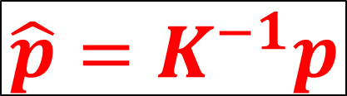
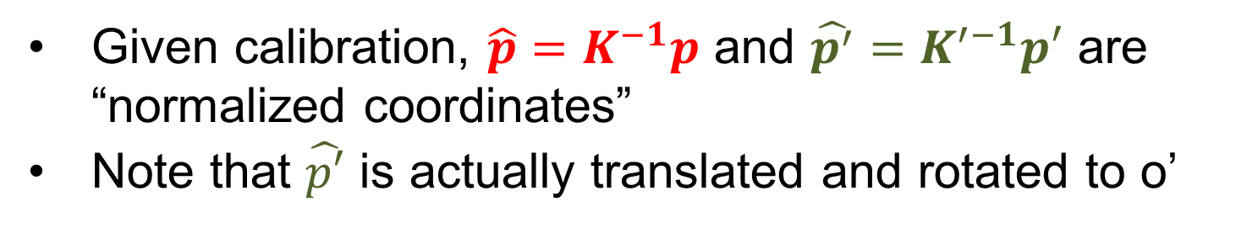
Epipolar Constraint: Calibrated Case
X
$${\hat{p′}=K′}^{−1}p′$$
$${\hat{p}=K}^{−1}p$$
p
p'
o
$$R,t$$
o'
Given calibration, $\hat{p}=K^{−1}p$ and $\hat{p^{′}}=K^{′−1}p′$ are “normalized coordinates”
Note that $\hat{p′}$ is actually translated and rotated to o’

Slide 33
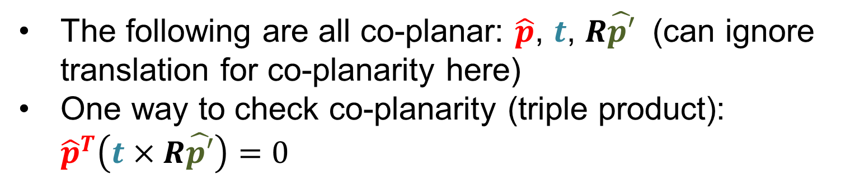
Epipolar Constraint: Calibrated Case
X
$${\hat{p′}=K′}^{−1}p′$$
$${\hat{p}=K}^{−1}p$$
p
p'
o
$$R,t$$
o'
The following are all co-planar: $\hat{p}$, $t$, $R\hat{p′}$ (can ignore translation for co-planarity here)
One way to check co-planarity (triple product): ${\hat{p}}^{T}\left(t×R\hat{p′}\right)=0$

Slide 34

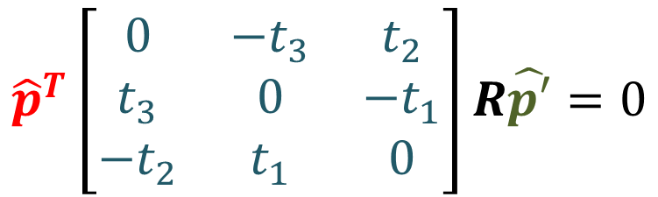

Epipolar Constraint: Calibrated Case
X
$${\hat{p′}=K′}^{−1}p′$$
$${\hat{p}=K}^{−1}p$$
p
p'
o
$$R,t$$
o'
$$[t_{x}]$$
$${\hat{p}}^{T}\left[\begin{matrix}0 & −t_{3} & t_{2} \\ t_{3} & 0 & −t_{1} \\ −t_{2} & t_{1} & 0\end{matrix}\right]R\hat{p′}=0$$
$${\hat{p}}^{T}\left(t×R\hat{p}′\right)=0$$
Want something like x^{T}My=0. What’s M?

Slide 35

Epipolar Constraint: Calibrated Case
X
$${\hat{p′}=K′}^{−1}p′$$
$${\hat{p}=K}^{−1}p$$
p
p'
o
$$R,t$$
o'
Essential matrix (Longuet-Higgins, 1981): $E=\left[t_{x}\right]R$
If you have a normalized point $\hat{p}$, its correspondence $\hat{p}′$ must satisfy ${\hat{p}}^{T}E\hat{p′}=0$

Slide 36

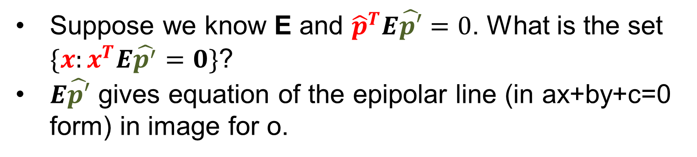


Essential Essential Matrix Facts
X
$${\hat{p}=K}^{−1}p$$
p
p'
$${\hat{p′}=K′}^{−1}p′$$
o
o'
Suppose we know E and ${\hat{p}}^{T}E\hat{p′}=0$. What is the set $\{x:x^{T}E\hat{p^{′}}=0\}$?
$E\hat{p′}$ gives equation of the epipolar line (in ax+by+c=0 form) in image for o.
What’s $E^{T}\hat{p}$ ?

Slide 37
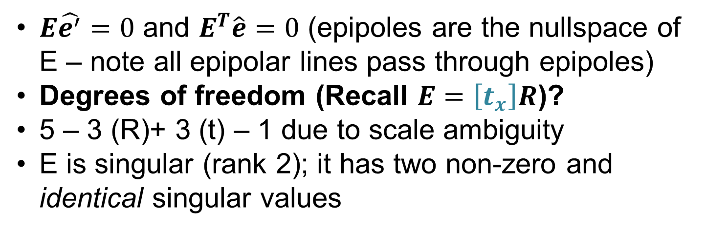
Essential Essential Matrix Facts
X
$${\hat{p}=K}^{−1}p$$
p
p'
$${\hat{p′}=K′}^{−1}p′$$
o
e
e'
o'
$E\hat{e^{′}}=0$ and $E^{T}\hat{e}=0$ (epipoles are the nullspace of E – note all epipolar lines pass through epipoles)
Degrees of freedom (Recall $E=\left[t_{x}\right]R$)?
5 – 3 (R)+ 3 (t) – 1 due to scale ambiguity
E is singular (rank 2); it has two non-zero and identical singular values

Slide 38
Essential Essential Matrix Facts
X
$${\hat{p}=K}^{−1}p$$
p
p'
$${\hat{p′}=K′}^{−1}p′$$
o
e
e'
o'
One nice thing: if I estimate E from two images (more on this later), it’s unique up to easy symmetries

Slide 39





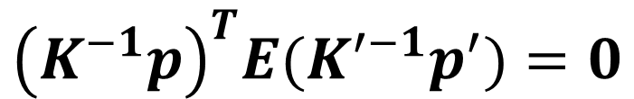

What if we don’t know K?
X
$${\hat{p}=K}^{−1}p$$
p
p'
$${\hat{p′}=K′}^{−1}p′$$
o
o'
Have:
$${\hat{p}=K}^{−1}p,$$
$${\hat{p′}=K′}^{−1}p^{′},$$
$${\hat{p}}^{T}E{\hat{p}}^{′}=0$$
$${\left(K^{−1}p\right)}^{T}E(K^{′−1}p^{′})=0$$
$$p^{T}K^{−T}EK^{′−1}p′=0$$
Set:
$$F=K^{−T}EK^{′−1}$$
Then:
$$p^{T}Fp^{′}=0$$
Fundamental Matrix (Faugeras and Luong, 1992)

Slide 40
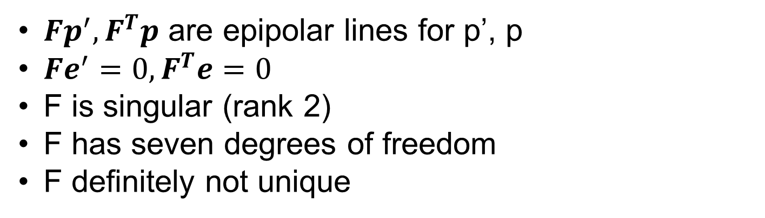
Fundamental Matrix Fundamentals
X
p
p'
o
e
e'
o'
$Fp^{′}, F^{T}p$ are epipolar lines for p’, p
$Fe^{′}=0, F^{T}e=0$
F is singular (rank 2)
F has seven degrees of freedom
F definitely not unique

Slide 41
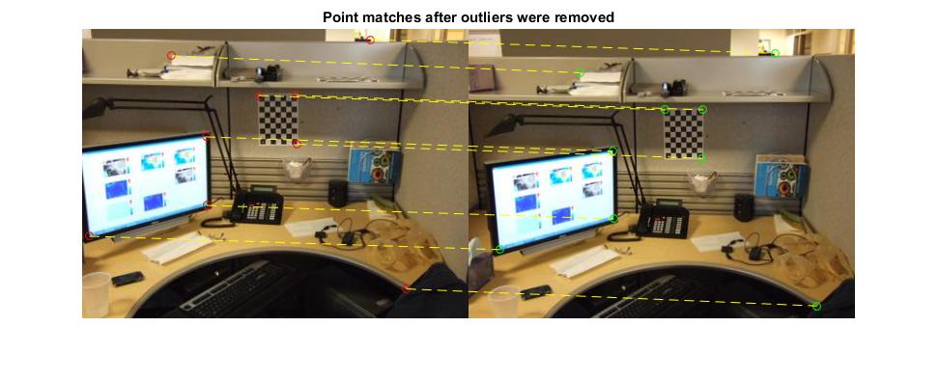
Estimating the fundamental matrix
Slide Credit: S. Lazebnik

Slide 42
Estimating the fundamental matrix
F has 7 degrees of freedom so it’s in principle possible to fit F with seven correspondences, but it’s a slightly more complex and typically not taught in regular vision classes

Slide 43
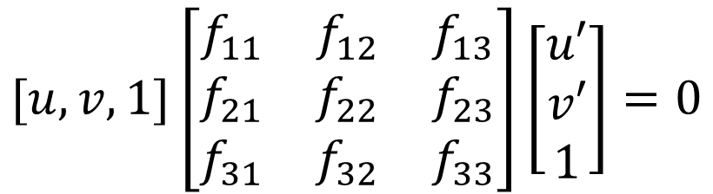
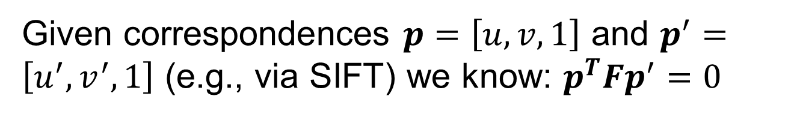

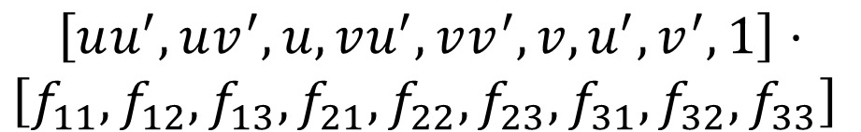
Estimating the fundamental matrix
Given correspondences $p=\left[u,v,1\right]$ and $p^{′}=\left[u^{′},v^{′},1\right]$ (e.g., via SIFT) we know: $p^{T}Fp^{′}=0$
$$[u,v,1]\left[\begin{matrix}f_{11} & f_{12} & f_{13} \\ f_{21} & f_{22} & f_{23} \\ f_{31} & f_{32} & f_{33}\end{matrix}\right]\left[\begin{matrix}u′ \\ v′ \\ 1\end{matrix}\right]=0$$
$$\left[uu^{′},uv^{′}, u,vu^{′},vv^{′},v,u^{′},v^{′},1\right]⋅$$
$${\left[f_{11},f_{12},f_{13},f_{21},f_{22},f_{23},f_{31},f_{32},f_{33}\right]}^{ }$$
$$=0$$
How do we solve for f?
How many correspondences do we need?
Leads to the eight point algorithm

Slide 44

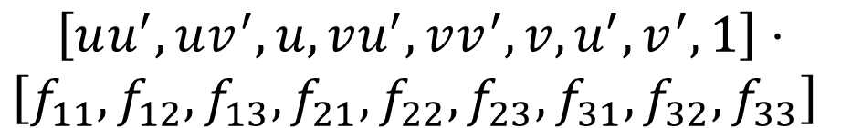

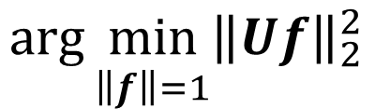
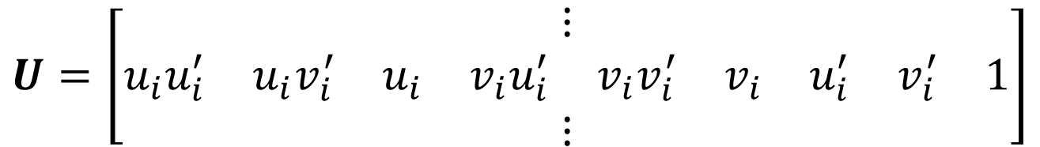
Eight Point Algorithm
Each point gives an equation:
$$\left[uu^{′},uv^{′}, u,vu^{′},vv^{′},v,u^{′},v^{′},1\right]⋅$$
$${\left[f_{11},f_{12},f_{13},f_{21},f_{22},f_{23},f_{31},f_{32},f_{33}\right]}^{ }$$
$$=0$$
Stack equations to yield U:
$$U=\left[\begin{matrix}⋮ \\ \begin{matrix}\begin{matrix}u_{i}u_{i}^{′} & u_{i}v_{i}^{′} & u_{i}\end{matrix} & \begin{matrix}v_{i}u_{i}^{′} & v_{i}v_{i}^{′} & v_{i}\end{matrix} & \begin{matrix}u_{i}^{′} & v_{i}^{′} & 1\end{matrix}\end{matrix} \\ ⋮\end{matrix}\right]$$
Usual eigenvalue stuff to find f (F unrolled):
$${\arg{\min_{\begin{aligned} \\ \left\|f\right\|=1\end{aligned}}\left\|Uf\right\|}}_{2}^{2}$$
Eigenvector of $U^{T}U$ with smallest eigenvalue

Slide 45
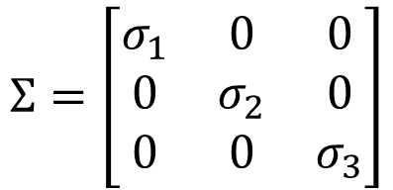

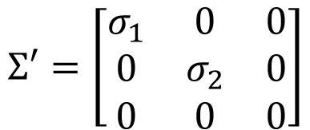

Eight Point Algorithm – Difficulty 1
If we estimate F, we get some 3x3 matrix F.
We know F needs to be singular/rank 2. How do we force F to be singular?
$$UΣV^{T}=F_{init}$$
Open it up with SVD, mess with singular values, put it back together.
$$Σ=\left[\begin{matrix}σ_{1} & 0 & 0 \\ 0 & σ_{2} & 0 \\ 0 & 0 & σ_{3}\end{matrix}\right]$$
$$Σ′=\left[\begin{matrix}σ_{1} & 0 & 0 \\ 0 & σ_{2} & 0 \\ 0 & 0 & 0\end{matrix}\right]$$
$$F=UΣ′V^{T}$$
See Eckart–Young–Mirsky theorem if you’re interested

Slide 46
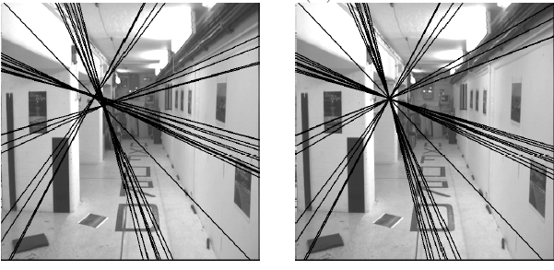
Eight Point Algorithm – Difficulty 1
Estimated F
(Wrong)
Estimated+SVD’d F
(Correct)
Slide Credit: S. Lazebnik

Slide 47

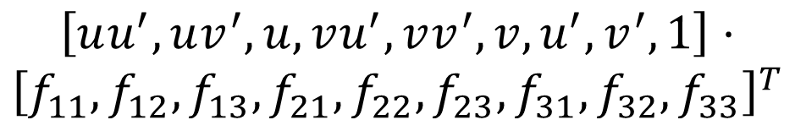
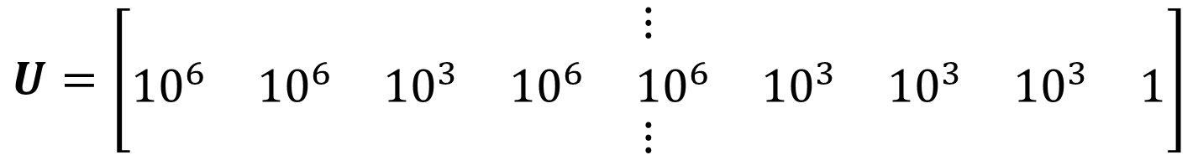
Eight Point Algorithm – Difficulty 2
$$\left[uu^{′},uv^{′}, u,vu^{′},vv^{′},v,u^{′},v^{′},1\right]⋅$$
$${\left[f_{11},f_{12},f_{13},f_{21},f_{22},f_{23},f_{31},f_{32},f_{33}\right]}^{T}$$
$$=0$$
Recall: u,u’ are in pixels. Suppose image is 1Kx1K
How big might uu’ be? How big might u be?
Each row looks like:
$$U=\left[\begin{matrix}⋮ \\ \begin{matrix}\begin{matrix}{10}^{6} & {10}^{6} & {10}^{3}\end{matrix} & \begin{matrix}{10}^{6} & {10}^{6} & {10}^{3}\end{matrix} & \begin{matrix}{10}^{3} & {10}^{3} & 1\end{matrix}\end{matrix} \\ ⋮\end{matrix}\right]$$
Then: $U^{T}U_{1,1}$ is ~10¹², $U^{T}U_{2,9}$ is ~10³

Slide 48
Eight Point Algorithm – Difficulty 2
Numbers of varying magnitude → instability
Remember: a floating point number (float/double) isn’t a “real” number: for sign, coefficient, exponent integers
(-1)^{sign} * coefficient * 2^{exponent}
Exercise to see how this screws up: add up Gaussian noise (mean=100, std=10), divide by number you added up

Slide 49
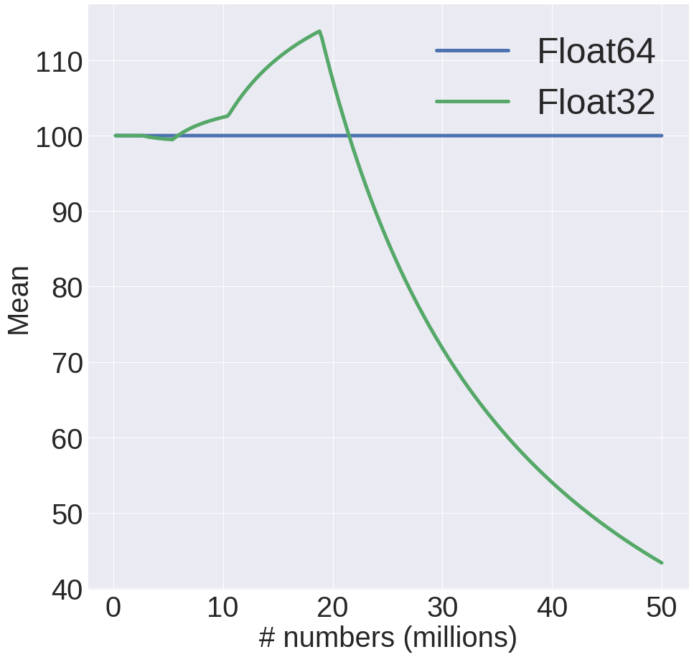
Remember Numerical Instability?
Code:
x += N(100,10)
i += 1
mean = x/I
Only change is the # of bits in accumulator x
Note: 50M is 50 1Kx1K images

Slide 50
Solution: Normalized 8-point
Center the image data at the origin, and scale it so the mean squared distance between the origin and the data points is 2 pixels
Use the eight-point algorithm to compute F from the normalized points
Enforce the rank-2 constraint (for example, take SVD of F and throw out the smallest singular value)
Transform fundamental matrix back to original units: if T and T’ are the normalizing transformations in the two images, than the fundamental matrix in original coordinates is T’^{T} F T
R. Hartley
In defense of the eight-point algorithm TPAMI 1997
Slide Credit:
S. Lazebnik

Slide 51


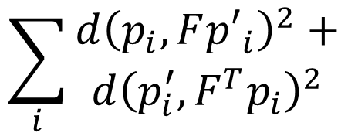
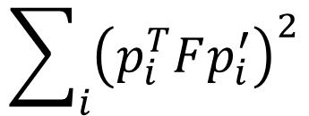
Last Trick
Minimizing via U^{T}U minimizes sum of squared algebraic distances between points p_{i} and epipolar lines Fp’_{i} (or points p’_{i} and epipolar lines F^{T}p_{i}):
$$\sum_{i}{{\left(p_{i}^{T}Fp_{i}^{′}\right)}^{2}}$$
May want to minimize geometric distance:
$$\sum_{i}{\begin{aligned}d{\left(p_{i},F{p′}_{i}\right)}^{2}+ \\ d{\left(p_{i}^{′},F^{T}p_{i}\right)}^{2}\end{aligned}}$$
$$p_{i}$$
$$Fp_{i}^{′}=0$$
Slide Credit: S. Lazebnik

Slide 52

Comparison
 | 8-point | Normalized 8-point | Nonlinear least squares
Av. Dist. 1 | 2.33 pixels | 0.92 pixel | 0.86 pixel
Av. Dist. 2 | 2.18 pixels | 0.85 pixel | 0.80 pixel
Slide Credit: S. Lazebnik

Slide 53
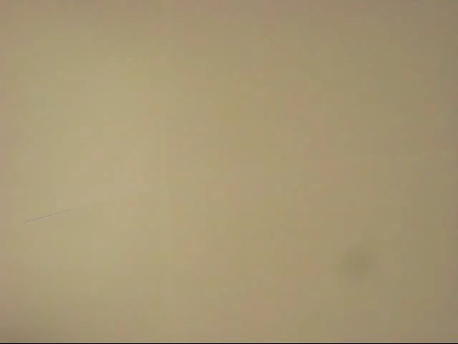
The Fundamental Matrix Song
http://danielwedge.com/fmatrix/

Slide 54
From Epipolar Geometry to Calibration
Estimating the fundamental matrix is known as “weak calibration”
If we know the calibration matrices of the two cameras, we can estimate the essential matrix: E = K’^{T}FK
The essential matrix gives us the relative rotation and translation between the cameras, or their extrinsic parameters
Alternatively, if the calibration matrices are known, the five-point algorithm can be used to estimate relative camera pose
Slide Credit: S. Lazebnik

