Slide 1
Intro to 3D +
Camera Calibration
EECS 442 – David Fouhey
Fall 2019, University of Michigan
http://web.eecs.umich.edu/~fouhey/teaching/EECS442_F19/

Slide 2
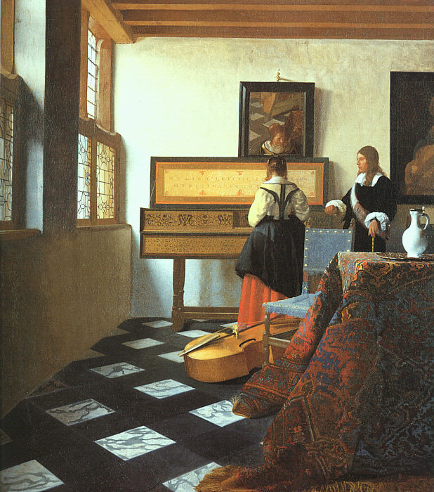
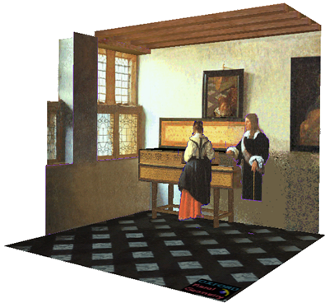
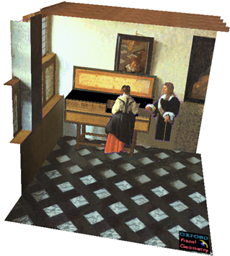
Our goal: Recovery of 3D structure
J. Vermeer, Music Lesson, 1662
A. Criminisi, M. Kemp, and A. Zisserman,Bringing Pictorial Space to Life: computer techniques for the analysis of paintings, Proc. Computers and the History of Art, 2002

Slide 3
Next few classes
First: some intuitions and examples from biological vision about 3D perception
But first, a brief review

Slide 4
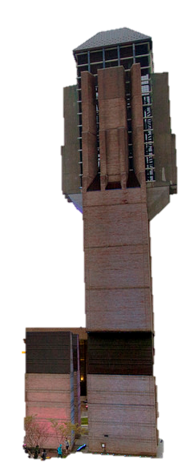
Let’s Take a Picture!
Photosensitive Material
Slide inspired by S. Seitz; image from Michigan Engineering

Slide 5
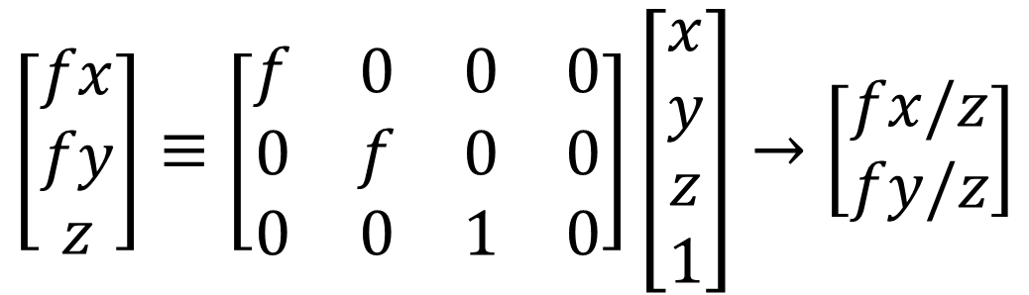
Projection Matrix
Projection (fx/z, fy/z) is matrix multiplication
f
O
$$\left[\begin{matrix}fx \\ fy \\ z\end{matrix}\right]≡\left[\begin{matrix}f & 0 & 0 & 0 \\ 0 & f & 0 & 0 \\ 0 & 0 & 1 & 0\end{matrix}\right]\left[\begin{matrix}x \\ y \\ z \\ 1\end{matrix}\right]→\left[\begin{matrix}fx/z \\ fy/z\end{matrix}\right]$$
Slide inspired from L. Lazebnik

Slide 6
Single-view Ambiguity
X?
X?
X?
x
Given a calibrated camera and an image, we only know the ray corresponding to each pixel.
Nowhere near enough constraints for X
Diagram credit: S. Lazebnik

Slide 7
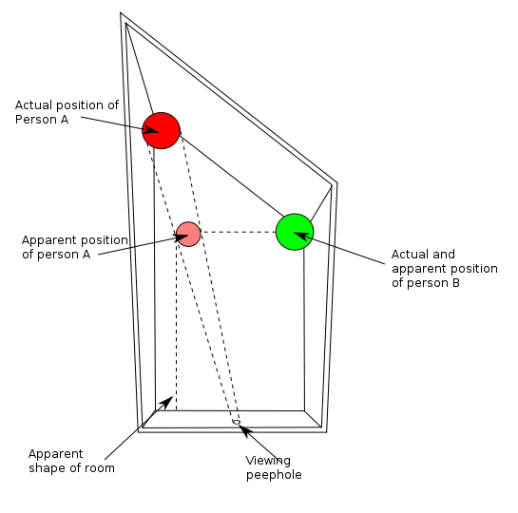
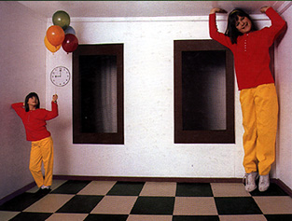
Single-view Ambiguity
http://en.wikipedia.org/wiki/Ames_room
Slide Credit: J. Hays

Slide 8
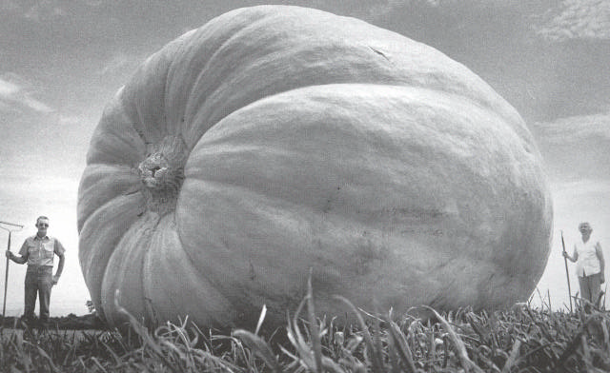
Single-view Ambiguity
Diagram credit: J. Hays

Slide 9
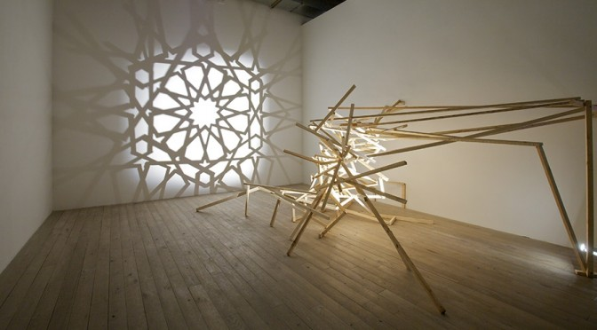
Single-view Ambiguity
Rashad Alakbarov shadow sculptures

Slide 10
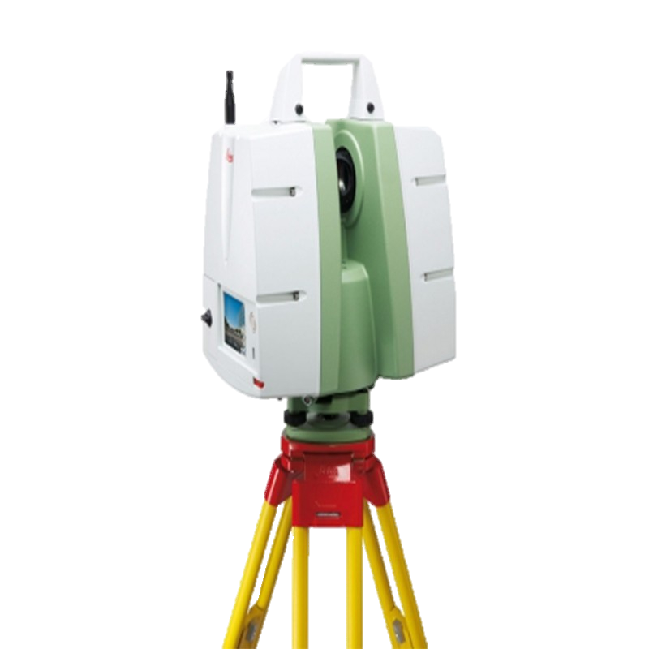
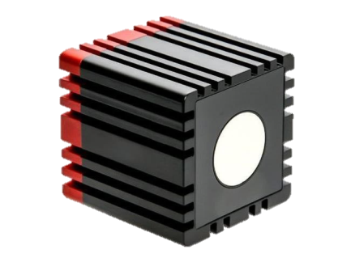
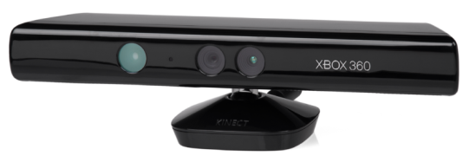
Resolving Single-view Ambiguity
Shoot light (lasers etc.) out of your eyes!
Con: not so biologically plausible, dangerous?

Slide 11
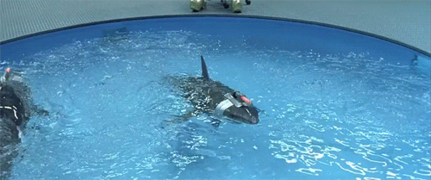
Resolving Single-view Ambiguity
Shoot light (lasers etc.) out of your eyes!
Con: not so biologically plausible, dangerous?

Slide 12
Resolving Single-view Ambiguity
X
x
x
Stereo: given 2 calibrated cameras in different views and correspondences, can solve for X
Original diagram credit: S. Lazebnik

Slide 13
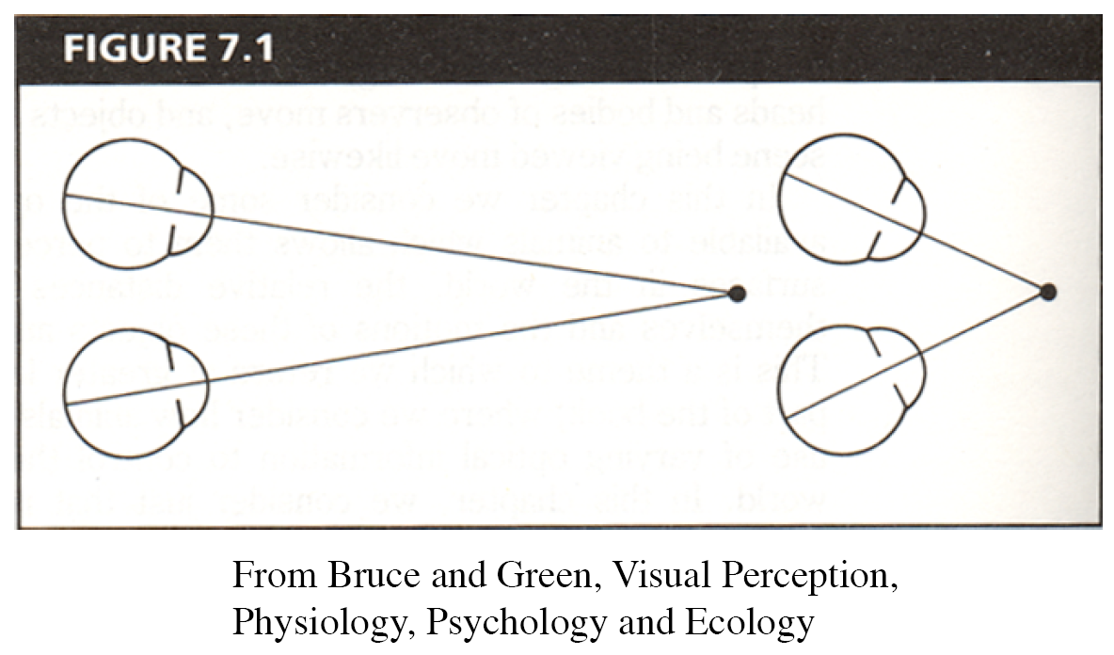
Human eyes fixate on point in space – rotate so that corresponding images form in centers of fovea.
Human stereopsis: disparity
Notes:
13

Slide 14
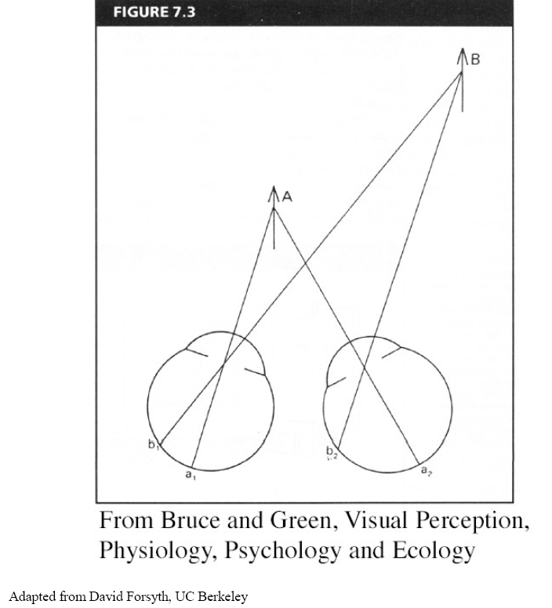
Human stereopsis: disparity
Disparity occurs when eyes fixate on one object; others appear at different visual angles
Notes:
14

Slide 15
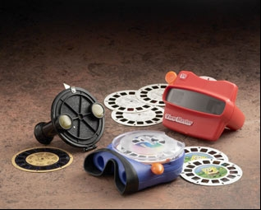
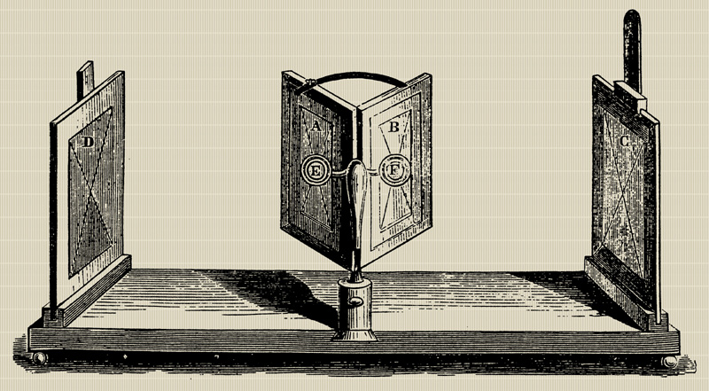
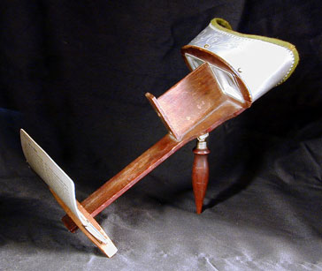
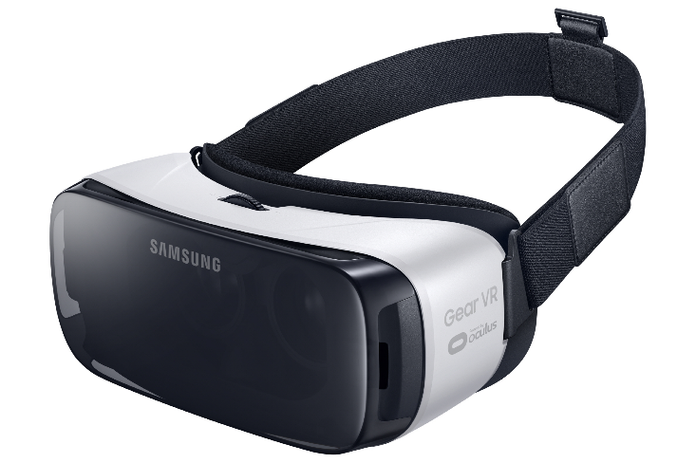
Stereo photography and stereo viewers
Take two pictures of the same subject from two slightly different viewpoints and display so that each eye sees only one of the images.
Image from fisher-price.com
Invented by Sir Charles Wheatstone, 1838
Slide credit: J. Hays

Slide 16
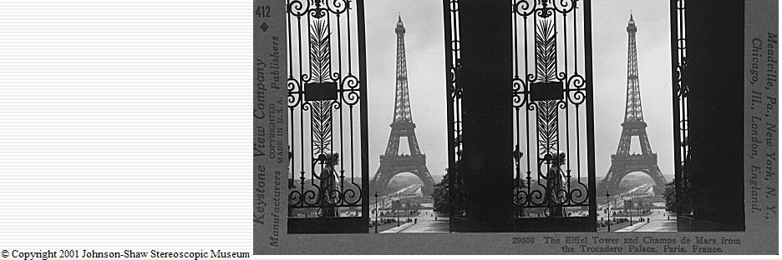
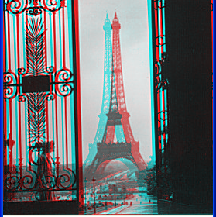
http://www.johnsonshawmuseum.org
Slide credit: J. Hays
Notes:
16

Slide 17
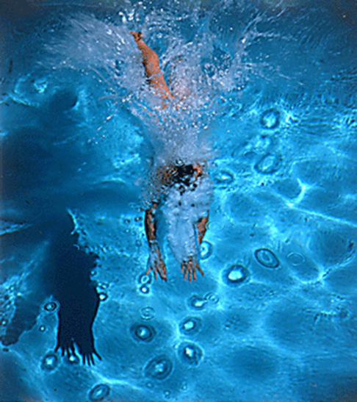
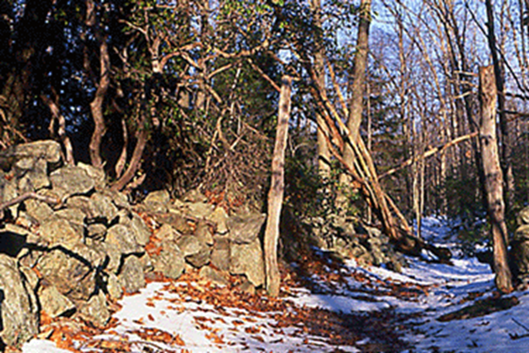
http://www.well.com/~jimg/stereo/stereo_list.html
Slide credit: J. Hays
Notes:
17

Slide 18

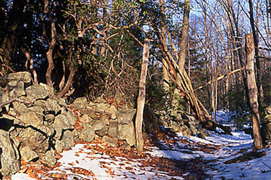
http://www.well.com/~jimg/stereo/stereo_list.html
Slide credit: J. Hays
Notes:
18

Slide 19
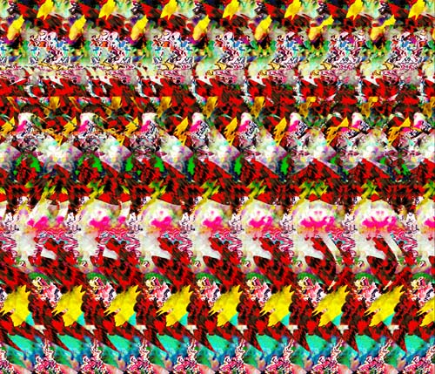
Autostereograms
Exploit disparity as depth cue using single image.
(Single image random dot stereogram, Single image stereogram)
Slide credit: J. Hays, Images from magiceye.com
Notes:
19

Slide 20
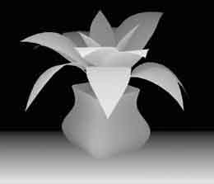
Autostereograms
Slide credit: J. Hays, Images from magiceye.com
Notes:
20

Slide 21

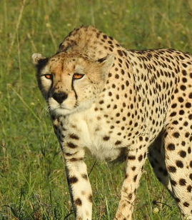
Yeah, yeah, but…
Not all animals see stereo:
Prey animals (large field of view to spot predators)
Stereoblind people

Slide 22
Resolving Single-view Ambiguity
X
x
R,t
One option: move, find correspondence.
If you know how you moved and have a calibrated camera, can solve for X
Original diagram credit: S. Lazebnik

Slide 23
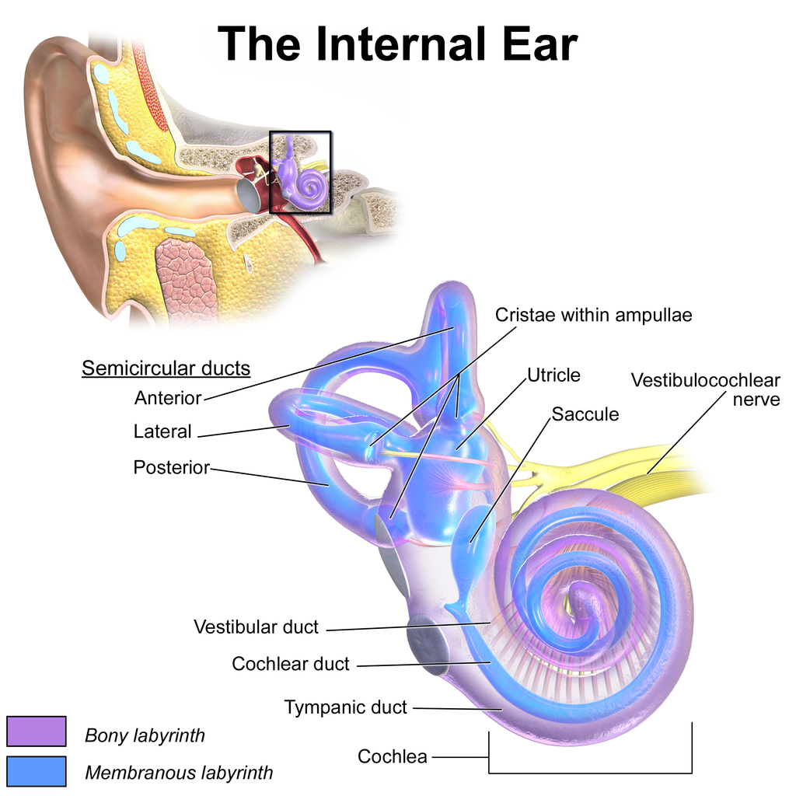
Knowing R,t
How do you know how far you moved?
Can solve via vision
Can solve via ears
Why does your inner ear have 3 ducts?
Can solve via signals sent to muscles

Slide 24
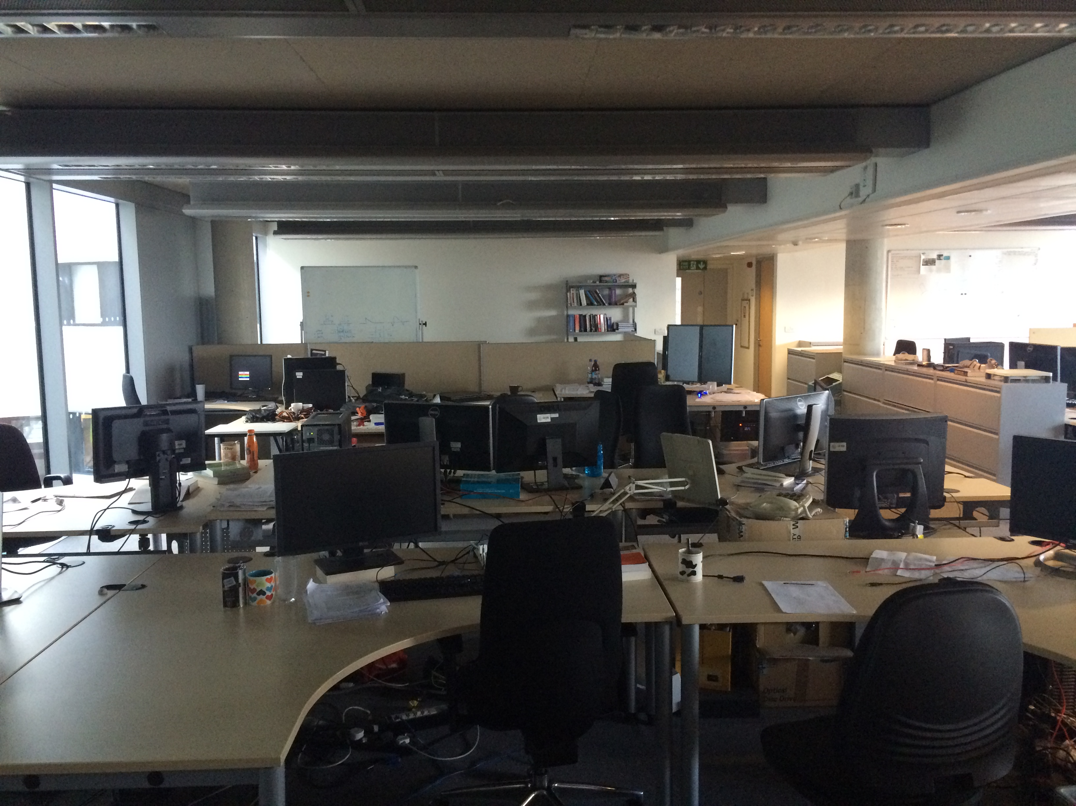
Yeah, yeah, but…
You haven’t been here before, yet you probably have a fairly good understanding of this scene.

Slide 25
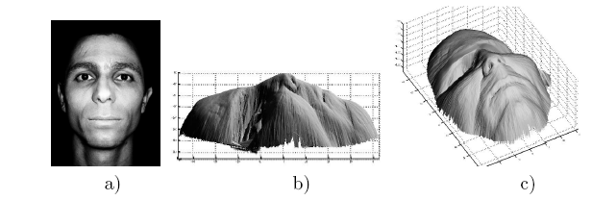
Pictorial Cues – Shading
[Figure from Prados & Faugeras 2006]
Notes:
25

Slide 26
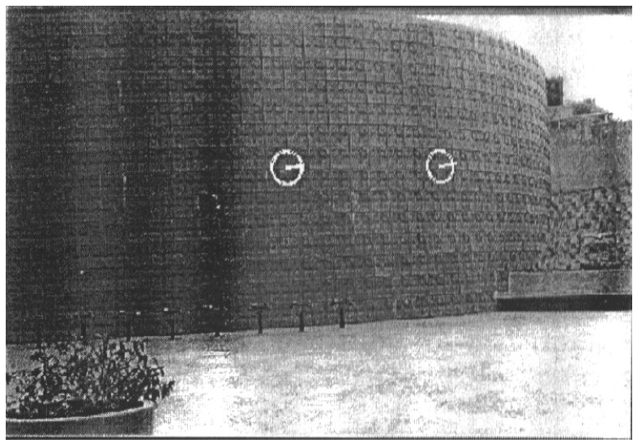
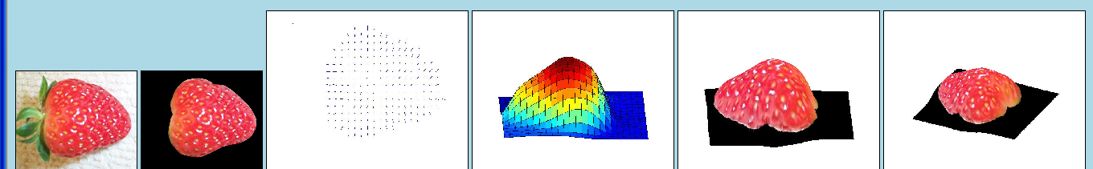
Pictorial Cues – Texture
[From A.M. Loh. The recovery of 3-D structure using visual texture patterns. PhD thesis]
Notes:
26

Slide 27

Pictorial Cues – Perspective effects
Image credit: S. Seitz

Slide 28
Pictorial Cues – Familiar Objects
Monitor: probably not
12 feet wide.
Desk surface: probably flat

Slide 29
Reality of 3D Perception
3D perception is absurdly complex and involves integration of many cues:
  Learned cues for 3D
  Stereo between eyes
  Stereo via motion
  Integration of known motion signals to muscles (efferent copy), acceleration sensed via ears
  Past experience of touching objects
All connect: learned cues from 3D probably come from stereo/motion cues in large part
Really fantastic article on cues for 3D from Cutting and Vishton, 1995: https://pmvish.people.wm.edu/cutting%26vishton1995.pdf

Slide 30
How are Cues Combined?
Ames illusion persists (in a weaker form) even if you have stereo vision –gussing the texture is rectilinear is usually incredibly reliable
Gehringer and Engel, Journal of Experimental Psychology: Human Perception and Performance, 1986

Slide 31
More Formally

Slide 32
Multi-view geometry problems
Calibration:
We need camera intrinsics / K in order to figure out where the rays are
Camera 1
?
K
Slide credit: Noah Snavely
Notes:
Structure from motion solves the following problem:
Given a set of images of a static scene with 2D points in correspondence, shown here as color-coded points, find…
a set of 3D points P and
a rotation R and position t of the cameras that explain the observed correspondences. In other words, when we project a point into any of the cameras, the reprojection error between the projected and observed 2D points is low.
This problem can be formulated as an optimization problem where we want to find the rotations R, positions t, and 3D point locations P that minimize sum of squared reprojection errors f. This is a non-linear least squares problem and can be solved with algorithms such as Levenberg-Marquart. However, because the problem is non-linear, it can be susceptible to local minima. Therefore, it’s important to initialize the parameters of the system carefully. In addition, we need to be able to deal with erroneous correspondences.

Slide 33
Multi-view geometry problems
Recovering structure:
Given cameras and correspondences, find 3D.
?
Camera 1
Camera 3
R₁,t₁
Camera 2
R₃,t₃
R₂,t₂
Slide credit: Noah Snavely
Notes:
Structure from motion solves the following problem:
Given a set of images of a static scene with 2D points in correspondence, shown here as color-coded points, find…
a set of 3D points P and
a rotation R and position t of the cameras that explain the observed correspondences. In other words, when we project a point into any of the cameras, the reprojection error between the projected and observed 2D points is low.
This problem can be formulated as an optimization problem where we want to find the rotations R, positions t, and 3D point locations P that minimize sum of squared reprojection errors f. This is a non-linear least squares problem and can be solved with algorithms such as Levenberg-Marquart. However, because the problem is non-linear, it can be susceptible to local minima. Therefore, it’s important to initialize the parameters of the system carefully. In addition, we need to be able to deal with erroneous correspondences.

Slide 34
Multi-view geometry problems
Stereo/Epipolar Geomery:
Given 2 cameras and find where a point could be
Camera 1
Camera 3
R₁,t₁
Camera 2
R₃,t₃
R₂,t₂
Slide credit: Noah Snavely
Notes:
Structure from motion solves the following problem:
Given a set of images of a static scene with 2D points in correspondence, shown here as color-coded points, find…
a set of 3D points P and
a rotation R and position t of the cameras that explain the observed correspondences. In other words, when we project a point into any of the cameras, the reprojection error between the projected and observed 2D points is low.
This problem can be formulated as an optimization problem where we want to find the rotations R, positions t, and 3D point locations P that minimize sum of squared reprojection errors f. This is a non-linear least squares problem and can be solved with algorithms such as Levenberg-Marquart. However, because the problem is non-linear, it can be susceptible to local minima. Therefore, it’s important to initialize the parameters of the system carefully. In addition, we need to be able to deal with erroneous correspondences.

Slide 35
Multi-view geometry problems
Motion:
Figure out R, t for a set of cameras given correspondences
Camera 1
?
Camera 2
?
?
Camera 3
R₁,t₁
R₃,t₃
R₂,t₂
Slide credit: Noah Snavely
Notes:
Structure from motion solves the following problem:
Given a set of images of a static scene with 2D points in correspondence, shown here as color-coded points, find…
a set of 3D points P and
a rotation R and position t of the cameras that explain the observed correspondences. In other words, when we project a point into any of the cameras, the reprojection error between the projected and observed 2D points is low.
This problem can be formulated as an optimization problem where we want to find the rotations R, positions t, and 3D point locations P that minimize sum of squared reprojection errors f. This is a non-linear least squares problem and can be solved with algorithms such as Levenberg-Marquart. However, because the problem is non-linear, it can be susceptible to local minima. Therefore, it’s important to initialize the parameters of the system carefully. In addition, we need to be able to deal with erroneous correspondences.

Slide 36
Outline
(Today) Calibration:
  Getting intrinsic matrix/K
Single view geometry:
  measurements with 1 image
Stereo/Epipolar geometry:
  2 pictures → depthmap
Structure from motion (SfM):
  2+ pictures → cameras, pointcloud

Slide 37
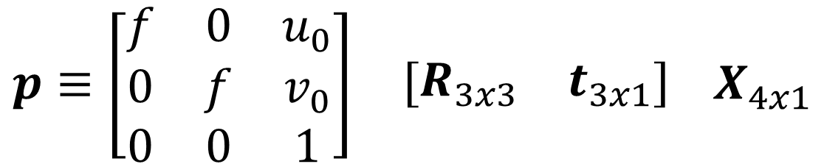
Typical Perspective Model
principal point (image coords of camera origin on retina)
Just moves camera origin
focal length
rotation
translation
$$p≡\begin{matrix}\left[\begin{matrix}f & 0 & u_{0} \\ 0 & f & v_{0} \\ 0 & 0 & 1\end{matrix}\right] & \left[\begin{matrix}R_{3x3} & t_{3x1}\end{matrix}\right]\end{matrix} X_{4x1}$$
2D Projection of X
3D point

Slide 38
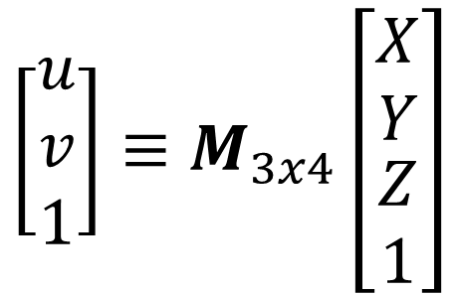
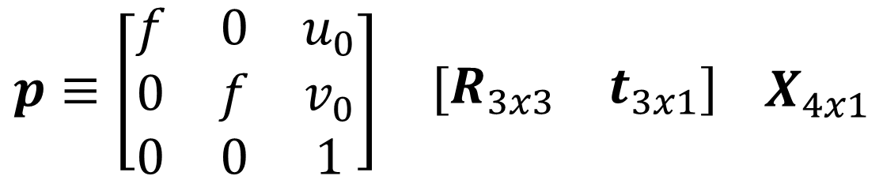
Camera Calibration
$$p≡\begin{matrix}\left[\begin{matrix}f & 0 & u_{0} \\ 0 & f & v_{0} \\ 0 & 0 & 1\end{matrix}\right] & \left[\begin{matrix}R_{3x3} & t_{3x1}\end{matrix}\right]\end{matrix} X_{4x1}$$
$$\left[\begin{matrix}u \\ v \\ 1\end{matrix}\right]≡M_{3x4}\left[\begin{matrix}\begin{matrix}X \\ Y\end{matrix} \\ \begin{matrix}Z \\ 1\end{matrix}\end{matrix}\right]$$
If I can get pairs of [X,Y,Z] and [u,v]
→ equations to constrain M
How do I get [X,Y,Z], [u,v]

Slide 39

Camera Calibration
A funny object with multiple planes.

Slide 40
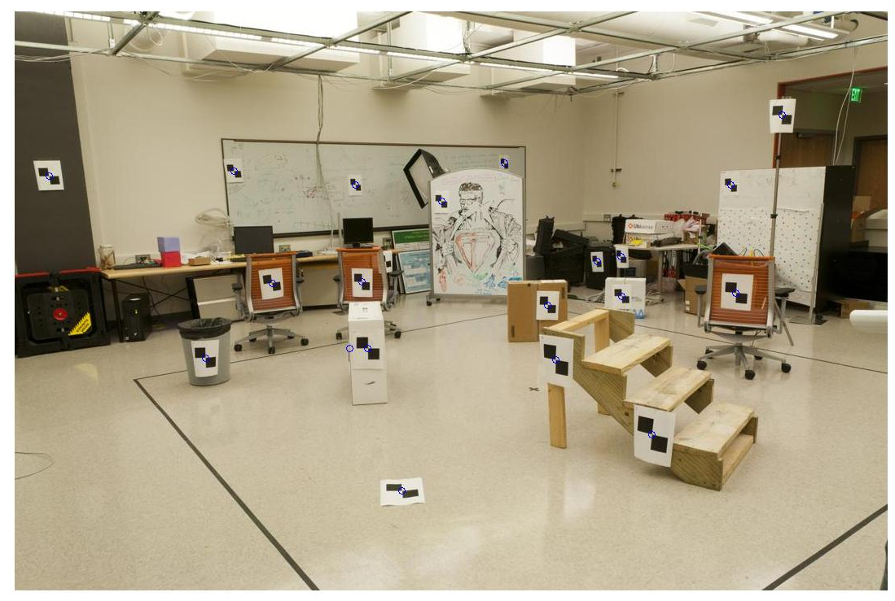
Camera Calibration Targets
Using a tape measure
Known 2d image coords
Known 3d locations
880 214
43 203
270 197
886 347
745 302
943 128
476 590
419 214
317 335
783 521
235 427
665 429
655 362
427 333
412 415
746 351
434 415
525 234
716 308
602 187
312.747 309.140 30.086
305.796 311.649 30.356
307.694 312.358 30.418
310.149 307.186 29.298
311.937 310.105 29.216
311.202 307.572 30.682
307.106 306.876 28.660
309.317 312.490 30.230
307.435 310.151 29.318
308.253 306.300 28.881
306.650 309.301 28.905
308.069 306.831 29.189
309.671 308.834 29.029
308.255 309.955 29.267
307.546 308.613 28.963
311.036 309.206 28.913
307.518 308.175 29.069
309.950 311.262 29.990
312.160 310.772 29.080
311.988 312.709 30.514
Image credit: J. Hays

Slide 41
Camera Calibration Targets
A set of views of a plane (not covered today)
…

Slide 42
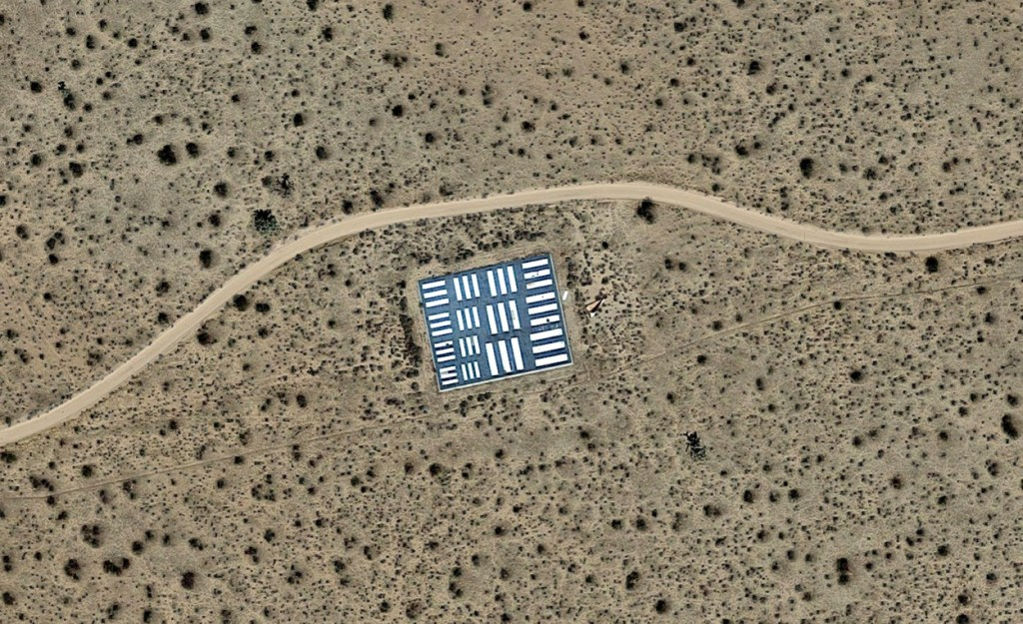
Camera Calibration Targets
A single, huge plane. What’s this for?

Slide 43
Camera calibration
Given n points with known 3D coordinates X_{i} and known image projections p_{i}, estimate the camera parameters
X_{i}
p_{i}
Slide credit: S. Lazebnik

Slide 44



Camera Calibration: Linear Method
$$p_{i}≡MX_{i}$$
Remember (from geometry): this implies MX_{i} p_{i} are scaled copies of each other
$$p_{i}=λMX_{i}, λ≠0$$
Remember (from homography fitting): this implies their cross product is 0
$$p_{i}×MX_{i}=0$$

Slide 45
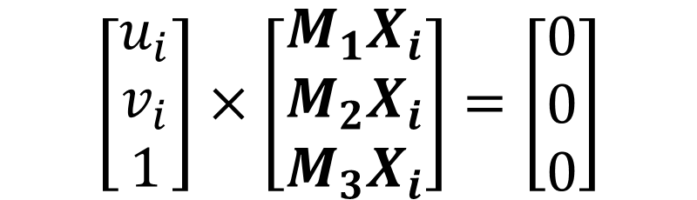

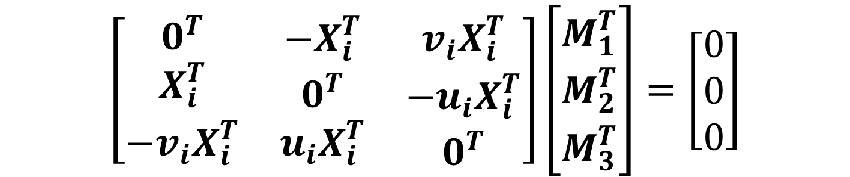
Camera Calibration: Linear Method
$$p_{i}×MX_{i}=0$$
$$\left[\begin{matrix}u_{i} \\ v_{i} \\ 1\end{matrix}\right]×\left[\begin{matrix}M_{1}X_{i} \\ M_{2}X_{i} \\ M_{3}X_{i}\end{matrix}\right]=\left[\begin{matrix}0 \\ 0 \\ 0\end{matrix}\right]$$
…Some tedious math occurs…
(see Homography deriviation)
$$\left[\begin{matrix}\begin{matrix}0^{T} \\ X_{i}^{T} \\ −v_{i}X_{i}^{T}\end{matrix} & \begin{matrix}−X_{i}^{T} \\ 0^{T} \\ u_{i}X_{i}^{T}\end{matrix} & \begin{matrix}v_{i}X_{i}^{T} \\ −u_{i}X_{i}^{T} \\ 0^{T}\end{matrix}\end{matrix}\right]\left[\begin{matrix}M_{1}^{T} \\ M_{2}^{T} \\ M_{3}^{T}\end{matrix}\right]=\left[\begin{matrix}0 \\ 0 \\ 0\end{matrix}\right]$$

Slide 46
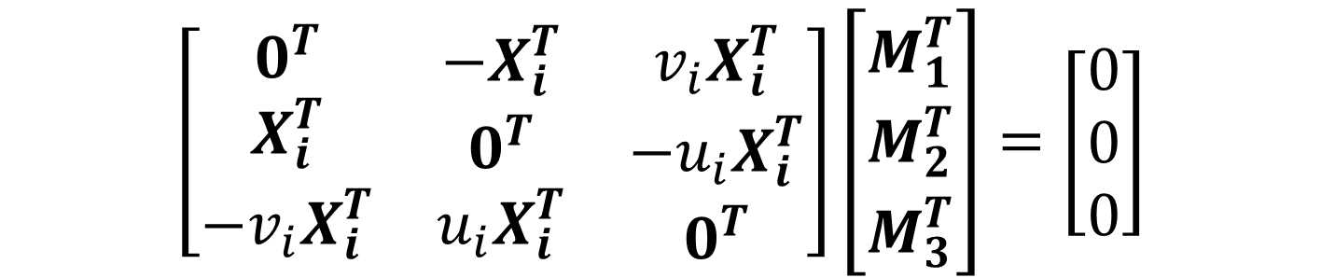
Camera Calibration: Linear Method
$$\left[\begin{matrix}\begin{matrix}0^{T} \\ X_{i}^{T} \\ −v_{i}X_{i}^{T}\end{matrix} & \begin{matrix}−X_{i}^{T} \\ 0^{T} \\ u_{i}X_{i}^{T}\end{matrix} & \begin{matrix}v_{i}X_{i}^{T} \\ −u_{i}X_{i}^{T} \\ 0^{T}\end{matrix}\end{matrix}\right]\left[\begin{matrix}M_{1}^{T} \\ M_{2}^{T} \\ M_{3}^{T}\end{matrix}\right]=\left[\begin{matrix}0 \\ 0 \\ 0\end{matrix}\right]$$
How many linearly independent equations?
2
How many equations per [u,v] + [X,Y,Z] pair?
2
If M is 3x4, how many degrees of freedom?
11

Slide 47
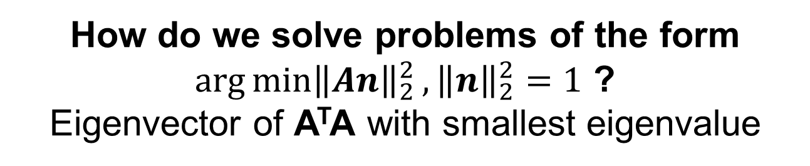
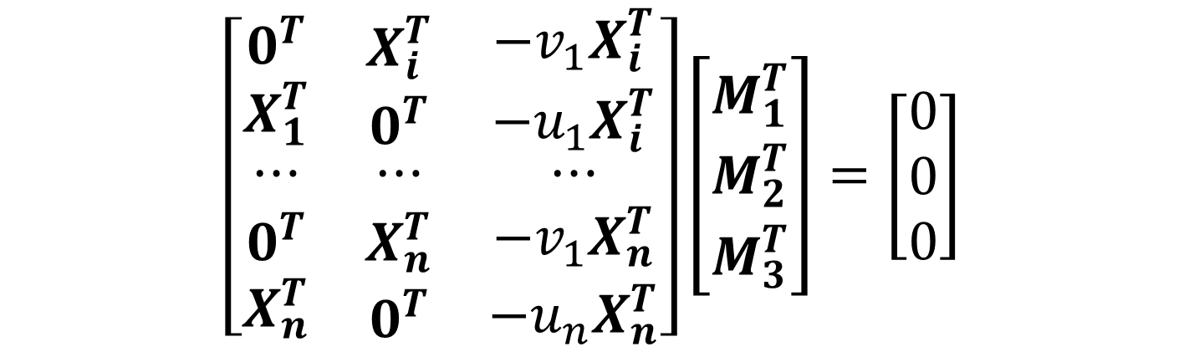
Camera Calibration: Linear Method
$$\left[\begin{matrix}\begin{matrix}0^{T} \\ X_{1}^{T}\end{matrix} & \begin{matrix}X_{i}^{T} \\ 0^{T}\end{matrix} & \begin{matrix}−v_{1}X_{i}^{T} \\ −u_{1}X_{i}^{T}\end{matrix} \\ ⋯ & ⋯ & ⋯ \\ \begin{matrix}0^{T} \\ X_{n}^{T}\end{matrix} & \begin{matrix}X_{n}^{T} \\ 0^{T}\end{matrix} & \begin{matrix}−v_{1}X_{n}^{T} \\ −u_{n}X_{n}^{T}\end{matrix}\end{matrix}\right]\left[\begin{matrix}M_{1}^{T} \\ M_{2}^{T} \\ M_{3}^{T}\end{matrix}\right]=\left[\begin{matrix}0 \\ 0 \\ 0\end{matrix}\right]$$
How do we solve problems of the form ${\arg{\min\left\|An\right\|}}_{2}^{2}, {\left\|n\right\|}_{2}^{2}=1$ ?
Eigenvector of A^{T}A with smallest eigenvalue
Derivation from L. Lazebnik; note we negate one of the equations from the cross product

Slide 48
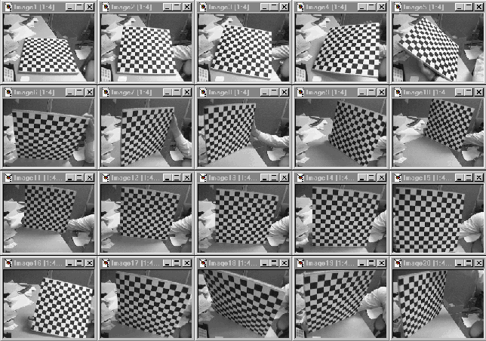
In Practice
Degenerate configurations (e.g., all points on one plane) an issue. Usually need multiplane targets.

Slide 49


In Practice
I pulled a fast one.
We want:
$$p≡K_{3x3}[R_{3x3},t_{3x1}] X_{4x1}$$
We get:
$$p≡M_{3x4}X_{4x1}$$
What’s the difference between K[R,t] and M?
Solution: QR-decomposition on left-most 3x3 matrix → finite options of a upper triangular matrix * rotation

Slide 50
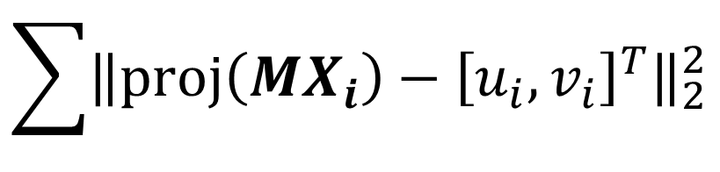
In Practice
If p_{i} = Mx_{i} is overconstrained, the objective function isn’t actually the one you care about.
Instead:
initialize parameters with linear model
2) Apply off-the-shelf non-linear optimizer to:
$$\sum{{\left\|proj\left(MX_{i}\right)−{\left[u_{i},v_{i}\right]}^{T}\right\|}_{2}^{2}}$$
Advantage: can also add radial distortion, not optimize over known variables, add constraints

Slide 51
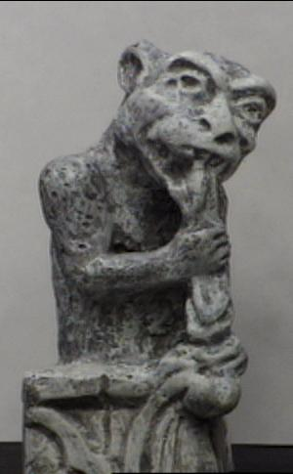
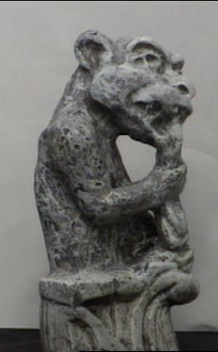
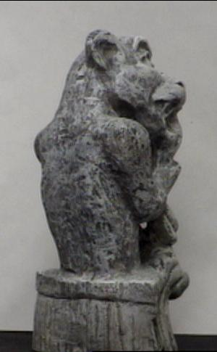
What Does This Get You?
Given projection p_{i} of unknown 3D point X in two or more images (with known cameras M_{i}), find X

Slide 52
Triangulation
Given projection p_{i} of unknown 3D point X in two or more images (with known cameras M_{i}), find X
Why is the calibration here important?
X?
p₁
p₂

Slide 53
Triangulation
Rays in principle should intersect, but in practice usually don’t exactly due to noise, numerical errors.
X?
p₁
p₂

Slide 54
Triangulation – Geometry
Find shortest segment between viewing rays, set X to be the midpoint of the segment.
X
p₁
p₂

Slide 55
Triangulation – Non-linear Optim.
Find X minimizing $d{\left(p_{1},M_{1}X\right)}^{2}+d{\left(p_{2},M_{2}X\right)}^{2}$
X
p₁
j
p₂
M₁X
M₂X

Slide 56



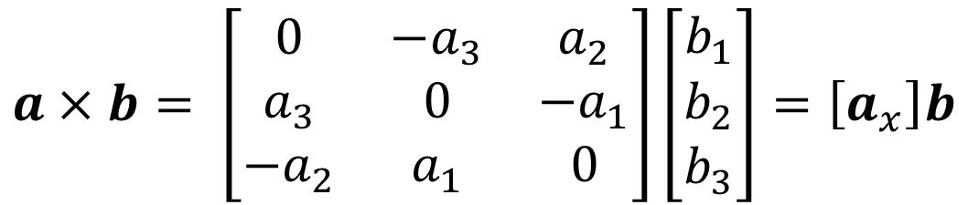







Triangulation – Linear Optimization
$$p_{1}≡M_{1}X$$
$$p_{1}×M_{1}X=0$$
$$[p_{1x}]M_{1}X=0$$
$$p_{2}≡M_{2}X$$
$$p_{2}×M_{2}X=0$$
$$[p_{2x}]M_{2}X=0$$
$$a×b= \left[\begin{matrix}0 & −a_{3} & a_{2} \\ a_{3} & 0 & −a_{1} \\ −a_{2} & a_{1} & 0\end{matrix}\right]\left[\begin{matrix}b_{1} \\ b_{2} \\ b_{3}\end{matrix}\right]=\left[a_{x}\right]b$$
Cross Prod.
as matrix
Two eqns per camera for 3 unkn. in X
$$[p_{1x}]M_{1}X=0$$
$$([p_{1x}]M_{1})X=0$$
$$[p_{2x}]M_{2}X=0$$
$$([p_{2x}]M_{2})X=0$$

