Slide 1
Detectors and Descriptors
EECS 442 – David Fouhey
Fall 2019, University of Michigan
http://web.eecs.umich.edu/~fouhey/teaching/EECS442_F19/

Slide 2
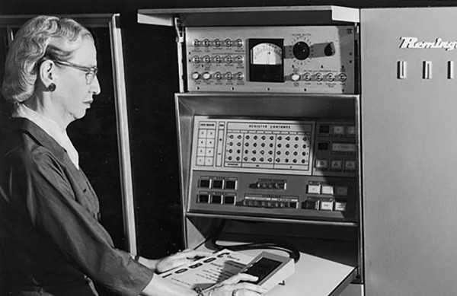
Goal
How big is this image as a vector?
389x600 = 233,400 dimensions (big)

Slide 3
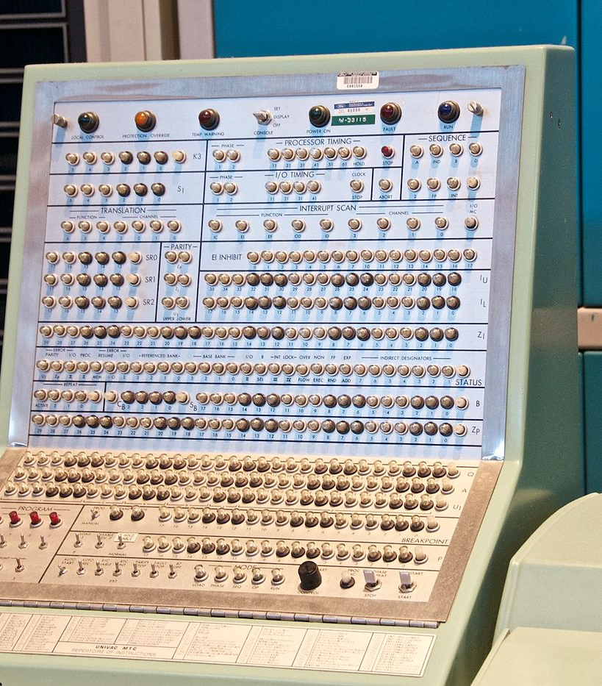
Applications To Have In Mind
Part of the same photo?
Same computer from another angle?

Slide 4
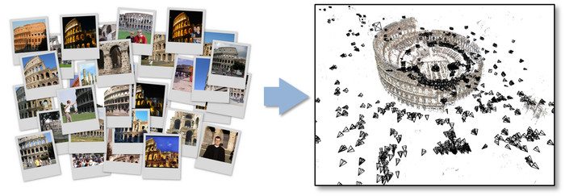
Applications To Have In Mind
Building a 3D Reconstruction Out Of Images
Slide Credit: N. Seitz

Slide 5
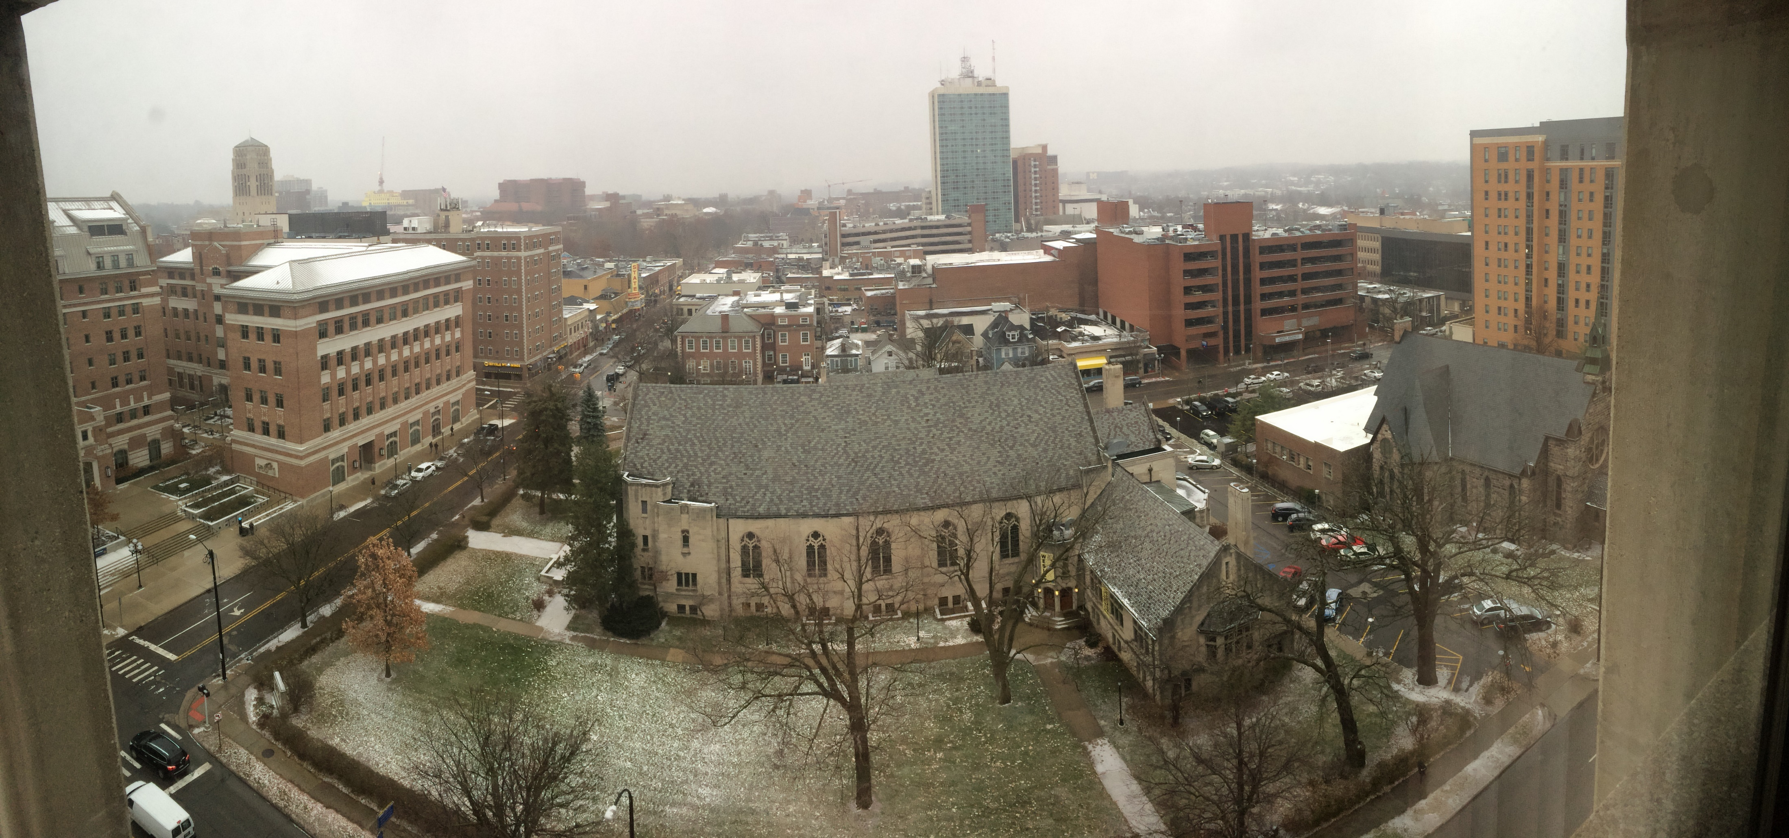
Applications To Have In Mind
Stitching photos taken at different angles

Slide 6
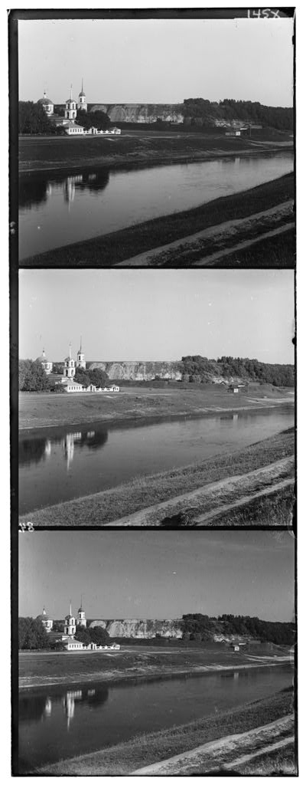
One Familiar Example
Given two images: how do you align them?

Slide 7
One (Hopefully Familiar) Solution
for y in range(-ySearch,ySearch+1):
for x in range(-xSearch,xSearch+1):
#Touches all HxW pixels!
check_alignment_with_images()

Slide 8


One Motivating Example
Given these images: how do you align them?
These aren’t off by a small 2D translation but instead by a 3D rotation + translation of the camera.
Photo credit: M. Brown, D. Lowe

Slide 9
One (Hopefully Familiar) Solution
for y in yRange:
for x in xRange:
for z in zRange:
for xRot in xRotVals:
for yRot in yRotVals:
for zRot in zRotVals:
#touches all HxW pixels!
check_alignment_with_images()
This code should make you really unhappy
Note: this actually isn’t even the full number of parameters; it’s actually 8 for loops.

Slide 10
An Alternate Approach
Given these images: how would you align them?
A mountain peak!
A mountain peak!
This dark spot
This dark spot

Slide 11


An Alternate Approach
Finding and Matching
1: find corners+features
2: match based on local image data
Slide Credit: S. Lazebnik, original figure: M. Brown, D. Lowe

Slide 12
What Now?
Given pairs
p1,p2 of correspondence, how do I align?
Consider translation-only case from HW1.

Slide 13
An Alternate Approach
Solving for a Transformation
T
3: Solve for transformation T (e.g. such that p1 ≡ T p2) that fits the matches well
Note the homogeneous coordinates, you’ll see them again.
Slide Credit: S. Lazebnik, original figure: M. Brown, D. Lowe

Slide 14

An Alternate Approach
Blend Them Together
Key insight: we don’t work with full image. We work with only parts of the image.
Photo Credit: M. Brown, D. Lowe

Slide 15
Today
Finding edges (part 1) and corners (part 2) in images.
Corner of
the glasses
Edge next to panel

Slide 16
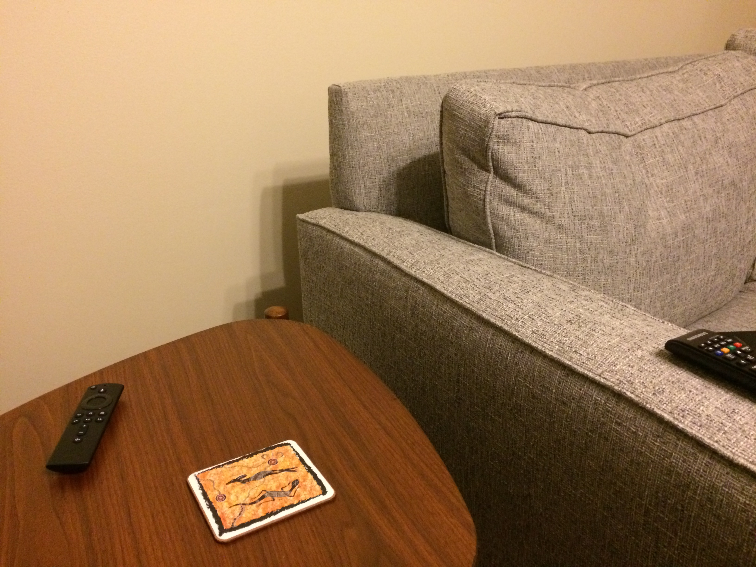
Where do Edges Come From?

Slide 17
Where do Edges Come From?
Depth / Distance
Discontinuity
Why?

Slide 18
Where do Edges Come From?
Surface Normal / Orientation Discontinuity
Why?

Slide 19
Where do Edges Come From?
Surface Color / Reflectance Properties Discontinuity

Slide 20
Where do Edges Come From?
Illumination
Discontinuity

Slide 21
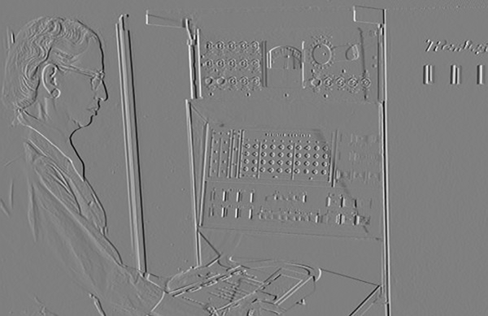
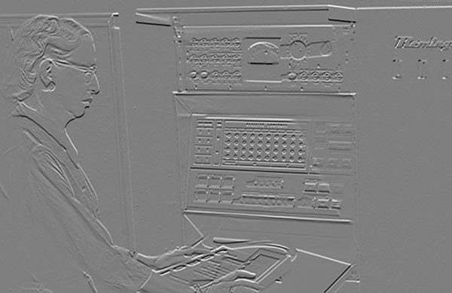
Last Time
T
-1
0
1
-1
0
1
Ix
Iy

Slide 22
Derivatives
Remember derivatives?
Derivative: rate at which a function f(x) changes at a point as well as the direction that increases the function

Slide 23
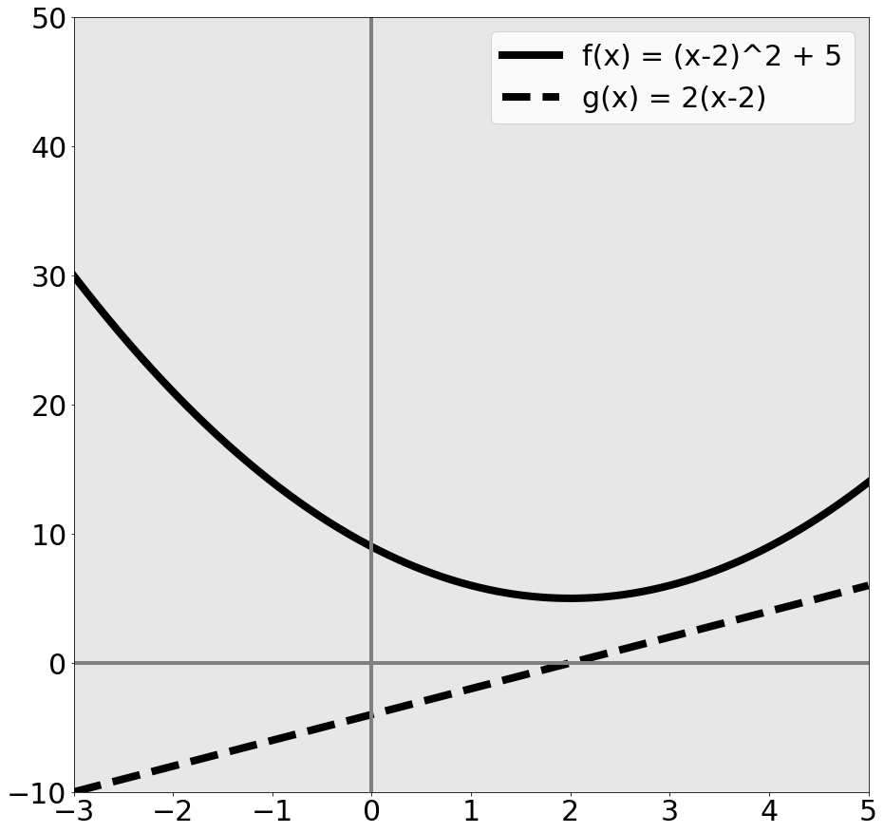
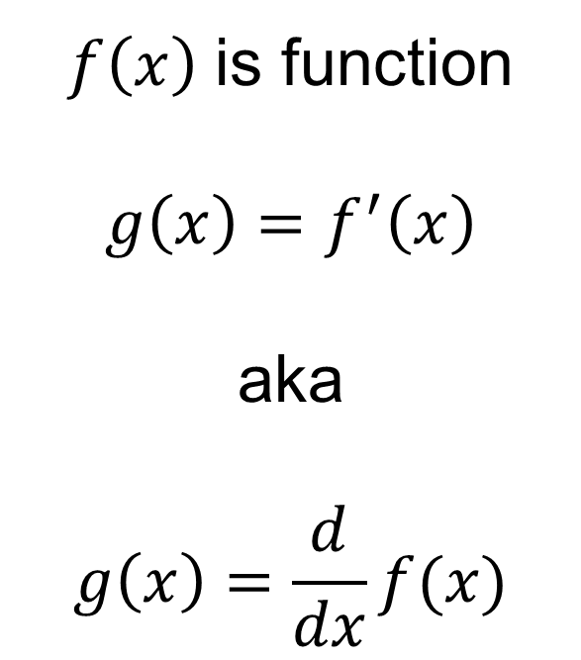

Given quadratic function f(x)
$$f\left(x\right)={\left(x−2\right)}^{2}+5$$
$f\left(x\right)$ is function
$g\left(x\right)=f^{′}\left(x\right)$
aka
$$g\left(x\right)=\frac{d}{dx}f(x)$$

Slide 24

Given quadratic function f(x)
$$f\left(x\right)={\left(x−2\right)}^{2}+5$$
What’s special about x=2?
$f\left(x\right)$ minim. at 2
$g\left(x\right)=0$ at 2
a = minimum of f →
$$g\left(a\right)=0$$
Reverse is not true

Slide 25
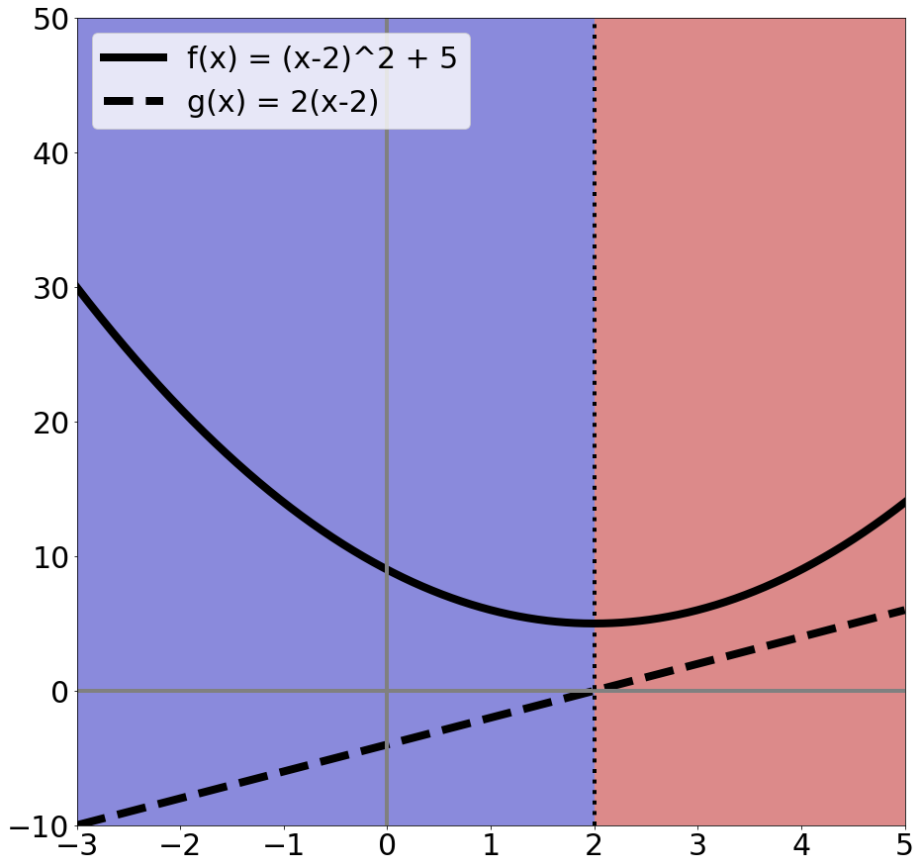
Rates of change
$$f\left(x\right)={\left(x−2\right)}^{2}+5$$
Suppose I want to increase f(x) by changing x:
Blue area: move left
Red area: move right
Derivative tells you direction of ascent and rate

Slide 26
What Calculus Should I Know
Really need intuition
Need chain rule
Rest you should look up / use a computer algebra system / use a cookbook
Partial derivatives (and that’s it from multivariable calculus)

Slide 27
Partial Derivatives
Pretend other variables are constant, take a derivative. That’s it.
Make our function a function of two variables
$$f\left(x\right)={\left(x−2\right)}^{2}+5$$
$$\frac{∂}{∂x}f\left(x\right)=2\left(x−2\right)∗1=2(x−2)$$
Pretend it’s constant → derivative = 0
$$f_{2}\left(x,y\right)={\left(x−2\right)}^{2}+5+{\left(y+1\right)}^{2}$$
$$\frac{∂}{∂x}f_{2}\left(x\right)=2(x−2)$$

Slide 28
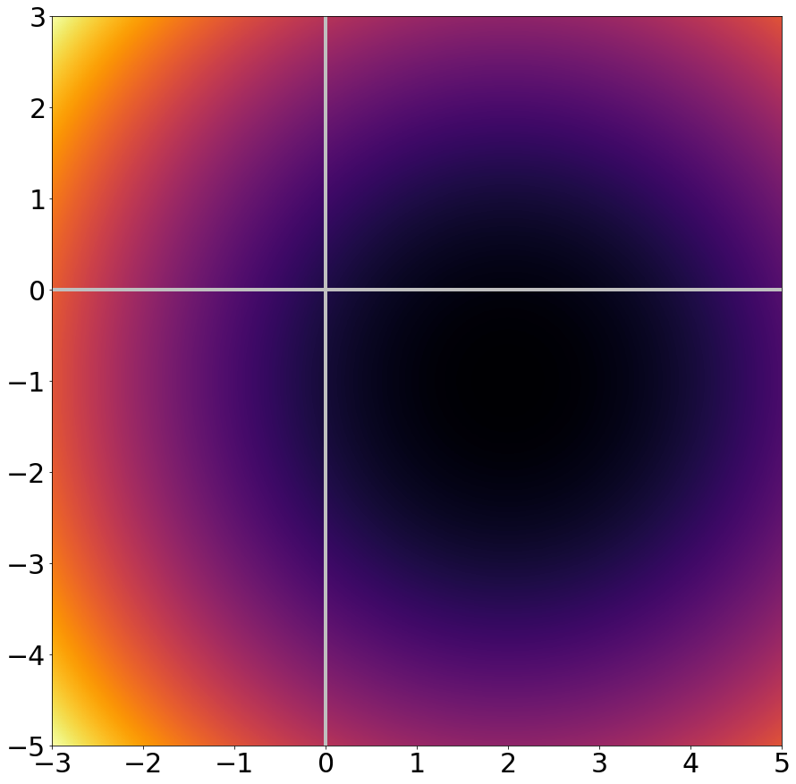
Zooming Out
$$f_{2}\left(x,y\right)={\left(x−2\right)}^{2}+5+{\left(y+1\right)}^{2}$$
Dark = f(x,y) low
Bright = f(x,y) high

Slide 29
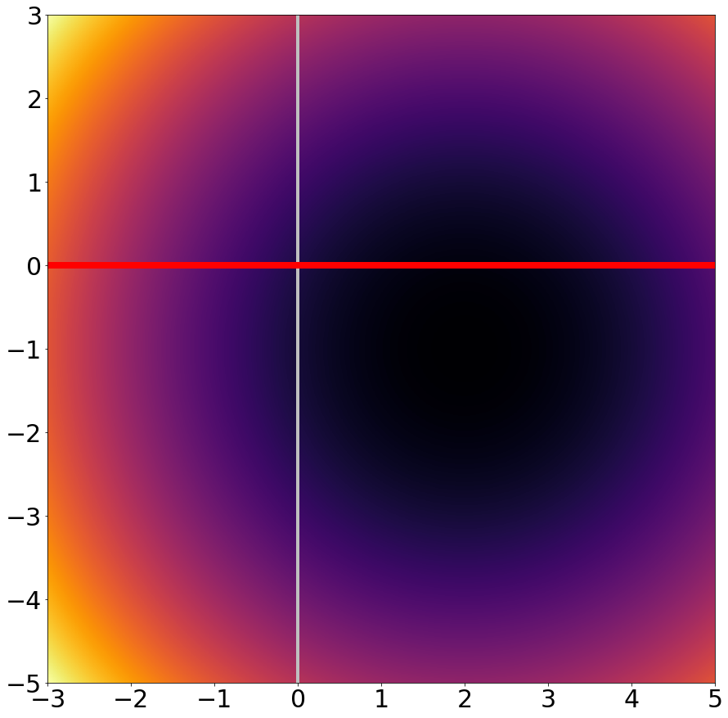
Taking a slice of
$$f_{2}\left(x,y\right)={\left(x−2\right)}^{2}+5+{\left(y+1\right)}^{2}$$
Slice of y=0 is the function from before:
$$f\left(x\right)={\left(x−2\right)}^{2}+5$$
$$f^{′}\left(x\right)=2(x−2)$$

Slide 30
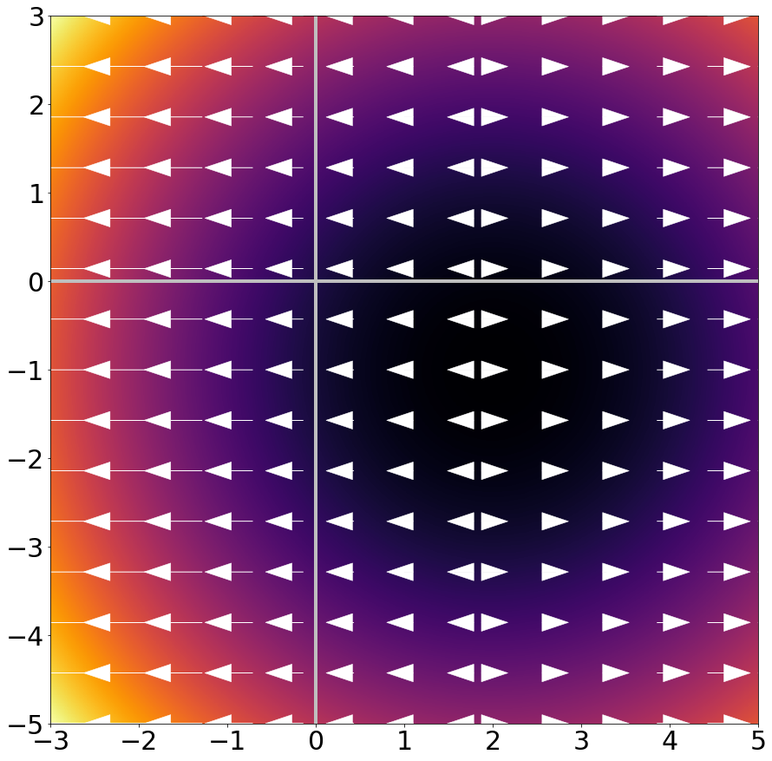
Taking a slice of
$$f_{2}\left(x,y\right)={\left(x−2\right)}^{2}+5+{\left(y+1\right)}^{2}$$
$\frac{∂}{∂x}f_{2}\left(x,y\right)$ is rate of change & direction in x dimension

Slide 31
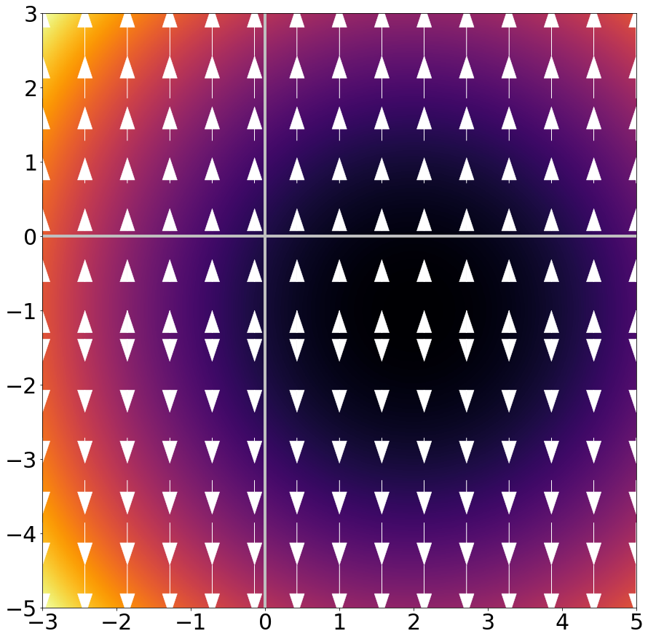
Zooming Out
$$f_{2}\left(x,y\right)={\left(x−2\right)}^{2}+5+{\left(y+1\right)}^{2}$$
$\frac{∂}{∂y}f_{2}\left(x,y\right)$ is
$$2(y+1)$$
and is the rate of change & direction in y dimension

Slide 32
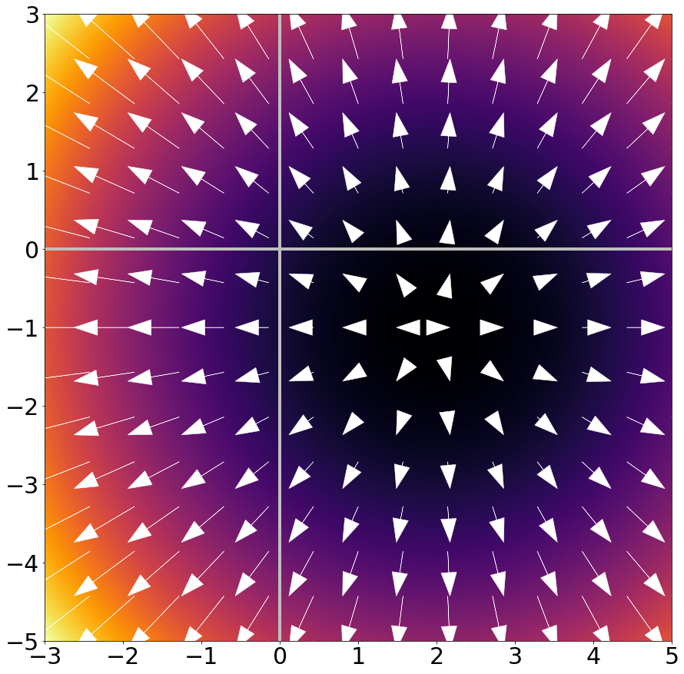
Zooming Out
$$f_{2}\left(x,y\right)={\left(x−2\right)}^{2}+5+{\left(y+1\right)}^{2}$$
Gradient/Jacobian:
Making a vector of
$$∇_{f}=\left[\frac{∂f}{∂x },\frac{∂f}{∂y}\right]$$
gives rate and direction of change.
Arrows point OUT of minimum / basin.

Slide 33
What Should I Know?
Gradients are simply partial derivatives per-dimension: if $x$ in $f(x)$ has n dimensions, $∇_{f}(x)$ has n dimensions
Gradients point in direction of ascent and tell the rate of ascent
If a is minimum of $f(x)$ → $∇_{f}\left(a\right)=0$
Reverse is not true, especially in high-dimensional spaces

Slide 34
Last Time
T
-1
0
1
-1
0
1
Ix
Iy

Slide 35
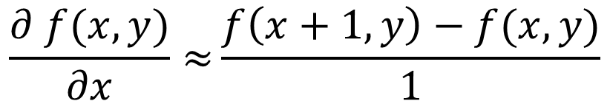
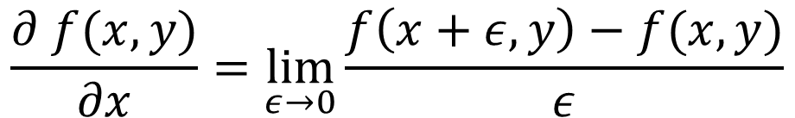
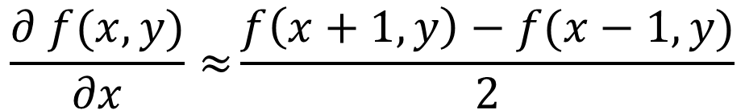
Why Does This Work?
Image is function f(x,y)
$$\frac{∂ f(x,y)}{∂x}=\lim_{ε→0}{\frac{f\left(x+ε,y\right)−f(x,y)}{ε}}$$
Remember:
$$\frac{∂ f(x,y)}{∂x}≈{\frac{f\left(x+1,y\right)−f(x,y)}{1}}$$
Approximate:
-1
1
$$\frac{∂ f(x,y)}{∂x}≈{\frac{f\left(x+1,y\right)−f(x−1,y)}{2}}$$
Another one:
-1
0
1

Slide 36
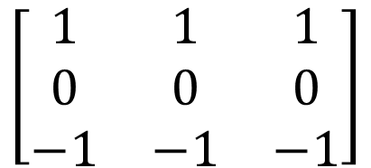
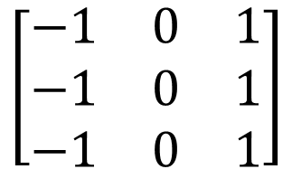
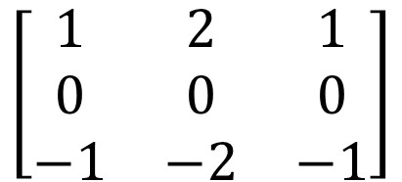
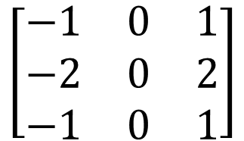
Other Differentiation Operations
Horizontal
Vertical
$$\left[\begin{matrix}−1 & 0 & 1 \\ −1 & 0 & 1 \\ −1 & 0 & 1\end{matrix}\right]$$
$$\left[\begin{matrix}1 & 1 & 1 \\ 0 & 0 & 0 \\ −1 & −1 & −1\end{matrix}\right]$$
Prewitt
$$\left[\begin{matrix}−1 & 0 & 1 \\ −2 & 0 & 2 \\ −1 & 0 & 1\end{matrix}\right]$$
$$\left[\begin{matrix}1 & 2 & 1 \\ 0 & 0 & 0 \\ −1 & −2 & −1\end{matrix}\right]$$
Sobel
Why might people use these compared to [-1,0,1]?

Slide 37
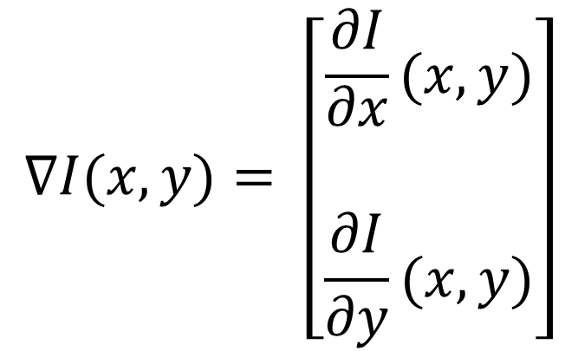
Images as Functions or Points
Key idea: can treat image as a point in R^{(HxW)} or as a function of x,y.
$$∇I(x,y)= \left[\begin{matrix}\frac{∂I}{\begin{aligned}∂x \\ \end{aligned}}(x,y) \\ \frac{∂I}{∂y}(x,y)\end{matrix}\right]$$
How much the intensity of the image changes as you go horizontally at (x,y)
(Often called Ix)

Slide 38
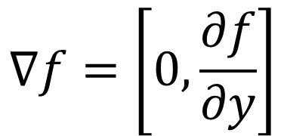
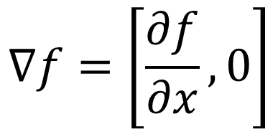
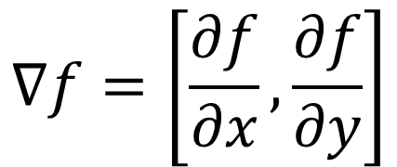
Image Gradient Direction
Some gradients
$$∇f=\left[\frac{∂f}{∂x}, 0\right]$$
$$∇f=\left[0,\frac{∂f}{∂y}\right]$$
$$∇f=\left[\frac{∂f}{∂x}, \frac{∂f}{∂y}\right]$$
Figure Credit: S. Seitz

Slide 39
Image Gradient
Gradient: direction of maximum change.
What’s the relationship to edge direction?
Ix
Iy

Slide 40
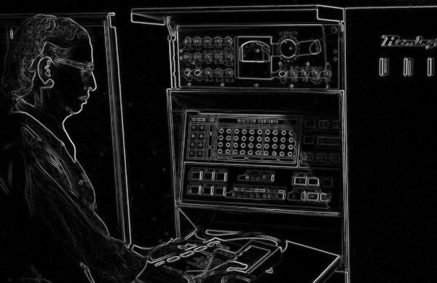
Image Gradient
(Ix² + Iy² )^{1/2} : magnitude

Slide 41
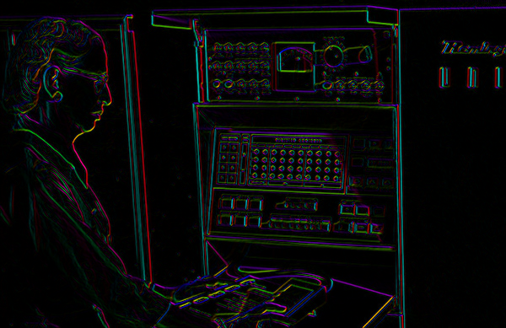

Image Gradient
atan2(Iy,Ix): orientation
I’m making the lightness equal to gradient magnitude

Slide 42
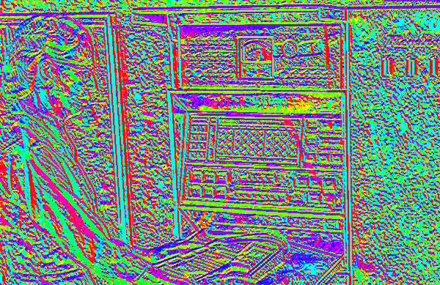
Image Gradient
atan2(Iy,Ix): orientation
Now I’m showing all the gradients

Slide 43
Image Gradient
atan2(Iy,Ix): orientation
Why is there structure at 1 and not at 2?
1
2

Slide 44



Noise
Consider a row of f(x,y) (i.e., fix y)
Slide Credit: S. Seitz

Slide 45



Noise
Conv. image + per-pixel noise with
-1
0
1
$$I_{i,j}=$$
True image
$$ε_{i,j}∼N(0,σ^{2})$$
$$D_{i,j}={(I}_{i,j+1}+ε_{i,j+1})−{(I}_{i,j−1}+ε_{i,j−1 })$$
$$D_{i,j}={(I}_{i,j+1}−{I_{i,j−1})+ ε}_{i,j+1}−ε_{i,j−1 }$$
True difference
Sum of 2 Gaussians
$$ε_{i,j}−ε_{k,l}∼N\left(0,{2σ}^{2}\right)→$$
Variance doubles!

Slide 46
Noise
Consider a row of f(x,y) (i.e., make y constant)
How can we use the last class to fix this?
Slide Credit: S. Seitz

Slide 47
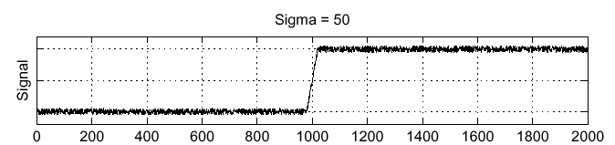
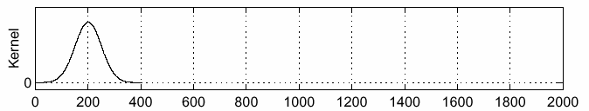
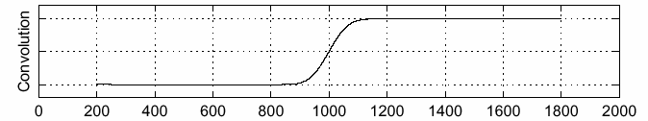
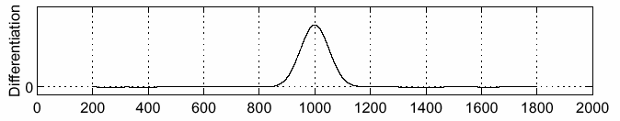
Handling Noise
f
g
f * g
Slide Credit: S. Seitz

Slide 48

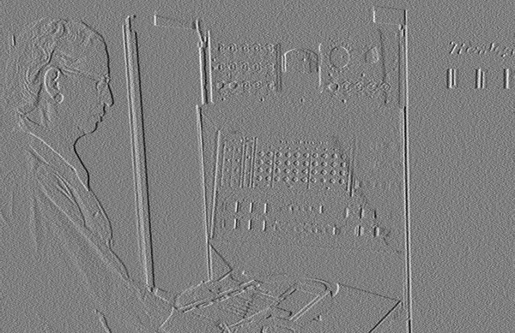
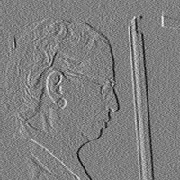

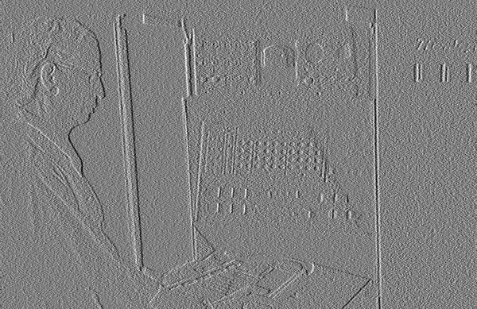
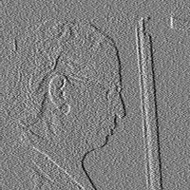
Noise in 2D
Noisy Input
Ix via [-1,01]
Zoom

Slide 49

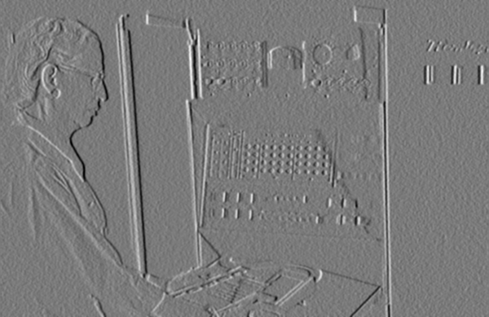
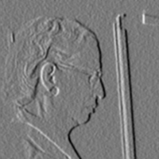



Noise + Smoothing
Smoothed Input
Ix via [-1,01]
Zoom

Slide 50

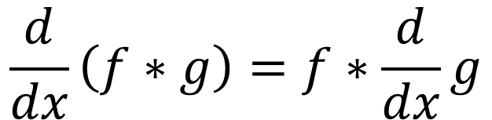
Let’s Make It One Pass (1D)
$$\frac{d}{dx}\left(f∗g\right)=f∗\frac{d}{dx}g$$
f
Slide Credit: S. Seitz

Slide 51


Let’s Make It One Pass (2D)
Gaussian Derivative Filter
Which one finds the X direction?
Slide Credit: L. Lazebnik

Slide 52
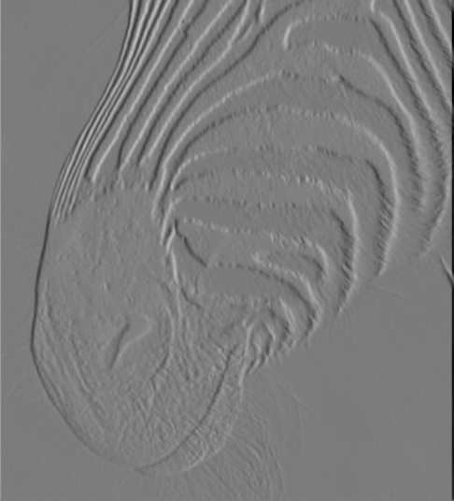
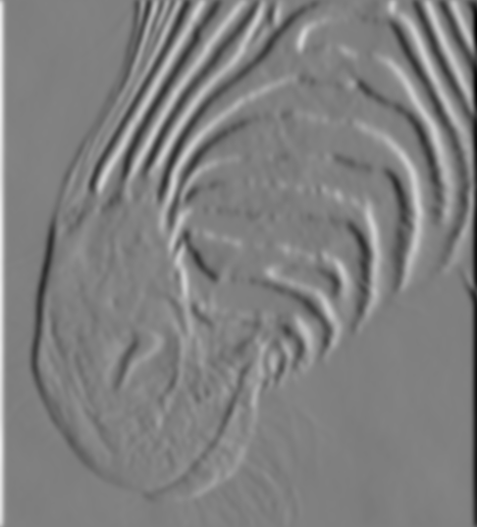
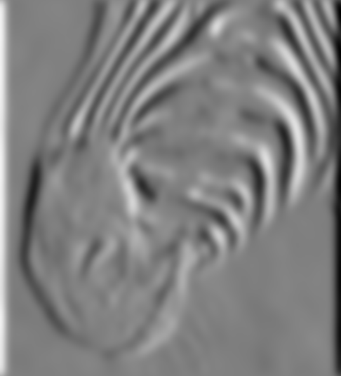
Applying the Gaussian Derivative
1 pixel
3 pixels
7 pixels
Removes noise, but blurs edge
Slide Credit: D. Forsyth

Slide 53
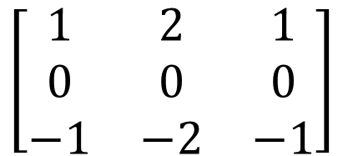
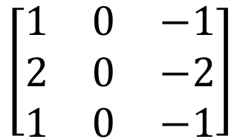
Compared with the Past
Gaussian
Derivative
Sobel
Filter
$$\left[\begin{matrix}1 & 0 & −1 \\ 2 & 0 & −2 \\ 1 & 0 & −1\end{matrix}\right]$$
$$\left[\begin{matrix}1 & 2 & 1 \\ 0 & 0 & 0 \\ −1 & −2 & −1\end{matrix}\right]$$
Why would anybody use the bottom filter?

Slide 54
Filters We’ve Seen
Smoothing
Derivative
Example
Gaussian
Deriv. of gauss
Goal
Remove noise
Find edges
Only +?
Yes
No
Sums to
1
0
Why sum to 1 or 0, intuitively?
Slide Credit: J. Deng

Slide 55






Problems
Image
human segmentation
gradient magnitude
Still an active area of research

Slide 56
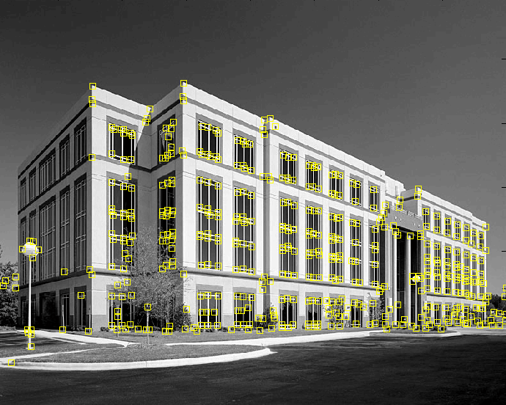
Corners
9300 Harris Corners Pkwy, Charlotte, NC
Slide Credit: S. Lazebnik

Slide 57
Desirables
Repeatable: should find same things even with distortion
Saliency: each feature should be distinctive
Compactness: shouldn’t just be all the pixels
Locality: should only depend on local image data
Property list: S. Lazebnik

Slide 58


Example
Can you find the correspondences?
Slide credit: N. Snavely

Slide 59


Example Matches
Look for the colored squares
Slide credit: N. Snavely

Slide 60

Basic Idea
Should see where we are based on small window, or any shift → big intensity change.
“flat” region:
no change in all directions
“edge”:
no change along the edge direction
“corner”:
significant change in all directions
Slide Credit: S. Lazebnik

Slide 61


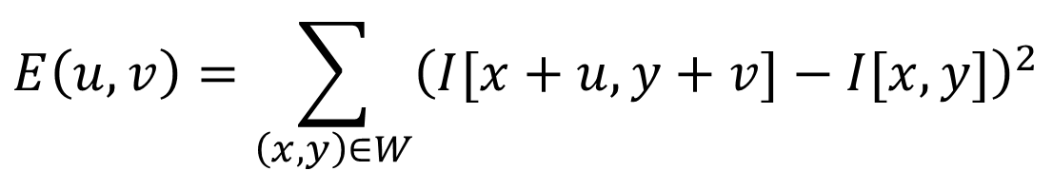
Formalizing Corner Detection
Sum of squared differences between image and image shifted u,v pixels over.
$$E\left(u,v\right)=\sum_{\left(x,y\right)∈W}{{\left(I[x+u,y+v]−I[x,y]\right)}^{2}}$$
Image I(x,y)
Plot of E(u,v)
E(3,2)
Slide Credit: S. Lazebnik

Slide 62
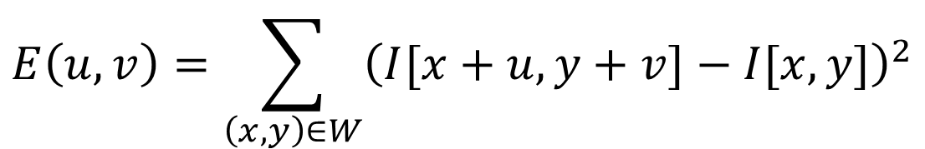
Formalizing Corner Detection
Sum of squared differences between image and image shifted u,v pixels over.
$$E\left(u,v\right)=\sum_{\left(x,y\right)∈W}{{\left(I[x+u,y+v]−I[x,y]\right)}^{2}}$$
Image I(x,y)
Plot of E(u,v)
E(0,0)
What’s the value of E(0,0)?
Slide Credit: S. Lazebnik

Slide 63
Formalizing Corner Detection
Can compute E[u,v] for any window and u,v.
But we’d like an simpler function of u,v.
Slide Credit: S. Lazebnik

Slide 64
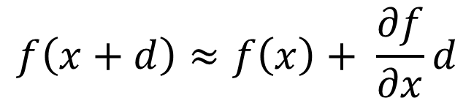
Aside: Taylor Series for Images
Recall Taylor Series:
$$f\left(x+d\right)≈f\left(x\right)+ \frac{∂f}{∂x}d$$
Do the same with images, treating them as function of x, y
$$I\left(x+u,y+v\right)≈I\left(x,y\right)+I_{x}u+I_{y}v$$

Slide 65




Formalizing Corner Detection
$$E\left(u,v\right)=\sum_{\left(x,y\right)∈W}{{\left(I[x+u,y+v]−I[x,y]\right)}^{2}}$$
Taylor series expansion for I at every single point in window
$$≈\sum_{\left(x,y\right)∈W}{{\left(I\left[x,y\right]+I_{x}[x,y]u+I_{y}[x,y]v−I[x,y]\right)}^{2}}$$
$$=\sum_{\left(x,y\right)∈W}{{\left(I_{x}[x,y]u+I_{y}[x,y]v\right)}^{2}}$$
Cancel
$$=\sum_{\left(x,y\right)∈W}{I_{x}^{2}u^{2}+2I_{x}I_{y}uv+I_{y}^{2}v^{2}}$$
Expand
For brevity: Ix = Ix at point (x,y), Iy = Iy at point (x,y)

Slide 66


Formalizing corner Detection
By linearizing image, we can approximate E(u,v) with quadratic function of u and v
$$E\left(u,v\right)≈\sum_{\left(x,y\right)∈W}{\left(I_{x}^{2}u^{2}+2I_{x}I_{y}uv+I_{y}^{2}v^{2}\right)}$$
$$=\left[u,v\right]M{\left[u,v\right]}^{T}$$
$$M= \left[\begin{matrix}\sum_{x,y∈W}{I_{x}^{2}} & \sum_{x,y∈W}{I_{x}I_{y}} \\ \sum_{x,y∈W}{I_{x}I_{y}} & \sum_{x,y∈W}{I_{y}^{2}}\end{matrix}\right]$$
M is called the second moment matrix

Slide 67

Intuitively what is M?
Pretend for now gradients are either vertical or horizontal at a pixel (so Ix Iy = 0)
Obviously Wrong!
$$M= \left[\begin{matrix}\sum_{x,y∈W}{I_{x}^{2}} & \sum_{x,y∈W}{I_{x}I_{y}} \\ \sum_{x,y∈W}{I_{x}I_{y}} & \sum_{x,y∈W}{I_{y}^{2}}\end{matrix}\right]= \left[\begin{matrix}a & 0 \\ 0 & b\end{matrix}\right]$$
If a,b are both small:
flat
If one is big, one is small:
edge
If a,b both big:
corner

Slide 68



Review: Quadratic Forms
Suppose have symmetric matrix M, scalar a, vector [u,v]:
$$E\left([u,v]\right)=\left[u,v\right]M{\left[u,v\right]}^{T}$$
Then the isocontour / slice-through of F, i.e.
$$E\left([u,v]\right)=a$$
is an ellipse.
Diagram credit: S. Lazebnik

Slide 69

Review: Quadratic Forms
We can look at the shape of this ellipse by decomposing M into a rotation + scaling
$$M=R^{−1}\left[\begin{matrix}λ_{1{ }} & 0 \\ 0 & λ_{2{ }}\end{matrix}\right]R$$
direction of the fastest change
What are λ₁ and λ₂?
direction of the slowest change
(λ₁)^{-1/2}
(λ₂)^{-1/2}
Slide credit: S. Lazebnik

Slide 70

Interpreting The Matrix M
The second moment matrix tells us how quickly the image changes and in which directions.
Can compute at each pixel
Directions
$$M= \left[\begin{matrix}\sum_{x,y∈W}{I_{x}^{2}} & \sum_{x,y∈W}{I_{x}I_{y}} \\ \sum_{x,y∈W}{I_{x}I_{y}} & \sum_{x,y∈W}{I_{y}^{2}}\end{matrix}\right]=R^{−1}\left[\begin{matrix}λ_{1} & 0 \\ 0 & λ_{2{ }}\end{matrix}\right]R$$
Amounts

Slide 71

Visualizing M
Slide credit: S. Lazebnik

Slide 72

Visualizing M
Technical note: M is often best visualized by first taking inverse, so long edge of ellipse goes along edge
Slide credit: S. Lazebnik

Slide 73
Interpreting Eigenvalues of M
λ₂
“Edge”
λ₂ >> λ₁
“Corner”
λ₁ and λ₂ are large,
λ₁ ~ λ₂;
E increases in all directions
λ₁ and λ₂ are small;
E is almost constant in all directions
“Flat” region
“Edge”
λ₁ >> λ₂
λ₁
Slide credit: S. Lazebnik; Note: this refers to previous ellipses, not original M ellipse. Other slides on the internet may vary

Slide 74

Putting Together The Eigenvalues
“Edge”
R < 0
$$R=\det\left(M\right)−α trace{\left(M\right)}^{2}$$
$$=λ_{1}λ_{2}−α{\left(λ_{1}+λ_{2}\right)}^{2}$$
“Corner”
R > 0
α: constant (0.04 to 0.06)
|R| small
“Flat” region
“Edge”
R < 0
Slide credit: S. Lazebnik; Note: this refers to previous ellipses, not original M ellipse. Other slides on the internet may vary

Slide 75

In Practice
Compute partial derivatives Ix, Iy per pixel
Compute M at each pixel, using Gaussian weighting w
$$M= \left[\begin{matrix}\sum_{x,y∈W}{{w(x,y)I}_{x}^{2}} & \sum_{x,y∈W}{{w(x,y)I}_{x}I_{y}} \\ \sum_{x,y∈W}{{w(x,y)I}_{x}I_{y}} & \sum_{x,y∈W}{{w(x,y)I}_{y}^{2}}\end{matrix}\right]$$
C.Harris and M.Stephens. “A Combined Corner and Edge Detector.” Proceedings of the 4th Alvey Vision Conference: pages 147—151, 1988.
Slide credit: S. Lazebnik

Slide 76

In Practice
Compute partial derivatives Ix, Iy per pixel
Compute M at each pixel, using Gaussian weighting w
Compute response function R
$$R=\det\left(M\right)−α trace{\left(M\right)}^{2}$$
$$=λ_{1}λ_{2}−α{\left(λ_{1}+λ_{2}\right)}^{2}$$
C.Harris and M.Stephens. “A Combined Corner and Edge Detector.” Proceedings of the 4th Alvey Vision Conference: pages 147—151, 1988.
Slide credit: S. Lazebnik

Slide 77

Computing R
Slide credit: S. Lazebnik

Slide 78

Computing R
Slide credit: S. Lazebnik

Slide 79
In Practice
Compute partial derivatives Ix, Iy per pixel
Compute M at each pixel, using Gaussian weighting w
Compute response function R
Threshold R
C.Harris and M.Stephens. “A Combined Corner and Edge Detector.” Proceedings of the 4th Alvey Vision Conference: pages 147—151, 1988.
Slide credit: S. Lazebnik

Slide 80

Thresholded R
Slide credit: S. Lazebnik

Slide 81
In Practice
Compute partial derivatives Ix, Iy per pixel
Compute M at each pixel, using Gaussian weighting w
Compute response function R
Threshold R
Take only local maxima (called non-maxima suppression)
C.Harris and M.Stephens. “A Combined Corner and Edge Detector.” Proceedings of the 4th Alvey Vision Conference: pages 147—151, 1988.
Slide credit: S. Lazebnik

Slide 82
Thresholded, NMS R
Slide credit: S. Lazebnik

Slide 83

Final Results
Slide credit: S. Lazebnik

Slide 84
Desirable Properties
If our detectors are repeatable, they should be:
Invariant to some things: image is transformed and corners remain the same
Covariant/equivariant with some things: image is transformed and corners transform with it.
Slide credit: S. Lazebnik

Slide 85


Recall Motivating Problem
Images may be different in lighting and geometry

Slide 86

Affine Intensity Change
$$I_{new}=aI_{old}+b$$
M only depends on derivatives, so b is irrelevant
But a scales derivatives and there’s a threshold
R
R
threshold
x (image coordinate)
x (image coordinate)
Partially invariant to affine intensity changes
Slide credit: S. Lazebnik

Slide 87
Image Translation
All done with convolution. Convolution is translation invariant.
Equivariant with translation
Slide credit: S. Lazebnik

Slide 88
Image Rotation
Rotations just cause the corner rotation to change. Eigenvalues remain the same.
Equivariant with rotation

Slide 89
Image Scaling
Corner
One pixel can become many pixels and vice-versa.
Not equivariant with scaling

