Slide 1
Scales and Descriptors
EECS 442 – David Fouhey
Fall 2019, University of Michigan
http://web.eecs.umich.edu/~fouhey/teaching/EECS442_F19/

Slide 2
Administrivia
HW1 due tonight (modulo late days)
HW2 out tonight
Collaborate
Read the syllabus for what’s allowed

Slide 3


Recap: Motivation
1: find corners+features
Image credit: M. Brown

Slide 4
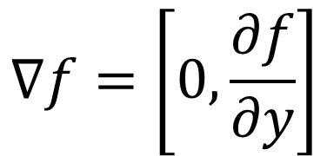
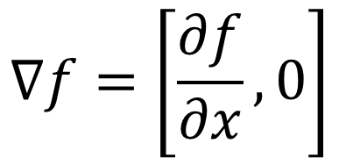
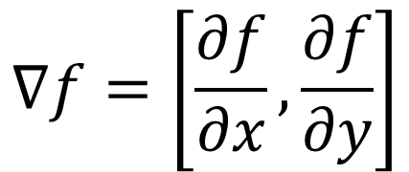
Last Time
Image gradients – treat image like function of x,y – gives edges, corners, etc.
$$∇f=\left[\frac{∂f}{∂x}, 0\right]$$
$$∇f=\left[0,\frac{∂f}{∂y}\right]$$
$$∇f=\left[\frac{∂f}{∂x}, \frac{∂f}{∂y}\right]$$
Figure credit: S. Seitz

Slide 5

Last Time – Corner Detection
Can localize the location, or any shift →
big intensity change.
“flat” region:
no change in all directions
“edge”:
no change along the edge direction
“corner”:
significant change in all directions
Diagram credit: S. Lazebnik

Slide 6
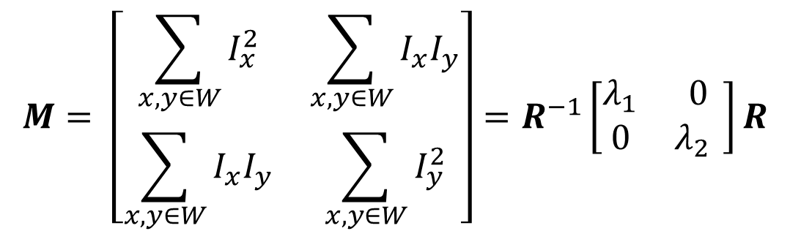
Corner Detection
By doing a taylor expansion of the image, the second moment matrix tells us how quickly the image changes and in which directions.
Can compute at each pixel
Directions
$$M= \left[\begin{matrix}\sum_{x,y∈W}{I_{x}^{2}} & \sum_{x,y∈W}{I_{x}I_{y}} \\ \sum_{x,y∈W}{I_{x}I_{y}} & \sum_{x,y∈W}{I_{y}^{2}}\end{matrix}\right]=R^{−1}\left[\begin{matrix}λ_{1} & 0 \\ 0 & λ_{2{ }}\end{matrix}\right]R$$
Amounts

Slide 7
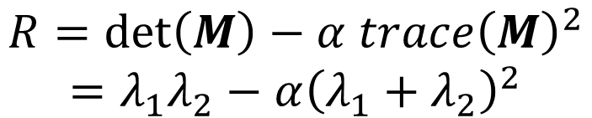
Putting Together The Eigenvalues
“Edge”
R < 0
$$R=\det\left(M\right)−α trace{\left(M\right)}^{2}$$
$$=λ_{1}λ_{2}−α{\left(λ_{1}+λ_{2}\right)}^{2}$$
“Corner”
R > 0
α: constant (0.04 to 0.06)
|R| small
“Flat” region
“Edge”
R < 0
Slide credit: S. Lazebnik; Note: this refers to visualization ellipses, not original M ellipse. Other slides on the internet may vary

Slide 8
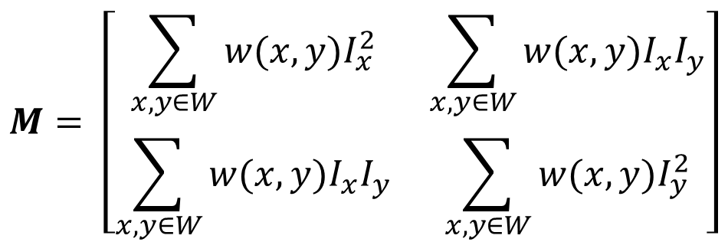
In Practice
Compute partial derivatives Ix, Iy per pixel
Compute M at each pixel, using Gaussian weighting w
$$M= \left[\begin{matrix}\sum_{x,y∈W}{{w(x,y)I}_{x}^{2}} & \sum_{x,y∈W}{{w(x,y)I}_{x}I_{y}} \\ \sum_{x,y∈W}{{w(x,y)I}_{x}I_{y}} & \sum_{x,y∈W}{{w(x,y)I}_{y}^{2}}\end{matrix}\right]$$
C.Harris and M.Stephens. “A Combined Corner and Edge Detector.” Proceedings of the 4th Alvey Vision Conference: pages 147—151, 1988.
Slide credit: S. Lazebnik

Slide 9
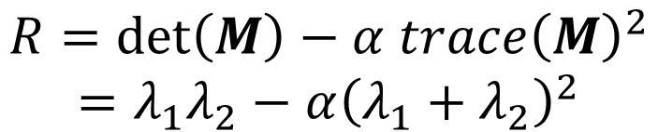
In Practice
Compute partial derivatives Ix, Iy per pixel
Compute M at each pixel, using Gaussian weighting w
Compute response function R
$$R=\det\left(M\right)−α trace{\left(M\right)}^{2}$$
$$=λ_{1}λ_{2}−α{\left(λ_{1}+λ_{2}\right)}^{2}$$
C.Harris and M.Stephens. “A Combined Corner and Edge Detector.” Proceedings of the 4th Alvey Vision Conference: pages 147—151, 1988.
Slide credit: S. Lazebnik

Slide 10

Computing R
Slide credit: S. Lazebnik

Slide 11

Computing R
Slide credit: S. Lazebnik

Slide 12
In Practice
Compute partial derivatives Ix, Iy per pixel
Compute M at each pixel, using Gaussian weighting w
Compute response function R
Threshold R
C.Harris and M.Stephens. “A Combined Corner and Edge Detector.” Proceedings of the 4th Alvey Vision Conference: pages 147—151, 1988.
Slide credit: S. Lazebnik

Slide 13

Thresholded R
Slide credit: S. Lazebnik

Slide 14
In Practice
Compute partial derivatives Ix, Iy per pixel
Compute M at each pixel, using Gaussian weighting w
Compute response function R
Threshold R
Take only local maxima (called non-maxima suppression)
C.Harris and M.Stephens. “A Combined Corner and Edge Detector.” Proceedings of the 4th Alvey Vision Conference: pages 147—151, 1988.
Slide credit: S. Lazebnik

Slide 15
Thresholded
Slide credit: S. Lazebnik

Slide 16

Final Results
Slide credit: S. Lazebnik

Slide 17
Desirable Properties
If our detectors are repeatable, they should be:
Invariant to some things: image is transformed and corners remain the same
Covariant/equivariant with some things: image is transformed and corners transform with it.
Slide credit: S. Lazebnik

Slide 18
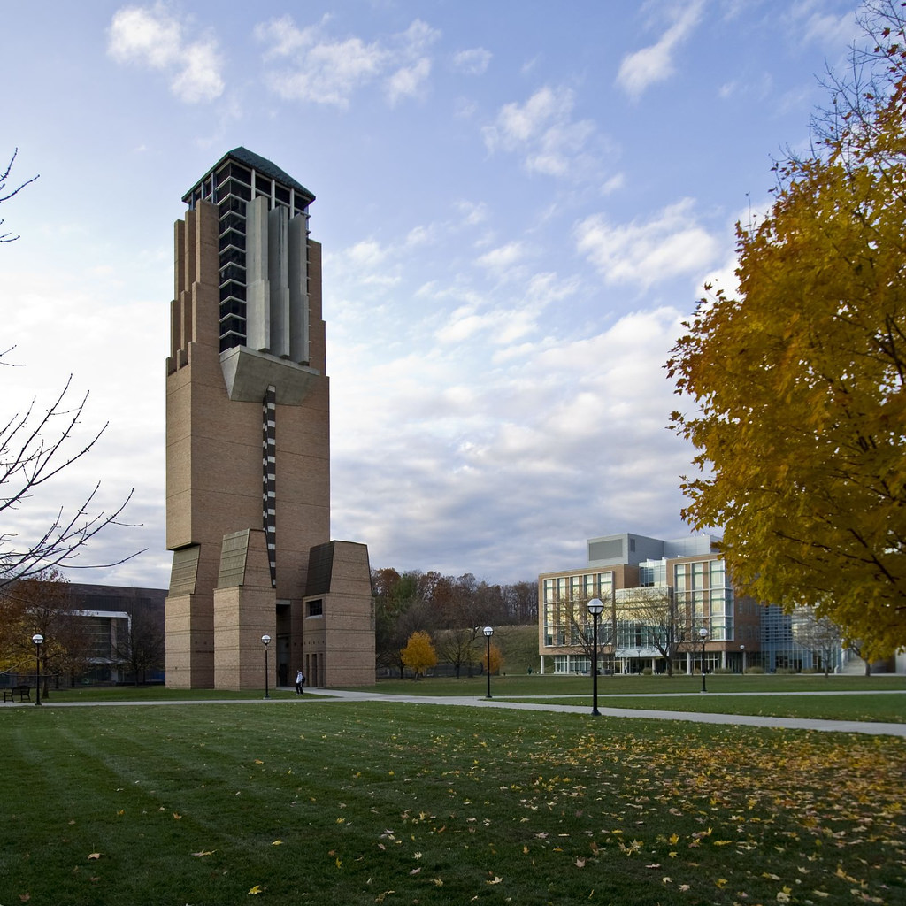
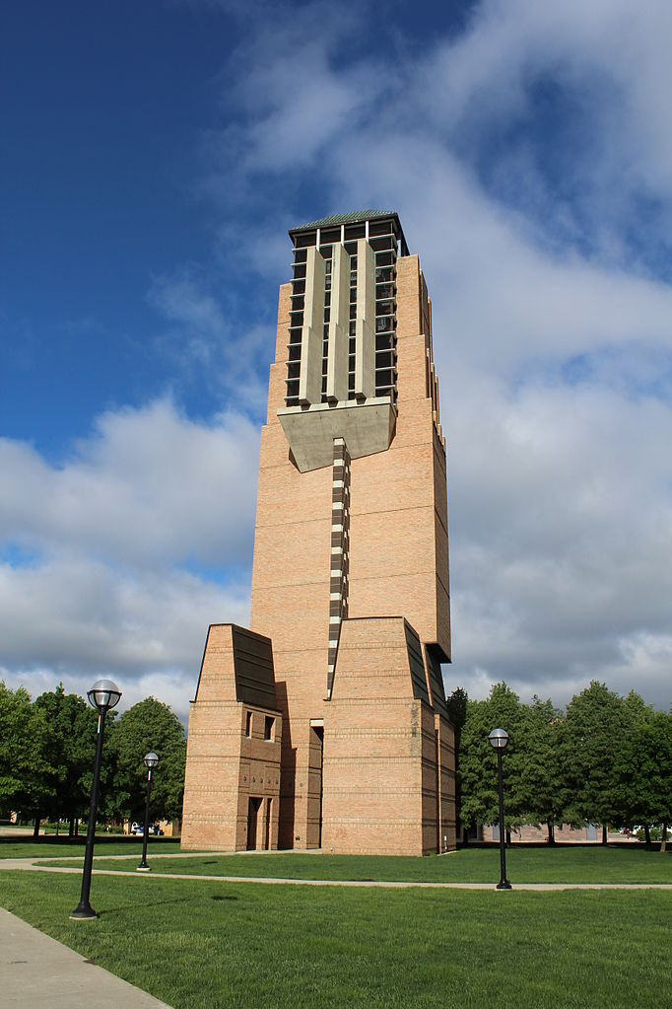
Recall Motivating Problem
Images may be different in lighting and geometry

Slide 19

Affine Intensity Change
$$I_{new}=aI_{old}+b$$
M only depends on derivatives, so b is irrelevant
But a scales derivatives and there’s a threshold
R
R
threshold
x (image coordinate)
x (image coordinate)
Partially invariant to affine intensity changes
Slide credit: S. Lazebnik

Slide 20
Image Translation
All done with convolution. Convolution is translation equivariant.
Equivariant with translation
Slide credit: S. Lazebnik

Slide 21
Image Rotation
Rotations just cause the corner rotation matrix to change. Eigenvalues remain the same.
Equivariant with rotation
Slide credit: S. Lazebnik

Slide 22
Image Scaling
Corner
One pixel can become many pixels and
vice-versa.
Not equivariant with scaling
How do we fix this?
Slide credit: S. Lazebnik

Slide 23
Recap: Motivation
1: find corners+features
2: match based on local image data
How?
Image credit: M. Brown

Slide 24
Today
Fixing scaling by making detectors in both location and scale
Enabling matching between features by describing regions

Slide 25
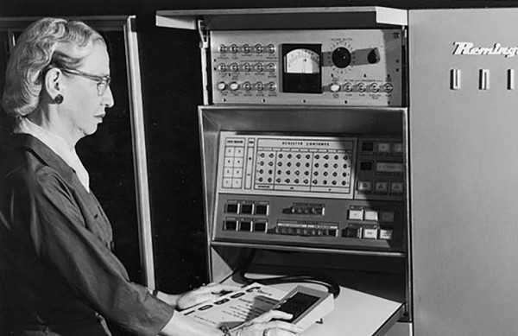





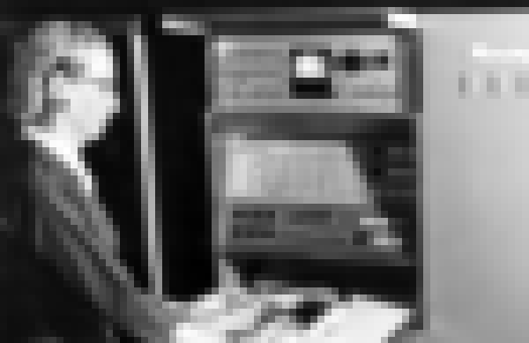
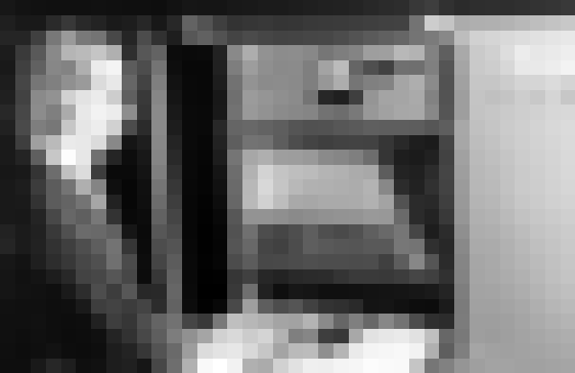
Key Idea: Scale
Left to right: each image is half-sized
Upsampled with big pixels below
1/2
1/2
1/2
Note: I’m also slightly blurring to prevent aliasing (https://en.wikipedia.org/wiki/Aliasing)

Slide 26
Key Idea: Scale
Left to right: each image is half-sized
If I apply a KxK filter, how much of the original image does it see in each image?
1/2
1/2
1/2
Note: I’m also slightly blurring to prevent aliasing (https://en.wikipedia.org/wiki/Aliasing)

Slide 27
Solution to Scales
Try them all!
Harris Detection
Harris Detection
Harris Detection
Harris Detection
See: Multi-Image Matching using Multi-Scale Oriented Patches, Brown et al. CVPR 2005

Slide 28
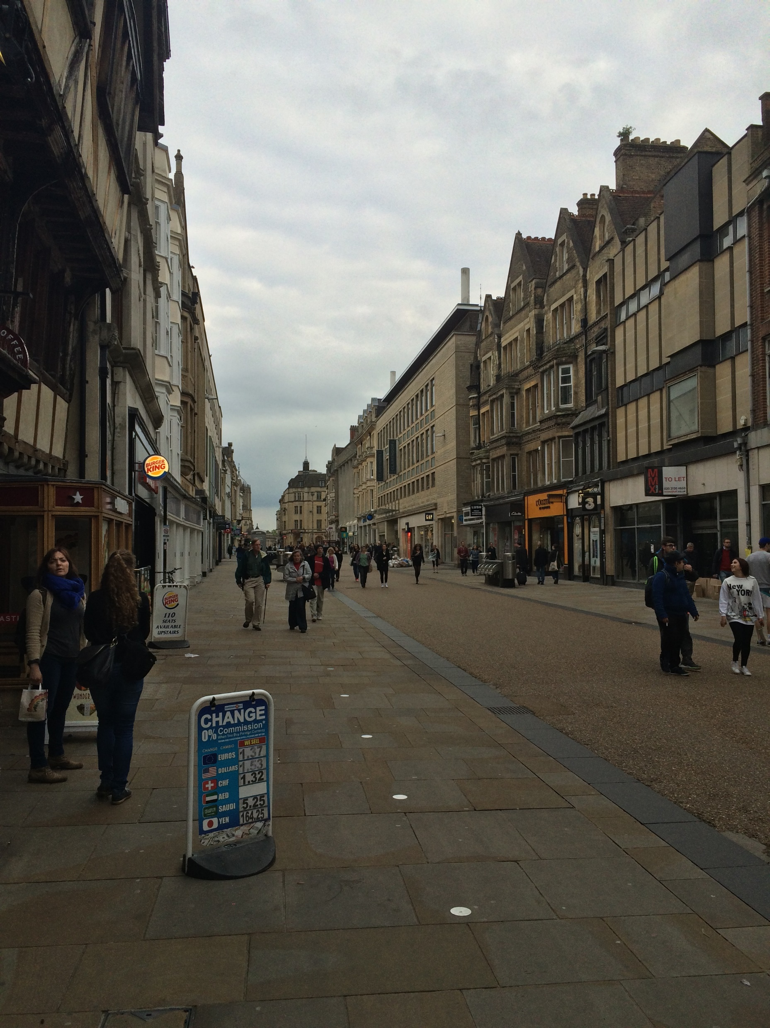
Aside: This Trick is Common
Given a 50x16 person detector, how do I detect:
(a) 250x80 (b) 150x48 (c) 100x32 (d) 25x8 people?
Sample people from image

Slide 29
Aside: This Trick is Common
Detecting all the people
The red box is a fixed size
Sample people from image

Slide 30
Aside: This Trick is Common
Detecting all the people
The red box is a fixed size
Sample people from image

Slide 31
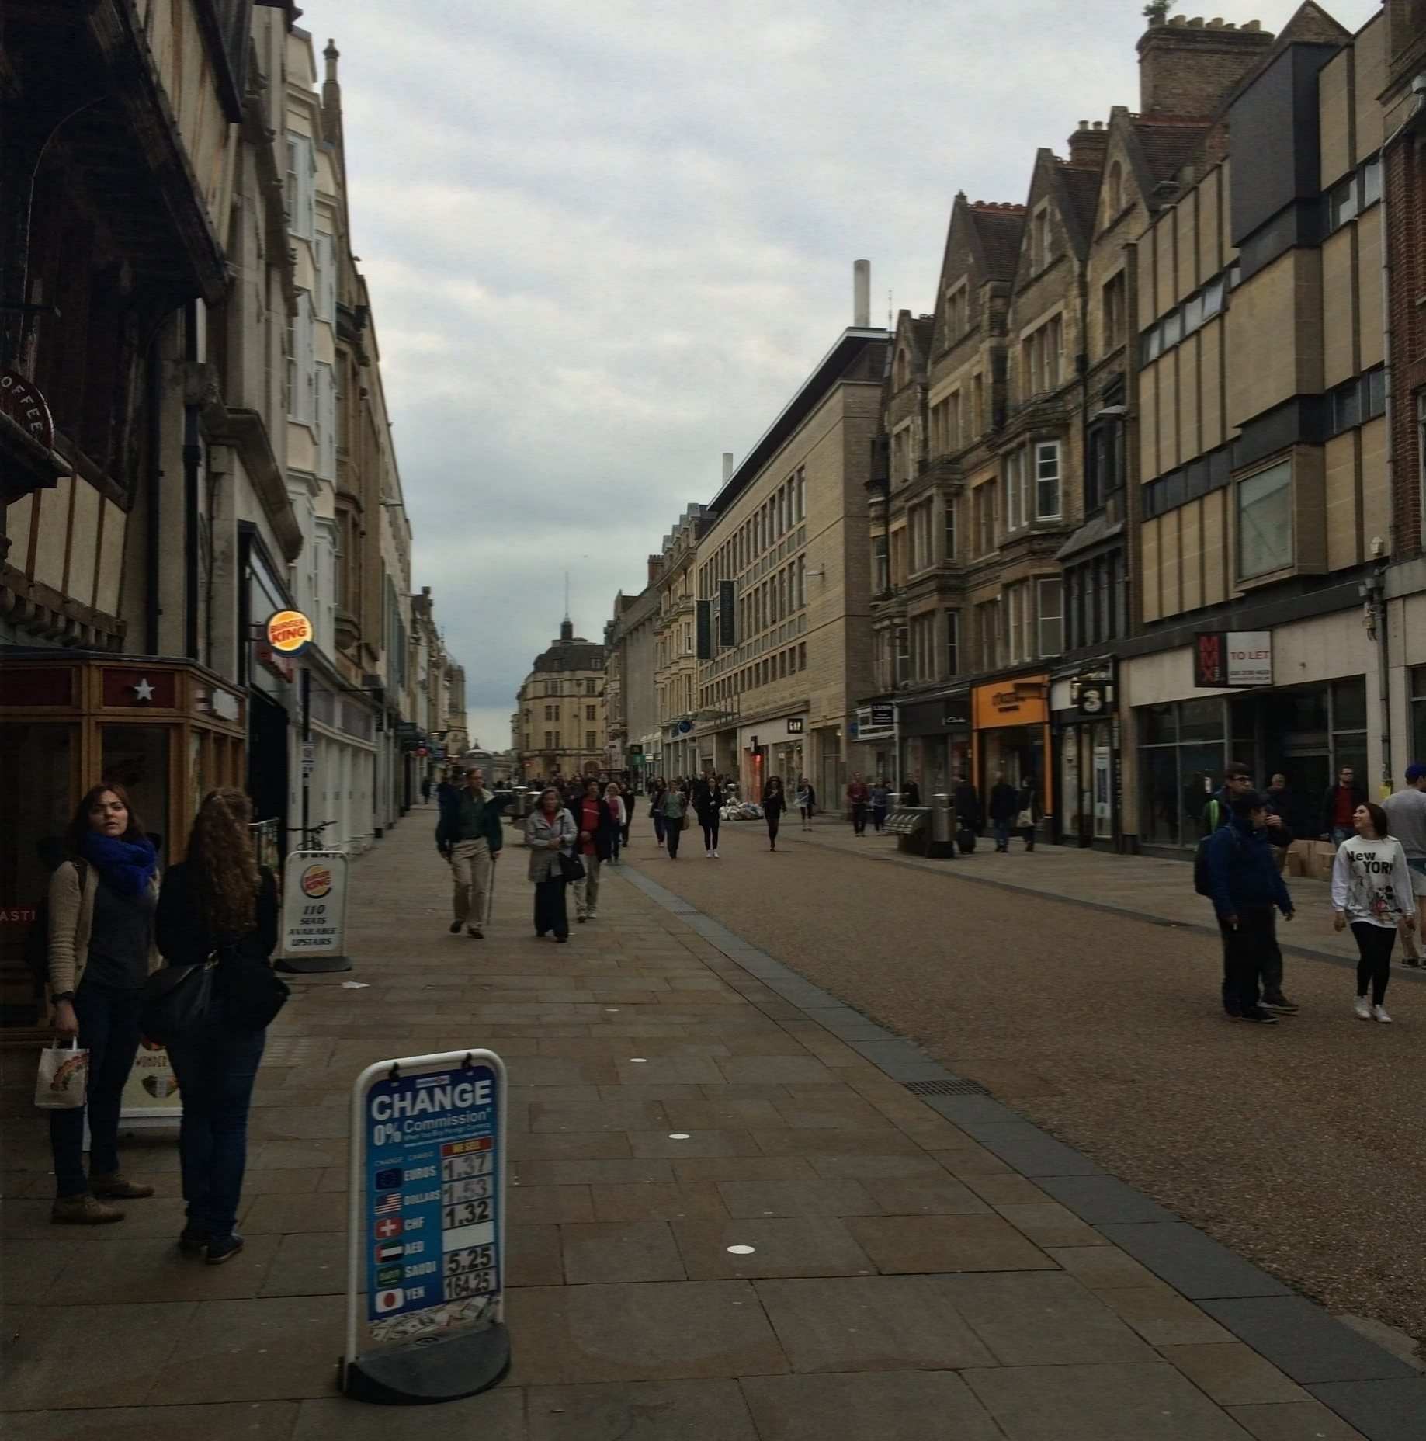
Aside: This Trick is Common
Detecting all the people
The red box is a fixed size
Sample people from image

Slide 32
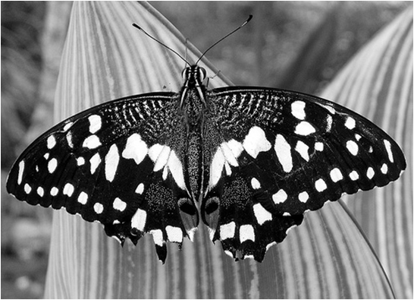
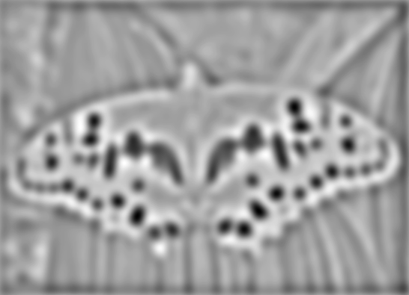



Blob Detection
Another detector (has some nice properties)
Minima
$$∗$$
$$=$$
Maxima
Find maxima and minima of blob filter response in scale and space
Slide credit: N. Snavely

Slide 33


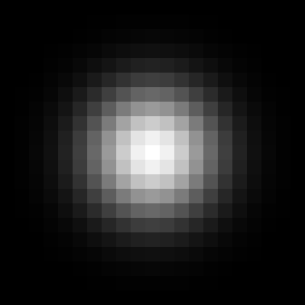


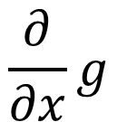
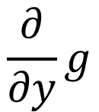
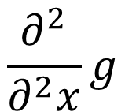
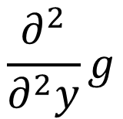
Gaussian Derivatives
1st Deriv
2nd Deriv
Gaussian
$$\frac{∂}{∂y}g$$
$$\frac{∂^{2}}{∂^{2}y}g$$
$$\frac{∂}{∂x}g$$
$$\frac{∂^{2}}{∂^{2}x}g$$

Slide 34

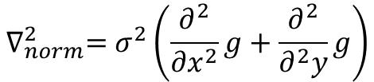
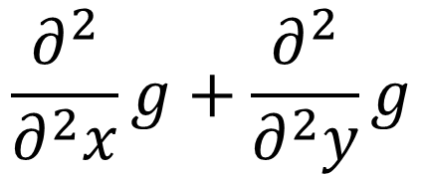
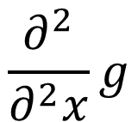
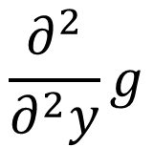
Laplacian of Gaussian
$$\frac{∂^{2}}{∂^{2}x}g+\frac{∂^{2}}{∂^{2}y}g$$
$$\frac{∂^{2}}{∂^{2}y}g$$
+
$$\frac{∂^{2}}{∂^{2}x}g$$
$$∇_{norm}^{2}=σ^{2}\left(\frac{∂^{2}}{∂x^{2}}g+\frac{∂^{2}}{∂^{2}y}g\right)$$
Slight detail: for technical reasons, you need to scale the Laplacian.

Slide 35
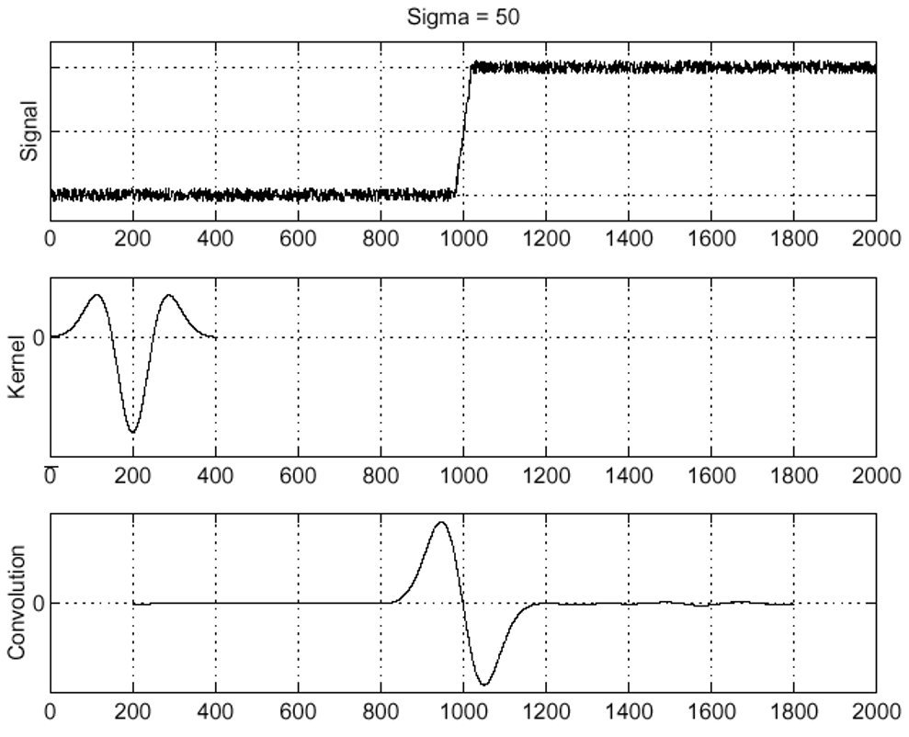
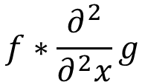
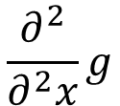

Edge Detection with Laplacian
$$f$$
Edge
$$\frac{∂^{2}}{∂^{2}x}g$$
Laplacian
Of Gaussian
$$f∗\frac{∂^{2}}{∂^{2}x}g$$
Edge =
Zero-crossing
Figure credit: S. Seitz

Slide 36
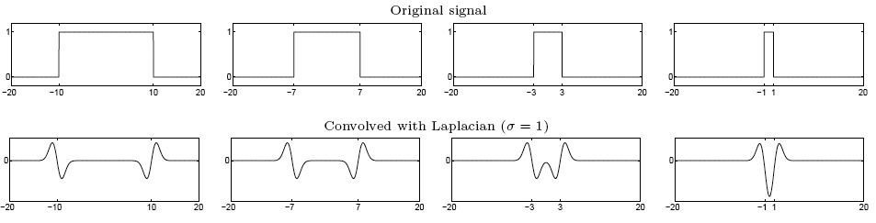
Blob Detection with Laplacian
Edge: zero-crossing
Blob: superposition of zero-crossing
Remember: can scale signal or filter
maximum
Figure credit: S. Lazebnik

Slide 37








Scale Selection
Given binary circle and Laplacian filter of scale σ, we can compute the response as a function of the scale.
$$Image$$
$$σ=2$$
$$σ=6$$
$$σ=10$$
Radius: 8
R: 0.02
R: 2.9
R: 1.8

Slide 38
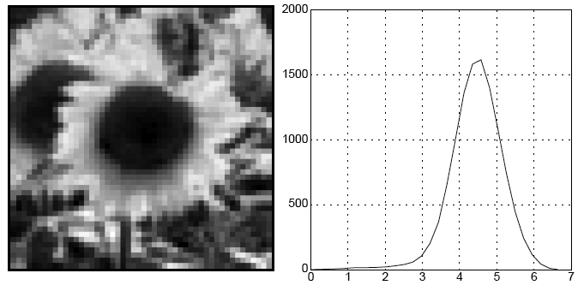
Characteristic Scale
Characteristic scale of a blob is the scale
that produces the maximum response
Image
Abs. Response
Slide credit: S. Lazebnik. For more, see: T. Lindeberg (1998). "Feature detection with automatic scale selection." International Journal of Computer Vision 30 (2): pp 77--116.

Slide 39
Scale-space blob detector
Convolve image with scale-normalized Laplacian at several scales
Slide credit: S. Lazebnik

Slide 40
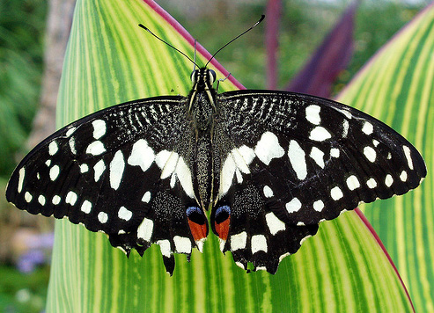
Scale-space blob detector: Example
Slide credit: S. Lazebnik

Slide 41
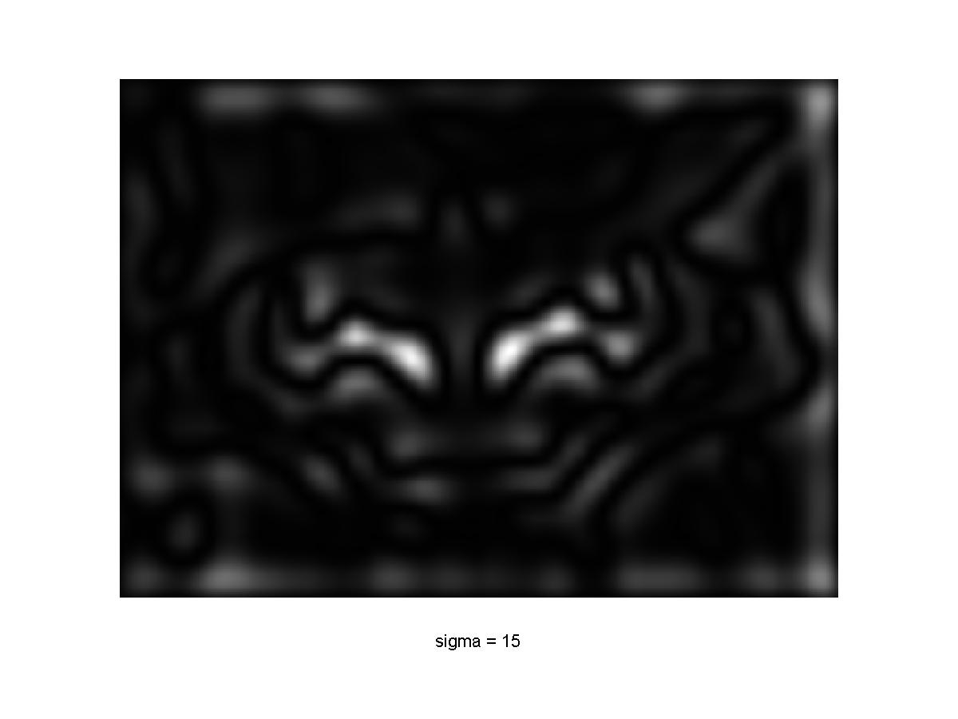
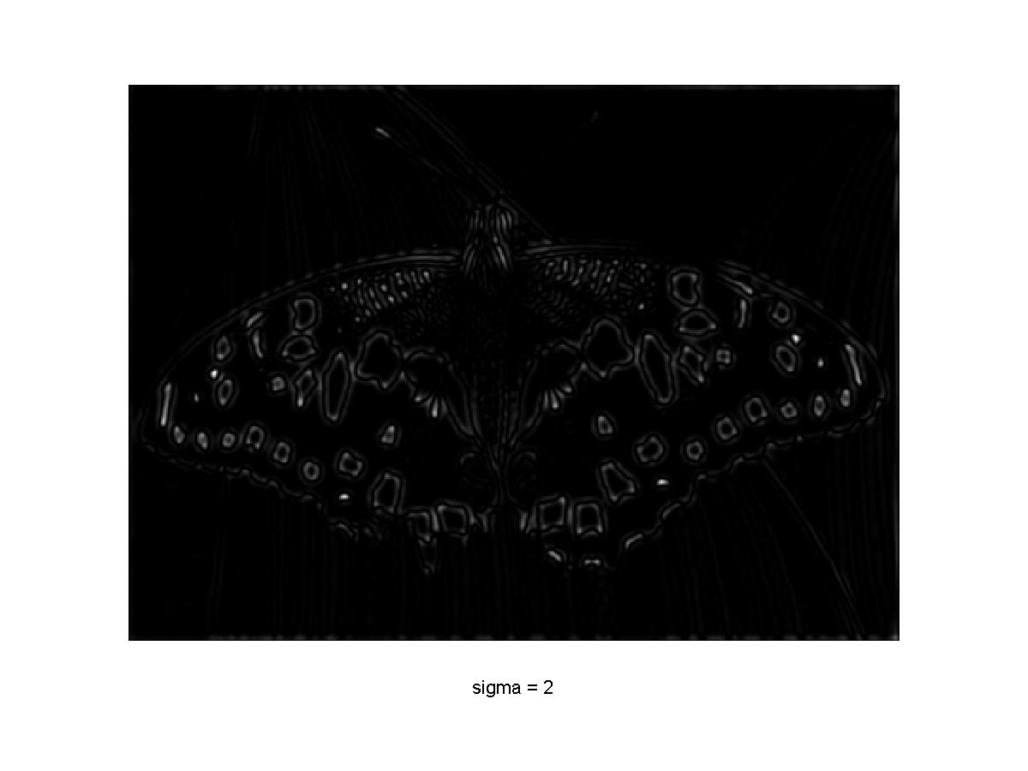
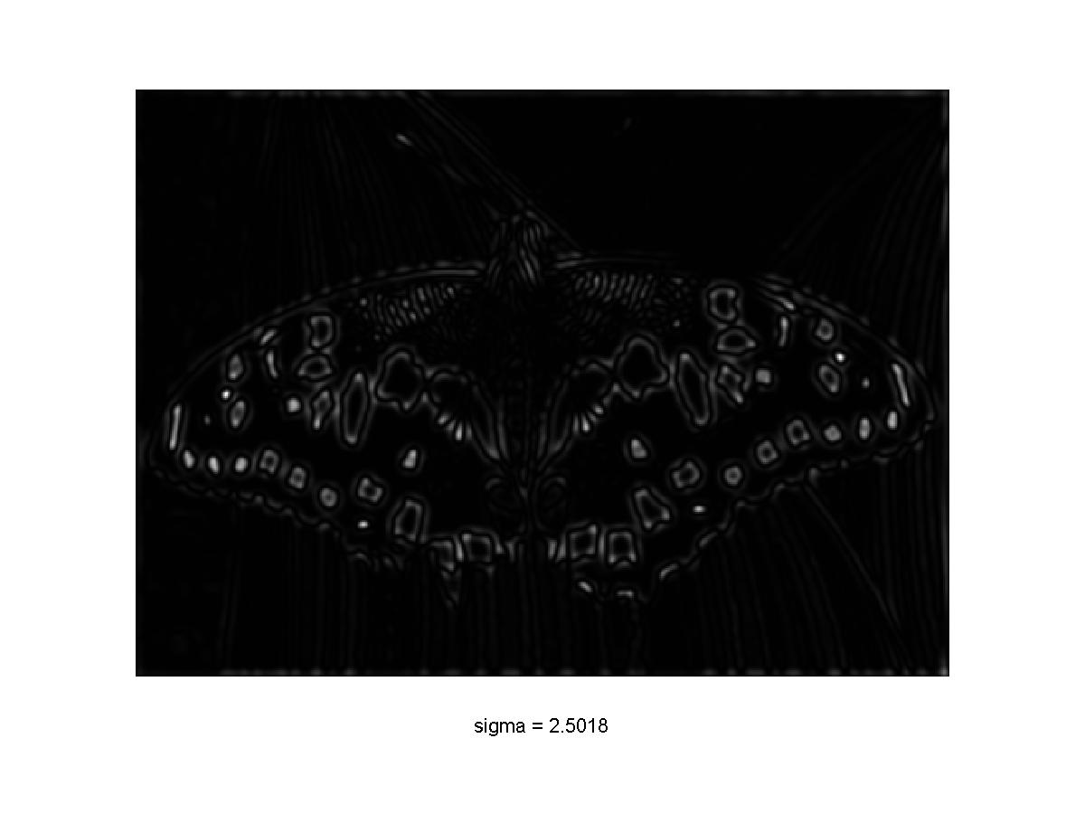
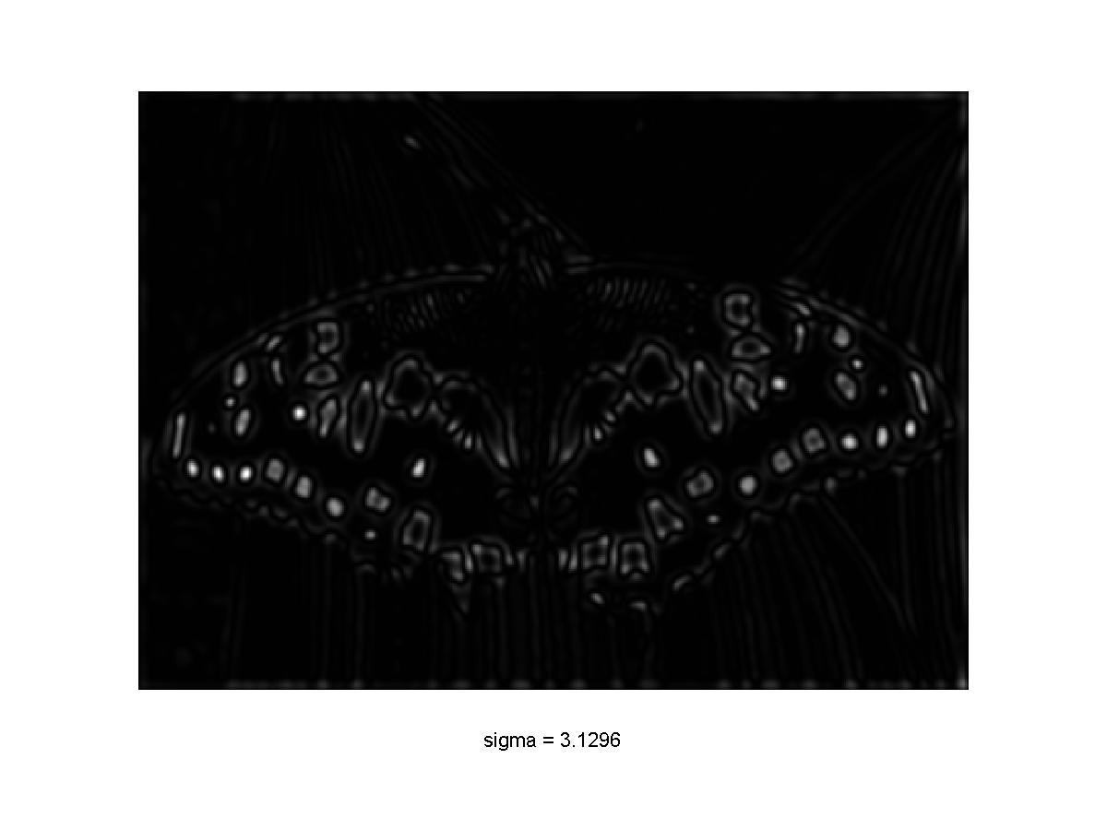
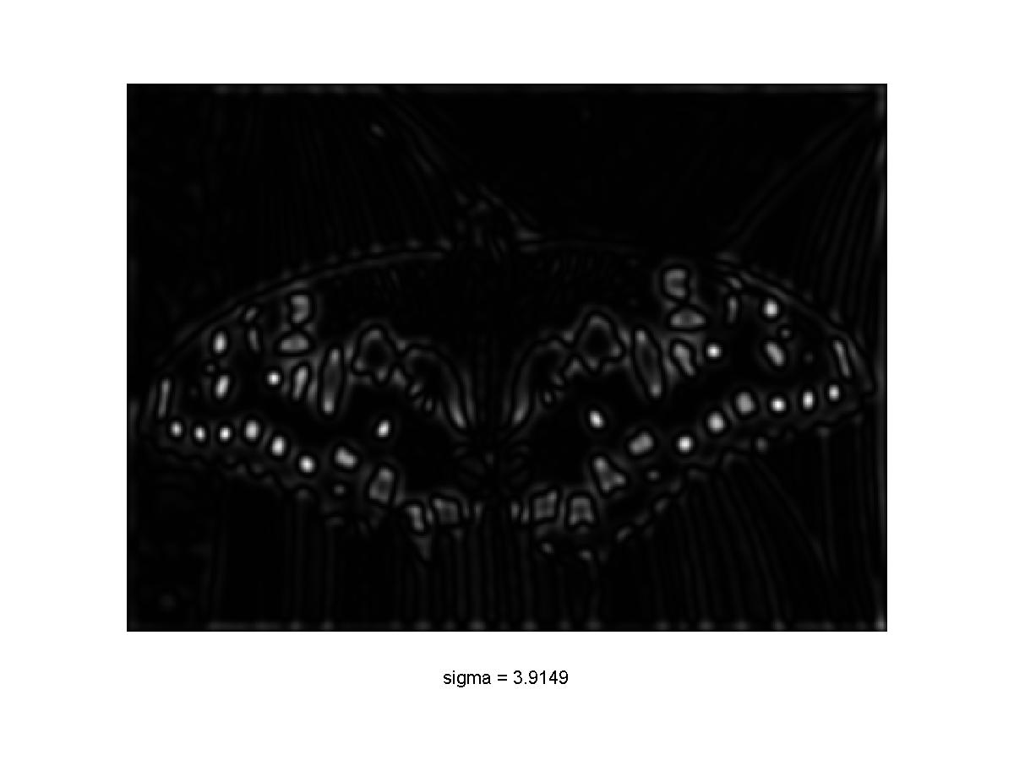
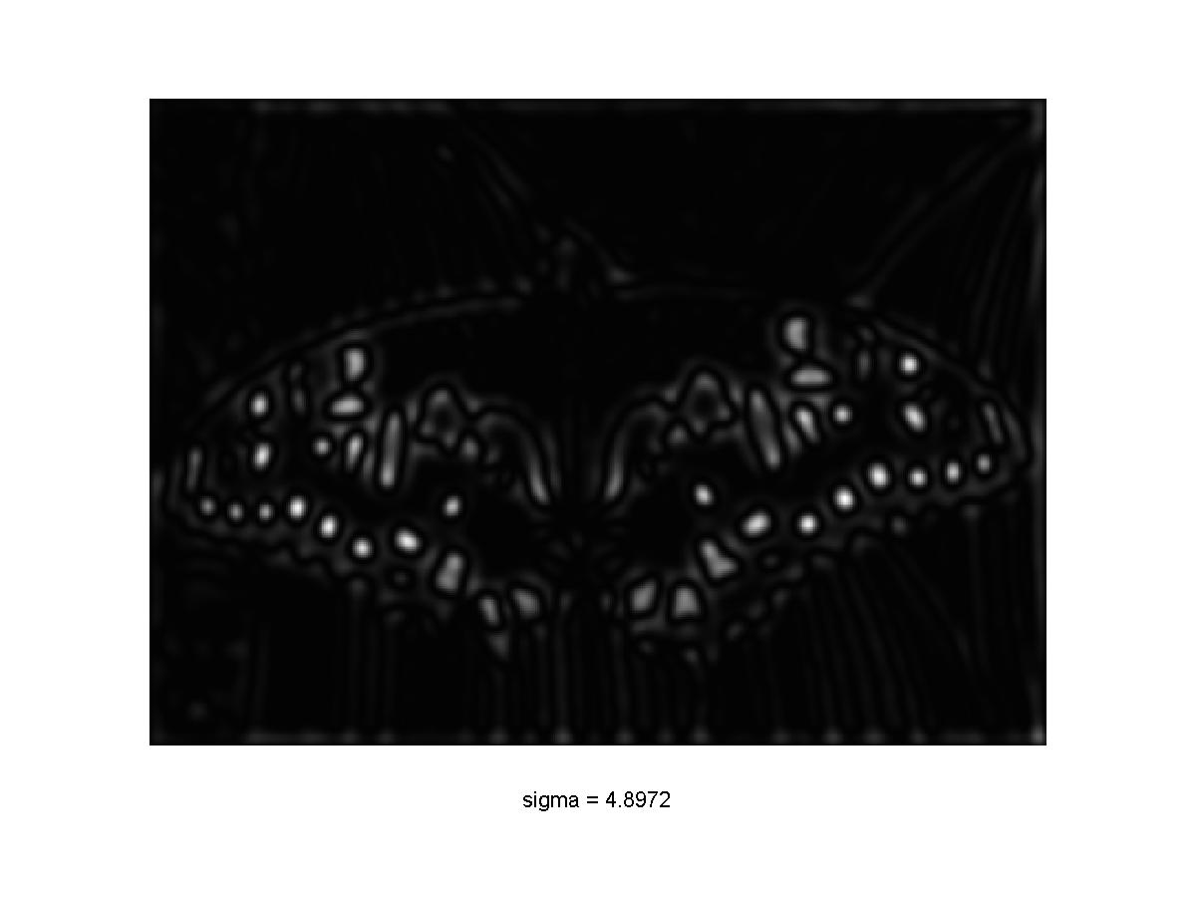

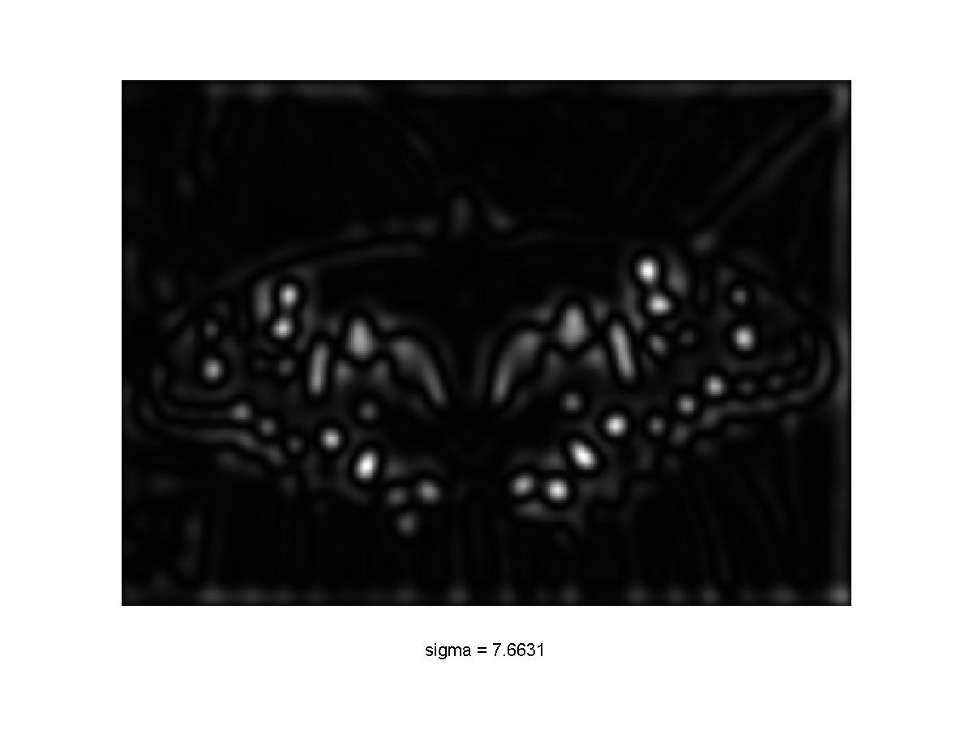
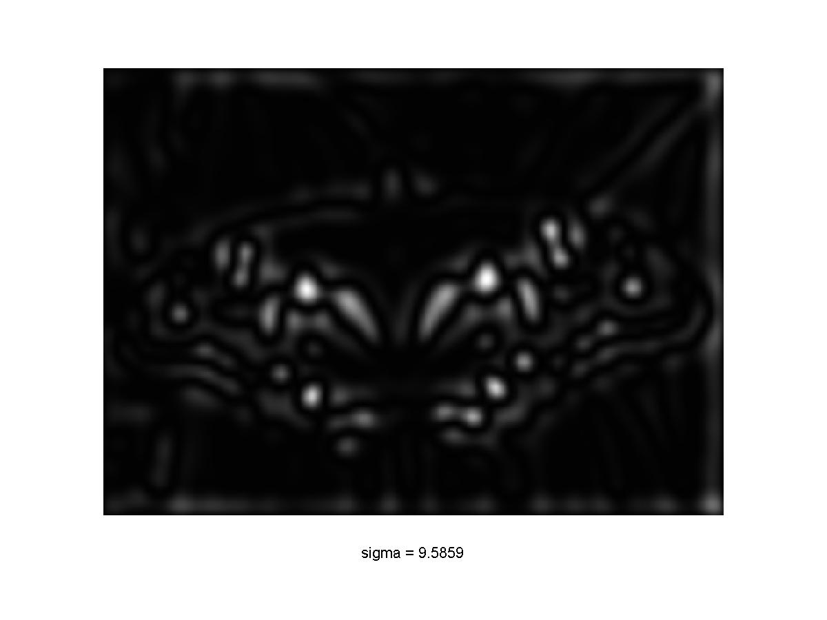
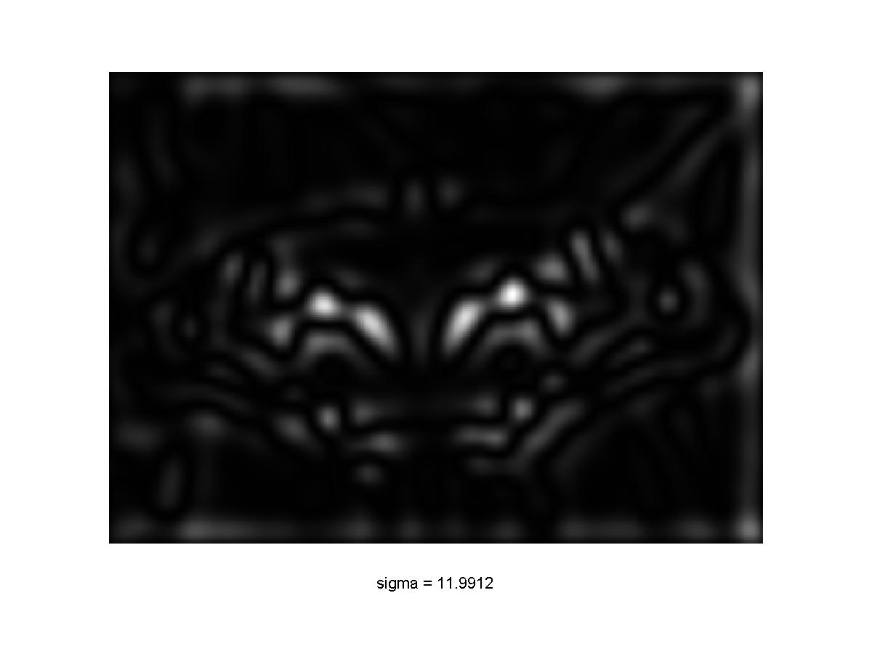
Scale-space blob detector: Example
Slide credit: S. Lazebnik

Slide 42
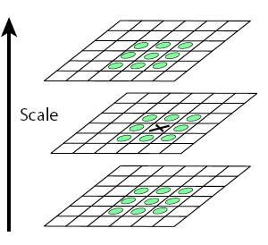
Scale-space blob detector
Convolve image with scale-normalized Laplacian at several scales
Find maxima of squared Laplacian response in scale-space
Slide credit: S. Lazebnik

Slide 43
Finding Maxima
Point i,j is maxima (minima if you flip sign) in image I if:
for y=range(i-1,i+1+1):
for x in range(j-1,j+1+1):
if y == i and x== j: continue
#below has to be true
I[y,x] < I[i,j]

Slide 44
Scale Space
Red lines are the scale-space neighbors
$$Image$$
$$σ=2$$
$$σ=6$$
$$σ=10$$
Radius: 8
R: 0.02
R: 2.9
R: 1.8

Slide 45
Scale Space
Blue lines are image-space neighbors (should be just one pixel over but you should get the point)
$$Image$$
$$σ=2$$
$$σ=6$$
$$σ=10$$
Radius: 8
R: 0.02
R: 2.9
R: 1.8

Slide 46
Finding Maxima
Suppose I[:,:,k] is image at scale k. Point i,j,k is maxima (minima if you flip sign) in image I if:
for y=range(i-1,i+1+1):
for x in range(j-1,j+1+1):
for c in range(k-1,k+1+1):
if y == i and x== j and c==k: continue
#below has to be true
I[y,x,c] < I[i,j,k]

Slide 47
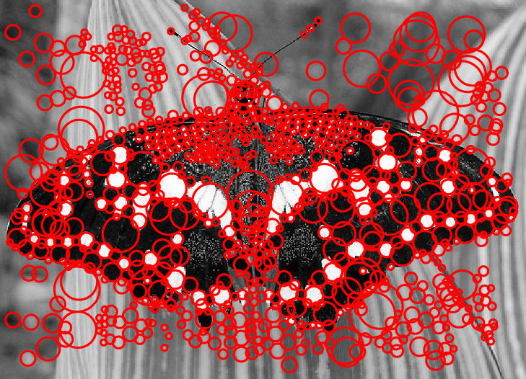
Scale-space blob detector: Example
Slide credit: S. Lazebnik

Slide 48
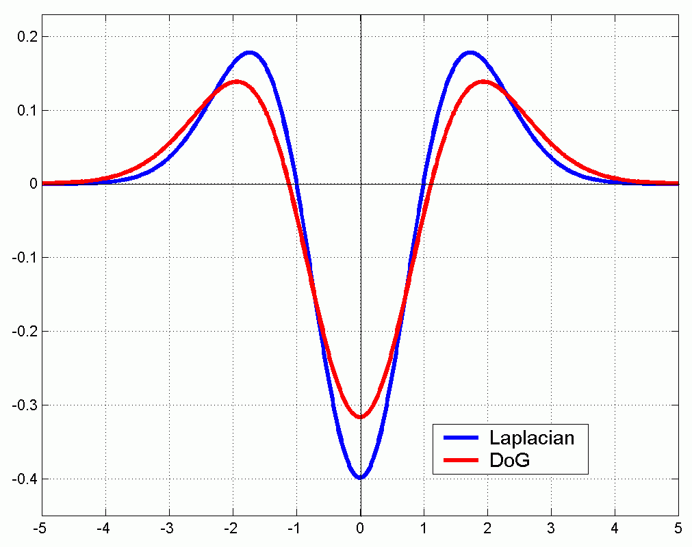
Efficient implementation
Approximating the Laplacian with a difference of Gaussians:
(Laplacian)
(Difference of Gaussians)
Slide credit: S. Lazebnik

Slide 49
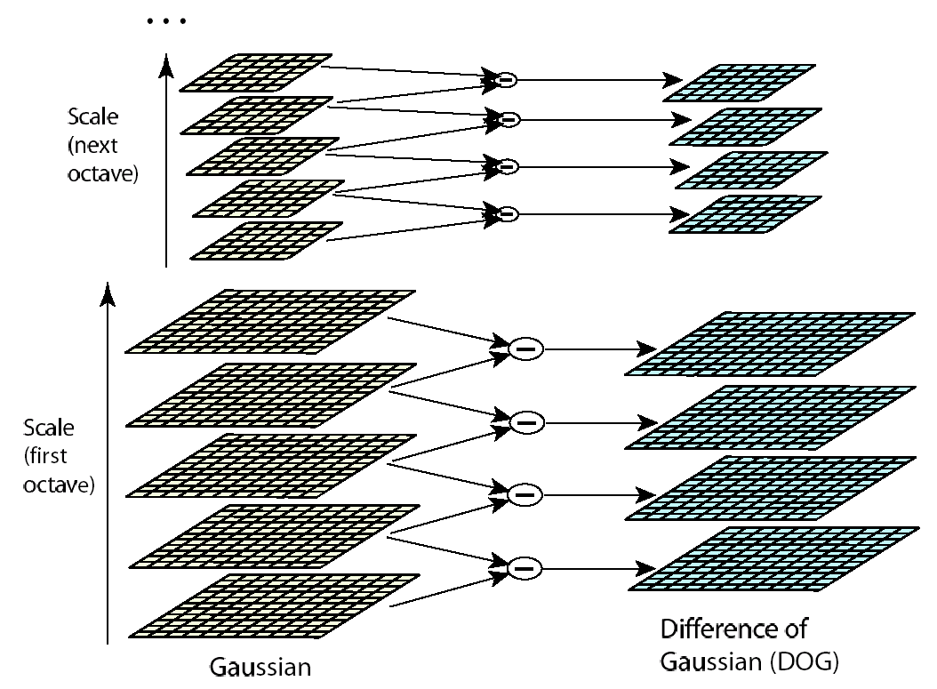
Efficient implementation
David G. Lowe. "Distinctive image features from scale-invariant keypoints.” IJCV 60 (2), pp. 91-110, 2004.
Slide credit: S. Lazebnik

Slide 50
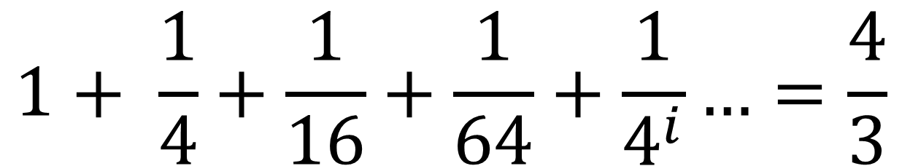
Problem 1 Solved
How do we deal with scales: try them all
Why is this efficient?
Vast majority of effort is in the first and second scales
$$1+ \frac{1}{4}+\frac{1}{16}+\frac{1}{64}+\frac{1}{4^{i}}…=\frac{4}{3}$$
Notes:
1 + 1/4

Slide 51
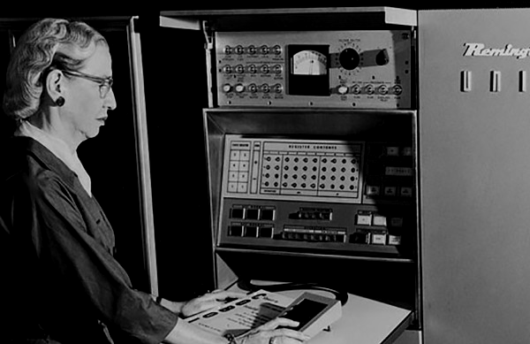
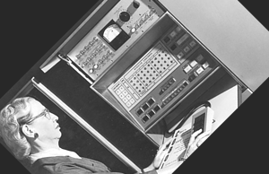
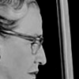
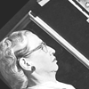
Problem 2 – Describing Features
Image – 40
1/2 size, rot. 45°
Lightened+40
Image
100x100 crop at Glasses

Slide 52
Problem 2 – Describing Features
Once we’ve found a corner/blobs, we can’t just use the image nearby. What about:
Scale?
Rotation?
Additive light?

Slide 53
Handling Scale
Given characteristic scale (maximum Laplacian response), we can just rescale image
Slide credit: S. Lazebnik

Slide 54

Handling Rotation
Given window, can compute dominant orientation and then rotate image
“y”
0
2
π
“x”
Slide credit: S. Lazebnik

Slide 55
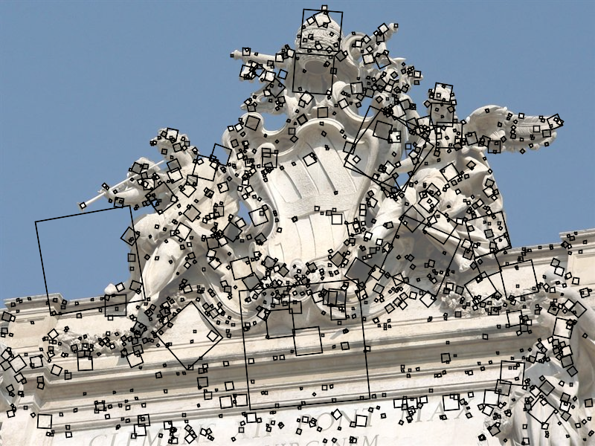
Scale and Rotation
SIFT features at characteristic scales and dominant orientations
Picture credit: S. Lazebnik. Paper: David G. Lowe. "Distinctive image features from scale-invariant keypoints.” IJCV 60 (2), pp. 91-110, 2004.

Slide 56
Scale and Rotation
Rotate and set to common scale
j
Rotate and set to common scale
Picture credit: S. Lazebnik. Paper: David G. Lowe. "Distinctive image features from scale-invariant keypoints.” IJCV 60 (2), pp. 91-110, 2004.

Slide 57

SIFT Descriptors
j
Compute gradients
Build histogram (2x2 here, 4x4 in practice)
Gradients ignore global illumination changes
Figure from David G. Lowe. "Distinctive image features from scale-invariant keypoints.” IJCV 60 (2), pp. 91-110, 2004.

Slide 58
SIFT Descriptors
In principle: build a histogram of the gradients
In reality: quite complicated
  Gaussian weighting: smooth response
  Normalization: reduces illumination effects
  Clamping
  Affine adaptation

Slide 59


Properties of SIFT
Can handle: up to ~60 degree out-of-plane rotation, Changes of illumination
Fast and efficient and lots of code available
Slide credit: N. Snavely

Slide 60
Feature Descriptors
Think of feature as some non-linear filter that maps pixels to 128D feature
128D vector x
Photo credit: N. Snavely

Slide 61
Using Descriptors
Instance Matching
Category recognition

Slide 62







Instance Matching
$$\left\|x_{1}−x_{3}\right\|=1.22$$
$$x_{1}$$
$$x_{3}$$
$$x_{2}$$
$$\left\|x_{1}−x_{2}\right\|=0.61$$
Example credit: J. Hays

Slide 63







Instance Matching
$$\left\|x_{4}−x_{5}\right\|=0.34$$
$$\left\|x_{4}−x_{6}\right\|=0.30$$
$$\left\|x_{4}−x_{6}\right\|=0.40$$
$$x_{4}$$
$$x_{5}$$
$$x_{6}$$
$$x_{7}$$
Example credit: J. Hays

Slide 64

2nd Nearest Neighbor Trick
Given a feature x, nearest neighbor to x is a good match, but distances can’t be thresholded.
Instead, find nearest neighbor and second nearest neighbor. This ratio is a good test for matches:
$$r=\frac{\left\|x_{q}−x_{1NN}\right\|}{\left\|x_{q}−x_{2NN}\right\|}$$

Slide 65

2nd Nearest Neighbor Trick
Figure from David G. Lowe. "Distinctive image features from scale-invariant keypoints.” IJCV 60 (2), pp. 91-110, 2004.

Slide 68
Extra Reading for the Curious

Slide 69
Affine adaptation
Consider the second moment matrix of the window containing the blob:
direction of the fastest change
Recall:
direction of the slowest change
(λ_{max})^{-1/2}
(λ_{min})^{-1/2}
This ellipse visualizes the “characteristic shape” of the window
Slide: S. Lazebnik

Slide 70
Affine adaptation example
Scale-invariant regions (blobs)
Slide: S. Lazebnik

Slide 71

Affine adaptation example
Affine-adapted blobs
Slide: S. Lazebnik

