Slide 1
Numerical Linear Algebra
EECS 442 – David Fouhey
Fall 2019, University of Michigan
http://web.eecs.umich.edu/~fouhey/teaching/EECS442_W19/

Slide 2
Administrivia
HW 1 out – due in two weeks
Follow submission format (wrong format = 0)
The homeworks are not fill-in-the-blank. This is harder to do but mirrors life
If it’s ambiguous: make a decision, document what you think and why in your homework, and move on
Highly encouraged to work together. See piazza
Please check syllabus for what’s allowed. I guarantee checking the syllabus thoroughly will help boost your grade.

Slide 3
This Week – Math
Two goals for the next two classes:
Math with computers ≠ Math
Practical math you need to know but may not have been taught

Slide 4
This Week – Goal
Not a “Linear algebra in two lectures” – that’s impossible.
Some of this you should know!
Aimed at reviving your knowledge and plugging any gaps
Aimed at giving you intuitions

Slide 5
Adding Numbers
1 + 1 = ?
Suppose $x_{i}$ is normally distributed with mean $μ$ and standard deviation $σ$ for $1≤i≤N$
How is the average, or $\hat{μ}=\frac{1}{N}\sum_{i=1}^{N}{x_{i}}$, distributed (qualitatively), in terms of variance?
The Free Drinks in Vegas Theorem: $\hat{μ}$ has mean $μ$ and standard deviation $\frac{σ}{\sqrt{N}}$ .

Slide 6
Free Drinks in Vegas
Each game/variable has mean $0.10, std $2
100K games is guaranteed profit: 99.999999% lowest value is $0.064.
$0.01 for drinks
$0.054 for profits
100 games is uncertain and fun!

Slide 7
Let’s Make It Big
Suppose I average 50M normally distributed numbers (mean: 31, standard deviation: 1)
For instance: have predicted and actual depth for 200 480x640 images and want to know the average error (|predicted – actual|)
numerator = 0
for x in xs:
numerator += x
return numerator / len(xs)

Slide 8
Let’s Make It Big
What should happen qualitatively?
Theory says that the average is distributed with mean 31 and standard deviation $\frac{1}{\sqrt{50M}}≈\left({10}^{−5}\right)$
What will happen?
Reality: 17.47

Slide 9
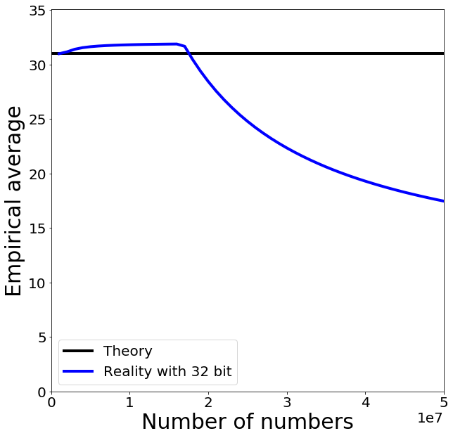
Trying it Out
Hmm.
Hmm.

Slide 10
What’s a Number?
2⁷
2⁶
2⁵
2⁴
2³
2²
2¹
2⁰
1
0
1
1
1
0
0
1
185
128 + 32 + 16 + 8 + 1 =
185

Slide 11
Adding Two Numbers
2⁸
2⁷
2⁶
2⁵
2⁴
2³
2²
2¹
2⁰
1
0
1
1
1
0
0
1
185
0
1
1
0
1
0
0
1
105
1
0
0
1
0
0
0
1
0
34
Carry
Flag
Result
“Integers” on a computer are integers modulo 2^{k}

Slide 12
Some Gotchas
32 + (3 / 4) x 40 =
32
Why?
32 + (3 x 40) / 4 =
62
Underflow
No Underflow
32 + 3 / 4 x 40 =
32 + 0 x 40 =
32 + 0 =
32
32 + 3 x 40 / 4 =
32 + 120 / 4 =
32 + 30 =
62
Ok – you have to multiply before dividing

Slide 13
Some Gotchas
Should be: 9x4=36
32 + (9 x 40) / 10 =
math
68
42
uint8
32 + (9 x 40) / 10 =
Overflow
32 + 9 x 40 / 10 =
32 + 104 / 10 =
Why 104?
9 x 40 = 360
360 % 256 = 104
32 + 10 =
42

Slide 14
What’s a Number?
2⁷
2⁶
2⁵
2⁴
2³
2²
2¹
2⁰
1
0
1
1
1
0
0
1
185
How can we do fractions?
2⁵
2⁴
2³
2²
2¹
2⁰
2⁻¹
2⁻²
1
0
1
1
1
0
0
1
45.25
45
0.25

Slide 15
Fixed-Point Arithmetic
2⁵
2⁴
2³
2²
2¹
2⁰
2⁻¹
2⁻²
1
0
1
1
1
0
0
1
45.25
What’s the largest number we can represent?
63.75 – Why?
How precisely can we measure at 63?
0.25
How precisely can we measure at 0?
0.25
Fine for many purposes but for science, seems silly

Slide 16
Floating Point
Sign (S)
Exponent (E)
Fraction (F)
1
0
1
1
1
0
0
1
1
7
1
-1
2⁷⁻⁷ = 2⁰ =1
1+1/8 = 1.125
$$\left(−1^{S}\right)\left(2^{E+bias}\right)\left(1+\frac{F}{2^{3}}\right)$$
Bias: allows exponent to be negative; Note: fraction = significant = mantissa; exponents of all ones or all zeros are special numbers

Slide 17
Floating Point – Generally
Sign (S)
Exponent (E)
Fraction (F)
1
0
1
1
1
0
0
1
sign
0 – 15
0 - 7
(-6 – 7 with bias, signaling bits)
$$\left(−1^{S}\right)\left(2^{E+bias}\right)\left(1+\frac{F}{2^{3}}\right)$$
Bias: allows exponent to be negative; Note: fraction = significant = mantissa; exponents of all ones or all zeros are special numbers

Slide 18
Floating Point
Fraction
0/8
0
0
0
-2⁰ x 1.00 = -1
1/8
0
0
1
-2⁰ x 1.125 = -1.125
Sign
Exponent
2/8
0
1
0
-2⁰ x 1.25 = -1.25
1
0
1
1
1
…
-1
7-7=0
*(-bias)*
1
1
0
6/8
-2⁰ x 1.75 = -1.75
7/8
1
1
1
-2⁰ x 1.875 = -1.875

Slide 19
Floating Point
Fraction
0/8
0
0
0
-2² x 1.00 = -4
1/8
0
0
1
-2² x 1.125 = -4.5
Sign
Exponent
2/8
0
1
0
-2² x 1.25 = -5
1
1
0
0
1
…
-1
9-7=2
*(-bias)*
1
1
0
6/8
-2² x 1.75 = -7
7/8
1
1
1
-2² x 1.875 = -7.5

Slide 20
Floating Point
Fraction
Sign
Exponent
0
0
0
-2⁰ x 1.00 = -1
1
0
1
1
1
0
0
1
-2⁰ x 1.125 = -1.125
0
0
0
-2² x 1.00 = -4
1
1
0
0
1
0
0
1
-2² x 1.125 = -4.5
Gap between numbers is relative, not absolute

Slide 21
Revisiting Adding Numbers
Sign
Exponent
Fraction
1
0
1
1
0
0
0
0
-2⁻¹ x 1.00 = -0.5
1
1
0
0
1
0
0
0
-2² x 1.00 = -4
1
1
0
0
1
0
0
1
-2² x 1.125 = -4.5
Actual implementation is complex

Slide 22
Revisiting Adding Numbers
Sign
Exponent
Fraction
1
0
1
0
0
0
0
0
-2⁻³ x 1.00 = -0.125
1
1
0
0
1
0
0
0
-2² x 1.00 = -4
-2² x 1.03125 = -4.125
1
1
0
0
1
0
0
0
-2² x 1.00 = -4
?
1
1
0
0
1
0
0
1
-2² x 1.125 = -4.5

Slide 23
Revisiting Adding Numbers
Sign
Exponent
Fraction
1
0
1
0
0
0
0
0
-2⁻³ x 1.00 = -0.125
1
1
0
0
1
0
0
0
-2² x 1.00 = -4
-2² x 1.03125 = -4.125
1
1
0
0
1
0
0
0
-2² x 1.00 = -4
For a and b, these can happen
a + b = a a+b-a ≠ b

Slide 24
Revisiting Adding Numbers
IEEE 754 Single Precision / Single
8 bits
2¹²⁷ ≈ 10³⁸
23 bits
≈ 7 decimal digits
S
Exponent
Fraction
IEEE 754 Double Precision / Double
11 bits
2¹⁰²³ ≈ 10³⁰⁸
52 bits
≈ 15 decimal digits
S
Exponent
Fraction

Slide 25
Trying it Out
Roundoff error occurs
a+b=a -> numerator is stuck, denominator isn’t

Slide 26
Take-homes
Computer numbers aren’t math numbers
Overflow, accidental zeros, roundoff error, and basic equalities are almost certainly incorrect for some values
Floating point defaults and numpy try to protect you.
Generally safe to use a double and use built-in-functions in numpy (not necessarily others!)
Spooky behavior = look for numerical issues

Slide 27
Vectors
[2,3] =
2 x [1,0]
+ 3 x [0,1]
2 x
+ 3 x
2 x
e₁
+ 3 x
e₂
x = [2,3]
Can be arbitrary # of dimensions
(typically denoted R^{n})

Slide 28
Vectors
$$x= \left[\begin{matrix}2 \\ 3\end{matrix}\right]$$
$$x_{1}=2$$
$$x_{2}=3$$
x = [2,3]
Just an array!
Get in the habit of thinking of them as columns.

Slide 29
Scaling Vectors
2x = [4,6]
Can scale vector by a scalar
Scalar = single number
Dimensions changed independently
Changes magnitude / length, does not change direction.
x = [2,3]

Slide 30
Adding Vectors
Can add vectors
Dimensions changed independently
Order irrelevant
Can change direction and magnitude
x = [2,3]
x+y = [5,4]
y = [3,1]

Slide 31
Scaling and Adding
2x+y = [7,7]
Can do both at the same time
x = [2,3]
y = [3,1]

Slide 32
Measuring Length
Magnitude / length / (L2) norm of vector
$$\left\|x\right\|={\left\|x\right\|}_{2}={\left(\sum_{i}^{n}{x_{i}^{2}}\right)}^{1/2}$$
x = [2,3]
There are other norms; assume L2 unless told otherwise
$${\left\|x\right\|}_{2}=\sqrt{13}$$
y = [3,1]
$${\left\|y\right\|}_{2}=\sqrt{10}$$
Why?

Slide 33
Normalizing a Vector
Diving by norm gives something on the unit sphere (all vectors with length 1)
x = [2,3]
$$x^{′}=x/{\left\|x\right\|}_{2}$$
y = [3,1]
$$y^{′}=y/{\left\|y\right\|}_{2}$$

Slide 34
Dot Products
$$x⋅y=\sum_{i=1}^{n}{x_{i}y_{i} }=x^{T}y$$
$$x⋅y=\cos\left(θ\right)\left\|x\right\|\left\|y\right\|$$
What happens with normalized / unit vectors?
$$x^{′}$$
$$θ$$
$$y^{′}$$

Slide 35
Dot Products
$$x⋅y=\sum_{i}^{n}{x_{i}y_{i}}$$
$$x=[2,3]$$
What’s $x⋅e_{1}$, $x⋅e_{2}$?
Ans: $x⋅e_{1}=2$ ; $x⋅e_{2}=3$
Dot product is projection
Amount of x that’s also pointing in direction of y
$$e_{1}$$
$$e_{2}$$

Slide 36
Dot Products
$$x⋅y=\sum_{i}^{n}{x_{i}y_{i}}$$
$$x=[2,3]$$
What’s $x⋅x$ ?
Ans: $x⋅x=∑x_{i}x_{i}={\left\|x\right\|}_{2}^{2}$

Slide 37
Special Angles
$$\left[\begin{matrix}1 \\ 0\end{matrix}\right]⋅\left[\begin{matrix}0 \\ 1\end{matrix}\right]=0∗1+1∗0=0$$
$$x$$
Perpendicular / orthogonal vectors have dot product 0 irrespective of their magnitude
$$x^{′}$$
$$θ$$
$$y^{′}$$
$$y$$

Slide 38
Special Angles
$$\left[\begin{matrix}x_{1} \\ x_{2}\end{matrix}\right]⋅\left[\begin{matrix}y_{1} \\ y_{2}\end{matrix}\right]=x_{1}y_{1}+x_{2}y_{2}=0$$
$$x$$
Perpendicular / orthogonal vectors have dot product 0 irrespective of their magnitude
$$x^{′}$$
$$θ$$
$$y$$
$$y^{′}$$

Slide 39
Orthogonal Vectors
$$x=[2,3]$$
Geometrically, what’s the set of vectors that are orthogonal to x?
A line [3,-2]

Slide 40
Orthogonal Vectors
$$x$$
What’s the set of vectors that are orthogonal to x = [5,0,0]?
A plane/2D space of vectors/any vector $[0,a,b]$
What’s the set of vectors that are orthogonal to x and y = [0,5,0]?
A line/1D space of vectors/any vector $[0,0,b]$
Ambiguity in sign and magnitude
$$x$$
$$y$$

Slide 41
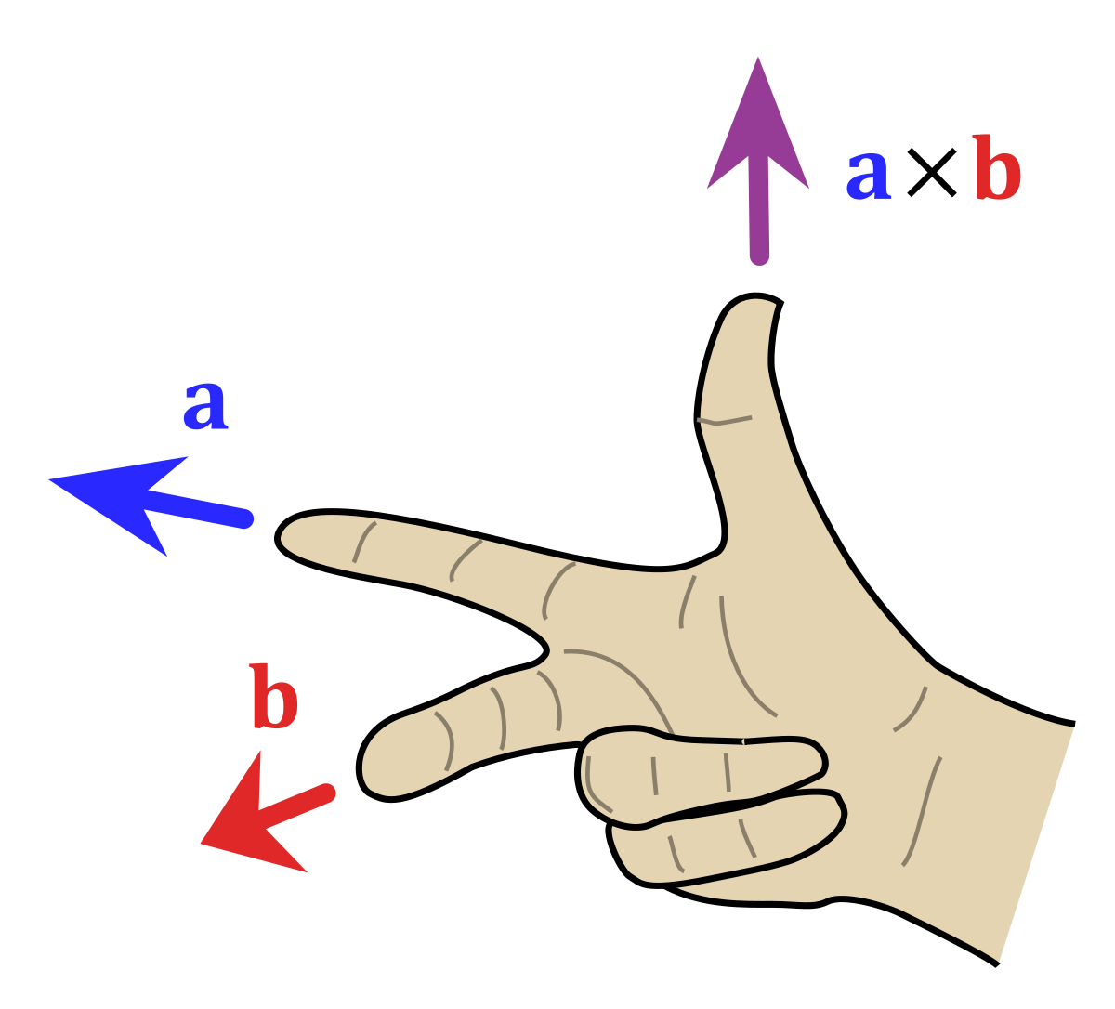
Cross Product
Set $\{z:z⋅x=0, z⋅y=0\}$ has an ambiguity in sign and magnitude
Cross product $x×y$ is: (1) orthogonal to x, y (2) has sign given by right hand rule and (3) has magnitude given by area of parallelogram of x and y
Important: if x and y are the same direction or either is 0, then $x×y=0$ .
Only in 3D!
$$x$$
$$y$$
$$x×y$$
Image credit: Wikipedia.org

Slide 42
Operations You Should Know
Scale (vector, scalar → vector)
Add (vector, vector → vector)
Magnitude (vector → scalar)
Dot product (vector, vector → scalar)
Dot products are projection / angles
Cross product (vector, vector → vector)
Vectors facing same direction have cross product 0
You can never mix vectors of different sizes

Slide 43
Matrices
Horizontally concatenate n, m-dim column vectors and you get a mxn matrix A (here 2x3)
$$A=\left[v_{1},⋯,v_{n}\right]=\left[\begin{matrix}v_{1_{1}} & v_{2_{1}} & v_{3_{1}} \\ v_{1_{2}} & v_{2_{2}} & v_{3_{2}}\end{matrix}\right]$$
a
(scalar)
lowercase
undecorated
a
(vector)
lowercase
bold or arrow
A
(matrix)
uppercase
bold

Slide 44
Matrices
$${\left[\begin{matrix}a \\ b \\ c\end{matrix}\right]}^{T}=\left[\begin{matrix}a & b & c\end{matrix}\right]$$
Transpose: flip rows / columns
(3x1)^{T} = 1x3
Vertically concatenate m, n-dim row vectors
and you get a mxn matrix A (here 2x3)
$$A=\left[\begin{matrix}u_{1}^{T} \\ ⋮ \\ u_{n}^{T}\end{matrix}\right]=\left[\begin{matrix}u_{1_{1}} & u_{1_{2}} & u_{1_{3}} \\ u_{2_{1}} & u_{2_{2}} & u_{2_{3}}\end{matrix}\right]$$

Slide 45
Matrix-Vector Product
$$y_{2x1}=A_{2x3}x_{3x1}$$
$$\left[\begin{matrix}x_{1} \\ x_{2} \\ x_{3}\end{matrix}\right]$$
$$\left[\begin{matrix}y_{1} \\ y_{2}\end{matrix}\right]=$$
$$\left[\begin{matrix}v_{1} & v_{2} & v_{3}\end{matrix}\right]$$
$$y=x_{1}v_{1}+x_{2}v_{2}+x_{3}v_{3}$$
Linear combination of columns of A

Slide 46
Matrix-Vector Product
$$y_{2x1}=A_{2x3}x_{3x1}$$
3
$$\left[\begin{matrix}y_{1} \\ y_{2}\end{matrix}\right]=$$
$$\left[\begin{matrix}{ u}_{1}^{T} \\ u_{2}^{T}\end{matrix}\right]$$
$$x$$
3
$$y_{1}=u_{1}^{T}x$$
$$y_{2}=u_{2}^{T}x$$
Dot product between rows of A and x

Slide 47
Matrix Multiplication
Generally: A_{mn} and B_{np} yield product (AB)_{mp}
$$\left[\begin{matrix}− & a_{1}^{T} & − \\ & ⋮ & \\ − & a_{m}^{T} & −\end{matrix}\right]$$
$$\left[\begin{matrix}| & & | \\ b_{1} & ⋯ & b_{p} \\ | & & |\end{matrix}\right]$$
$$AB=$$
Yes – in A, I’m referring to the rows, and in B, I’m referring to the columns

Slide 48
Matrix Multiplication
Generally: A_{mn} and B_{np} yield product (AB)_{mp}
$$\left[\begin{matrix}| & & | \\ { b}_{1} & ⋯ & b_{p} \\ | & & |\end{matrix}\right]$$
$$\left[\begin{matrix}− & a_{1}^{T} & − \\ & ⋮ & \\ − & a_{m}^{T} & −\end{matrix}\right]$$
$$\left[\begin{matrix}a_{1}^{T}b_{1} & ⋯ & a_{1}^{T}b_{p} \\ ⋮ & ⋱ & ⋮ \\ a_{m}^{T}b_{1} & ⋯ & a_{m}^{T}b_{p}\end{matrix}\right]$$
$$AB=$$
$$AB_{ij}=a_{i}^{T}b_{j}$$

Slide 49
Matrix Multiplication
Dimensions must match
Dimensions must match
Dimensions must match
(Yes, it’s associative): ABx = (A)(Bx) = (AB)x
(No it’s not commutative): ABx ≠ (BA)x ≠ (BxA)

Slide 50
Operations They Don’t Teach
You Probably Saw Matrix Addition
$$\left[\begin{matrix}a & b \\ c & d\end{matrix}\right]+\left[\begin{matrix}e & f \\ g & h\end{matrix}\right]=$$
$$\left[\begin{matrix}a+e & b+f \\ c+g & d+h\end{matrix}\right]$$
What is this? FYI: e is a scalar
$$\left[\begin{matrix}a & b \\ c & d\end{matrix}\right]+e=$$
$$\left[\begin{matrix}a+e & b+e \\ c+e & d+e\end{matrix}\right]$$

Slide 51
Broadcasting
If you want to be pedantic and proper, you expand e by multiplying a matrix of 1s (denoted 1)
$$\left[\begin{matrix}a & b \\ c & d\end{matrix}\right]+e$$
$$=\left[\begin{matrix}a & b \\ c & d\end{matrix}\right]+1_{2x2}e$$
$$=\left[\begin{matrix}a & b \\ c & d\end{matrix}\right]+\left[\begin{matrix}e & e \\ e & e\end{matrix}\right]$$
Many smart matrix libraries do this automatically. This is the source of many bugs.

Slide 52
Broadcasting Example
Given: a nx2 matrix P and a 2D column vector v, Want: nx2 difference matrix D
$$P=\left[\begin{matrix}x_{1} & y_{1} \\ ⋮ & ⋮ \\ x_{n} & y_{n}\end{matrix}\right]$$
$$D=\left[\begin{matrix}x_{1}−a & y_{1}−b \\ ⋮ & ⋮ \\ x_{n}−a & y_{n}−b\end{matrix}\right]$$
$$v=\left[\begin{matrix}a \\ b\end{matrix}\right]$$
$$\left[\begin{matrix}x_{1} & y_{1} \\ ⋮ & ⋮ \\ x_{n} & y_{n}\end{matrix}\right]−$$
$$\left[\begin{matrix}a & b\end{matrix}\right]$$
Blue stuff is assumed / broadcast
$$P−v^{T}=$$
$$⋮$$
$$\left[\begin{matrix}a & b\end{matrix}\right]$$

Slide 53
Two Uses for Matrices
Storing things in a rectangular array (images, maps)
Typical operations: element-wise operations, convolution (which we’ll cover next)
Atypical operations: almost anything you learned in a math linear algebra class
A linear operator that maps vectors to another space (Ax)
Typical/Atypical: reverse of above

Slide 54
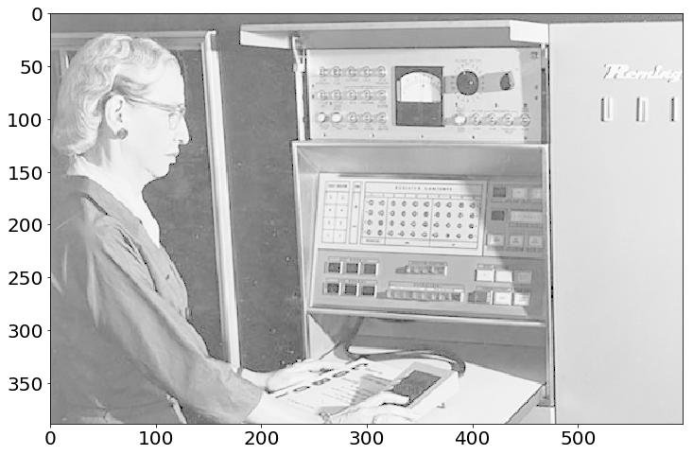
Images as Matrices
Suppose someone hands you this matrix.
What’s wrong with it?
No contrast!

Slide 55
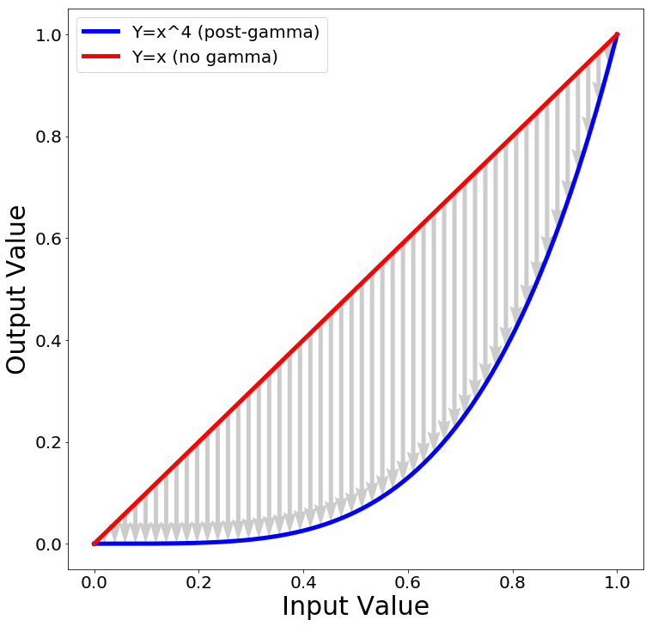
Contrast – Gamma curve
Typical way to change the contrast is to apply a nonlinear correction
$${pixelvalue}^{γ}$$
The quantity $γ$ controls how much contrast gets added

Slide 56
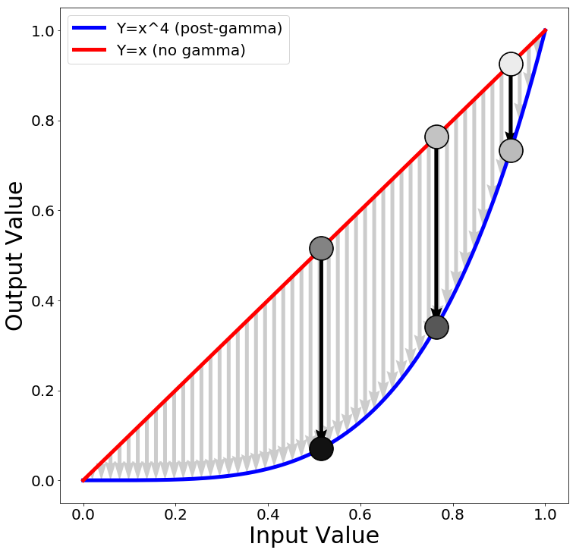
Contrast – Gamma curve
Now the darkest regions (10th pctile) are much darker than the moderately dark regions (50th pctile).
90%
50%
new
90%
10%
new
50%
new 10%

Slide 57
Implementation
Python+Numpy (right way):
imNew = im**4
Python+Numpy (slow way – why? ):
imNew = np.zeros(im.shape)
for y in range(im.shape[0]):
for x in range(im.shape[1]):
imNew[y,x] = im[y,x]**expFactor

Slide 58
Numerical Linear Algebra
EECS 442 – David Fouhey
Fall 2019, University of Michigan
http://web.eecs.umich.edu/~fouhey/teaching/EECS442_W19/

Slide 59
Images as Matrices
Suppose someone hands you this matrix.
The contrast is wrong!
No contrast!

Slide 60
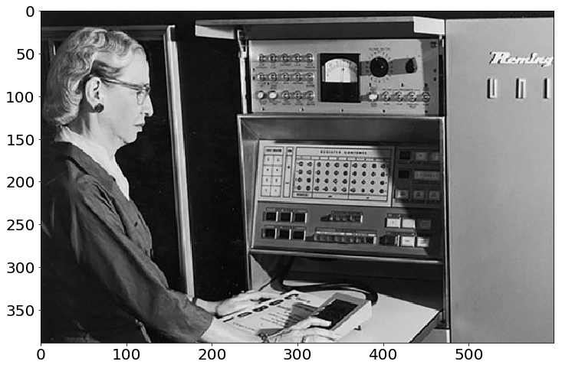
Results
Phew! Much Better.

Slide 61
Implementation
Python+Numpy (right way):
imNew = im**4
Python+Numpy (slow way – why? ):
imNew = np.zeros(im.shape)
for y in range(im.shape[0]):
for x in range(im.shape[1]):
imNew[y,x] = im[y,x]**expFactor

Slide 62
Element-wise Operations
Element-wise power – beware notation
$${\left(A^{p}\right)}_{ij}=A_{ij}^{p}$$
“Hadamard Product” / Element-wise multiplication
$${\left(A⊙B\right)}_{ij}=A_{ij}∗B_{ij}$$
Element-wise division
$${\left(A/B\right)}_{ij}=\frac{A_{ij}}{B_{ij}}$$

Slide 63
Sums Across Axes
$$A=\left[\begin{matrix}x_{1} & y_{1} \\ ⋮ & ⋮ \\ x_{n} & y_{n}\end{matrix}\right]$$
Suppose have Nx2 matrix A
$$Σ(A, 1)=\left[\begin{matrix}x_{1}+y_{1} \\ ⋮ \\ x_{n}+y_{n}\end{matrix}\right]$$
ND col. vec.
$$Σ(A, 0)=\left[\begin{matrix}\sum_{i=1}^{n}{x_{i}} & , \sum_{i=1}^{n}{y_{i}}\end{matrix}\right]$$
2D row vec
Note – libraries distinguish between N-D column vector and Nx1 matrix.

Slide 64
Vectorizing Example
Suppose I represent each image as a 128-dimensional vector
I want to compute all the pairwise distances between {x₁, …, x_{N}} and {y₁, …, y_{M}} so I can find, for every x_{i} the nearest y_{j}
Identity:${\left\|x−y\right\|}_{ }^{2}={\left\|x\right\|}_{ }^{2}+{\left\|y\right\|}_{ }^{2}−2x^{T}y$
Or: ${\left\|x−y\right\|}_{ }^{ }={\left({\left\|x\right\|}_{ }^{2}+{\left\|y\right\|}_{ }^{2}−2x^{T}y\right)}^{1/2}$

Slide 65
Vectorizing Example
$$X=\left[\begin{matrix}− & x_{1} & − \\ & ⋮ & \\ − & x_{N} & −\end{matrix}\right]$$
$$Y=\left[\begin{matrix}− & y_{1} & − \\ & ⋮ & \\ − & y_{M} & −\end{matrix}\right]$$
$$Y^{T}=\left[\begin{matrix}| & & | \\ y_{1} & ⋯ & y_{M} \\ | & & |\end{matrix}\right]$$
$$Σ\left(X^{2},1\right)=\left[\begin{matrix}{\left\|x_{1}\right\|}^{2} \\ ⋮ \\ {\left\|x_{N}\right\|}^{2}\end{matrix}\right]$$
Compute a Nx1 vector of norms
(can also do Mx1)
Compute a NxM matrix of dot products
$${\left(XY^{T}\right)}_{ij}=x_{i}^{T}y_{j}$$

Slide 66
Vectorizing Example
$$D={\left(Σ\left(X^{2},1\right)+Σ{\left(Y^{2},1\right)}^{T}−2XY^{T}\right)}^{1/2}$$
$$\left[\begin{matrix}{\left\|x_{1}\right\|}^{2} \\ ⋮ \\ {\left\|x_{N}\right\|}^{2}\end{matrix}\right]$$
$$+\left[\begin{matrix}{\left\|y_{1}\right\|}^{2} & ⋯ & {\left\|y_{M}\right\|}^{2}\end{matrix}\right]$$
$$\left[\begin{matrix}{\left\|x_{1}\right\|}^{2}+{\left\|y_{1}\right\|}^{2} & ⋯ & {\left\|x_{1}\right\|}^{2}+{\left\|y_{M}\right\|}^{2} \\ ⋮ & ⋱ & ⋮ \\ {\left\|x_{N}\right\|}^{2}+{\left\|y_{1}\right\|}^{2} & ⋯ & {\left\|x_{N}\right\|}^{2}+{\left\|y_{M}\right\|}^{2}\end{matrix}\right]$$
Why?
$${\left(Σ\left(X^{2},1\right)+Σ{\left(Y^{2},1\right)}^{T}\right)}_{ij}={\left\|x_{i}\right\|}^{2}+{\left\|y_{j}\right\|}^{2}$$

Slide 67
Vectorizing Example
$$D={\left(Σ\left(X^{2},1\right)+Σ{\left(Y^{2},1\right)}^{T}−2XY^{T}\right)}^{1/2}$$
$$D_{ij}={\left\|x_{i}\right\|}^{2}+{\left\|y_{j}\right\|}^{2}+ 2x^{T}y$$
Numpy code:
XNorm = np.sum(X**2,axis=1,keepdims=True)
YNorm = np.sum(Y**2,axis=1,keepdims=True)
D = (XNorm+YNorm.T-2*np.dot(X,Y.T))**0.5
*May have to make sure this is at least 0 (sometimes roundoff issues happen)

Slide 68
Does it Make a Difference?
Computing pairwise distances between 300 and 400 128-dimensional vectors
for x in X, for y in Y, using native python: 9s
for x in X, for y in Y, using numpy to compute distance: 0.8s
vectorized: 0.0045s (~2000x faster than 1, 175x faster than 2)
Expressing things in primitives that are optimized is usually faster

Slide 69
Linear Independence
A set of vectors is linearly independent if you can’t write one as a linear combination of the others.
$$a=\left[\begin{matrix}0 \\ 0 \\ 2\end{matrix}\right]$$
$$b=\left[\begin{matrix}0 \\ 6 \\ 0\end{matrix}\right]$$
$$c=\left[\begin{matrix}5 \\ 0 \\ 0\end{matrix}\right]$$
Suppose:
$$x=\left[\begin{matrix}0 \\ 0 \\ 4\end{matrix}\right]=$$
$$y=\left[\begin{matrix}0 \\ −2 \\ 1\end{matrix}\right]=$$
$$\frac{1}{2}a−\frac{1}{3}b$$
$$2a$$
Is the set {a,b,c} linearly independent?
Is the set {a,b,x} linearly independent?
Max # of independent 3D vectors?

Slide 70
Span
Span: all linear combinations of a set of vectors
Span({ }) =
Span({[0,2]}) = ?
All vertical lines through origin =
$$\left\{λ\left[0,1\right]:λ∈R\right\}$$
Is blue in {red}’s span?

Slide 71
Span
Span: all linear combinations of a set of vectors
Span({ , }) = ?

Slide 72
Span
Span: all linear combinations of a set of vectors
Span({ , }) = ?

Slide 73
Matrix-Vector Product
$$Ax=\left[\begin{matrix}| & & | \\ c_{1} & ⋯ & c_{n} \\ | & & |\end{matrix}\right]x$$
Right-multiplying A by x mixes columns of A according to entries of x
The output space of f(x) = Ax is constrained to be the span of the columns of A.
Can’t output things you can’t construct out of your columns

Slide 74
An Intuition
$$y=Ax=\left[\begin{matrix}| & | & | \\ c_{1} & c_{2} & c_{n} \\ | & | & |\end{matrix}\right]\left[\begin{matrix}x_{1} \\ x_{2} \\ x_{3}\end{matrix}\right]$$
y
y₁
x
y₂
Ax
x₁
x₂
x₃
y₃
x – knobs on machine (e.g., fuel, brakes)
y – state of the world (e.g., where you are)
A – machine (e.g., your car)

Slide 75
Linear Independence
Suppose the columns of 3x3 matrix A are not linearly independent (c₁, αc₁, c₂ for instance)
$$y=Ax=\left[\begin{matrix}| & | & | \\ c_{1} & {αc}_{1} & c_{2} \\ | & | & |\end{matrix}\right]\left[\begin{matrix}x_{1} \\ x_{2} \\ x_{3}\end{matrix}\right]$$
$$y=x_{1}c_{1}+αx_{2}c_{1}+x_{3}c_{2}$$
$$y=\left(x_{1}+αx_{2}\right)c_{1}+x_{3}c_{2}$$

Slide 76
Linear Independence Intuition
Knobs of x are redundant. Even if y has 3 outputs, you can only control it in two directions
$$y=\left(x_{1}+αx_{2}\right)c_{1}+x_{3}c_{2}$$
y
y₁
x
y₂
Ax
x₁
x₂
x₃
y₃

Slide 77
Linear Independence
$$Ax=\left(x_{1}+αx_{2}\right)c_{1}+x_{3}c_{2}$$
Recall:
$$y=A\left[\begin{matrix}x_{1}+β \\ x_{2}−β/α \\ x_{3}\end{matrix}\right]$$
$$=\left(x_{1}+β+αx_{2}−α\frac{β}{α}\right)c_{1}+x_{3}c_{2}$$
Can write y an infinite number of ways by adding $β$ to x₁ and subtracting $\frac{β}{α}$from x₂
Or, given a vector y there’s not a unique vector x s.t. y =Ax
Not all y have a corresponding x s.t. y=Ax

Slide 78
Linear Independence
$$Ax=\left(x_{1}+αx_{2}\right)c_{1}+x_{3}c_{2}$$
$$y=A\left[\begin{matrix}β \\ −β/α \\ 0\end{matrix}\right]$$
$$=\left(β−α\frac{β}{α}\right)c_{1}+0c_{2}$$
What else can we cancel out?
An infinite number of non-zero vectors x can map to a zero-vector y
Called the right null-space of A.

Slide 79
Rank
Rank of a nxn matrix A – number of linearly independent columns (or rows) of A / the dimension of the span of the columns
Matrices with full rank (n x n, rank n) behave nicely: can be inverted, span the full output space, are one-to-one.
Matrices with full rank are machines where every knob is useful and every output state can be made by the machine

Slide 80
Inverses
Given $y=Ax$, y is a linear combination of columns of A proportional to x. If A is full-rank, we should be able to invert this mapping.
Given some y (output) and A, what x (inputs) produced it?
x = A⁻¹y
Note: if you don’t need to compute it, never ever compute it. Solving for x is much faster and stable than obtaining A⁻¹.

Slide 81
Symmetric Matrices
Symmetric: $A^{T}=A$ or $A_{ij}=A_{ji}$
Have lots of special properties
$$\left[\begin{matrix}a_{11} & a_{12} & a_{13} \\ a_{21} & a_{22} & a_{23} \\ a_{31} & a_{32} & a_{33}\end{matrix}\right]$$
Any matrix of the form ${A=X}^{T}X$ is symmetric.
Quick check:
$$A^{T}={\left(X^{T}X\right)}^{T}$$
$$A^{T}=X^{T}{\left(X^{T}\right)}^{T}$$
$$A^{T}=X^{T}X$$

Slide 82
Special Matrices – Rotations
$$\left[\begin{matrix}r_{11} & r_{12} & r_{13} \\ r_{21} & r_{22} & r_{23} \\ r_{31} & r_{32} & r_{33}\end{matrix}\right]$$
Rotation matrices $R$ rotate vectors and do not change vector L2 norms (${\left\|Rx\right\|}_{2}={\left\|x\right\|}_{2}$)
Every row/column is unit norm
Every row is linearly independent
Transpose is inverse $RR^{T}=R^{T}R=I$
Determinant is 1 (otherwise it’s also a coordinate flip/reflection), eigenvalues are 1

Slide 83
Eigensystems
An eigenvector $v_{i}$ and eigenvalue $λ_{i}$ of a matrix $A$ satisfy $Av_{i}=λ_{i}v_{i}$ ($Av_{i}$ is scaled by $λ_{i}$)
Vectors and values are always paired and typically you assume ${\left\|v_{i}\right\|}^{2}=1$
Biggest eigenvalue of A gives bounds on how much $f\left(x\right)=Ax$ stretches a vector x.
Hints of what people really mean:
“Largest eigenvector” = vector w/ largest value
Spectral just means there’s eigenvectors

Slide 84
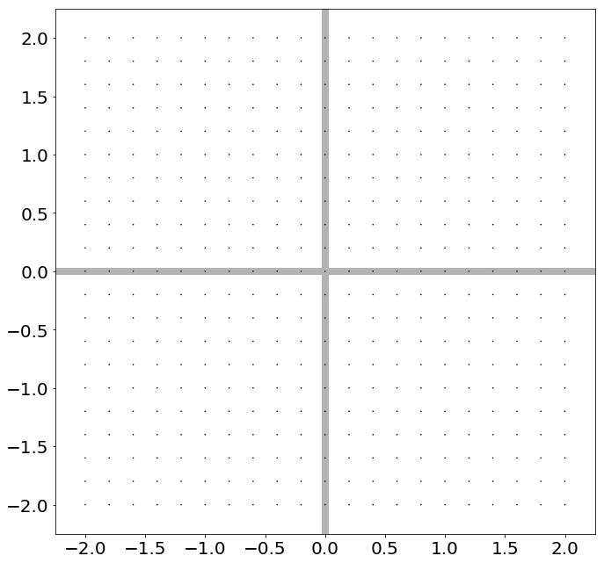
Suppose I have points in a grid

Slide 85
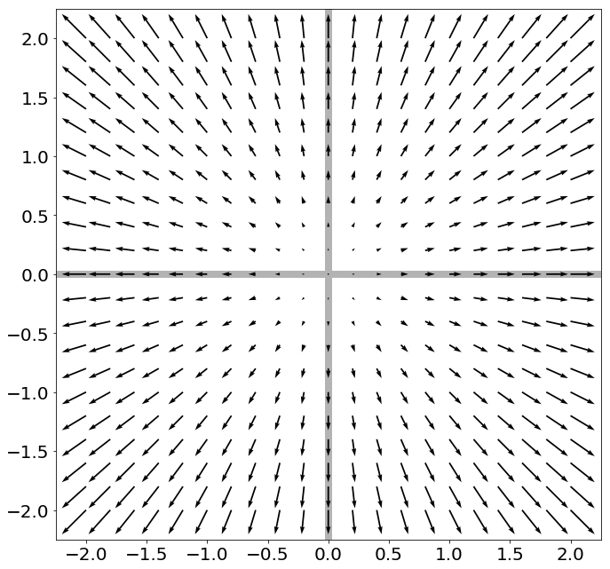
Now I apply f(x) = Ax to these points
Pointy-end: Ax . Non-Pointy-End: x

Slide 86
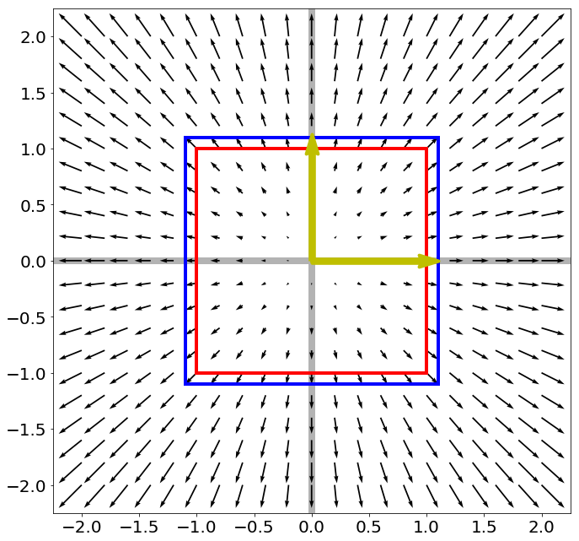
$$A=$$
$$\left[\begin{matrix}1.1 & 0 \\ 0 & 1.1\end{matrix}\right]$$
Red box – unit square, Blue box – after f(x) = Ax.
What are the yellow lines and why?

Slide 87
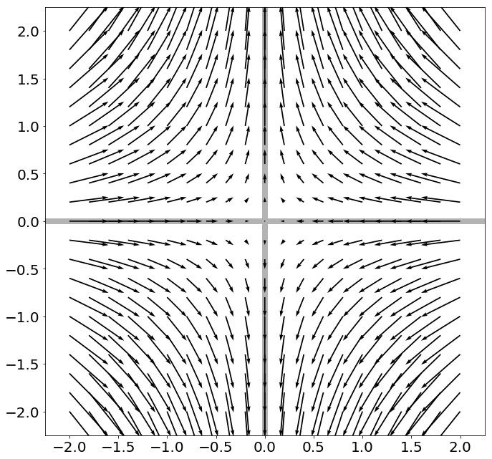
$$A=$$
$$\left[\begin{matrix}0.8 & 0 \\ 0 & 1.25\end{matrix}\right]$$
Now I apply f(x) = Ax to these points
Pointy-end: Ax . Non-Pointy-End: x

Slide 88
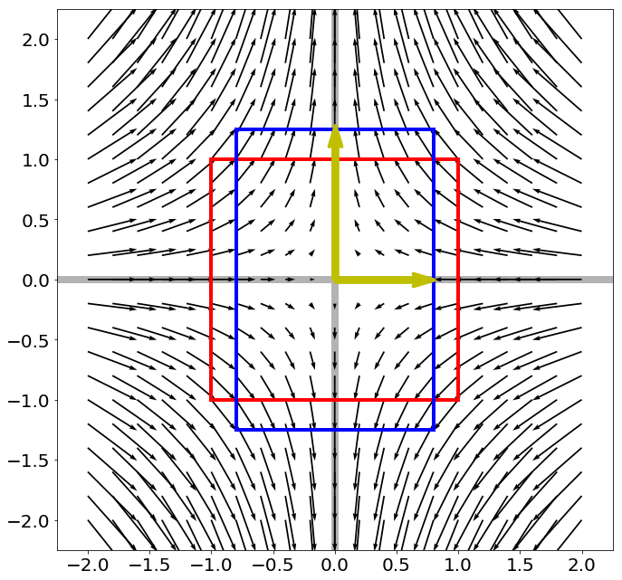
$$A=$$
$$\left[\begin{matrix}0.8 & 0 \\ 0 & 1.25\end{matrix}\right]$$
Red box – unit square, Blue box – after f(x) = Ax.
What are the yellow lines and why?

Slide 89
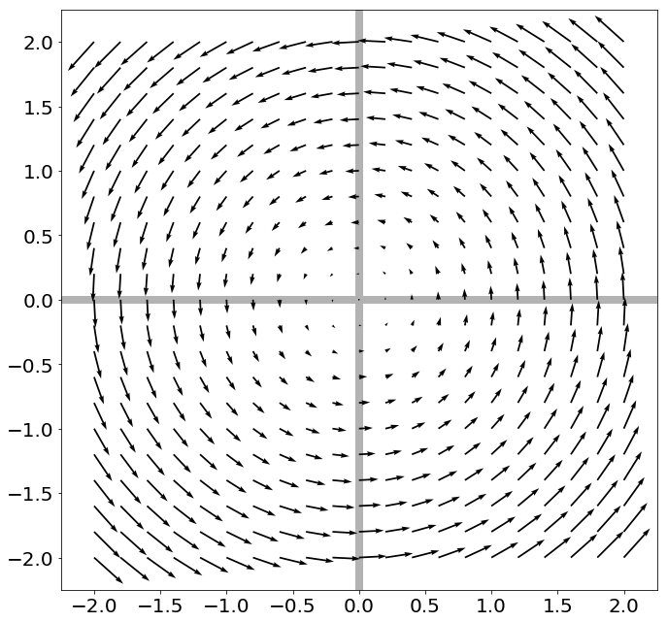
$$A=$$
$$\left[\begin{matrix}cos⁡(t) & −sin⁡(t) \\ sin⁡(t) & cos⁡(t)\end{matrix}\right]$$
Red box – unit square, Blue box – after f(x) = Ax.
Can we draw any yellow lines?

Slide 90
Eigenvectors of Symmetric Matrices
Always n mutually orthogonal eigenvectors with n (not necessarily) distinct eigenvalues
For symmetric $A$, the eigenvector with the largest eigenvalue maximizes $\frac{x^{T}Ax}{x^{T}x}$ (smallest/min)
So for unit vectors (where $x^{T}x=1$), that eigenvector maximizes $x^{T}Ax$
A surprisingly large number of optimization problems rely on (max/min)imizing this

Slide 91
The Singular Value Decomposition
Can always write a mxn matrix A as: $A=UΣV^{T}$
A
U
∑
σ₁
0
=
σ₂
σ₃
Rotation
Scale
0
Eigenvectors
of AA^{T}
Sqrt of Eigenvalues of A^{T}A

Slide 92
The Singular Value Decomposition
Can always write a mxn matrix A as: $A=UΣV^{T}$
A
U
∑
V^{T}
=
Rotation
Rotation
Scale
Eigenvectors
of AA^{T}
Sqrt of Eigenvalues of A^{T}A
Eigenvectors
of A^{T}A

Slide 93
Singular Value Decomposition
Every matrix is a rotation, scaling, and rotation
Number of non-zero singular values = rank / number of linearly independent vectors
“Closest” matrix to A with a lower rank
A
U
σ₁
0
V^{T}
=
σ₂
σ₃
0

Slide 94
Singular Value Decomposition
Every matrix is a rotation, scaling, and rotation
Number of non-zero singular values = rank / number of linearly independent vectors
“Closest” matrix to A with a lower rank
Â
U
σ₁
0
V^{T}
=
σ₂
0
0

Slide 95
Singular Value Decomposition
Every matrix is a rotation, scaling, and rotation
Number of non-zero singular values = rank / number of linearly independent vectors
“Closest” matrix to A with a lower rank
Secretly behind basically many things you do with matrices

Slide 96
Solving Least-Squares
(x₂,y₂)
Start with two points (x_{i},y_{i})
$$y=Av$$
$$\left[\begin{matrix}y_{1} \\ y_{2}\end{matrix}\right]=\left[\begin{matrix}x_{1} & 1 \\ x_{2} & 1\end{matrix}\right]\left[\begin{matrix}m \\ b\end{matrix}\right]$$
(x₁,y₁)
$$\left[\begin{matrix}y_{1} \\ y_{2}\end{matrix}\right]=\left[\begin{matrix}mx_{1}+b \\ mx_{2}+b\end{matrix}\right]$$
We know how to solve this – invert A and find v (i.e., (m,b) that fits points)

Slide 97
Solving Least-Squares
(x₂,y₂)
Start with two points (x_{i},y_{i})
$$y=Av$$
$$\left[\begin{matrix}y_{1} \\ y_{2}\end{matrix}\right]=\left[\begin{matrix}x_{1} & 1 \\ x_{2} & 1\end{matrix}\right]\left[\begin{matrix}m \\ b\end{matrix}\right]$$
(x₁,y₁)
$${\left\|\left[\begin{matrix}y_{1} \\ y_{2}\end{matrix}\right]−\left[\begin{matrix}mx_{1}+b \\ mx_{2}+b\end{matrix}\right]\right\|}^{2}$$
$${\left\|y−Av\right\|}^{2}=$$
$${=\left(y_{1}−\left(mx_{1}+b\right)\right)}^{2}+{\left(y_{2}−\left(mx_{2}+b\right)\right)}^{2}$$
The sum of squared differences between the actual value of y and
what the model says y should be.

Slide 98
Solving Least-Squares
Suppose there are n > 2 points
$$y=Av$$
$$\left[\begin{matrix}y_{1} \\ ⋮ \\ y_{N}\end{matrix}\right]=\left[\begin{matrix}x_{1} & 1 \\ ⋮ & ⋮ \\ x_{N} & 1\end{matrix}\right]\left[\begin{matrix}m \\ b\end{matrix}\right]$$
Compute ${\left\|y−Ax\right\|}^{2}$ again
$${\left\|y−Av\right\|}^{2}=\sum_{i=1}^{n}{{\left(y_{i}−(mx_{i}+b)\right)}^{2}}$$

Slide 99
Solving Least-Squares
Given y, A, and v with y = Av overdetermined
(A tall / more equations than unknowns)
We want to minimize ${\left\|y−Av\right\|}^{2}$, or find:
$${arg min_{v}\left\|y−Av\right\|}^{2}$$
(The value of x that makes the expression smallest)
Solution satisfies $\left(A^{T}A\right)v^{∗}=A^{T}y$
or
$${v^{∗}=\left(A^{T}A\right)}^{−1}A^{T}y$$
(Don’t actually compute the inverse!)

Slide 100
When is Least-Squares Possible?
Given y, A, and v. Want y = Av
y
A
v
Want n outputs, have n knobs to fiddle with, every knob is useful if A is full rank.
=
y
=
A
v
A: rows (outputs) > columns (knobs). Thus can’t get precise output you want (not enough knobs). So settle for “closest” knob setting.

Slide 101
When is Least-Squares Possible?
Given y, A, and v. Want y = Av
y
A
v
Want n outputs, have n knobs to fiddle with, every knob is useful if A is full rank.
=
y
=
A
v
A: columns (knobs) > rows (outputs). Thus, any output can be expressed in infinite ways.

Slide 102
Homogeneous Least-Squares
Given a set of unit vectors (aka directions) $x_{1},…, x_{n}$ and I want vector $v$ that is as orthogonal to all the $x_{i}$ as possible (for some definition of orthogonal)
Stack $x_{i}$ into A, compute Av
$$…$$
$$x_{n}$$
$$x_{2}$$
$$Av=\left[\begin{matrix}− & x_{1}^{T} & − \\ & ⋮ & \\ − & x_{n}^{T} & −\end{matrix}\right]v$$
$$=\left[\begin{matrix}x_{1}^{T}v \\ ⋮ \\ x_{n}^{T}v\end{matrix}\right]$$
0 if
orthog
$$x_{1}$$
$$v$$
$${\left\|Av\right\|}^{2}=\sum_{i}^{n}{{\left(x_{i}^{T}v\right)}^{2}}$$
Compute
Sum of how orthog. v is to each x

Slide 103
Homogeneous Least-Squares
A lot of times, given a matrix A we want to find the v that minimizes ${\left\|Av\right\|}^{2}$ .
I.e., want $v^{∗}=arg{\min_{v}{{\left\|Av\right\|}_{2}^{2}}}$
What’s a trivial solution?
Set v = 0 → Av = 0
Exclude this by forcing v to have unit norm

Slide 104
Homogeneous Least-Squares
Let’s look at ${\left\|Av\right\|}_{2}^{2}$
$${\left\|Av\right\|}_{2}^{2}=$$
Rewrite as dot product
$${\left\|Av\right\|}_{2}^{2}={\left(Av\right)}^{T}(Av)$$
Distribute transpose
$${\left\|Av\right\|}_{2}^{2}=v^{T}A^{T}Av=v^{T}\left(A^{T}A\right)v$$
We want the vector minimizing this quadratic form
Where have we seen this?

Slide 105
Homogeneous Least-Squares
Ubiquitious tool in vision:
$$\arg{{\min_{{\left\|v\right\|}^{2}=1}\left\|Av\right\|}^{2}}$$
(1) “Smallest”* eigenvector of $A^{T}A$
(2) “Smallest” right singular vector of $A$
For min → max, switch smallest → largest
*Note: $A^{T}A$is positive semi-definite so it has all non-negative eigenvalues

Slide 106
Derivatives
Remember derivatives?
Derivative: rate at which a function f(x) changes at a point as well as the direction that increases the function

Slide 107
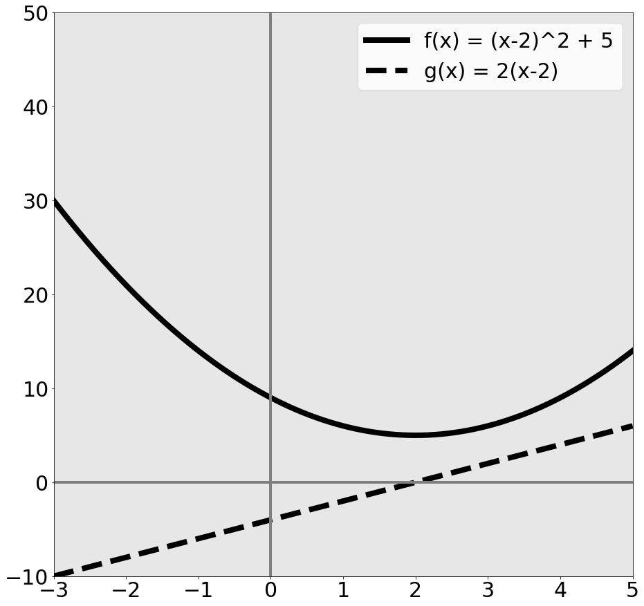
Given quadratic function f(x)
$$f\left(x,y\right)={\left(x−2\right)}^{2}+5$$
$f\left(x\right)$ is function
$g\left(x\right)=f^{′}\left(x\right)$
aka
$$g\left(x\right)=\frac{d}{dx}f(x)$$

Slide 108
Given quadratic function f(x)
$$f\left(x,y\right)={\left(x−2\right)}^{2}+5$$
What’s special about x=2?
$f\left(x\right)$ minim. at 2
$g\left(x\right)=0$ at 2
a = minimum of f →
$$g\left(a\right)=0$$
Reverse is not true

Slide 109
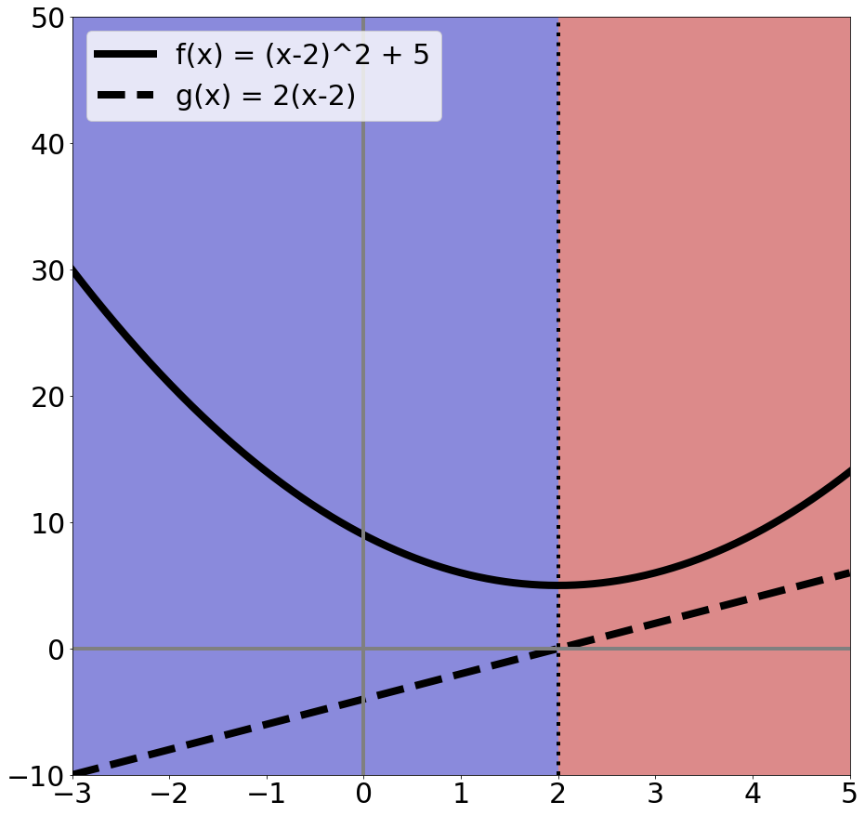
Rates of change
$$f\left(x,y\right)={\left(x−2\right)}^{2}+5$$
Suppose I want to increase f(x) by changing x:
Blue area: move left
Red area: move right
Derivative tells you direction of ascent and rate

Slide 110
What Calculus Should I Know
Really need intuition
Need chain rule
Rest you should look up / use a computer algebra system / use a cookbook
Partial derivatives (and that’s it from multivariable calculus)

Slide 111
Partial Derivatives
Pretend other variables are constant, take a derivative. That’s it.
Make our function a function of two variables
$$f\left(x\right)={\left(x−2\right)}^{2}+5$$
$$\frac{∂}{∂x}f\left(x\right)=2\left(x−2\right)∗1=2(x−2)$$
Pretend it’s constant → derivative = 0
$$f_{2}\left(x,y\right)={\left(x−2\right)}^{2}+5+{\left(y+1\right)}^{2}$$
$$\frac{∂}{∂x}f_{2}\left(x\right)=2(x−2)$$

Slide 112
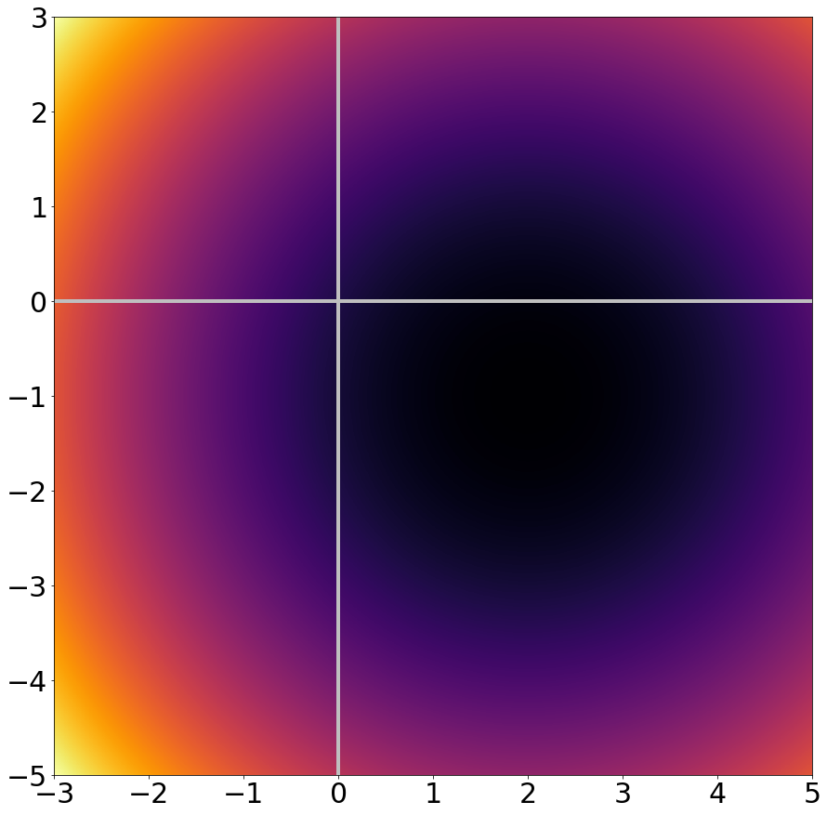
Zooming Out
$$f_{2}\left(x,y\right)={\left(x−2\right)}^{2}+5+{\left(y+1\right)}^{2}$$
Dark = f(x,y) low
Bright = f(x,y) high

Slide 113
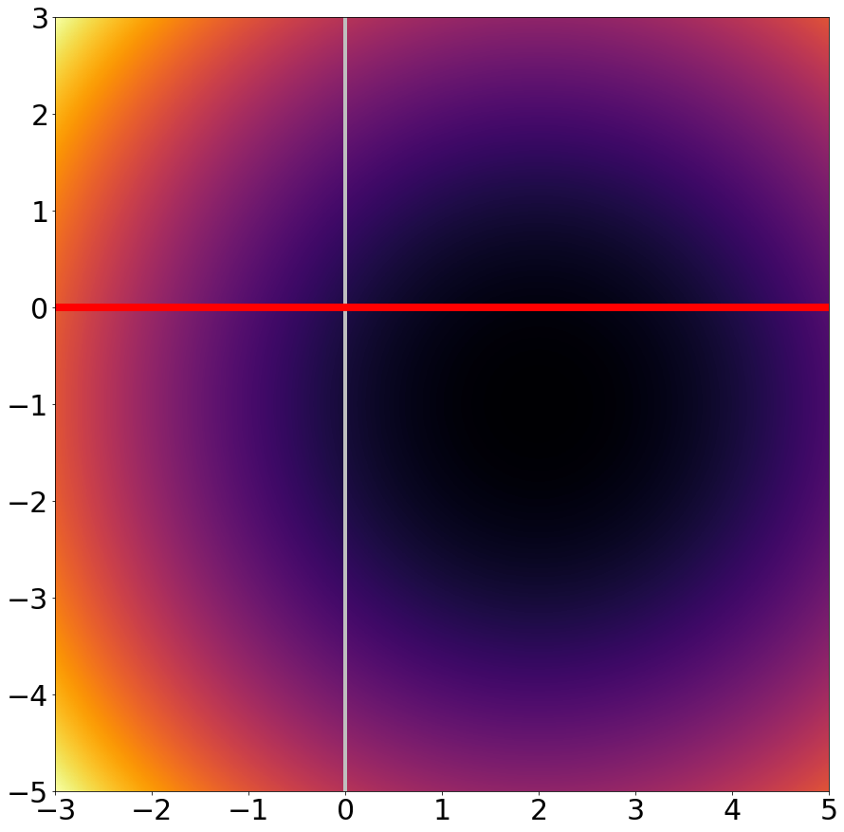
Taking a slice of
$$f_{2}\left(x,y\right)={\left(x−2\right)}^{2}+5+{\left(y+1\right)}^{2}$$
Slice of y=0 is the function from before:
$$f\left(x\right)={\left(x−2\right)}^{2}+5$$
$$f^{′}\left(x\right)=2(x−2)$$

Slide 114
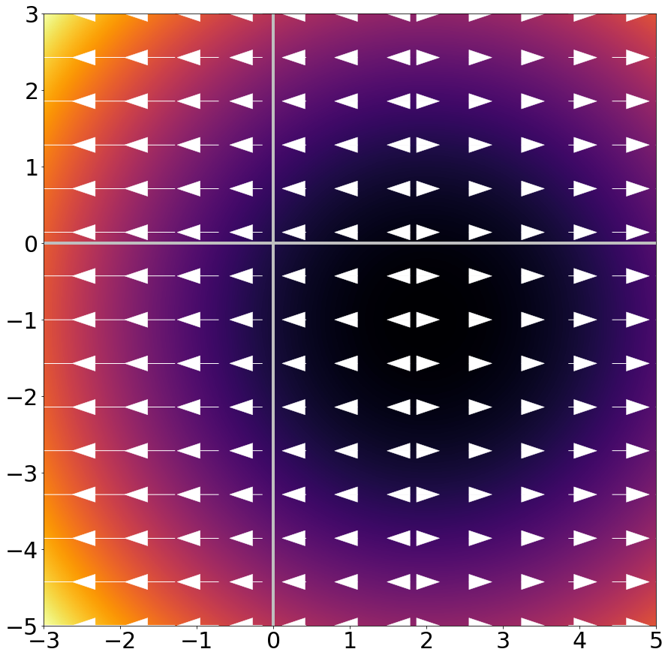
Taking a slice of
$$f_{2}\left(x,y\right)={\left(x−2\right)}^{2}+5+{\left(y+1\right)}^{2}$$
$\frac{∂}{∂x}f_{2}\left(x,y\right)$ is rate of change & direction in x dimension

Slide 115
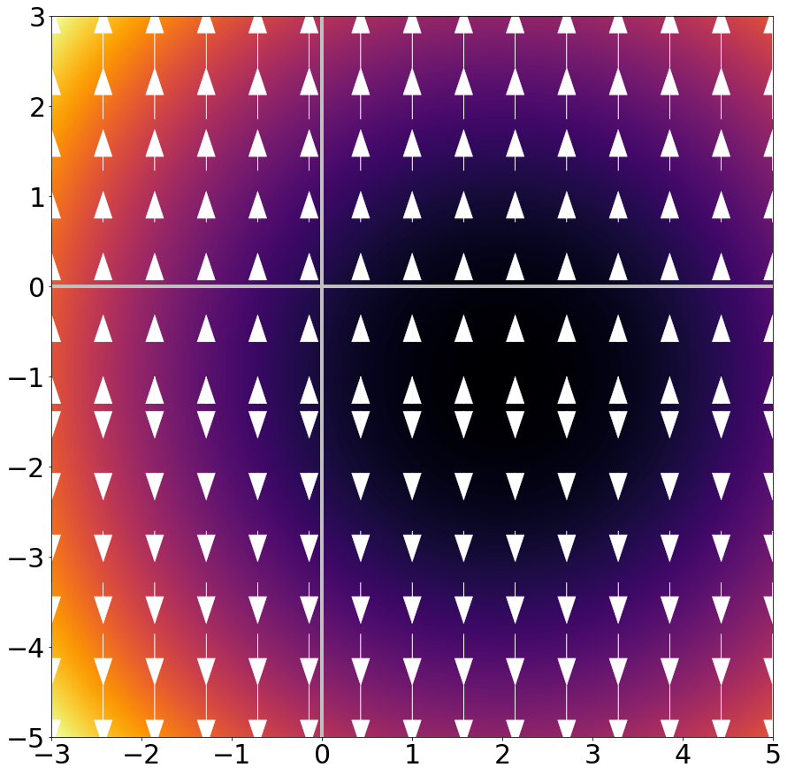
Zooming Out
$$f_{2}\left(x,y\right)={\left(x−2\right)}^{2}+5+{\left(y+1\right)}^{2}$$
$\frac{∂}{∂y}f_{2}\left(x,y\right)$ is
$$2(y+1)$$
and is the rate of change & direction in y dimension

Slide 116
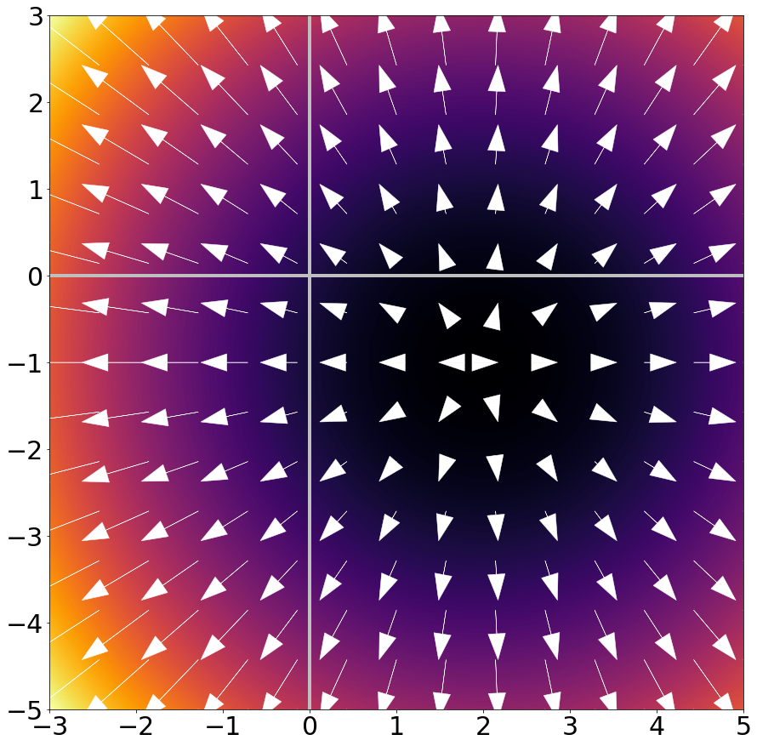
Zooming Out
$$f_{2}\left(x,y\right)={\left(x−2\right)}^{2}+5+{\left(y+1\right)}^{2}$$
Gradient/Jacobian:
Making a vector of
$$∇_{f}=\left[\frac{∂f}{∂x },\frac{∂f}{∂y}\right]$$
gives rate and direction of change.
Arrows point OUT of minimum / basin.

Slide 117
What Should I Know?
Gradients are simply partial derivatives per-dimension: if $x$ in $f(x)$ has n dimensions, $∇_{f}(x)$ has n dimensions
Gradients point in direction of ascent and tell the rate of ascent
If a is minimum of $f(x)$ → $∇_{f}\left(a\right)=0$
Reverse is not true, especially in high-dimensional spaces

Slide 119
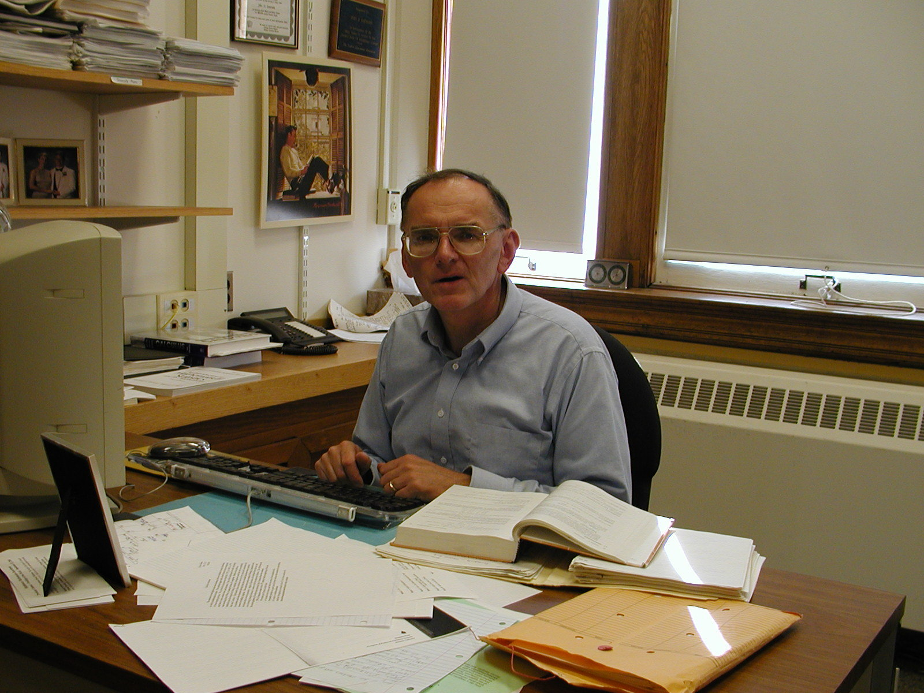
Monte Carlo Methods
Suppose a wise math professor (pictured below) gives you an integral and you’re lazy but a decent programmer
$$\int_{−∞}^{∞}{\frac{1}{\sqrt{2π}}\exp\left(−\frac{1}{2}x^{2}\right)dx }$$
Prof: “complete the square.”
Student: “hmmmm”
John Emerson, Math Prof at Middlebury

Slide 120
Monte Carlo Methods
Integral of f(x) from a to b:
Draw a bunch of random x_{i} over [a,b]
Compute average value over x_{i}, multiply (b-a)
Done!
Size of area
you’re integrating
$$\int_{a}^{b}{f\left(x\right)dx}≈\left(b−a\right)\frac{1}{N}\sum_{i}^{N}{f(x_{i})}$$
Average height of f over area you’re integrating

Slide 121
Monte Carlo Methods

Slide 122
Goldbach Conjecture
For every even number n ≥ 2 there are two primes a, b such that a + b = n

