Slide 1
Cameras
EECS 442 – David Fouhey
Fall 2019, University of Michigan
http://web.eecs.umich.edu/~fouhey/teaching/EECS442_F19/

Slide 2
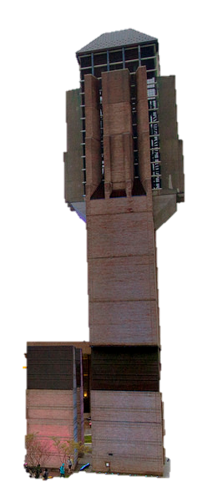
Let’s Take a Picture!
Photosensitive Material
Idea 1: Just use film
Result: Junk
Slide inspired by S. Seitz; image from Michigan Engineering

Slide 3
Let’s Take a Picture!
Photosensitive Material
Idea 2: add a barrier
Slide inspired by S. Seitz; image from Michigan Engineering

Slide 4
Let’s Take a Picture!
Photosensitive Material
Idea 2: add a barrier
Slide inspired by S. Seitz; image from Michigan Engineering

Slide 5
Let’s Take a Picture!
Photosensitive Material
Film captures all the rays going through a point (a pencil of rays).
Result: good in theory!
Slide inspired by S. Seitz; image from Michigan Engineering

Slide 6
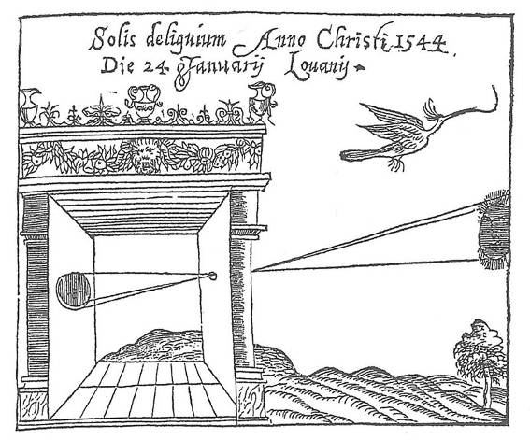
Camera Obscura
Basic principle known to Mozi (470-390 BCE), Aristotle (384-322 BCE)
Drawing aid for artists: described by Leonardo da Vinci (1452-1519)
Gemma Frisius, 1558
Source: A. Efros

Slide 7
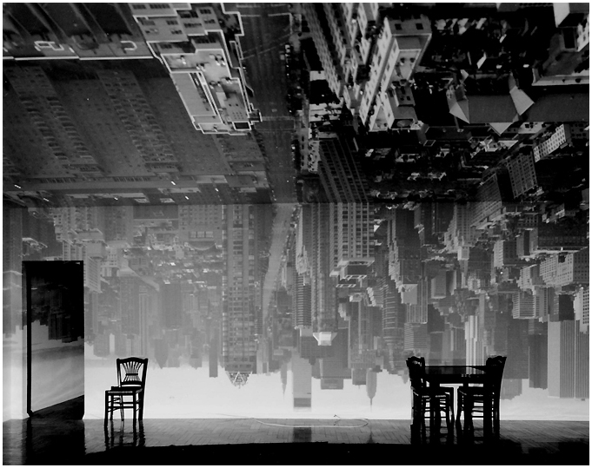
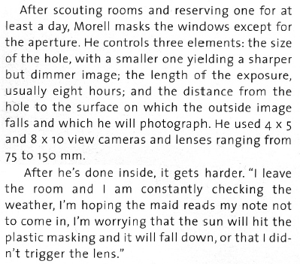
Camera Obscura
From Grand Images Through a Tiny Opening, Photo District News, February 2005
Abelardo Morell, Camera Obscura Image of Manhattan View Looking South in Large Room, 1996
http://www.abelardomorell.net/project/camera-obscura/

Slide 8

Abelardomorell.com

Slide 9
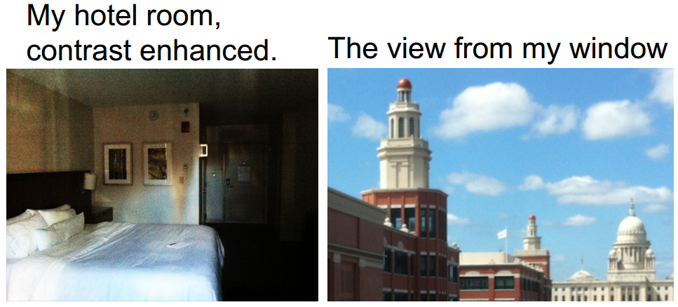
Camera Obscura
Hotel room
contrast enhanced
View Out of
Hotel Room Window
Source: A. Torralba, W. Freeman Accidental Pinhole and Pinspeck Cameras, CVPR 2012

Slide 10
Projection
X
P
O
How do we find the projection P of a point X?
Form visual ray from X to camera center and intersect it with camera plane
Source: L Lazebnik

Slide 11
Projection
X
X’
P
O
Both X and X’ project to P. Which appears in the image?
Are there points for which projection is undefined?
Source: L Lazebnik

Slide 12
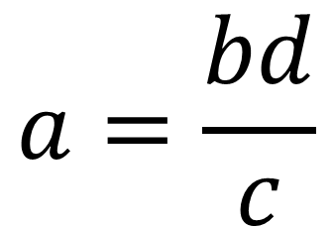
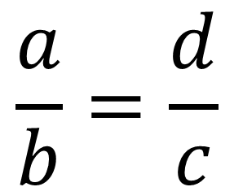
Quick Aside: Remember This?
d
b
θ
θ
c
a
$$\frac{a}{b}=\frac{d}{c}$$
$$a=\frac{bd}{c}$$

Slide 13
Projection Equations
f
y
X (x,y,z)
O
z
P
x
Coordinate system: O is origin, XY in image, Z sticks out.
XY is image plane, Z is optical axis.
(x,y,z) projects to (fx/z,fy/z) via similar triangles
Source: L Lazebnik

Slide 14
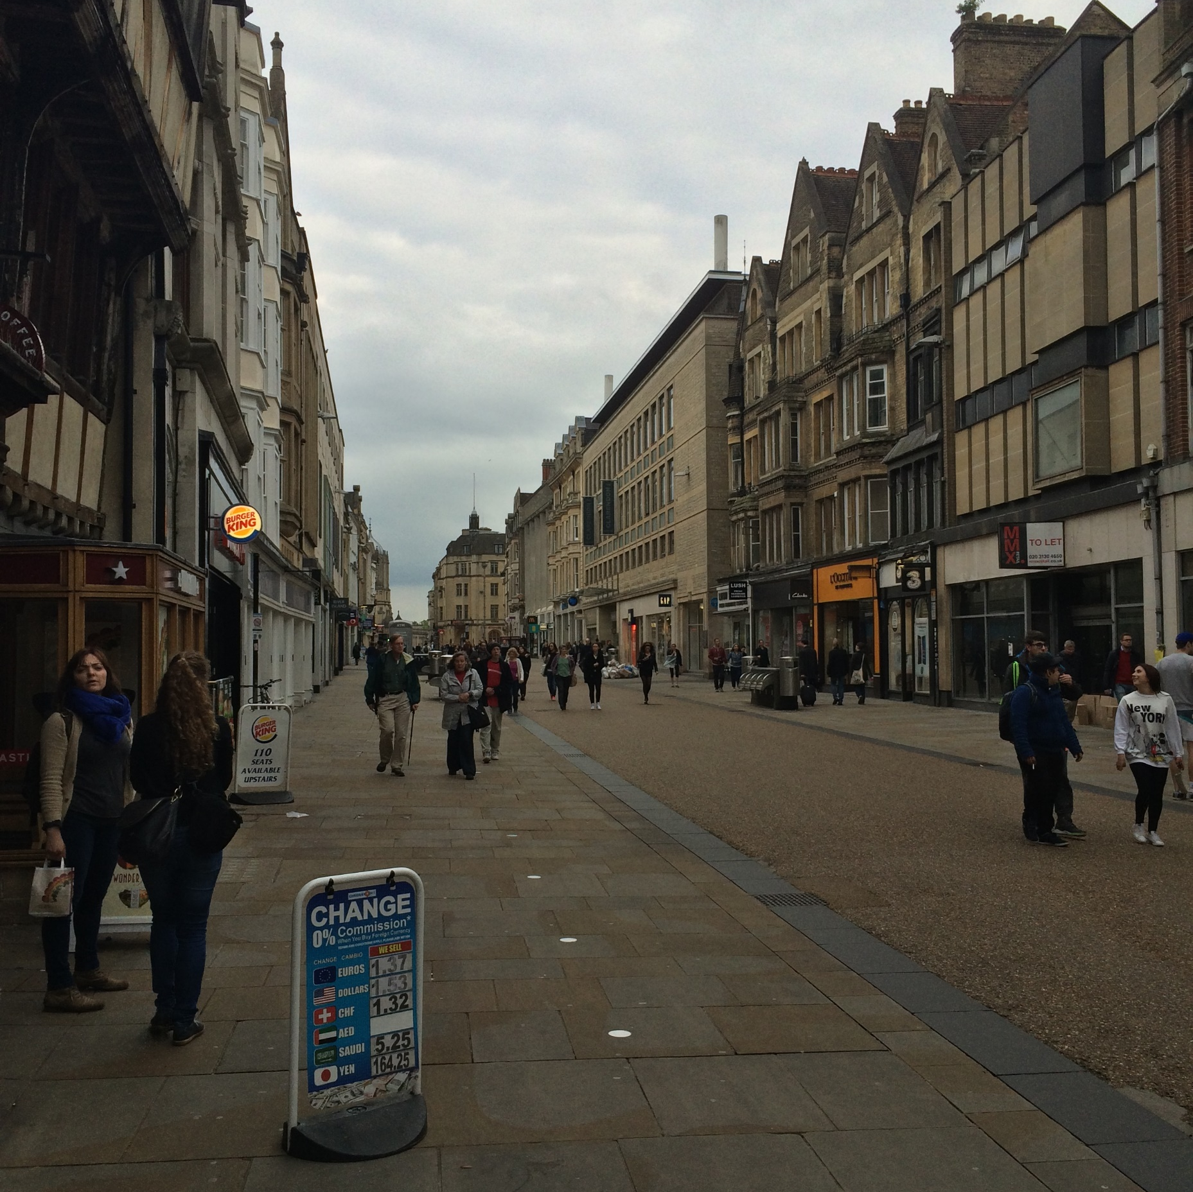



Some Facts About Projection
3D lines project to 2D lines
The projection of any 3D parallel lines converge at a vanishing point
Distant objects are smaller
List of properties from M. Hebert

Slide 15
Some Facts About Projection
Let’s try some fake images

Slide 16




Some Facts About Projection
Slide by Steve Seitz

Slide 17
Some Facts About Projection
Slide by Steve Seitz

Slide 18
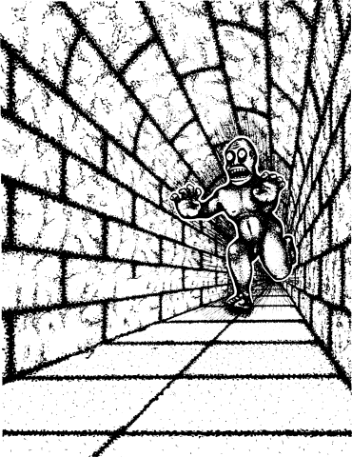

Some Facts About Projection
Illusion Credit: RN Shepard, Mind Sights: Original Visual Illusions, Ambiguities, and other Anomalies

Slide 19
What’s Lost?
Is she shorter or further away?
1
Are the orange lines we see parallel / perpendicular / neither to the red line?
4
2
3
Inspired by D. Hoiem slide

Slide 20
What’s Lost?
Is she shorter or further away?
1
Are the orange lines we see parallel / perpendicular / neither to the red line?
4
2
3
Adapted from D. Hoiem slide

Slide 21
What’s Lost?
Be careful of drawing conclusions:
Projection of 3D line is 2D line; NOT 2D line is 3D line.
Can you think of a counter-example (a 2D line that is not a 3D line)?
Projections of parallel 3D lines converge at VP; NOT any pair of lines that converge are parallel in 3D.
Can you think of a counter-example?

Slide 22
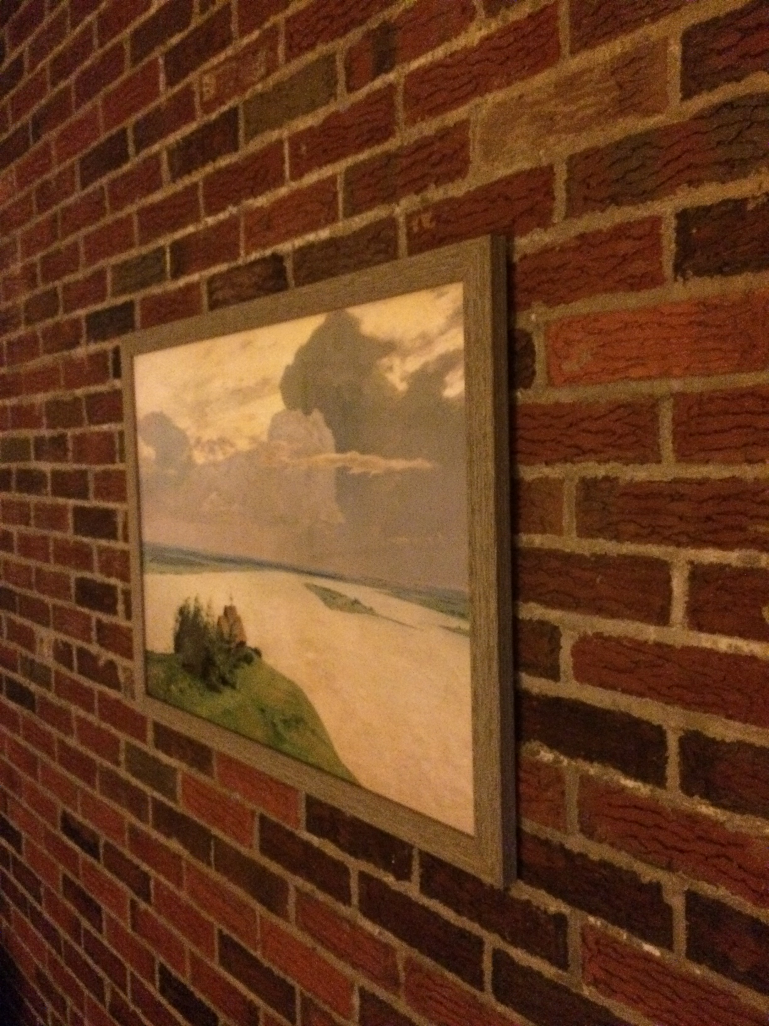

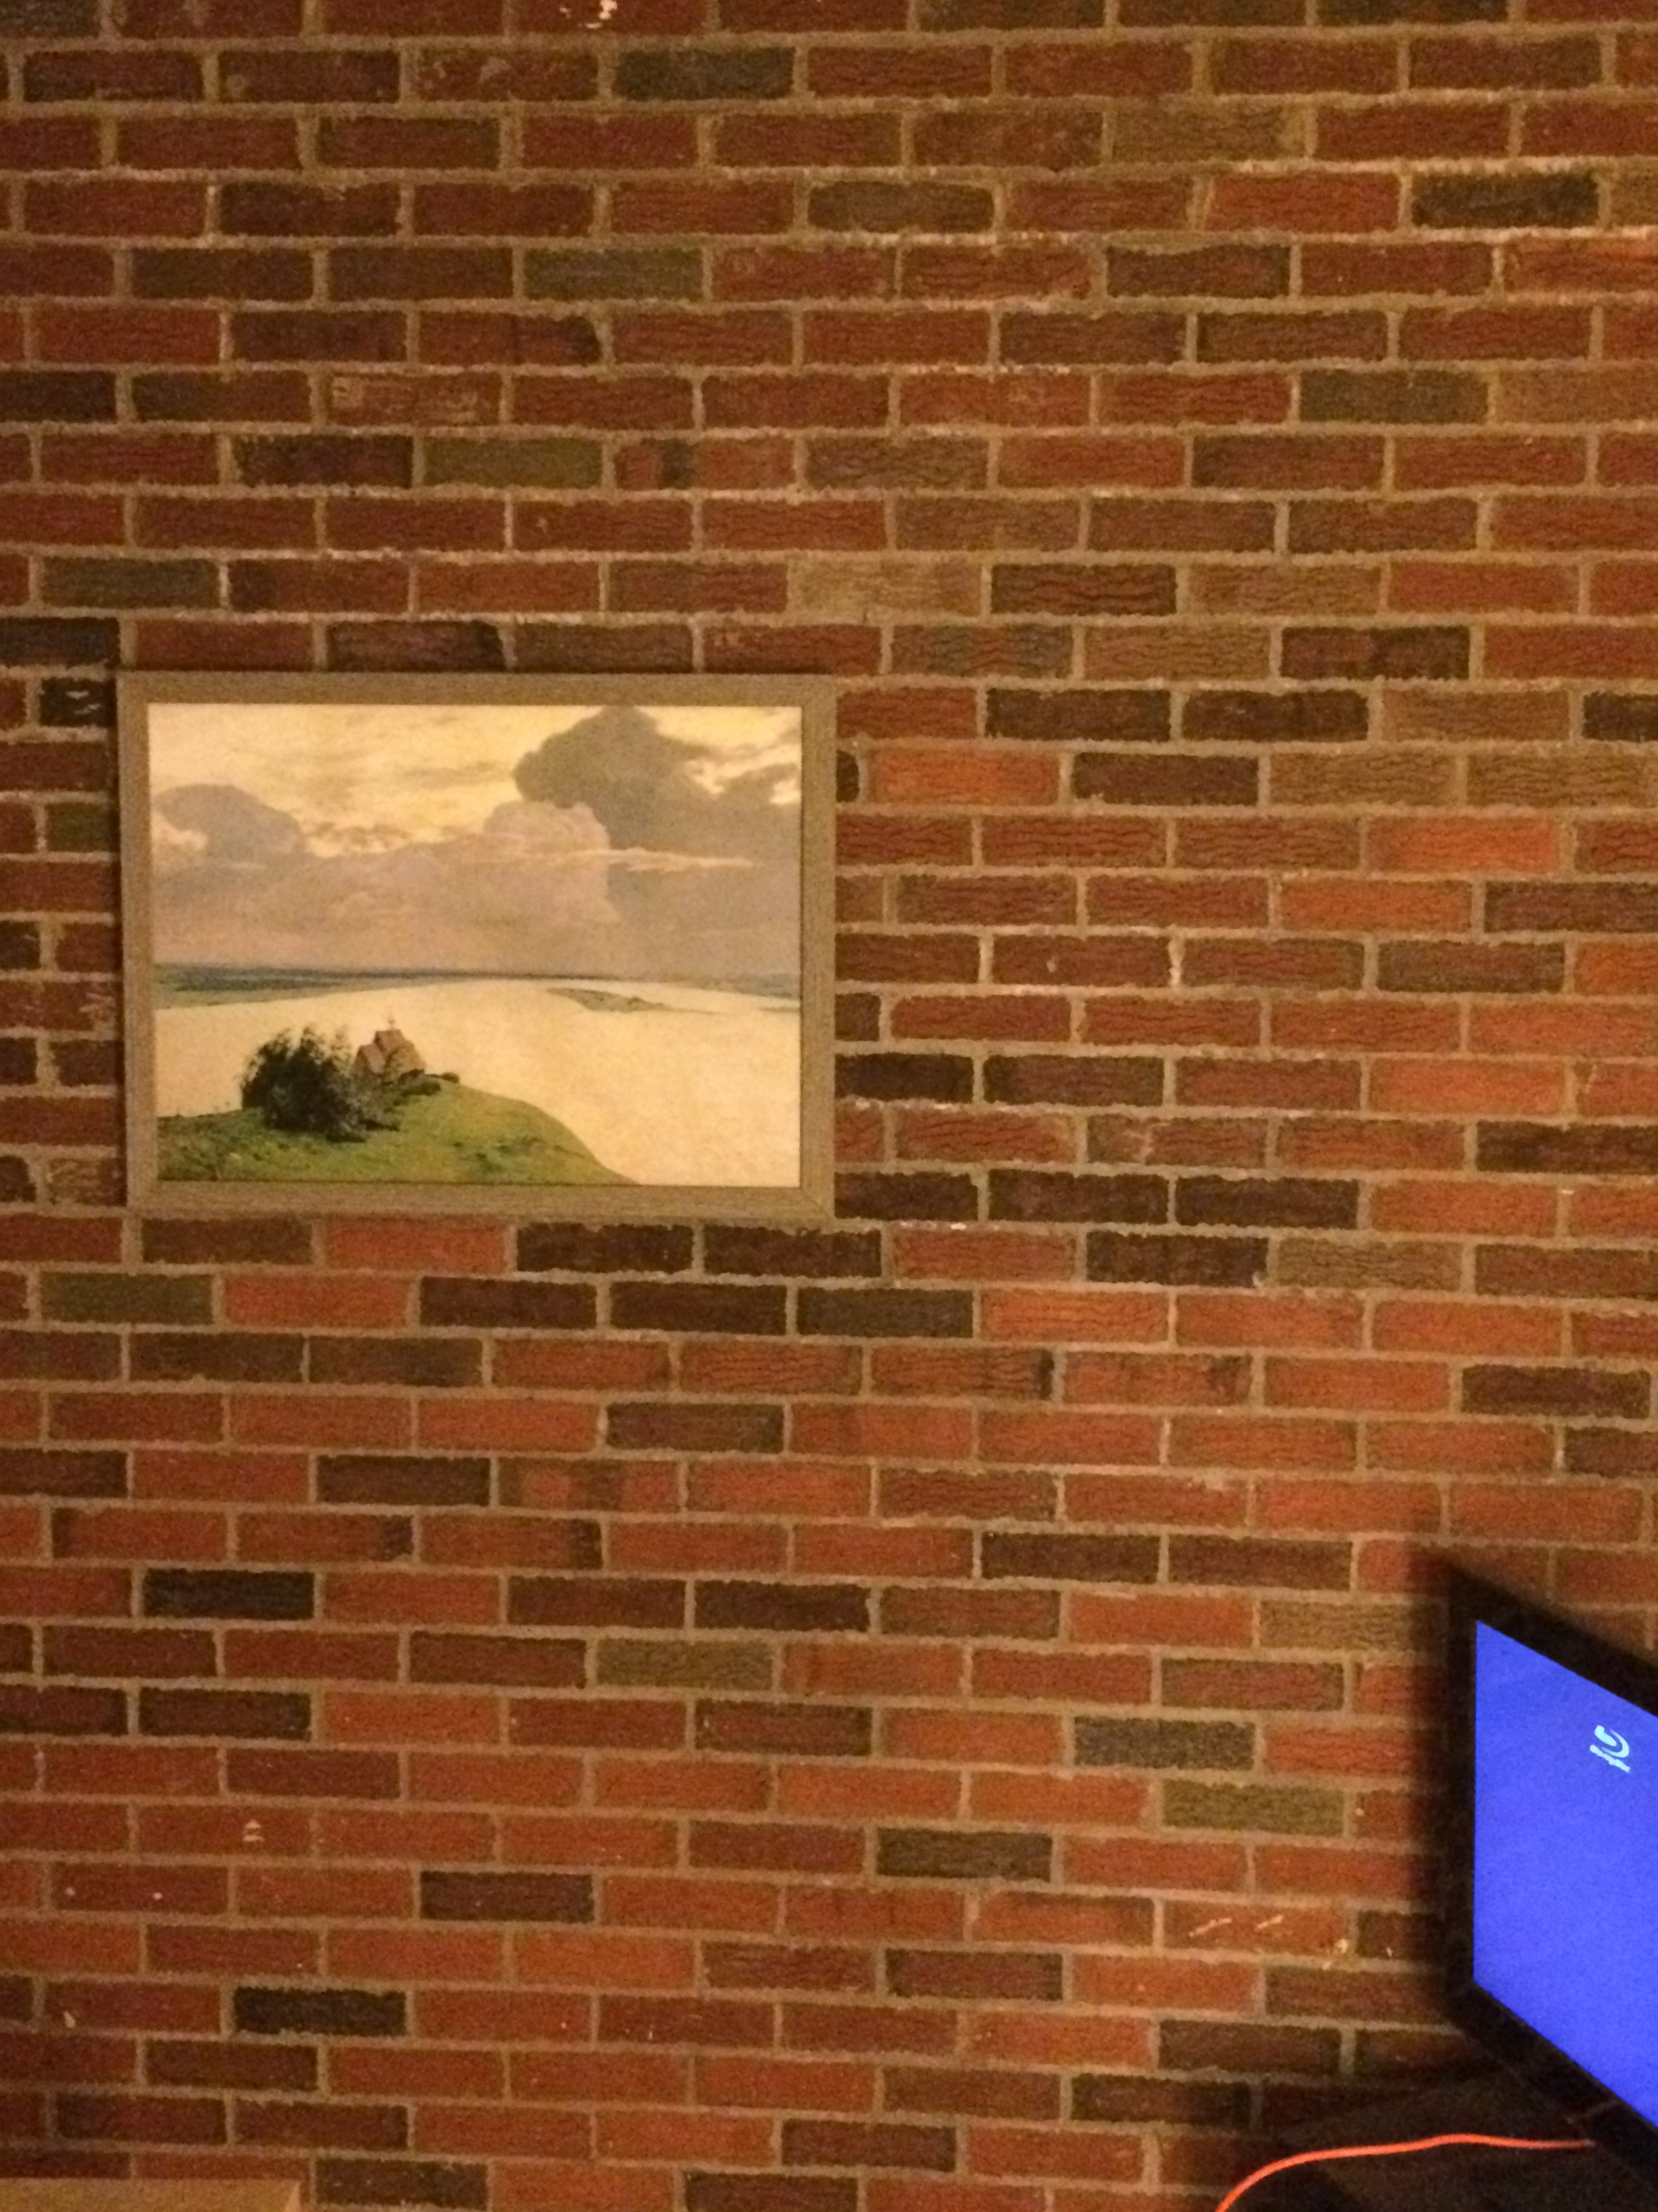
Do You Always Get Perspective?

Slide 23




Do You Always Get Perspective?
Y location of blue and red dots in image:
$$\frac{fy}{z_{2}}$$
$$\frac{fy}{z_{1}}$$
$$\frac{fy}{z}$$
$$\frac{fy}{z}$$

Slide 24
Do You Always Get Perspective?
When plane is fronto-parallel (parallel to camera plane), everything is:
scaled by f/z
otherwise is preserved.

Slide 25
What’s This Useful For?
Things looking different when viewed from different angles seems like a nuisance. It’s also a cue. Why?

Slide 26
Projection Equation
f
y
X
P
O
z
x
(x,y,z) → (fx/z,fy/z)
I promised you linear algebra: is this linear?
Nope: division by z is non-linear
(and risks division by 0)
Adapted from S. Seitz slide

Slide 27
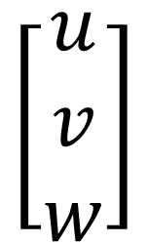
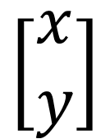
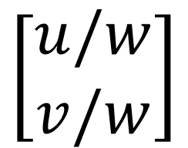
Homogeneous Coordinates (2D)
Trick: add a dimension!
This also clears up lots of nasty special cases
Physical
Point
Homogeneous
Point
Physical
Point
$$\left[\begin{matrix}u \\ v \\ w\end{matrix}\right]$$
$$\left[\begin{matrix}x \\ y\end{matrix}\right]$$
$$\left[\begin{matrix}u/w \\ v/w\end{matrix}\right]$$
Concat
w=1
Divide by w
What if w = 0?
Adapted from M. Hebert slide

Slide 28

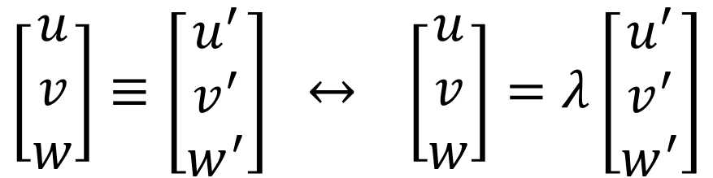
Homogeneous Coordinates
λ[x,y,w]
Triple /
Equivalent
Double /
Equals
[x,y,w]
$$\left[\begin{matrix}u \\ v \\ w\end{matrix}\right]≡\left[\begin{matrix}u^{′} \\ v^{′} \\ w^{′}\end{matrix}\right] ↔ \left[\begin{matrix}u \\ v \\ w\end{matrix}\right]=λ\left[\begin{matrix}u^{′} \\ v^{′} \\ w^{′}\end{matrix}\right]$$
y
$$λ≠0$$
z
Two homogeneous coordinates are equivalent if they are proportional to each other. Not = !
x

Slide 29
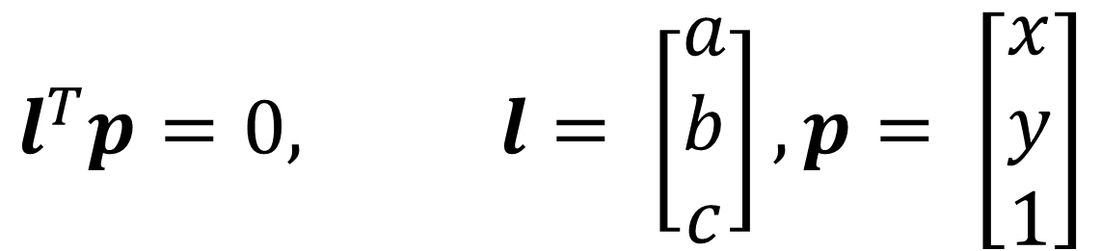
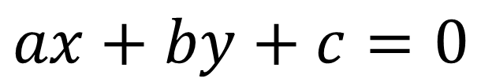
Benefits of Homogeneous Coords
General equation of 2D line:
$$ax+by+c=0$$
Homogeneous Coordinates
$$l^{T}p=0, l= \left[\begin{matrix}a \\ b \\ c\end{matrix}\right], p= \left[\begin{matrix}x \\ y \\ 1\end{matrix}\right]$$
Slide from M. Hebert

Slide 30
Benefits of Homogeneous Coords
Lines (3D) and points (2D → 3D) are now the same dimension.
Use the cross (x) and dot product for:
  Intersection of lines l and m: l x m
  Line through two points p and q: p x q
  Point p on line l: l^{T}p
Parallel lines, vertical lines become easy (compared to y=mx+b)

Slide 31
Benefits of Homogeneous Coords
What’s the intersection?
0x + 1y - 2 = 0
1x + 0y - 1 = 0
[0,1,-2] x [1,0,-1] = [-1,-2,-1]
Converting back (divide by -1)
(1,2)

Slide 33
Cameras
EECS 442 – David Fouhey
Fall 2019, University of Michigan
http://web.eecs.umich.edu/~fouhey/teaching/EECS442_F19/

Slide 34






Recap: Homogeneous Coords
Line of y=2 in
ax+by+c=0:
0x + 1y - 2 = 0
$$\left(a,b,c\right)=\left(0,1,−2\right)$$
$$\left(x,y\right)=(1,2)$$
Append 1
Point-on-line test: l^{T}p
$$\left(u,v,w\right)=(1,2,1)$$
Divide by w
$${\left(a,b,c\right)}^{T}\left(u,v,w\right)=$$
$$\left(x,y\right)=(1,2)$$
$${\left(0,1,−2\right)}^{T}\left(1,2,1\right)=0$$

Slide 35


Recap: Homogeneous Coords
$$\left(a_{1},b_{1},c_{1}\right)=(0,1,−2)$$
Line y=2
0x + 1y - 2 = 0
$$\left(a_{2},b_{2},c_{2}\right)=(1,0,−1)$$
Intersection: l₁ x l₂
Line x=1
1x + 0y - 1 = 0
[0,1,-2] x [1,0,-1] = [-1,-2,-1]
Converting back (divide by -1)
(1,2)

Slide 36
Benefits of Homogeneous Coords
0x + 1y - 3 = 0
0x + 1y - 2 = 0
0x + 1y - 1 = 0
Intersection of y=2, y=1
[0,1,-2] x [0,1,-1] = [1,0,0]
Does it lie on y=3? Intuitively?
[0,1,-3]^{T}[1,0,0] = 0

Slide 37
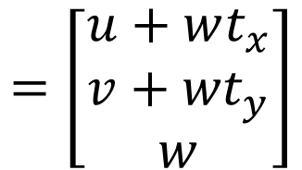
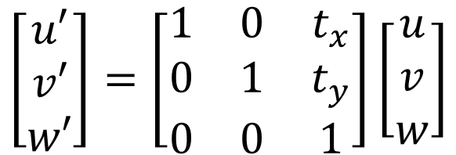
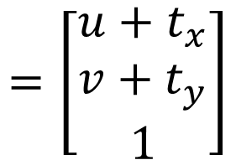
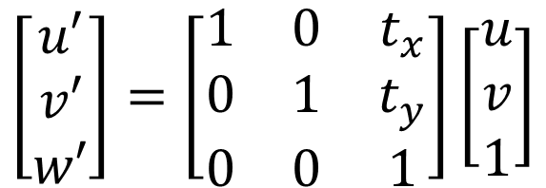
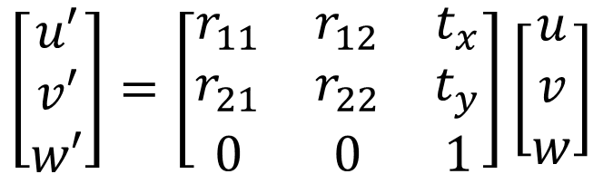
Benefits of Homogeneous Coords
Translation is now linear / matrix-multiply
$$\left[\begin{matrix}u′ \\ v′ \\ w′\end{matrix}\right]=\left[\begin{matrix}1 & 0 & t_{x} \\ 0 & 1 & t_{y} \\ 0 & 0 & 1\end{matrix}\right]\left[\begin{matrix}u \\ v \\ 1\end{matrix}\right]$$
$$=\left[\begin{matrix}u+t_{x} \\ v+t_{y} \\ 1\end{matrix}\right]$$
If w = 1
$$\left[\begin{matrix}u′ \\ v′ \\ w′\end{matrix}\right]=\left[\begin{matrix}1 & 0 & t_{x} \\ 0 & 1 & t_{y} \\ 0 & 0 & 1\end{matrix}\right]\left[\begin{matrix}u \\ v \\ w\end{matrix}\right]$$
$$=\left[\begin{matrix}u+wt_{x} \\ v+{wt}_{y} \\ w\end{matrix}\right]$$
Generically
Rigid body transforms (rot + trans) now linear
$$\left[\begin{matrix}u′ \\ v′ \\ w′\end{matrix}\right]=\left[\begin{matrix}r_{11} & r_{12} & t_{x} \\ r_{21} & r_{22} & t_{y} \\ 0 & 0 & 1\end{matrix}\right]\left[\begin{matrix}u \\ v \\ w\end{matrix}\right]$$

Slide 38



3D Homogeneous Coordinates
Same story: add a coordinate, things are equivalent if they’re proportional
$$\left[\begin{matrix}u \\ v \\ w \\ t\end{matrix}\right]$$
$$\left[\begin{matrix}u/t \\ v/t \\ w/t\end{matrix}\right]$$
$$\left[\begin{matrix}x \\ y \\ z\end{matrix}\right]$$

Slide 39
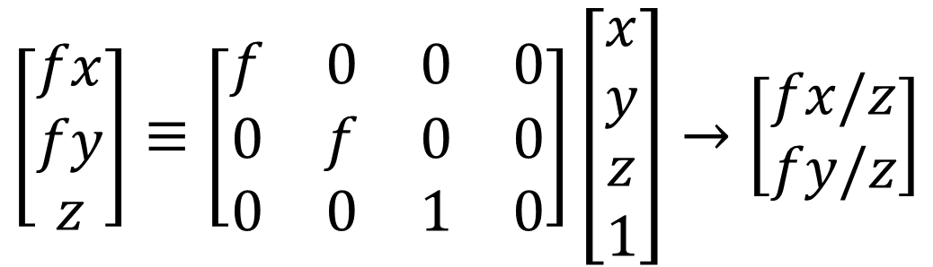
Projection Matrix
Projection (fx/z, fy/z) is matrix multiplication
f
O
dis
$$\left[\begin{matrix}fx \\ fy \\ z\end{matrix}\right]≡\left[\begin{matrix}f & 0 & 0 & 0 \\ 0 & f & 0 & 0 \\ 0 & 0 & 1 & 0\end{matrix}\right]\left[\begin{matrix}x \\ y \\ z \\ 1\end{matrix}\right]→\left[\begin{matrix}fx/z \\ fy/z\end{matrix}\right]$$
Slide inspired from L. Lazebnik

Slide 40
Projection Matrix
Projection (fx/z, fy/z) is matrix multiplication
f
O
$$\left[\begin{matrix}fx \\ fy \\ z\end{matrix}\right]≡\left[\begin{matrix}f & 0 & 0 & 0 \\ 0 & f & 0 & 0 \\ 0 & 0 & 1 & 0\end{matrix}\right]\left[\begin{matrix}x \\ y \\ z \\ 1\end{matrix}\right]→\left[\begin{matrix}fx/z \\ fy/z\end{matrix}\right]$$
Slide inspired from L. Lazebnik

Slide 41
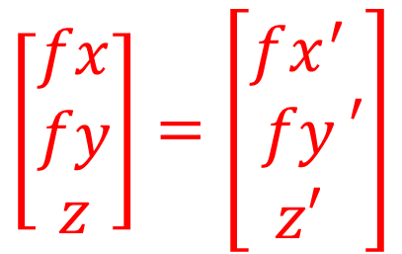
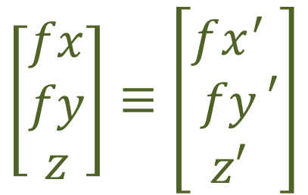
Why ≡ ≠ =
X
X’
P
O
Project X and X’ to the image and compare them
$$\left[\begin{matrix}fx \\ fy \\ z\end{matrix}\right]≡\left[\begin{matrix}fx^{′} \\ fy \\ z′\end{matrix}′\right]$$
$$\left[\begin{matrix}fx \\ fy \\ z\end{matrix}\right]=\left[\begin{matrix}fx^{′} \\ fy \\ z′\end{matrix}′\right]$$
YES
NO

Slide 42
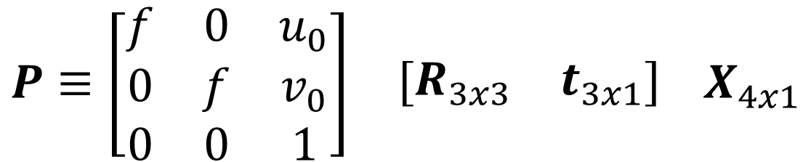
Typical Perspective Model
P: 2D homogeneous point (3D)
X: 3d homogeneous point (4D)
$$P≡\begin{matrix}\left[\begin{matrix}f & 0 & u_{0} \\ 0 & f & v_{0} \\ 0 & 0 & 1\end{matrix}\right] & \left[\begin{matrix}R_{3x3} & t_{3x1}\end{matrix}\right]\end{matrix} X_{4x1}$$

Slide 43
Typical Perspective Model
R: rotation between world system and camera
t: translation between world system and camera
$$P≡\begin{matrix}\left[\begin{matrix}f & 0 & u_{0} \\ 0 & f & v_{0} \\ 0 & 0 & 1\end{matrix}\right] & \left[\begin{matrix}R_{3x3} & t_{3x1}\end{matrix}\right]\end{matrix} X_{4x1}$$

Slide 44
Typical Perspective Model
f focal length
u0,v0: principal point (image coords of camera origin on retina)
$$P≡\begin{matrix}\left[\begin{matrix}f & 0 & u_{0} \\ 0 & f & v_{0} \\ 0 & 0 & 1\end{matrix}\right] & \left[\begin{matrix}R_{3x3} & t_{3x1}\end{matrix}\right]\end{matrix} X_{4x1}$$

Slide 45

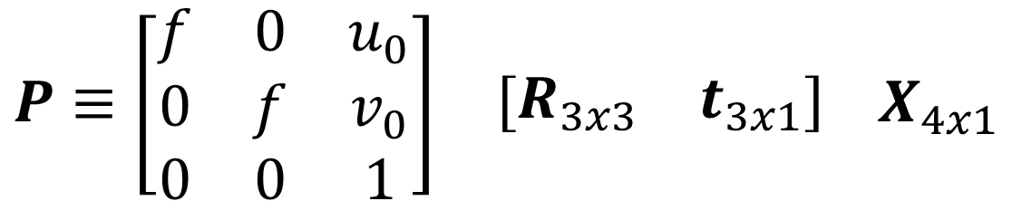
Typical Perspective Model
Intrinsic Matrix K
Extrinsic Matrix [R,t]
$$P≡\begin{matrix}\left[\begin{matrix}f & 0 & u_{0} \\ 0 & f & v_{0} \\ 0 & 0 & 1\end{matrix}\right] & \left[\begin{matrix}R_{3x3} & t_{3x1}\end{matrix}\right]\end{matrix} X_{4x1}$$
$$P≡K\left[R,t\right]X≡M_{3x4}X_{4x1}$$

Slide 46
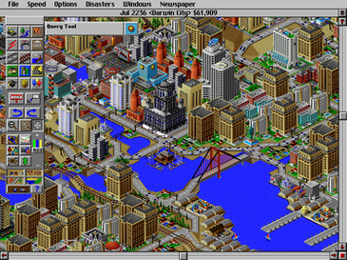
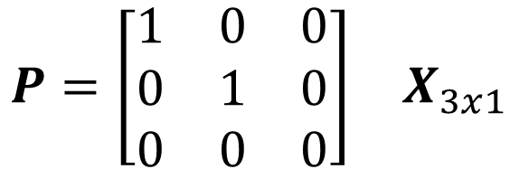
Other Cameras – Orthographic
Orthographic Camera (z infinite)
$$P=\begin{matrix}\left[\begin{matrix}1 & 0 & 0 \\ 0 & 1 & 0 \\ 0 & 0 & 0\end{matrix}\right] & X_{3x1}\end{matrix}$$
Image Credit: Wikipedia

Slide 47
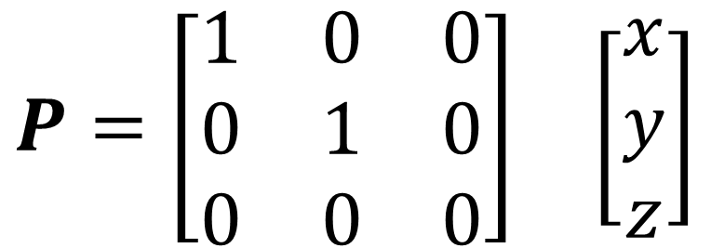
Other Cameras – Orthographic
Why does this make things easy and why is this popular in old games?
$$P=\begin{matrix}\left[\begin{matrix}1 & 0 & 0 \\ 0 & 1 & 0 \\ 0 & 0 & 0\end{matrix}\right] & \left[\begin{matrix}x \\ y \\ z\end{matrix}\right]\end{matrix}$$

Slide 48
Cameras
EECS 442 – David Fouhey
Fall 2019, University of Michigan
http://web.eecs.umich.edu/~fouhey/teaching/EECS442_F19/

Slide 49



Recap – Homog. Coordinates
Normal
Homogeneous
Normal
$$\left[\begin{matrix}u \\ v \\ w\end{matrix}\right]$$
$$\left[\begin{matrix}x \\ y\end{matrix}\right]$$
$$\left[\begin{matrix}u/w \\ v/w\end{matrix}\right]$$
Concat
1
Divide by w
w = 0 => point is at infinity
$x≡y$
$$∃ λ≠0 x=λy$$
$x=y$
YES!
NO!

Slide 50
Recap – Homog. Coordinates
Lots of transformations become linear:
  Rotation, translation, affine transformations are now all matrix multiplications
Lots of special cases go away (useful for both computation and proofs):
  Try defining two vertical lines
  Try finding their intersection

Slide 51
Recap – Projection
f
X (x,y,z)
O
P
(x,y,z) -> (fx/z, fy/z)
Your location in the image depends on depth!

Slide 52
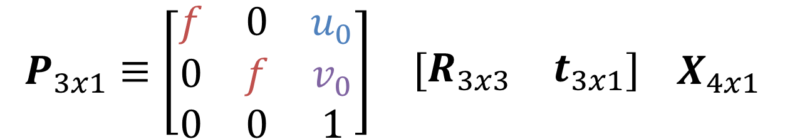
Recap – Projection
f: focal length
u0,v0: principal point (image coords of camera origin on retina)
R: camera rotation
t: camera translation
$$P_{3x1}≡\begin{matrix}\left[\begin{matrix}f & 0 & u_{0} \\ 0 & f & v_{0} \\ 0 & 0 & 1\end{matrix}\right] & \left[\begin{matrix}R_{3x3} & t_{3x1}\end{matrix}\right]\end{matrix} X_{4x1}$$

Slide 53
The Big Issue
Photosensitive Material
Film captures all the rays going through a point (a pencil of rays).
How big is a point?
Slide inspired by S. Seitz; image from Michigan Engineering

Slide 54
Math vs. Reality
Math: Any point projects to one point
Reality (as pointed out by the class)
  Don’t image points behind the camera / objects
  Don’t have an infinite amount of sensor material
Other issues
  Light is limited
  Spooky stuff happens with infinitely small holes

Slide 55
Limitations of Pinhole Model
Ideal Pinhole
-1 point generates 1 image
-Low-light levels
Finite Pinhole
-1 point generates region
-Blurry.
Why is it blurry?
Slide inspired by M. Hebert

Slide 56
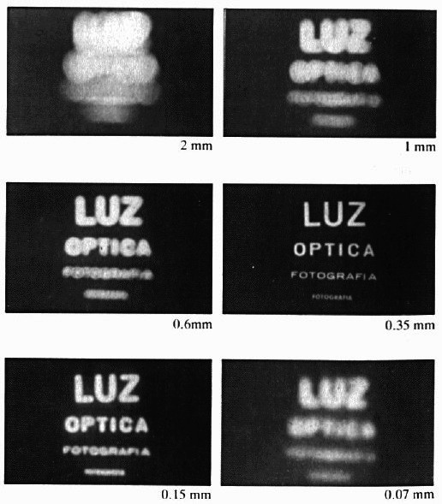
Limitations of Pinhole Model
Slide Credit: S. Seitz

Slide 57
Adding a Lens
A lens focuses light onto the film
Thin lens model: rays passing through the center are not deviated (pinhole projection model still holds)
Slide Credit: S. Seitz

Slide 58
Adding a Lens
focal point
f
All rays parallel to the optical axis pass through the focal point
Slide Credit: S. Seitz

Slide 59
What’s The Catch?
“circle of
confusion”
There’s a distance where objects are “in focus”
Other points project to a “circle of confusion”
Slide Credit: S. Seitz

Slide 60
Thin Lens Formula
We care about images that are in focus.
When is this true? Discuss with your neighbor.
When two paths from a point hit the same image location.
object
lens
image plane
Diagram credit: F. Durand

Slide 61
Thin Lens Formula
Let’s derive the relationship between object distance D, image plane distance D’, and focal length f.
D
D′
f
y
y′
object
lens
image plane
Diagram credit: F. Durand

Slide 62
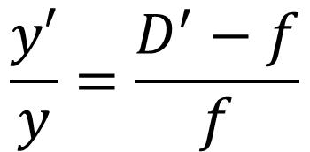
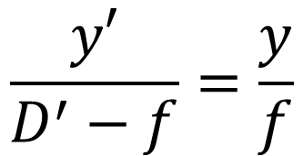
Thin Lens Formula
One set of similar triangles:
$$\frac{y′}{D^{′}−f}=\frac{y}{f}$$
$$\frac{y′}{y}=\frac{D^{′}−f}{f}$$
D
D′
f
y
y′
object
lens
image plane
Diagram credit: F. Durand

Slide 63
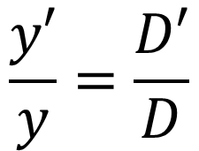
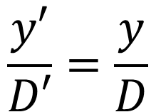
Thin Lens Formula
Another set of similar triangles:
$$\frac{y′}{D′}=\frac{y}{D}$$
$$\frac{y′}{y}=\frac{D′}{D}$$
D
D′
f
y
y′
object
lens
image plane
Diagram credit: F. Durand

Slide 64
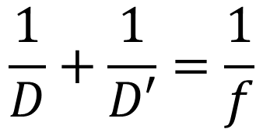
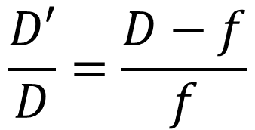
Thin Lens Formula
Set them
equal:
$$\frac{D′}{D}=\frac{D−f}{f}$$
$$\frac{1}{D}+\frac{1}{D′}=\frac{1}{f}$$
D
D′
f
y
y′
object
lens
image plane
Diagram credit: F. Durand

Slide 65
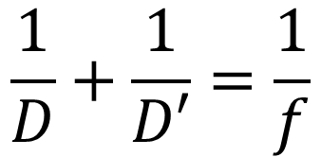
Thin Lens Formula
Suppose I want to take a picture of a lion with D big?
Which of D, D’, f are fixed?
How do we take pictures of things at different distances?
D
D′
f
$$\frac{1}{D}+\frac{1}{D′}=\frac{1}{f}$$
object
lens
image plane
Diagram credit: F. Durand

Slide 66

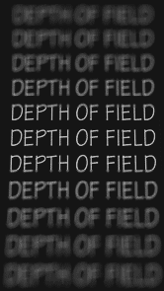
Depth of Field
http://www.cambridgeincolour.com/tutorials/depth-of-field.htm
Slide Credit: A. Efros

Slide 67
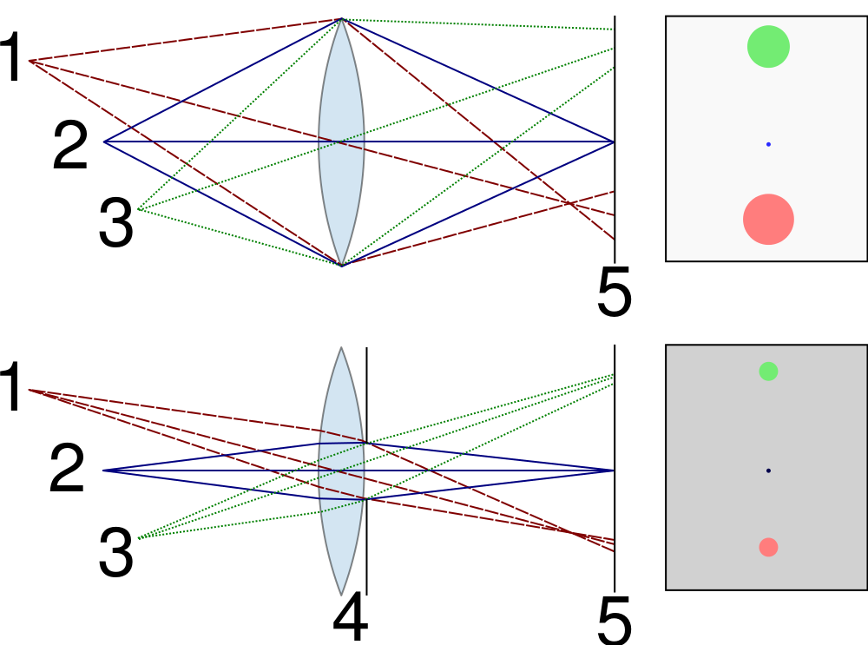


Controlling Depth of Field
Changing the aperture size affects depth of field
A smaller aperture increases the range in which the object is approximately in focus
Diagram: Wikipedia

Slide 68
Controlling Depth of Field
If a smaller aperture makes everything focused, why don’t we just always use it?
Diagram: Wikipedia

Slide 69


Varying the Aperture
Small aperture = large DOF
Large aperture = small DOF
Slide Credit: A. Efros, Photo: Philip Greenspun

Slide 70
Varying the Aperture

Slide 71



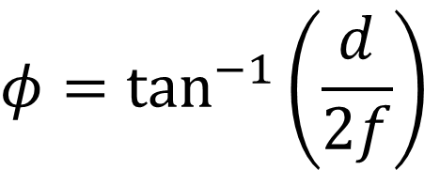
Field of View (FOV)
$$φ$$
$$f$$
$$d$$
Photo. Material
$$φ=\tan^{−1}\left(\frac{d}{2f}\right)$$
tan⁻¹ is monotonic increasing.
How can I get the FOV bigger?

Slide 72
Field of View
Slide Credit: A. Efros

Slide 73
Field of View
Slide Credit: A. Efros

Slide 74

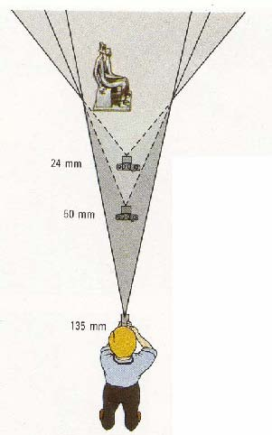

Field of View and Focal Length
Large FOV, small f
Camera close to car
Small FOV, large f
Camera far from the car
Slide Credit: A. Efros, F. Durand

Slide 75



Field of View and Focal Length
wide-angle
standard
telephoto
Slide Credit: F. Durand

Slide 76

Dolly Zoom
Change f and distance at the same time
Video Credit: Goodfellas 1990

Slide 77
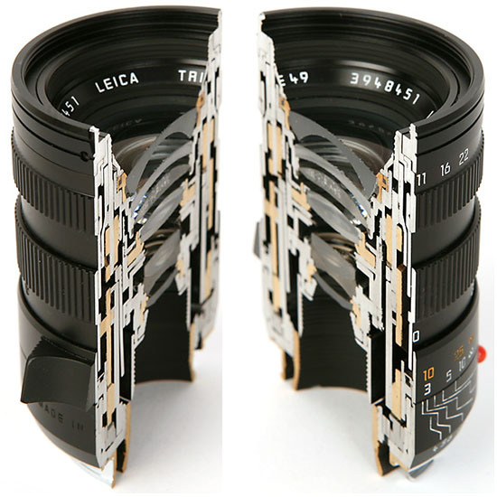
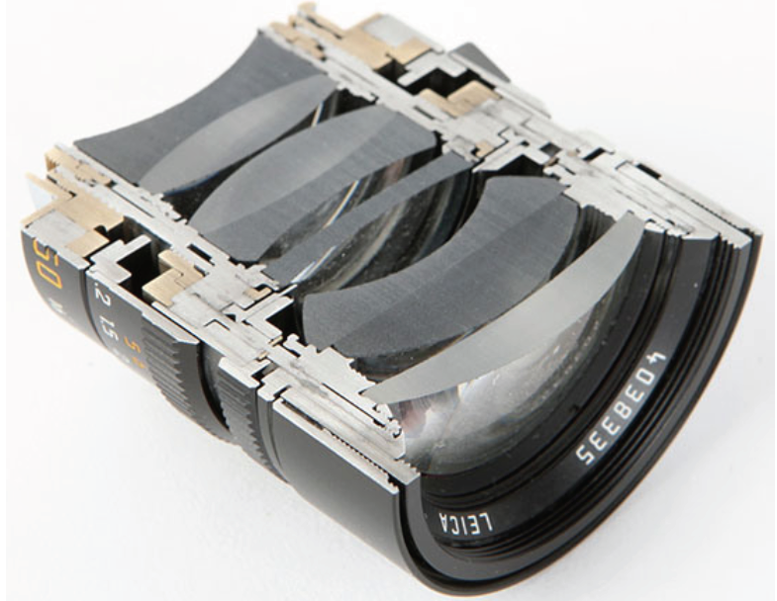
More Bad News!
First a pinhole…
Then a thin lens model….
Slide: L. Lazebnik

Slide 78
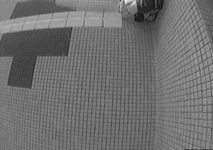
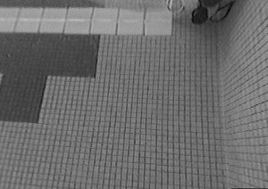
Lens Flaws: Radial Distortion
Lens imperfections cause distortions as a function of distance from optical axis
Less common these days in consumer devices
Photo: Mark Fiala, U. Alberta

Slide 79


Radial Distortion Correction
y
f
Photo. Material
r
z
y'
Ideal
Distorted
$$y′=f\frac{y}{z}$$
$$y′=(1+k_{1}r^{2}+…)\frac{y}{z}$$

Slide 80
Vignetting
Photo. Material
What happens to the light between the
black and red lines?
Slide inspired by L. Lazebnik Slide

Slide 81

Vignetting
Photo credit: Wikipedia (https://en.wikipedia.org/wiki/Vignetting)

Slide 82

Lens Flaws: Spherical Abberation
Lenses don’t focus light perfectly!
Rays farther from the optical axis focus closer
Slide: L. Lazebnik

Slide 83


Lens Flaws: Chromatic Abberation
Lens refraction index is a function of the wavelength. Colors “fringe” or bleed
Image credits: L. Lazebnik, Wikipedia

Slide 84

Lens Flaws: Chromatic Abberation
Researchers tried teaching a network about objects by forcing it to assemble jigsaws.
Slide Credit: C. Doersch

Slide 85


From Photon to Photo
Each cell in a sensor array is a light-sensitive diode that converts photons to electrons
  Dominant in the past: Charge Coupled Device (CCD)
  Dominant now: Complementary Metal Oxide Semiconductor (CMOS)
Slide Credit: L. Lazebnik, Photo Credit: Wikipedia, Stefano Meroli

Slide 86

From Photon to Photo
Rolling Shutter: pixels read in sequence
Can get global reading, but $$$

Slide 87



Preview of What’s Next
Bayer grid
Demosaicing:
Estimation of missing components from neighboring values
Slide Credit: S. Seitz
Human Luminance Sensitivity Function

Slide 88



Historic milestones
Pinhole model: Mozi (470-390 BCE),
Aristotle (384-322 BCE)
Principles of optics (including lenses):
Alhacen (965-1039 CE)
Camera obscura: Leonardo da Vinci
(1452-1519), Johann Zahn (1631-1707)
First photo: Joseph Nicephore Niepce (1822)
Daguerréotypes (1839)
Photographic film (Eastman, 1889)
Cinema (Lumière Brothers, 1895)
Color Photography (Lumière Brothers, 1908)
Television (Baird, Farnsworth, Zworykin, 1920s)
First consumer camera with CCD
Sony Mavica (1981)
First fully digital camera: Kodak DCS100 (1990)
Alhacen’s notes
Niepce, “La Table Servie,” 1822
Slide Credit: S. Lazebnik
Old television camera

Slide 89

First digitally scanned photograph
1957, 176x176 pixels
Slide Credit: http://listverse.com/history/top-10-incredible-early-firsts-in-photography/
Notes:
From the website: “Russell Kirsch was a computer pioneer at the National Institute of Standards and Technology in the USA when he developed the system by which a camera could be fed into a computer. The photo is of Kirsch’s three month old son Walden and it measured a mere 176×176 pixels. Baby Walden now works in communications for Intel.”

Slide 90


Historic Milestone
Sergey Prokudin-Gorskii (1863-1944)
Photographs of the Russian empire (1909-1916)
Slide Credit: S. Maji

Slide 91

Historic Milestone
Slide Credit: S. Maji

Slide 92
Future Milestone
Your job in homework 1:
Make the left look like the right.

Slide 94
Old Slides

Slide 95
Benefits of Homogeneous Coords
What about parallel lines?
0x + 1y - 2 = 0
0x + 1y - 1 = 0
[0,1,-2] x [0,1,-1] = [1,0,0]
Any point [x,y,0] is at infinity
All operations generate valid results!

Slide 96

What’s This Useful For?
O’Brien and Farid, SIGGRAPH 2012, Exposing Photo Manipulation with Inconsistent Reflections

Slide 97
What’s This Useful For?
Mirror

Slide 98

What’s This Useful For?
O’Brien and Farid, SIGGRAPH 2012, Exposing Photo Manipulation with Inconsistent Reflections

Slide 99

Typical Perspective Model
θ: 90°, cot = 0, sin = 1
α: f
u0,v0: principal point (image coords of camera origin on retina)
$$P≡\begin{matrix}\left[\begin{matrix}α & −α\cot{θ} & u_{0} \\ 0 & \frac{β}{\sin{θ}} & v_{0} \\ 0 & 0 & 1\end{matrix}\right] & \left[\begin{matrix}R_{3x3} & t_{3x1}\end{matrix}\right]\end{matrix} X_{4x1}$$
β:f

Slide 100










3D Homogeneous Coordinates
Vector Coordinates
Homogeneous Coordinates
$$y= \left[\begin{matrix}I_{3x3} & t \\ \begin{matrix}0 & 0 & 0\end{matrix} & 1\end{matrix}\right]x$$
Translation
$$y=x+t$$
$$y= \left[\begin{matrix}R_{3x3} & 0 \\ \begin{matrix}0 & 0 & 0\end{matrix} & 1\end{matrix}\right]x$$
Rotation
$$y=Rx$$
$$R^{T}R=RR^{T}=I$$
$$det\left(R\right)=1$$
$$y= \left[\begin{matrix}R_{3x3} & t \\ \begin{matrix}0 & 0 & 0\end{matrix} & 1\end{matrix}\right]x$$
Rigid Body
$$y=Rx+t$$
$$y= \left[\begin{matrix}A_{3x3} & t \\ \begin{matrix}0 & 0 & 0\end{matrix} & 1\end{matrix}\right]x$$
Affine
$$y=Ax+t$$

Slide 101
Typical Perspective Model
P: 2D homogeneous point (3D)
X: 3d homogeneous point (4D)
$$P≡\begin{matrix}\left[\begin{matrix}α & −α\cot{θ} & u_{0} \\ 0 & \frac{β}{\sin{θ}} & v_{0} \\ 0 & 0 & 1\end{matrix}\right] & \left[\begin{matrix}R_{3x3} & t_{3x1}\end{matrix}\right]\end{matrix} X_{4x1}$$

Slide 102
Typical Perspective Model
R: rotation between world system and camera
t: translation between world system and camera
$$P≡\begin{matrix}\left[\begin{matrix}α & −α\cot{θ} & u_{0} \\ 0 & \frac{β}{\sin{θ}} & v_{0} \\ 0 & 0 & 1\end{matrix}\right] & \left[\begin{matrix}R_{3x3} & t_{3x1}\end{matrix}\right]\end{matrix} X_{4x1}$$

Slide 103
Standard Full Perspective Model
α scale between world and image x coords
θ skew of camera axes
u0,v0: principal point (image coords of camera origin on retina)
$$P≡\begin{matrix}\left[\begin{matrix}α & −α\cot{θ} & u_{0} \\ 0 & \frac{β}{\sin{θ}} & v_{0} \\ 0 & 0 & 1\end{matrix}\right] & \left[\begin{matrix}R_{3x3} & t_{3x1}\end{matrix}\right]\end{matrix} X_{4x1}$$
β scale between world and image y coords

Slide 104
Standard Full Perspective Model
3x1
3x3
3x4
4x1
$$P≡\begin{matrix}\left[\begin{matrix}α & −α\cot{θ} & u_{0} \\ 0 & \frac{β}{\sin{θ}} & v_{0} \\ 0 & 0 & 1\end{matrix}\right] & \left[\begin{matrix}R_{3x3} & t_{3x1}\end{matrix}\right]\end{matrix} X_{4x1}$$

