Slide 1
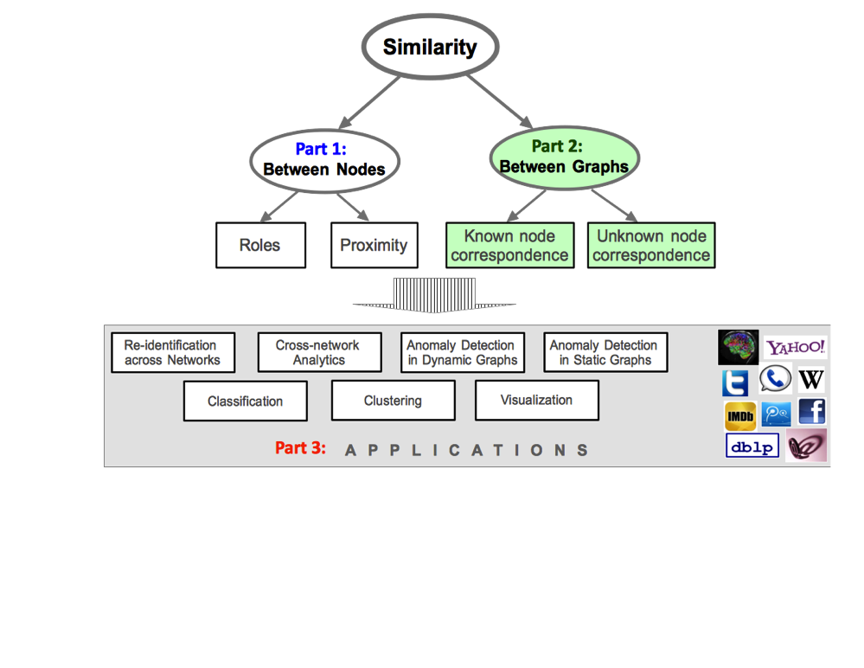
Part 2b Similarity between Graphs: Unknown node correspondence

Slide 2
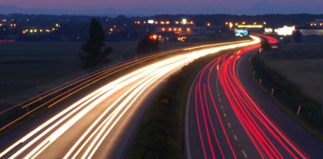
Roadmap
Known node correspondence
Unknown node correspondence
Motivation
Unipartite graphs
Bipartite graphs
Summary

Slide 3
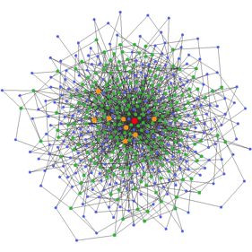
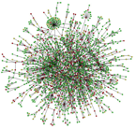
Graph Similarity with unknown node correspondence
INPUT: 2 anonymized networks
GIVEN: node IDs
NOT GIVEN: side-info
class labels
OUTPUT: structural similarity score
OR node mapping
2
1
Notes:
Only 2 graphs
Given: node-ids,
NO class labels

Slide 4
Roadmap
Known node correspondence
Unknown node correspondence
Motivation
Unipartite graphs
Bipartite graphs
Summary

Slide 5
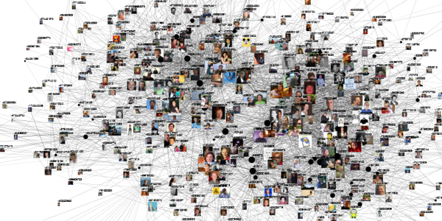
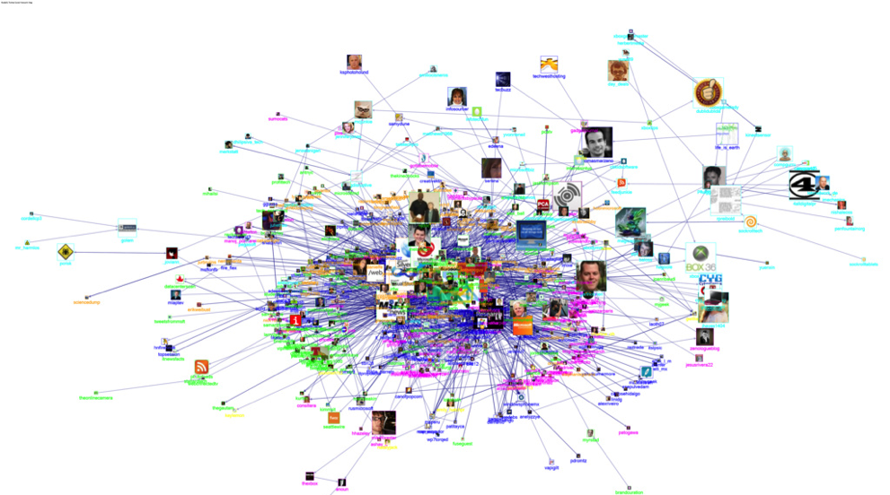
Can we identify users across social networks?
Same or “similar” users?
Notes:
Task: link prediction (friend link), recommendations

Slide 6
More Data Mining Applications
information network
social network
x-fer
learning
Smarter
Commerce
better INPUT for graph similarity + graph kernel
internal external networks
better anomaly detection
team formation
healthcare
Notes:
1) e-commerce: identify customers in external networks + do more personalized advertisements
2) transfer learning between social and information network (“Does mentoring improve performance of mentorees in the organization?”, or “How is the structure of social networks influenced by the formal organizational chart?”, and “How can vast volume of data about social networks be efficiently stored and accessed?”)
3) anomaly detection (link internal + external network, try to do better anomaly detection)
4) Better input on graph similarity / graph kernel -→ healthcare and team formation

Slide 7
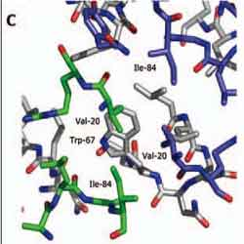
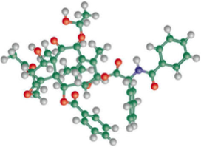
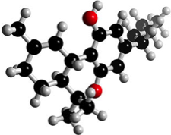
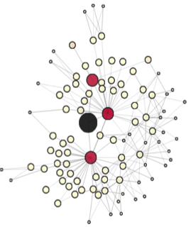
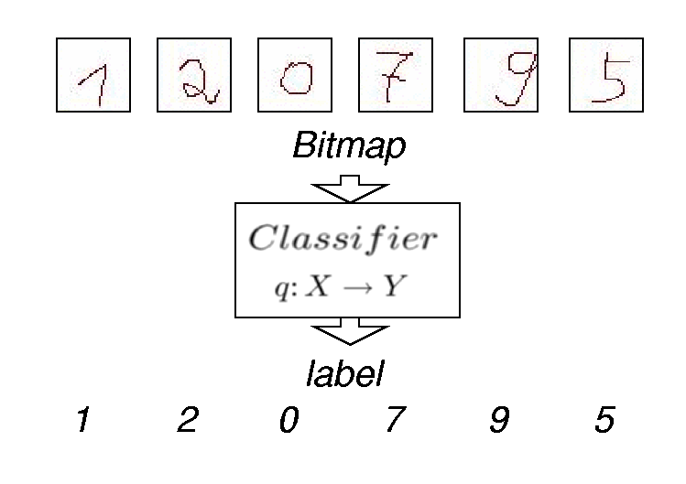
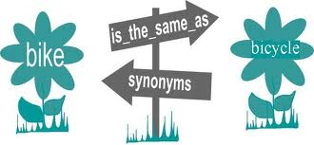
More Applications?
chemical compound comparison
protein-protein alignment
Optical character recognition
link prediction &
viral marketing
IR: synonym
extraction
Structure matching in DB
wiki
translation
Notes:
IR: Information Retrieval
link prediction and viral marketing in social networks
2) protein-protein interaction networks
3) optical character recognition
4) chemical compounds comparison
5) structure matching in databases
6) synonyms extraction in information retrieval
7) Wiki translation (graphs of documents from different language – learn automatic translation)

Slide 8
Roadmap
Known node correspondence
Unknown node correspondence
Motivation
Unipartite graphs
Avoiding the correspondence problem
Solving the correspondence problem
Bipartite graphs
Summary

Slide 9
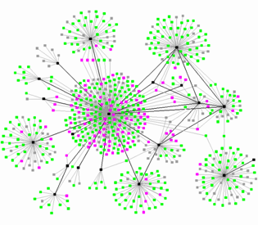
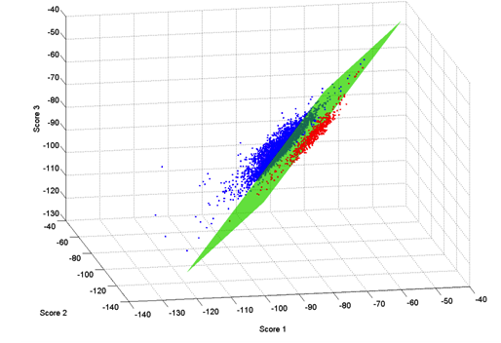
Main Idea
eccentricity
deg, cc
e-vals
e-vectors
Extract graph features
sim(G_{A}, G_{B}) = “similarity” between
the features
Or
apply some classifier

Slide 10
Spectral Methods

Slide 11
λ-distance
Eigenvalues of G_{A}: λ_{Α1}<= ...<= λ_{Αt}
Eigenvalues of G_{B}: λ_{B1}<= ...<= λ_{Bs}
d(G_{A}, G_{B}) = Σ(λ_{Ai} - λ_{Bi})²
[Bunke ’06, Wilson ’08, ElGhawalby ‘08]

Slide 12
λ-distance: Variations
Eigenvalues of different matrices:
Adjacency A
Laplacian L = D – A
0 = λ_{Α1}<= ...<= λ_{Αt}
Normalized Laplacian L_{norm} = D^{-1/2} A D^{-1/2}
0 = λ_{Α1}<= ...<= λ_{Αt}<=2
0 1 0
1 0 1
0 1 0
d1
d2
d3
0 1 0
1 0 1
0 1 0
d₁^{-.5}
d₂^{-.5}
d₃^{-.5}
0 1 0
1 0 1
0 1 0
d₁^{-.5}
d₂^{-.5}
d₃^{-.5}
[Bunke ’06, Wilson ’08, ElGhawalby ‘08]

Slide 13
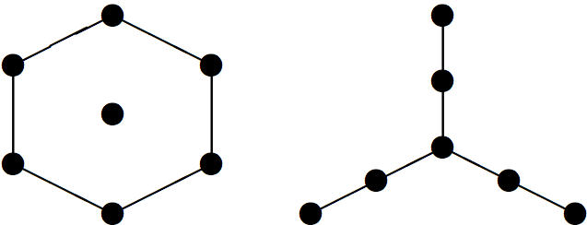
λ-distance: Disadvantages
co-spectral graphs with different structure
Non-isomorphic graphs, co-spectral w.r.t. A
Non-isomorphic graphs, co-spectral w.r.t. L
[Haemers+ ’04, Brouwer ’09]

Slide 14
λ-distance: Disadvantages
co-spectral graphs with different structure
subtle changes in the graphs =>
big differences in spectra
O(n³) runtime
→ SVD
Haemers+ ’04, Brouwer ’09

Slide 15
Comparison of methods revisited
edge weight returns focus
Metric | P1 | P2 | P3 | P4
Vertex/Edge Overlap | ✗ | ✗ | ✗ | ?
Graph Edit Distance (XOR) | ✗ | ✗ | ✗ | ?
Signature Similarity | ✗ | ✔ | ✗ | ?
λ-distance (adjacency matrix) | ✗ | ✔ | ✗ | ?
λ-distance (graph laplacian) | ✗ | ✔ | ✗ | ?
λ-distance (normalized lapl.) | ✗ | ✔ | ✗ | ?
DeltaCon₀ | ✔ | ✔ | ✔ | ✔
DeltaCon | ✔ | ✔ | ✔ | ✔

Slide 16
Graph Kernels

Slide 17
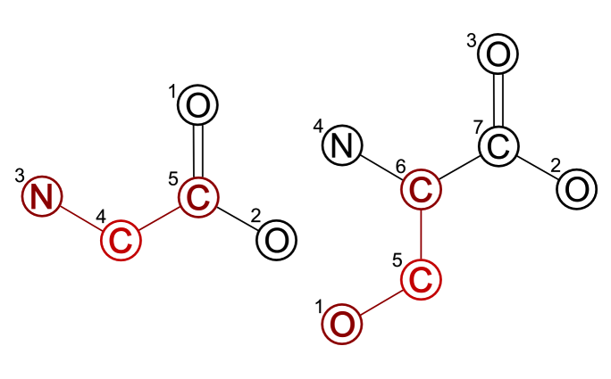
Graph Kernels: Idea
Compute graph substructures in poly time
Coming up ☺
G_{A} G_{B}
G_{B}
Source: http://mloss.org/software/view/139/
[Vishwanathan]

Slide 18
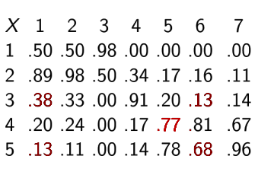
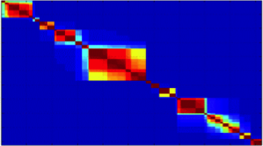
Graph Kernels: Idea
Compute graph substructures in poly time
Compare them to find sim(G_{A}, G_{B})
G_{A} G_{B}
sim(G_{A}, G_{B})
G_{B}
G_{A}
Source: http://mloss.org/software/view/139/

Slide 19
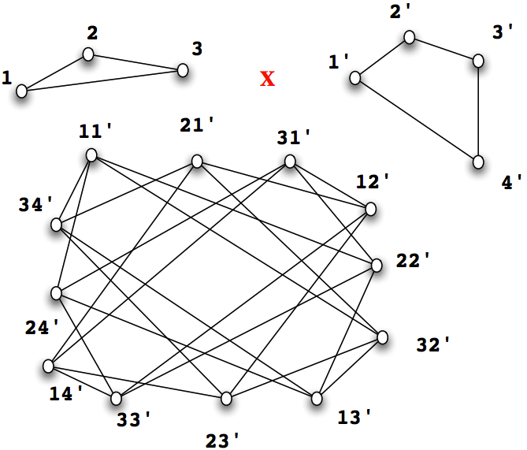
Random Walk Kernels
sim(G_{A}, G_{B}) = # of common walks
G_{A}
G_{B}
[Kashima+ ‘03, Gaertner+ ‘03,Vishwanathan ’10]

Slide 20
Random Walk Kernels
sim(G_{A}, G_{B}) = # of common walks
G_{A}
G_{B}
=
=
Random walk
on the
Product graph
[Kashima+ ‘03, Gaertner+ ‘03,Vishwanathan ’10]

Slide 21
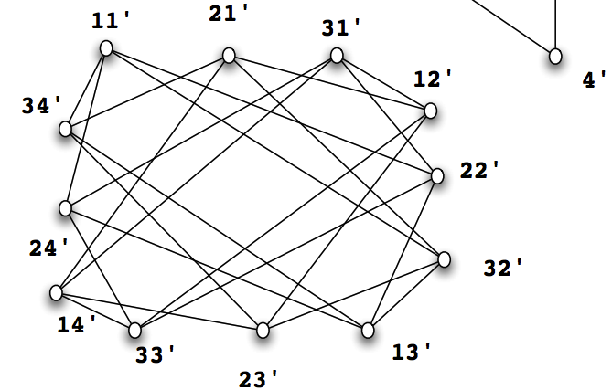
Random Walk Kernels
O(n⁶)
O(n³) by reduction to Sylvester equation!
X = S X T + X₀
?
?
Random walk
on the
Product graph
[Vishwanathan+ ’10, Kang ‘12]

Slide 22
Shortest Path Kernels
- sim(G_{A},G_{B}) = Σsim( all-shortest-paths(G_{A}),
all-shortest-paths(G_{B}) )
- O(n⁴)
all-shortest-paths(G_{A})
all-shortest-paths(G_{B})
 | 1 | 2 | 3
1 | 10 | 6
2 | 3 | 23 | 9
3 |  | 11 | 20
 | 1’ | 2’ | 3’
1’ | 23 | 5
2’ |  | 54 | 4
3’ | 7 | 9 | 16
∞
∞
∞
∞
[Borgwardt & Kriegel ‘05]

Slide 23
Other Graph Kernels
Cyclic Path Kernels
[Horvath+ ’04]
Depth-first search kernels
[Swamidass+ ‘05]
Subtree Kernels
[Shervashidze+ ‘09, Ralaivola+ ‘05]
Graphlet / Subgraph Kernels
[Shervashidze+ ‘09, Thoma+ ‘10 ]
All-paths Kernels
[Airola+ ‘08]
…

Slide 24
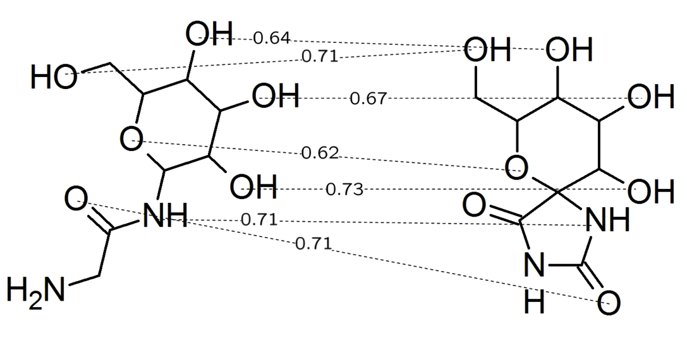
Aligning Chemical Compounds
[Ralaivola+ ’05]
Source: http://www.ra.cs.uni-tuebingen.de/forschung/molsim/welcome_e.html

Slide 25
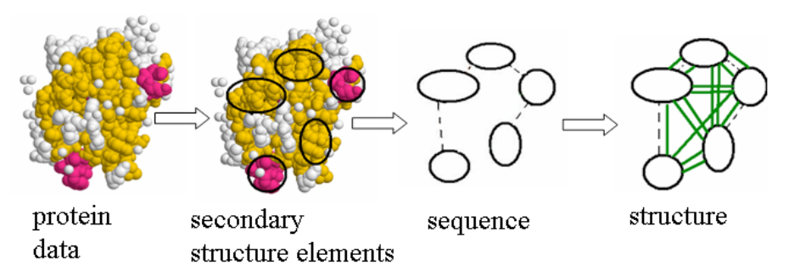
Protein function classification
Similarity: graph kernels
Prediction of functional class: SVM
[Borgwardt+ ’05]

Slide 26
Similarity in Social Networks

Slide 27
Socially Relevant Features
Leadership
measures the extent to which the edge connectivity is dominated by a single node
L = 1
L = 0
[Macindoe ’10]

Slide 28
Socially Relevant Features
Leadership
Bonding = clustering coefficient
B = 1
B = 0
[Macindoe ’10]

Slide 29
Socially Relevant Features
Leadership
Bonding
Diversity
Number of disjoint communities
D = low
D = high
[Macindoe ’10]

Slide 30
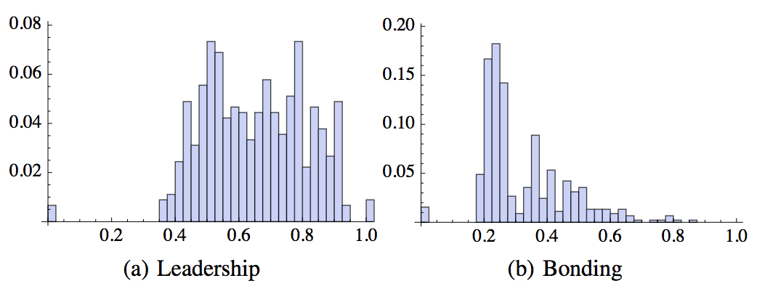
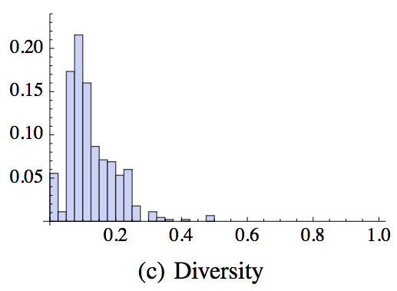
Step 1: LBD Distributions
For 2-hop subgraphs
2-hop subgraph
[Macindoe ’10]

Slide 31
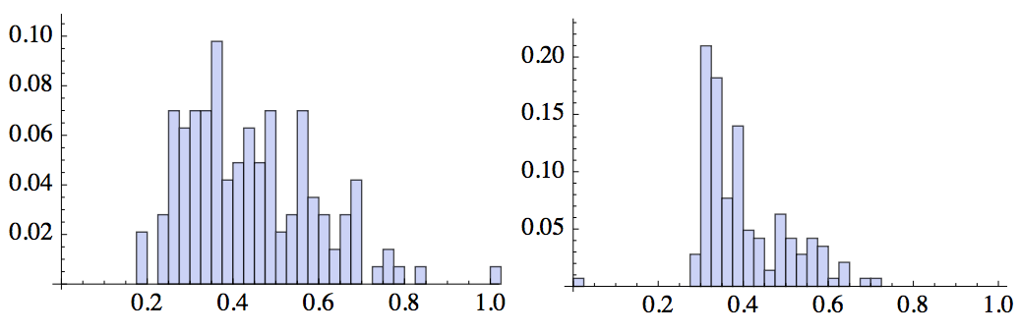
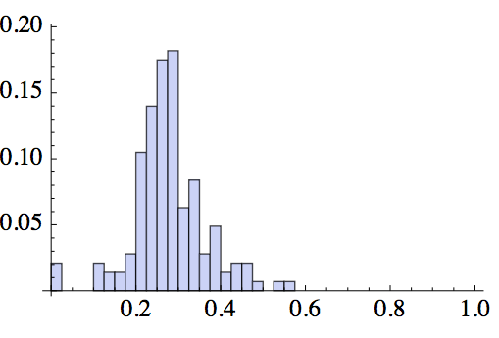
Step 2: Comparison
Earth mover’s distance to obtain d(G_{A}, G_{B}).
G_{A}
sim(G_{A}, G_{B}) = 1-d(G_{A}, G_{B})
d: distance between
distributions
G_{B}
Leadership Bonding Diversity
[Macindoe ’10]

Slide 32
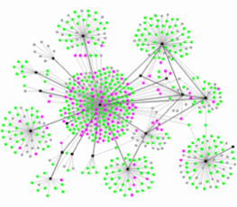
NetSimile: overview
deg, cc
E_{ego}, N_{ego}
1 – Feature Extraction
2 – Feature Aggregation
3 - Comparison
similarity measure
[Berlingerio, Koutra, Eliassi-Rad, Faloutsos ‘13]

Slide 33
Step 1: Feature Extraction
egonet
Local and egonet features:
# of neighbors
clustering coefficient
avg. # of neighbors’ neighbors
avg. clustering coeff. of neighbors
edges in egonet
outgoing edges from egonet
# of neighbors of egonet
features
1
2
3
. . .
7
1
2
.
.
.
n
n
o
d
e
s
F_{G} =
[Berlingerio, Koutra,
Eliassi-Rad, Faloutsos ‘13]
... ...

Slide 34
Step 2: Feature Aggregation
features
5 aggregators
median
mean
standard deviation
skewness
kurtosis
1
2
3
. . .
7
1
2
.
.
.
n
n
o
d
e
s
Moments
of feature
distributions
... ...
median
…
kurtosis
mean
s.d.
skewness
single ‘signature’ vector per network
[Berlingerio, Koutra, Eliassi-Rad, Faloutsos ‘13]
Notes:
moments

Slide 35
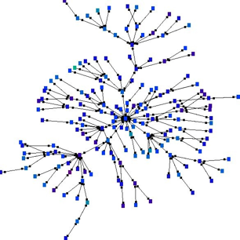
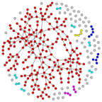
Step 3: Comparison
Networks
‘Signature’ Vectors
(aggr. features)
Similarity scores
sim₁₂
sim₁₃
…
sim_{1k}
sim₂₃
.
.
.
sim_{k-1,k}
s_{G1}
2
s_{G2}
Canberra distance
s_{G3}
1
3
k
.
.
.
.
.
.
s_{Gk}
[Berlingerio, Koutra, Eliassi-Rad, Faloutsos ‘13]
Notes:
Euclidean, L1, canberra, chi2…

Slide 36
Application: Discontinuity Detection in Yahoo! IM
Microsoft offers
to buy Yahoo!.
2. New features for
flickr were announced.
nodes: IM users
edges: communication
events
[Berlingerio, Koutra, Eliassi-Rad, Faloutsos ‘13]

Slide 37
Other Works
SVM on global feature vectors
[Li+, Zaki ’12]
Edge curvatures under heat kernel embedding
[Elghawalby & Hancock ’08]
Number of spanning trees
[Kelmans ’76]
…

Slide 38
Roadmap
Known node correspondence
Unknown node correspondence
Motivation
Unipartite graphs
Avoiding the correspondence problem
Solving the correspondence problem
Bipartite graphs
Summary

Slide 39
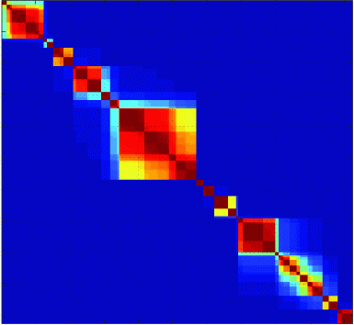
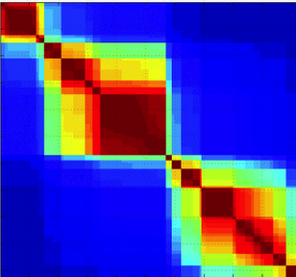
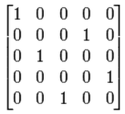
Eigen-Decomposition Approach
A B
G_{A} G_{B}
Goal: min || PAP^{T} - B|| _{F} ²
P
permutation matrix
[Umeyama ‘88]

Slide 40
Eigen-Decomposition Approach
A B
A = U_{A}Λ_{A}U_{A}^{T} B = U_{B}Λ_{B}U_{B}^{T}
G_{A} G_{B}
Near-optimal for noiseless graphs
O(n³) runtime
Only for graphs of same size
eigendecomp.
P = Hungarian method on
|U_{A}| |U_{B}^{T}|
[Umeyama ‘88]

Slide 41
NMF-based Approach
G_{A} G_{B}
A B
Goal: min || PAP^{T} - B|| _{F} ²
PP^{T}= P^{T}P = I
P>=0
non-0 elements
per row/column
[Ding+ ‘08]

Slide 42
NMF-based Algorithm
Step 1: P₀ = |U_{A}| |U_{B}^{T}| [Umeyama]
[Ding+ ‘08]

Slide 43
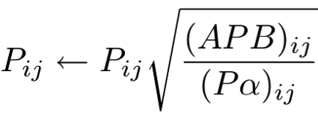
NMF-based Algorithm
Step 1: P₀ = |U_{A}| |U_{B}^{T}| [Umeyama]
Step 2: Non-Negative Matrix Factorization
to find P∞
O(n³) runtime
+
Guaranteed
convergence
[Ding+ ‘08]

Slide 44
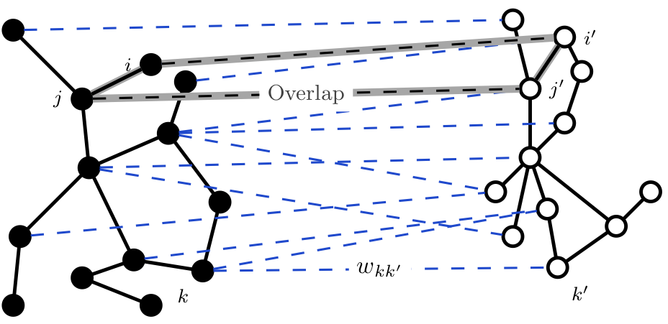
NetAlign
A L B
Possible matchings!
[Bayati+ ’11]

Slide 45
NetAlign
[Bayati+ ’11]
W_{kk’}
A L B
s.t. it maximizes
a linear combination of the weights w
& the number of overlapped edges.
Goal: find matching M C L

Slide 46
NetAlign
[Bayati+ ’11]
W_{kk’}
NP-hard problem
But,
fast solution by using Belief Propagation
(graphs with thousands of nodes/edges)
A L B
Goal: find matching M C L
s.t. it maximizes
a linear combination of the weights w
& the number of overlapped edges.

Slide 47
Pairwise Global Alignment
A L B
Same problem as before, but
Lagrangian algorithm.
[Klau+ ’09]

Slide 48
Pairwise Global Alignment
A L B
Performs better than [Bayati ’11] for sparse L.
1.3% slower than [Bayati ’11].
[Klau+ ’09]

Slide 49
More Approaches
Cavity approach [Bradde+ ‘10]
Graduated Assignment [Gold ‘96]
Pattern Recognition [Conte+ ‘04]
Biological Networks [Berg, Lassig ‘04], IsoRank [Singh ’07]
Linear Programming [Almohamad & Duffuaa ’93]
EM [Luo ‘02]
Similarity Flooding [Melnik+ ’02]
Path-following [Zaslavskiy ’09]
Graph Kernels [Smalter+ ‘08]
Spectral methods [Qiu, Hancock ‘]
….

Slide 50
Roadmap
Known node correspondence
Unknown node correspondence
Motivation
Unipartite graphs
Bipartite graphs
Summary

Slide 51
Bipartite Graph Alignment
INPUT:
A, B
groups
A
B
groups
1 1 0 0 0
0 1 0 1 0
0 0 1 1 1
0 0 0 1 0
0 0 0 1 0
u
s
e
r
s
1 1 0 0
1 1 0 0
0 0 1 0
1 0 1 0
1 1 0 1
users
Notes:
Combinatorial problem
Relax the problem + approximate the solution

Slide 52
Bipartite Graph Alignment
INPUT:
A, B
OUTPUT:
P and …
(permutation
matrices)
groups
A
B
groups
u
s
e
r
s
1 1 0 0
1 1 0 0
0 0 1 0
1 0 1 0
1 1 0 1
users
1 1 0 0 0
0 1 0 1 0
0 0 1 1 1
0 0 0 1 0
0 0 0 1 0
P (users)
A
B
0 1 0 0
1 0 0 0
0 0 1 0
0 0 0 1
Notes:
Combinatorial problem
Relax the problem + approximate the solution
Output: mappings at two granularities; users and groups/communities

Slide 53
Bipartite Graph Alignment
INPUT:
A, B
OUTPUT:
P and Q
(permutation
matrices)
s.t. min || PAQ - B||_{F} ²
groups
A
B
groups
1 1 0 0 0
0 1 0 1 0
0 0 1 1 1
0 0 0 1 0
0 0 0 1 0
u
s
e
r
s
1 1 0 0
1 1 0 0
0 0 1 0
1 0 1 0
1 1 0 1
users
constraints / relaxations
Graph isomorphism:
HARD (P or NP complete?)
Subgraph isomorphism:
NP-complete
And now what?
P (users)
Q (groups)
A
B
A
B
0 1 0 0
1 0 0 0
0 0 1 0
0 0 0 1
users/groups permutation of A
permutation of users/groups in A
Notes:
Output: mappings at two granularities; users and groups/communities

Slide 54
Main Idea
g
g
A
B
INPUT:
A, B
OUTPUT:
P, Q
correspondence
matrices
s.t. min || PAQ - B|| _{F} ²
1 1 0 0
… …
1 1 0 1
u
1 1 0 0 0
… … …
0 1 0 1 0
u
P (users)
Q (groups)
A
B
A
B
0 1 0 0
1 0 0 0
0 0 1 0
0 0 0 1
0 .9 .2 0
.7 .3 0 .1
0 .3 .6 .4
.2 0 .5 .8

Slide 55
Main Idea
g
g
A
B
INPUT:
A, B
OUTPUT:
P, Q
correspondence
matrices
s.t. min || PAQ - B|| _{F} ²
CONSTRAINTS:
P_{ij}, Q_{ij} = probabilities (not 1-1 mapping)
sparse matrices P and Q (more efficient for large scale graphs)
1 1 0 0
… …
1 1 0 1
u
1 1 0 0 0
… … …
0 1 0 1 0
u
P (users)
Q (groups)
A
B
A
B

Slide 56
Main Idea
g
g
A
B
INPUT:
A, B
OUTPUT:
P, Q
correspondence
matrices
.
1 1 0 0
… …
1 1 0 1
u
1 1 0 0 0
… … …
0 1 0 1 0
u
P (users)
Q (groups)
A
B
A
B
min || PAQ - B|| _{F} ² +λ|| P|| ₁ + μ|| Q|| ₁
P,Q
P
A
Q
B
sparsity

Slide 57
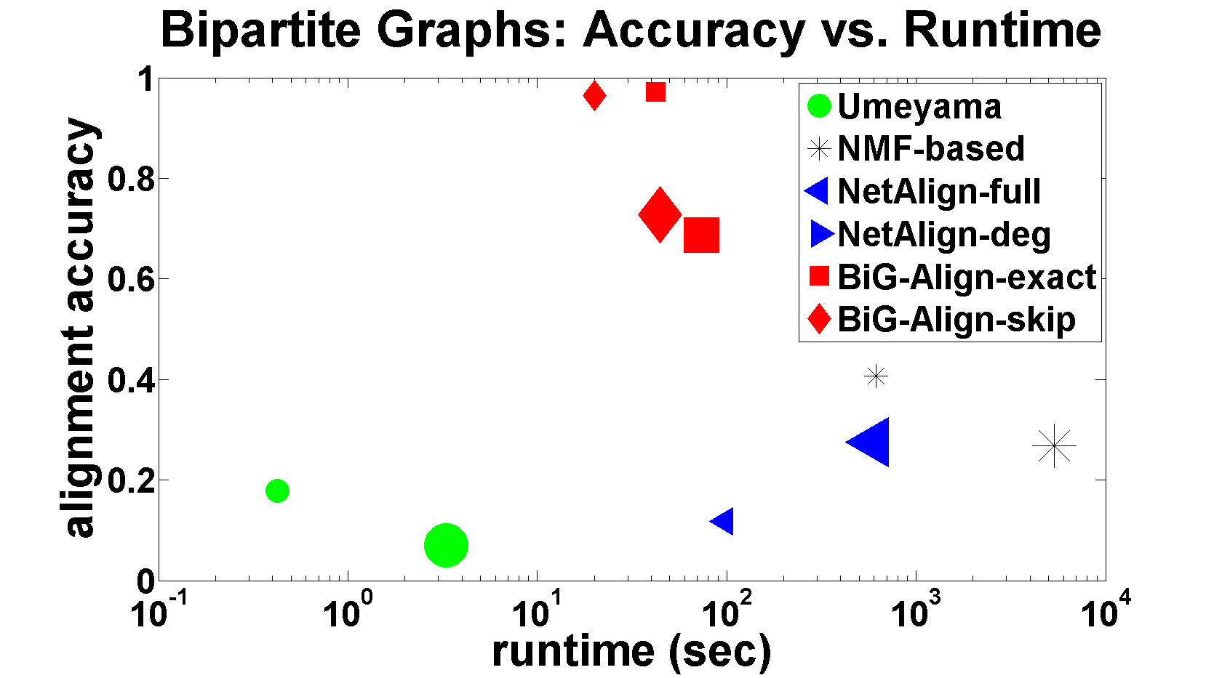
Big-Align: Accuracy vs. Runtime
BiG-Align
exact
BiG-Align
skip
NMF-based
Umeyama
NetAlign
Big-Align improves both speed and accuracy.

Slide 58
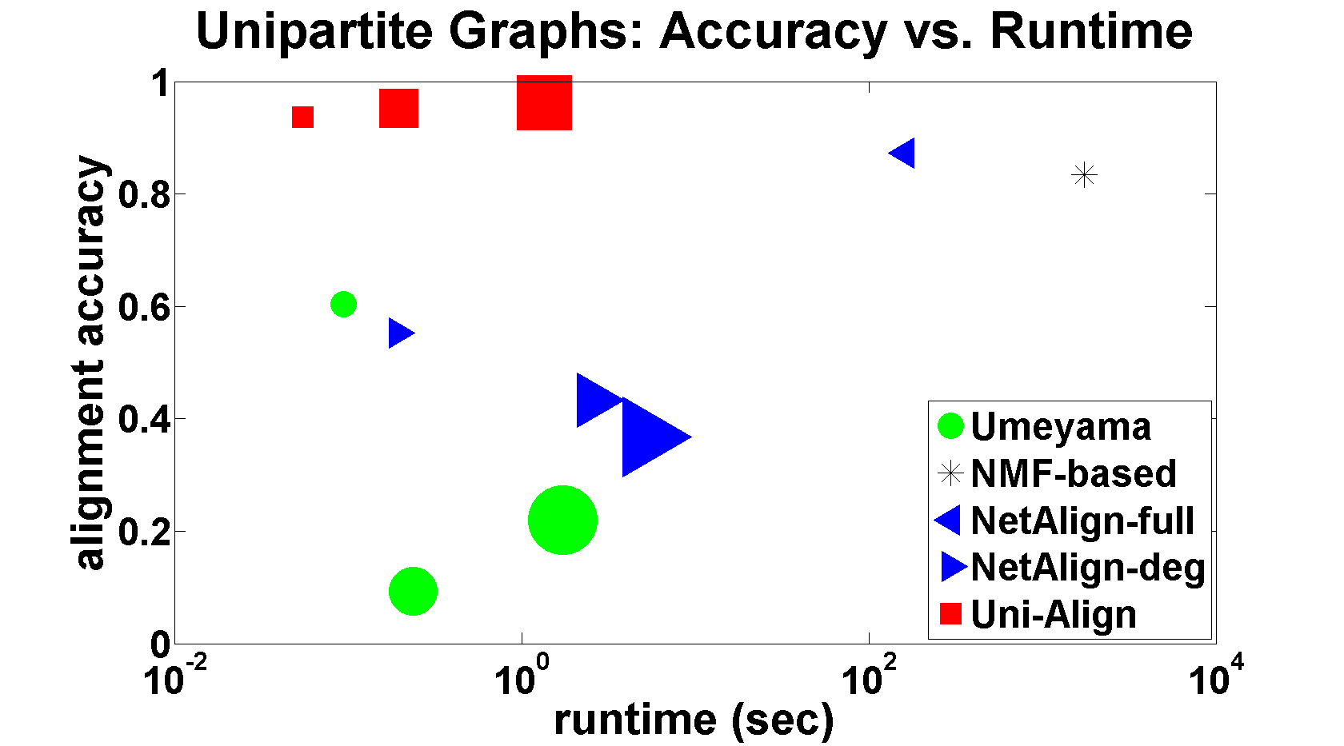
Uni-Align: Accuracy vs. Runtime
Uni-Align
NMF-based
Extension to unipartite graphs
… details in the paper…
subgraphs
(64K x 64K users)
NetAlign
Umeyama
Uni-Align is faster and more accurate than other approaches.
Notes:
The algorithm can be extended to unipartite graphs and here is an application

Slide 59
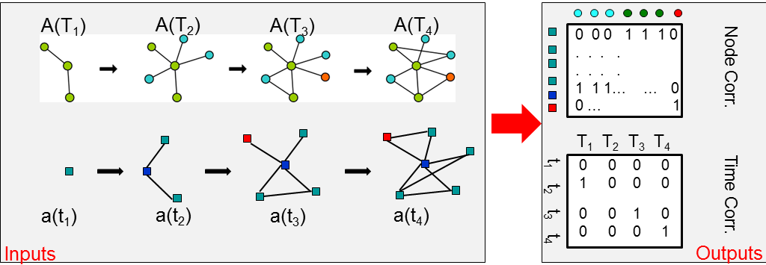
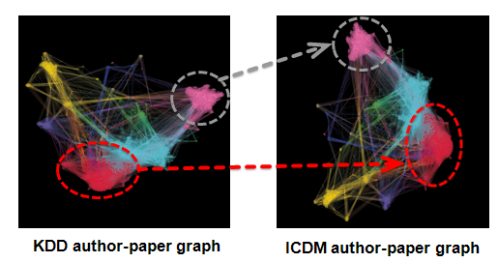
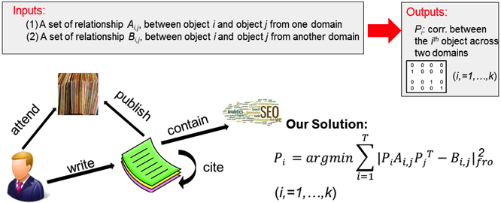
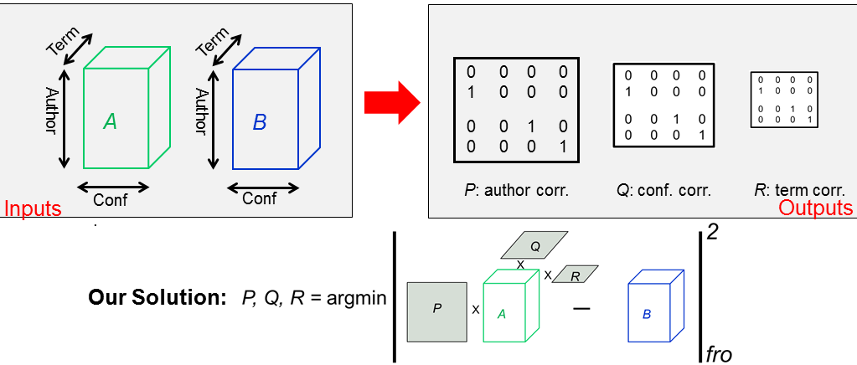
Beyond BiG-Align: Multi-way Linkage
~
S1: Dynamic Graph Linkage
S2: Community-level Linkage
~
~
S3: Hetero. Graph Linkage
S4: Multi-relational DB Linkage
All build upon BiG-Align (2) Led to 7 patents
Notes:
beyond this paper, we found that big-align forms a core building block for several other more complicated matching task, such as ..... we will not go into the details, but the bottom line is that all of them can be built upon big-align. and this also led to 7 patents

Slide 60
Roadmap
Known node correspondence
Unknown node correspondence
Motivation
Unipartite graphs
Bipartite graphs
Summary

Slide 61
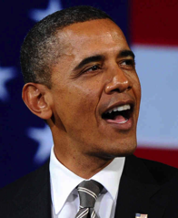
Summary
Two main approaches:
Avoiding the correspondence problem
Faster
Might give good estimates
By finding the node correspondence
Potentially more accurate
Variety of methods for unipartite graphs
One approach explicitly for bipartite graphs

Slide 62
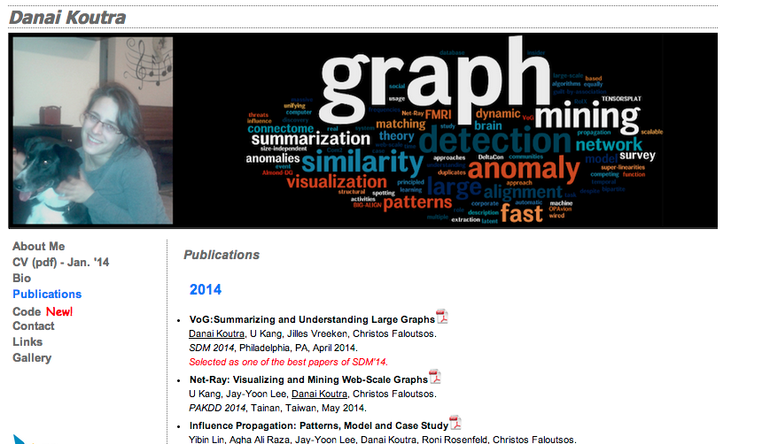
Papers at
http://www.cs.cmu.edu/~dkoutra/pub.htm

Slide 63
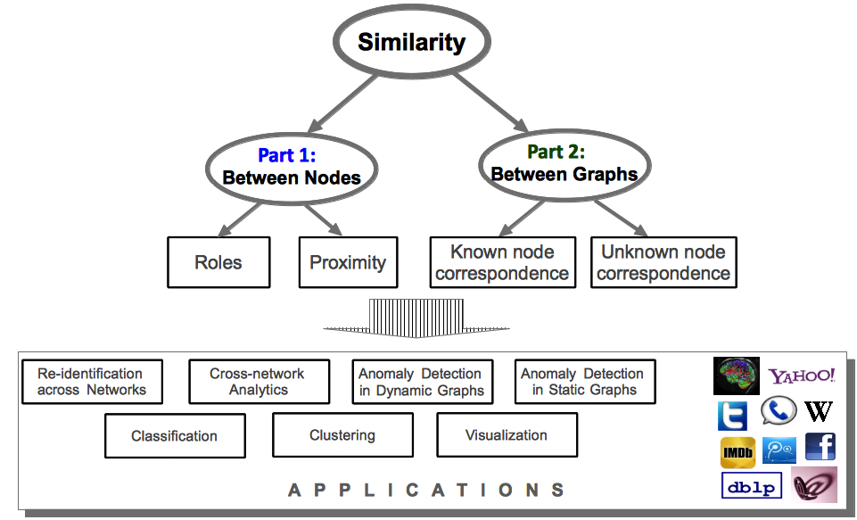
What we covered

Slide 64
References
S. V. N. Vishwanathan, K. M. Borgwardt, and N. N. Schraudolph. Fast computation of graph kernels. In Neural Information Processing Systems, p. 1449–1456, 2006.
S. V. N. Vishwanathan, N. N. Schraudolph, R. I. Kondor, and K. M. Borgwardt, Graph kernels. JMLR, vol. 11, pp. 1201–1242, 2010.
M. Fiedler, Algebraic connectivity of graphs. Czechoslovak. Mathematical Journal, vol. 23, no. 98, pp. 298–305, 1973.
T. Horvath, T. Gartner, and S. Wrobel. Cyclic pattern kernels for predictive graph mining. In SIGKDD, pages 158–167, 2004.
L. Ralaivola, S. J. Swamidass, H. Saigo, and P. Baldi. Graph kernels for chemical informatics. Neural Networks, 18:1093–1110, 2005.
K. M. Borgwardt, C. S. Ong, S. Sch¨onauer, S. V. N. Vishwanathan, A. J. Smola, and H.-P. Kriegel. Protein function prediction via graph kernels. In ISMB (Supplement of Bioinformatics), pages 47–56, 2005.
N. Shervashidze, S. V. Vishwanathan, T. H. Petri, K. Mehlhorn, and K. M. Borgwardt. Eﬃcient graphlet kernels for large graph comparison. In 12th International Conference on Artiﬁcial Intelligence and Statistics, pages 488–495, 2009.

Slide 65
References
N. Shervashidze and K. M. Borgwardt. Fast subtree kernels on graphs. In Advances in Neural Information Processing Systems, pages 1660–1668, 2009.
Airola, A., Pyysalo, S., Björne, J., Pahikkala, T., Ginter, F., & Salakoski, T. (2008). All-paths graph kernel for protein-protein interaction extraction with evaluation of cross-corpus learning. BMC Bioinformatics C7 - S2, 9(Suppl 11).
U. Kang, H. Tong, and J. Sun. Fast random walk graph kernel. in SDM, 2012.
H. Bunke, P. J. Dickinson, M. Kraetzl, and W. D. Wallis, A Graph-Theoretic Approach to Enterprise Network Dynamics (PCS). Birkhauser, 2006.
R. C. Wilson and P. Zhu, A study of graph spectra for comparing graphs and trees. Journal of Pattern Recognition, vol. 41, no. 9, pp. 2833–2841, 2008.
Elghawalby, H., & Hancock, E. R. (2008). Measuring Graph Similarity Using Spectral Geometry, 517-526.
J. T. Vogelstein and C. E. Priebe. Shufﬂed graph classiﬁcation: Theory and connectome applications. 2011
Geng Li, Murat Semerci, Bülent Yener, and Mohammed J. Zaki. 2012. Effective graph classification based on topological and label attributes. Stat. Anal. Data Min. 5, 4 (August 2012), 265-283.

Slide 66
References
Macindoe, O. and Richards, W. 2010. Graph comparison using fine structure analysis. InSocialCom/PASSAT. 193–200.
A. E. Brouwer and E Spence, Cospectral graphs on 12 vertices. Elec. Journ. Combin., Vol. 16 (20) (2009).
W. H. Haemers, E. Spence, Enumeration of cospectral graphs. European J. Combin, 25 (2004), 199-211.
A. Kelmans. Comparisons of graphs by their number of spanning trees. Discrete Math., 16 (1976), pp. 241–261

Slide 67
References
Graph Alignment
G. W. Klau. A new graph-based method for pairwise global network alignment. BMC, 10(S-1), 2009.
B. Luo and E. R. Hancock. Iterative procrustes alignment with the EM algorithm. Image Vision Comput., 20(5-6):377–396, 2002.
S. Melnik, H. Garcia-Molina, and E. Rahm. Similarity ﬂooding: A versatile graph matching algorithm and its application to schema matching. In ICDE, 2002.
A. Narayanan and V. Shmatikov. De-anonymizing social networks. In SSP, pages 173 –187, may 2009.
H. Qiu and E. R. Hancock. Graph matching and clustering using spectral partitions. IEEE TPAMI, 39(1):22–34, 2006.
A. Smalter, J. Huan, and G. Lushington. GPM: A Graph Pattern Matching Kernel with Diffusion for Chemical Compound Classiﬁcation. In ICBBE, 2008.
S. Umeyama. An eigendecomposition approach to weighted graph matching problems. IEEE TPAMI, 10(5):695–703, 1988.

Slide 68
References
L. Zager and G. Verghese. Graph similarity scoring and matching. Applied Mathematics Letters, 21(1):86–94, 2008.
M. Zaslavskiy, F. Bach, and J.-P. Vert. A path following algorithm for the graph matching problem. IEEE TPAMI, 31(12):2227–2242, Dec. 2009.
M. Bayati, M. Gerritsen, D. Gleich, A. Saberi, and Y. Wang. Algorithms for large, sparse network alignment problems. In ICDM, pages 705– 710, 2009.
S. Bradde, A. Braunstein, H. Mahmoudi, F. Tria, M. Weigt, and R. Zecchina. Aligning graphs and ﬁnding substructures by a cavity approach. Europhysics Letters, 89, 2010.
D. Conte, P. Foggia, C. Sansone, and M. Vento. Thirty years of graph matching in pattern recognition. IJPRAI, 18(3):265–298, 2004.
C. H. Q. Ding, T. Li, and M. I. Jordan. Nonnegative matrix factorization for combinatorial optimization: Spectral clustering, graph matching, and clique ﬁnding. In ICDM, pages 183–192, 2008.
S. Gold and A. Rangarajan. A graduated assignment algorithm for graph matching. IEEE TPAMI, 18(4):377–388, 1996.
J. Berg and M. Lassig. Local graph alignment and motif search in ¨ biological networks. PNAS, 101(41):14689–14694, Oct. 2004.

Slide 69
References
Rohit Singh, Jinbo Xu, and Bonnie Berger. 2007. Pairwise global alignment of protein interaction networks by matching neighborhood topology. In RECOMB ’07.
J. T. Vogelstein, J. M. Conroy, L. J. Podrazik, S. G. Kratzer, D. E. Fishkind, R. J. Vogelstein, and C. E. Priebe. Fast inexact graph matching with applications in statistical connectomics. CoRR, abs/1112.5507, 2011.

Slide 70
Backup Slides

Slide 71
Algorithm: Uni-Align
Details
n nodes
min || PAQ - B||_{F} ²
P
fixed
d features
node degree
clustering coeff
… …

Slide 72
Algorithm: Uni-Align
Details
n nodes
min || PAQ - B||_{F} ²
P
SVD
A = USV^{T}
d features
P = g*(A,B,S,U)=
= closed-form solution
O(n.d²)
Notes:
Explain it somehow

Slide 73
Uni-Align
Details
Dataset: Facebook friendship graph
(64K users)
Setup: uni-partite ➔ bi-partite graph
Feature extraction
node degree
egonet degree
edges in egonet
mean degree of node’s neighbors
egonet

Slide 74
Uni-Align: Accuracy vs. Runtime
Uni-Align
NMF-based
NetAlign
Umeyama
Uni-Align, followed by Net-Align, is more accurate and faster than other approaches.

Slide 75
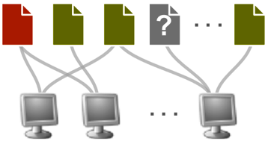
Why bipartite graphs?
ubiquitous – e.g., users-files, authors-papers, customers-products, users-msg/groups user-movie rating graphs

Slide 76
Why bipartite graphs?
ubiquitous – e.g., users-files, authors-papers, customers-products, users-msg/groups user-movie rating graphs
coupled alignment:
individual & community-level
nodes
communities

Slide 77
Why bipartite graphs?
ubiquitous – e.g., users-files, authors-papers, customers-products, users-msg/groups user-movie rating graphs
coupled alignment:
individual & community-level
conversion of uni-partite graph to
bi-partite --> clustering + (2)
nodes
communities

Slide 78
Why bipartite graphs?
ubiquitous – e.g., users-files, authors-papers, customers-products, users-msg/groups user-movie rating graphs
coupled alignment:
individual & community-level
conversion of unipartite graph to
bipartite --> clustering + (2)
general formulation:
match clouds of points (point-feature graph)
tensors (e.g. time-evolving, or other 3rd dimension)
nodes
communities
users
time
email

