Slide 1
EECS 373
An Introduction to Real Time Oses
Prabal Dutta
Slides originally created by Mark Brehob

Slide 2
Updates
Should be working on your project at this point
  Your group should have something to work on as of today.
  Your group should target having all components be “mostly working” by the first week of December
We’re ending the “regular” lectures & labs
  Focus on special topics
    Slides, spreadsheets
  More time for project work

Slide 3
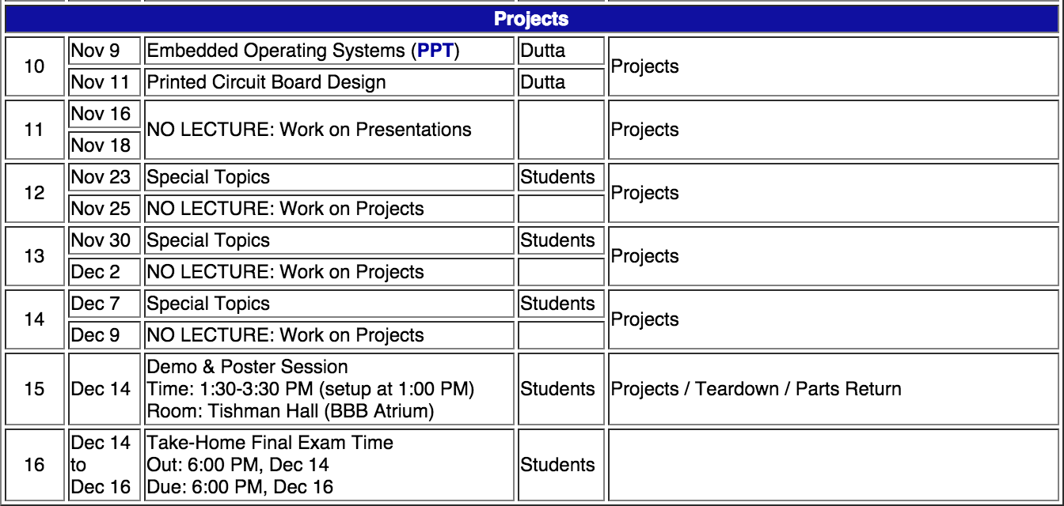
What’s left

Slide 4
Outline
Quick review of real-time systems
Overview of RTOSes
  Goals of an RTOS
  Features you might want in an RTOS
Learning by example: FreeRTOS
  Introduction
  Tasks
  Interrupts
  Internals (briefly)
  What’s missing?

Slide 5
Outline
Quick review of real-time systems
Overview of RTOSes
  Goals of an RTOS
  Features you might want in an RTOS
Learning by example: FreeRTOS
  Introduction
  Tasks
  Interrupts
  Internals (briefly)
  What’s missing?

Slide 6
What is a Real-Time System?
RTS overview
Real-time systems have been defined as: "those systems in which the correctness of the system depends not only on the logical result of the computation, but also on the time at which the results are produced";
  J. Stankovic, "Misconceptions About Real-Time Computing," IEEE Computer, 21(10), October 1988.

Slide 7
Real-Time Characteristics
RTS overview
Pretty much your typical embedded system
  Sensors & actuators all controlled by a processor.
  The big difference is timing constraints (deadlines).
Those tasks can be broken into two categories¹
  Periodic Tasks: Time-driven and recurring at regular intervals.
    A car checking for a wall every 0.1 seconds;
    An air monitoring system grabbing an air sample every 10 seconds.
  Aperiodic: event-driven
    That car having to react to a wall it found
    The loss of network connectivity.
  ¹Sporadic tasks are sometimes also discussed as a third category. They are tasks similar to aperiodic tasks but activated with some
  known bounded rate. The bounded rate is characterized by a minimum interval of time between two successive activations.

Slide 8
Some Definitions
RTS overview
Timing constraint: constraint imposed on timing behavior of a job: hard, firm, or soft.
Release Time: Instant of time job becomes available for execution.
Deadline: Instant of time a job's execution is required to be completed. If deadline is infinity, then job has no deadline.
Response time: Length of time from release time to instant job completes.

Slide 9
Soft, Firm and Hard deadlines
RTS overview
The instant at which a result is needed is called a deadline.
  If the result has utility even after the deadline has passed, the deadline is classified as soft, otherwise it is firm.
  If a catastrophe could result if a firm deadline is missed, the deadline is hard.
Examples?
Definitions taken from a paper by Kanaka Juvva, not sure who originated them.

Slide 10
Scheduling algorithms
RTS overview: Scheduling algorithms
A scheduling algorithm is a scheme that selects what job to run next.
  Can be preemptive or non-preemptive.
  Dynamic or static priorities
  Etc.
In general, a RTS will use some scheduling algorithm to meet
its deadlines.

Slide 11
Two common scheduling schemes
RTS overview: Scheduling algorithms
Rate monotonic
(RM)
  Static priority scheme
  Preemption required
  Simple to implement
  Nice properties
Earliest deadline first (EDF)
  Dynamic priority scheme
  Preemption required
  Harder to implement
  Very nice properties
We aren’t going to worry about the details of either. The point
is that we sometimes want static priorities (each task has a fixed
priority) and sometimes we want dynamic priorities (priorities
change for a task over time).

Slide 12
But tasks don’t operate in a vacuum
RTS overview: Scheduling algorithms
It is generally the case that different tasks might need shared resources
  For example, multiple tasks might wish to use a UART to print messages
    You’ve seen this in the lab.
How can we share resources?
  Could have task using resource disable interrupts while using resource.
    But that would mess with interrupts that don’t (or won’t) use the resource.
  Could disable those that could use the resource
    But would mess with interrupts that won’t use it this time.

Slide 13
Sharing resources
RTS overview: Scheduling algorithms
Need some kind of a lock on a resource.
  If a high priority task finds a resource is locked, it goes to sleep until the resource is available.
  Task is woken up when resource is freed by lower priority task.
  Sounds reasonable, but leads to problems.
More formally stated on next slide.

Slide 14
Priority Inversion
RTS overview: Scheduling algorithms
In a preemptive priority based real-time system, sometimes tasks may need to access resources that cannot be shared.
  The method of ensuring exclusive access is to guard the critical sections with binary semaphores.
  When a task seeks to enter a critical section, it checks if the corresponding semaphore is locked.
  If it is not, the task locks the semaphore and enters the critical section.
  When a task exits the critical section, it unlocks the corresponding semaphore.
This could cause a high priority task to be waiting on a lower priority one.
  Even worse, a medium priority task might be running and cause the high priority task to not meet its deadline!
Mohammadi, Arezou, and Selim G. Akl. "Scheduling Algorithms for Real-Time Systems." (2005)

Slide 15
Example: Priority inversion
RTS overview: Scheduling algorithms
Low priority task “C” locks resource “Z”.
High priority task “A” preempts “C” then requests resource “Z”
  Deadlock, but solvable by having “A” sleep until resource is unlocked.
But if medium priority “B” were to run, it would preempt C, thus effectively making C and A run with a lower priority than B.
  Thus priority inversion.

Slide 16
Solving Priority inversion
RTS overview: Scheduling algorithms
Priority Inheritance
  When a high priority task sleeps because it is waiting on a lower priority task, have it boost the priority of the blocking task to its own priority.

Slide 17
Outline
Quick review of real-time systems
Overview of RTOSes
  Goals of an RTOS
  Features you might want in an RTOS
Learning by example: FreeRTOS
  Introduction
  Tasks
  Interrupts
  Internals (briefly)
  What’s missing?

Slide 18
Goals of an RTOS?
RTOS overview
Well, to manage to meet RT deadlines.
  While that’s all we need we’d like a lot more.
    After all, we can meet RT deadlines fairly well on the bare metal (no OS)
      But doing this is time consuming and difficult to get right as the system gets large.
    We’d like something that supports us
      Deadlines met
      Interrupts just work
      Tasks stay out of each others way
      Device drivers already written (and tested!) for us
      Portable—runs on a huge variety of systems
      Oh, and nearly no overhead so we can use a small device!
        That is a small memory and CPU footprint.

Slide 19
Detailed features we’d like
RTOS overview
Deadlines met
Interrupts just work
Ability to specify scheduling algorithm
  We’d like priority inversion dealt with
Interrupts are fast
  So tasks with tight deadlines get service as fast as possible
    Basically—rarely disable interrupts and when doing so only for a short time.
Don’t need to worry about saving/restoring registers
  Which C just generally does for us anyways.
Interrupt prioritization easy to set.

Slide 20
Detailed features we’d like:
Tasks stay out of each others way
RTOS overview
This is actually remarkably hard
  Clearly we need to worry about CPU utilization issues
    That is what our scheduling algorithm discussion was to address
  But we also need to worry about memory problems.
    One task running awry shouldn’t take the rest of the system down.
  So we want to prevent tasks from harming each other
    This can be key. If we want mission critical systems sharing the CPU with less important things we have to do this.
    Alternative it to have separate processors.
      $$$$
The standard way to do this is with page protection.
  If a process tries to access memory that isn’t its own, it fails.
    Probably a fault.
    This also makes debugging a LOT easier.
This generally requires a lot of overhead.
  Need some sense of process number/switching
  Need some kind of MMU in hardware
    Most microcontrollers lack this…
    So we hit some kind of minimum size.
Further reading on page protection (short) http://homepage.cs.uiowa.edu/~jones/security/notes/06.shtml

Slide 21
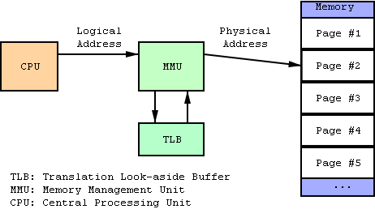
Aside: What is an MMU?
Memory Management Unit
  Tracks what parts of memory a process can access.
    Actually a bit more complex as it manages this by mapping virtual addresses to physical ones.
    Keeps processes out of each other’s memory.
Figure from Wikipedia

Slide 22
Device drivers written (and tested!) for us
RTOS overview
Ideally the RTOS has drivers for all the on-board peripherals.
  It’s a lot easier to call a “configure_I2C()” function than to read the details of the device specification and do the memory-mapped work yourself

Slide 23
Portable
RTOS overview
RTOS runs on many platforms.
  This is potentially incomputable with the previous slide.
  It’s actually darn hard to do even without peripherals
    For example I spent 10 hours debugging a RTOS that had a pointer problem that only comes up if the pointer type is larger than the int type (20 bit pointers, 16 bit ints, yea!)
    Things like timers change and we certainly need timers.

Slide 24
Outline
FreeRTOS
Quick review of real-time systems
Overview of RTOSes
  Goals of an RTOS
  Features you might want in an RTOS
Learning by example: FreeRTOS
  Introduction
  Tasks
  Interrupts
  Internals (briefly)
  What’s missing?

Slide 25
Learning by example: FreeRTOS
FreeRTOS
Introduction taken from Amr Ali Abdel-Naby
  Nice blog:
    http://www.embedded-tips.blogspot.com

Slide 26

FreeRTOS Features
FreeRTOS
  Source code
  Portable
  Scalable
  Preemptive and co-operative scheduling
  Multitasking
  Services
  Interrupt management
  Advanced features
Amr Ali Abdel-Naby@2010
Introduction to FreeRTOS V6.0.5

Slide 27
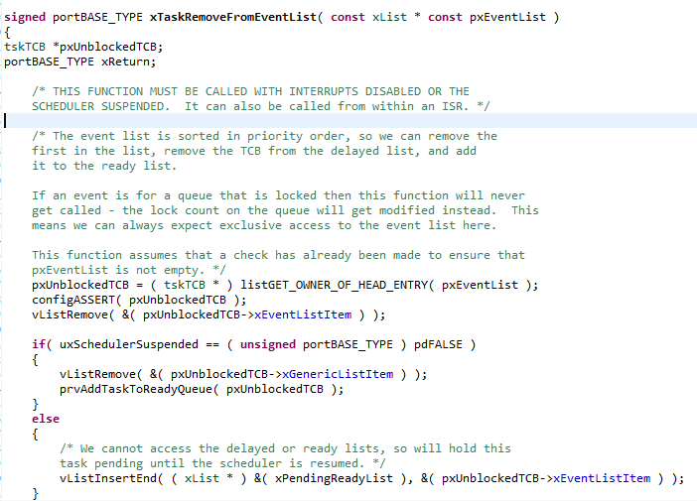
Source Code
FreeRTOS
  High quality
  Neat
  Consistent
  Organized
  Commented
Amr Ali Abdel-Naby@2010
Introduction to FreeRTOS V6.0.5

Slide 28





Portable
FreeRTOS
  Highly portable C
  24 architectures supported
  Assembly is kept minimum.
  Ports are freely available in source code.
  Other contributions do exist.
Amr Ali Abdel-Naby@2010
Introduction to FreeRTOS V6.0.5

Slide 29

Scalable
FreeRTOS
  Only use the services you only need.
    FreeRTOSConfig.h
  Minimum footprint = 4 KB
  Version in lab is 24 KB including the application (which is fairly large) and data for the OS and application.
    Pretty darn small for what you get.
    ~6000 lines of code (including a lot of comments, maybe half that without?)
Amr Ali Abdel-Naby@2010

Slide 30
Preemptive and Cooperative Scheduling
FreeRTOS
  Preemptive scheduling:
    Fully preemptive
    Always runs the highest priority task that is ready to run
    Comparable with other preemptive kernels
    Used in conjunction with tasks
  Cooperative scheduling:
    Context switch occurs if:
      A task/co-routine blocks
      Or a task/co-routine yields the CPU
    Used in conjunction with tasks/co-routines
Amr Ali Abdel-Naby@2010
Introduction to FreeRTOS V6.0.5

Slide 31
Multitasking
FreeRTOS
  No software restriction on:
    # of tasks that can be created
    # of priorities that can be used
    Priority assignment
      More than one task can be assigned the same priority.
      RR with time slice = 1 RTOS tick
Amr Ali Abdel-Naby@2010
Introduction to FreeRTOS V6.0.5

Slide 32
Services
FreeRTOS
  Queues
  Semaphores
    Binary and counting
  Mutexes
    With priority inheritance
    Support recursion
Amr Ali Abdel-Naby@2010
Introduction to FreeRTOS V6.0.5
Notes:
Source: http://koti.mbnet.fi/niclasw/MutexSemaphore.html
Mutex vs. Semaphore, what is the difference?
The Toilet Example (c) Copyright 2005, Niclas Winquist ;)
Mutex:
Is a key to a toilet. One person can have the key - occupy the toilet - at the time. When finished, the person gives (frees) the key to the next person in the queue.
Officially: "Mutexes are typically used to serialise access to a section of re-entrant code that cannot be executed concurrently by more than one thread. A mutex object only allows one thread into a controlled section, forcing other threads which attempt to gain access to that section to wait until the first thread has exited from that section."
Ref: Symbian Developer Library
(A mutex is really a semaphore with value 1.) (*
Semaphore:
Is the number of free identical toilet keys. Example, say we have four toilets with identical locks and keys. The semaphore count - the count of keys - is set to 4 at beginning (all four toilets are free), then the count value is decremented as people are coming in. If all toilets are full, ie. there are no free keys left, the semaphore count is 0. Now, when eq. one person leaves the toilet, semaphore is increased to 1 (one free key), and given to the next person in the queue.
Officially: "A semaphore restricts the number of simultaneous users of a shared resource up to a maximum number. Threads can request access to the resource (decrementing the semaphore), and can signal that they have finished using the resource (incrementing the semaphore)."
Ref: Symbian Developer Library

Slide 33
Interrupts
FreeRTOS
  An interrupt can suspend a task execution.
  Interrupt mechanism is port dependent.
Amr Ali Abdel-Naby@2010
Introduction to FreeRTOS V6.0.5

Slide 34
Advanced Features
FreeRTOS
  Execution tracing
  Run time statistics collection
  Memory management
  Memory protection support
  Stack overflow protection
Amr Ali Abdel-Naby@2010
Introduction to FreeRTOS V6.0.5

Slide 35
Device support in related products
FreeRTOS
  Connect Suite from High Integrity Systems
    TCP/IP stack
    USB stack
      Host and device
    File systems
      DOS compatible FAT
Amr Ali Abdel-Naby@2010
Introduction to FreeRTOS V6.0.5

Slide 36
Licensing
FreeRTOS
  Modified GPL
    Only FreeRTOS is GPL.
    Independent modules that communicate with FreeRTOS through APIs can be anything else.
    FreeRTOS can’t be used in any comparisons without the authors’ permission.
Amr Ali Abdel-Naby@2010
Introduction to FreeRTOS V6.0.5

Slide 37
A bit more
FreeRTOS
System runs on “ticks”
  Every tick the kernel runs and figures out what to do next.
    Interrupts have a different mechanism
  Basically hardware timer is set to generate regular interrupts and calls the scheduler.
    This means the OS eats one of the timers—you can’t easily share.
OK, onto tasks!

Slide 38
Outline
Quick review of real-time systems
Overview of RTOSes
  Goals of an RTOS
  Features you might want in an RTOS
Learning by example: FreeRTOS
  Introduction
  Tasks
  Interrupts
  Internals (briefly)
  What’s missing?

Slide 39
Tasks
FreeRTOS: Tasks
Each task is a function that must not return
  So it’s in an infinite loop (just like you’d expect in an embedded system really, think Arduino).
You inform the scheduler of
  The task’s resource needs (stack space, priority)
  Any arguments the tasks needs
All tasks here must be of void return type and take a single void* as an argument.
  You cast the pointer as needed to get the argument.
    I’d have preferred var_args, but this makes the common case (one argument) easier (and faster which probably doesn’t matter).
Code examples mostly from Using the FreeRTOS Real Time Kernel (a pdf book), fair use claimed.

Slide 40
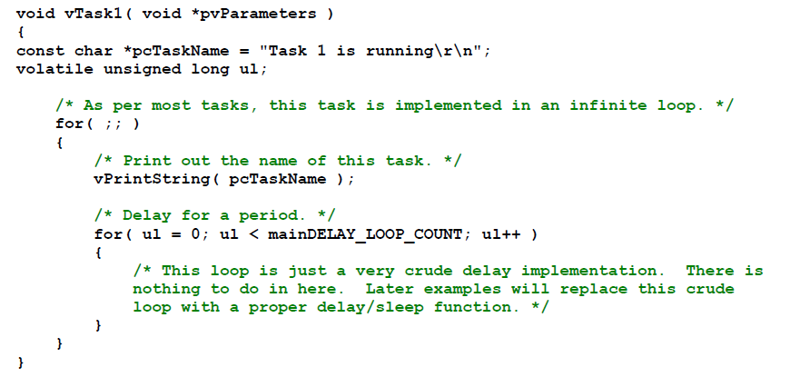
Example trivial task with busy wait (bad)
FreeRTOS: Tasks

Slide 41
Task creation
FreeRTOS: Tasks
portBASE_TYPE xTaskCreate(
pdTASK_CODE pvTaskCode,
const char * const pcName,
unsigned short usStackDepth,
void *pvParameters,
unsigned portBASE_TYPE uxPriority,
xTaskHandle *pvCreatedTask
);
Create a new task and add it to the list of tasks that are ready to run. xTaskCreate() can only be used to create a task that has unrestricted access to the entire microcontroller memory map. Systems that include MPU support can alternatively create an MPU constrained task using xTaskCreateRestricted().
pvTaskCode: Pointer to the task entry function. Tasks must be implemented to never return (i.e. continuous loop).
pcName: A descriptive name for the task. This is mainly used to facilitate debugging. Max length defined by tskMAX_TASK_NAME_LEN – default is 16.
usStackDepth: The size of the task stack specified as the number of variables the stack can hold - not the number of bytes. For example, if the stack is 16 bits wide and usStackDepth is defined as 100, 200 bytes will be allocated for stack storage.
pvParameters: Pointer that will be used as the parameter for the task being created.
uxPriority: The priority at which the task should run. Systems that include MPU support can optionally create tasks in a privileged (system) mode by setting bit portPRIVILEGE_BIT of the priority parameter. For example, to create a privileged task at priority 2 the uxPriority parameter should be set to ( 2 | portPRIVILEGE_BIT ).
pvCreatedTask: Used to pass back a handle by which the created task can be referenced.
pdPASS: If the task was successfully created and added to a ready list, otherwise an error code defined in the file errors.h
From the task.h file in FreeRTOS

Slide 42
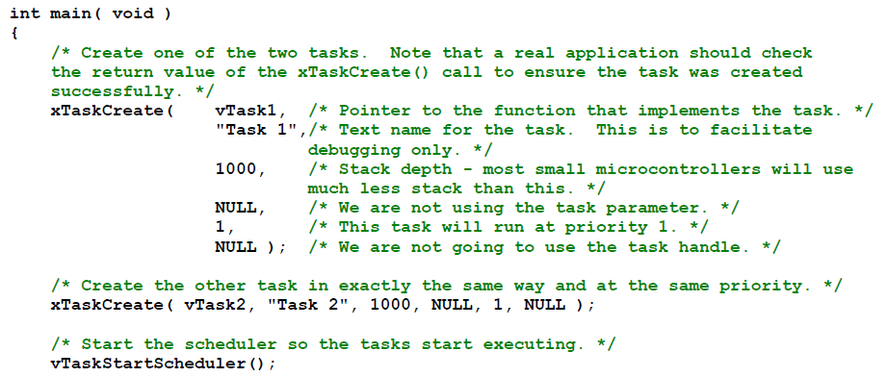
Creating a task: example
FreeRTOS: Tasks

Slide 43
OK, I’ve created a task, now what?
FreeRTOS: Tasks
Task will run if there are no other tasks of higher priority
  And if others the same priority will RR.
But that raises the question: “How do we know if a task wants to do something or not?”
  The previous example gave always wanted to run.
    Just looping for delay (which we said was bad)
    Instead should call vTaskDelay(x)
      Delays current task for X “ticks” (remember those?)
    There are a few other APIs for delaying…
Now we need an “under the hood” understanding

Slide 44
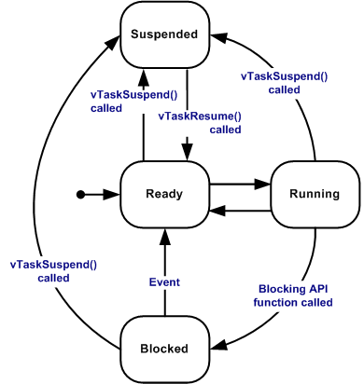
Task status in FreeRTOS
FreeRTOS: Tasks
Running
  Task is actually executing
Ready
  Task is ready to execute but a task of equal or higher priority is Running.
Blocked
  Task is waiting for some event.
    Time: if a task calls vTaskDelay() it will block until the delay period has expired.
    Resource: Tasks can also block waiting for queue and semaphore events.
Suspended
  Much like blocked, but not waiting for anything.
  Tasks will only enter or exit the suspended state when explicitly commanded to do so through the vTaskSuspend() and xTaskResume() API calls respectively.
Mostly from http://www.freertos.org/RTOS-task-states.html

Slide 45
Tasks: there’s a lot more
FreeRTOS: Tasks
Can do all sorts of things
  Change priority of a task
  Delete a task
  Suspend a task (mentioned above)
  Get priority of a task.
Example on the right
  But we’ll stop here…
void vTaskPrioritySet( xTaskHandle pxTask,
unsigned uxNewPriority );
Set the priority of any task.
pxTask: Handle to the task for which the priority is being set. Passing a NULL handle results in the priority of the calling task being set.
uxNewPriority: The priority to which the task will be set.

Slide 46
Outline
Quick review of real-time systems
Overview of RTOSes
  Goals of an RTOS
  Features you might want in an RTOS
Learning by example: FreeRTOS
  Introduction
  Tasks
  Interrupts
  Internals (briefly)
  What’s missing?

Slide 47
Interrupts in FreeRTOS
FreeRTOS: Interrupts
There is both a lot and a little going on here.
  The interface mainly uses whatever the native environment uses to handle interrupts
    This can be very port dependent. In Code Composer Studio (TI) you’d set it up as follows:
      #pragma vector=PORT2_VECTOR
      interrupt void prvSelectButtonInterrupt( void )
  That would cause the code to run on the PORT2 interrupt.
    Need to set that up etc. Very device specific (of course).

Slide 48
More: Deferred Interrupt Processing
FreeRTOS: Interrupts
The best way to handle complex events triggered by interrupts is to not do the code in the ISR.
  Rather create a task that is blocking on a semaphore.
    When the interrupt happens, the ISR just sets the semaphore and exits.
      Task can now be scheduled like any other. No need to worry about nesting interrupts (and thus interrupt priority).
      FreeRTOS does support nested interrupts on some platforms though.
  Semaphores implemented as one/zero-entry queue.

Slide 49
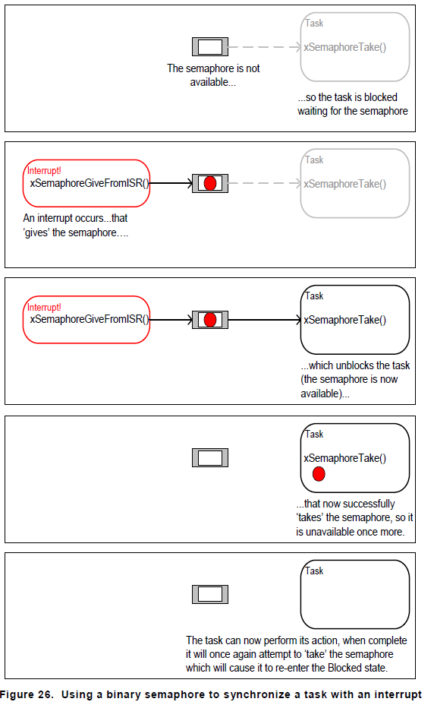
Semaphore example in FreeRTOS
FreeRTOS: Interrupts
Figure from Using the FreeRTOS Real Time Kernel (a pdf book), fair use claimed.

Slide 50
Semaphore take
FreeRTOS: Interrupts
xSemaphoreTake(
xSemaphoreHandle xSemaphore,
portTickType xBlockTime
)
Macro to obtain a semaphore. The semaphore must have previously been created.
xSemaphore A handle to the semaphore being taken - obtained when the semaphore was created.
xBlockTime The time in ticks to wait for the semaphore to become available. The macro portTICK_RATE_MS can be used to convert this to a real time. A block time of zero can be used to poll the semaphore.|
TRUE if the semaphore was obtained.
There are a handful of variations.
  Faster but more locking version, non-binary version, etc.

Slide 51
Outline
Quick review of real-time systems
Overview of RTOSes
  Goals of an RTOS
  Features you might want in an RTOS
Learning by example: FreeRTOS
  Introduction
  Tasks
  Interrupts
  Internals (briefly)
  What’s missing?

Slide 52
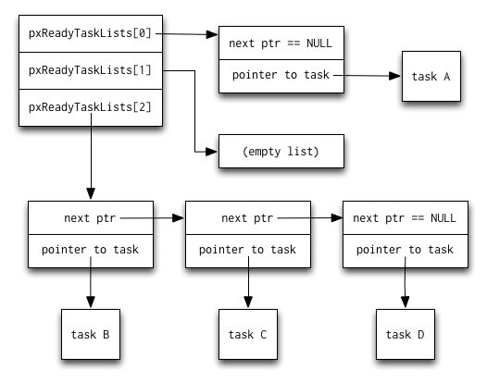
Common data structures
FreeRTOS: Internals
This figure and the next are from http://www.aosabook.org/en/freertos.html

Slide 53
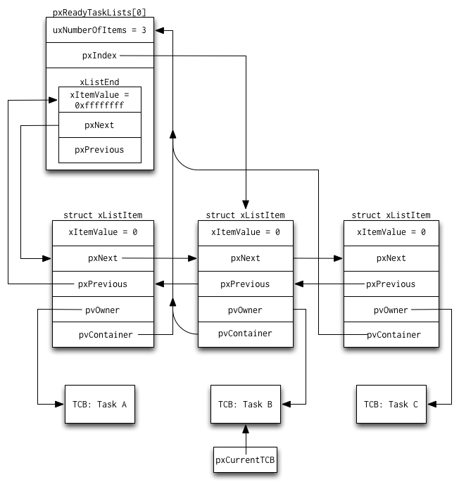
FreeRTOS: Internals

Slide 54
Midterm Results
Statistics
  Mean: 68.5
  Med: 69.3
  Stdev: 12.9

